Slide 1
AUP DOE IPR July 23-35, 2024 General Instructions & Considerations
HL-LHC AUP DOE IPR – July 23rd–25th 2024

Slide 2
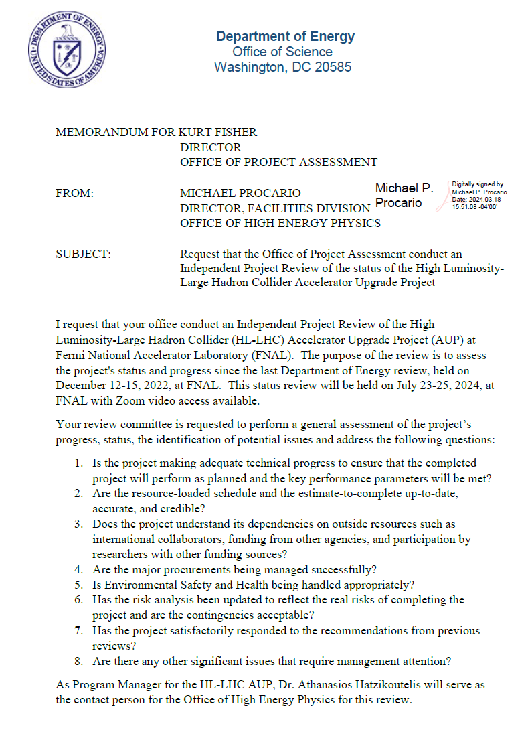
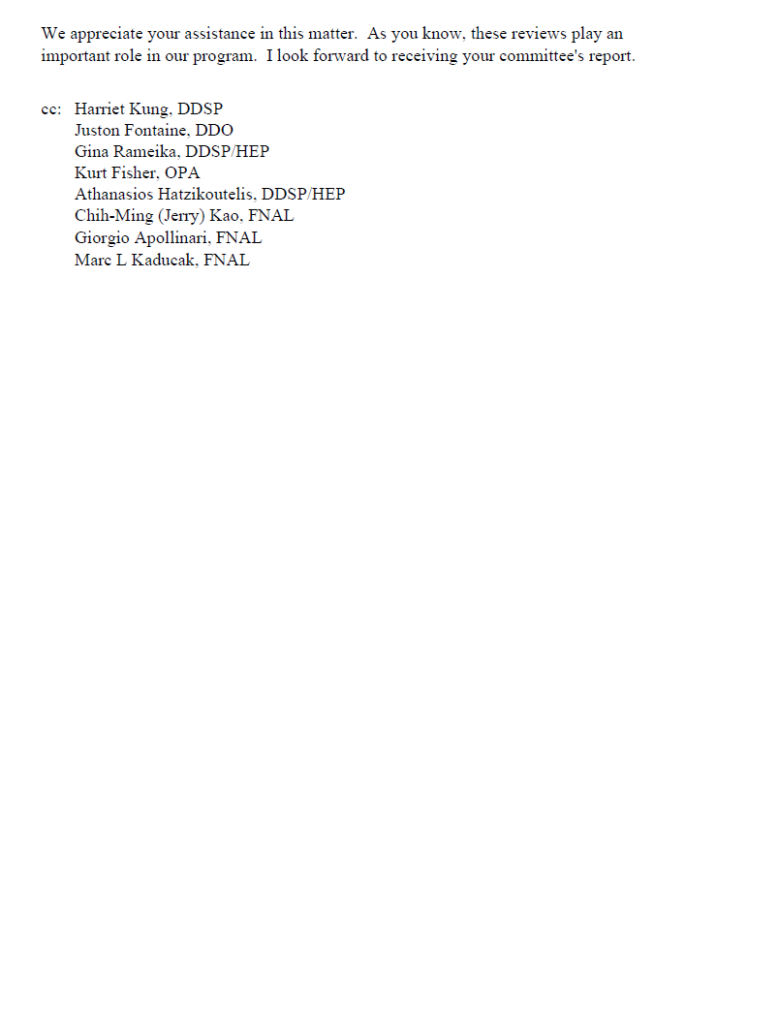
Charges for AUP DOE IPR
No Surprises in Charges, “standard” Charges for an IPR DOE review
There will be no Director’s Review
First and foremost, we need to insure we are addressing and answering the Charges

Slide 3
Timeline Status Review
DOE IPR Jul. 23rd – 25th
Posting Monday Jul 8th (after 4th)
Plenary/L2 Rehars. Week Jun 24th
To accommodate “FNAL Low Tempo” period on Jul 1st – 5th
L3 Rehars. Weeks Jun. 10th & 17th
EVMS Reports ready by ~13th–14th of June (for May closing)
Preliminary versions on week of Jun 10th will miss EVMS Closing numbers
Decision: May ’24 Closing for DOE Review

Slide 4
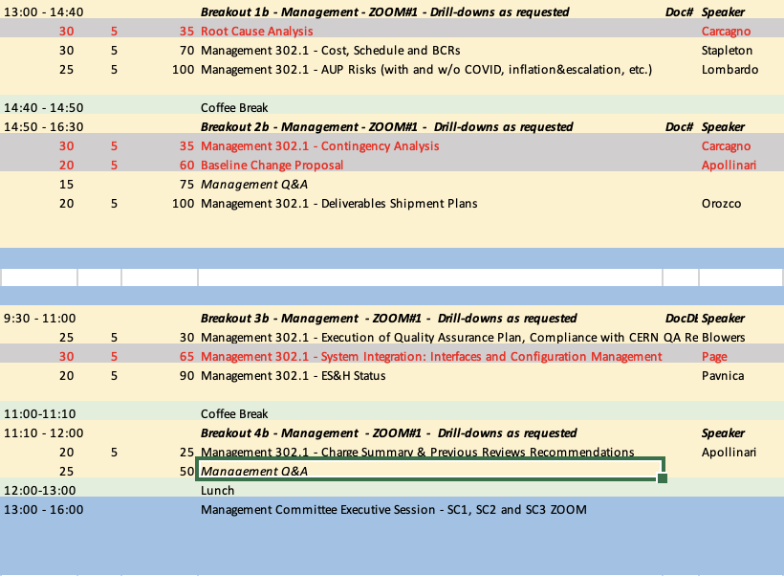
Agenda Considerations
Rebaseline/COVID related presentations can be dropped for the Jul. ‘24 IPR.
Activities in 302.2 (Magnets) are winding down in several L3s and talks can be consolidated
CryoAssemblies (302.4) and Cavities (302.3) are still at flat-top execution
Decisions:
Limit Agenda to 2 Parallel Sessions (after 1st day morning Plenary)
Consolidation of Management (302.1) and Magnets (302.2) talks.
Include tour of facilities (suggested by DOE)
Highlighted in Red are
“Rebaseline Specific” talks
that we are dropping to
Consolidate the schedule

Slide 5
Logistic
Agenda already shared with DOE and OPSS, as well as all L2/Deputy L2s.
1st day:
8:45 to 12:15: Plenary Session
13:15 to 16:30: Breakout Sessions
2nd day:
9:00 to 10:00: Tour of FNAL Cryoassembly and Test Facilities
10:00 to 14:50: Breakout Sessions
2 parallel sessions:
Magnets and CM/CA
Crab Cavities and Management
C&S Drilldown planned at the end of presentation, but will commit to accommodate any request from the Review team
OPSS taking care of multiple ZOOM-rooms (to be confirmed).

Slide 6
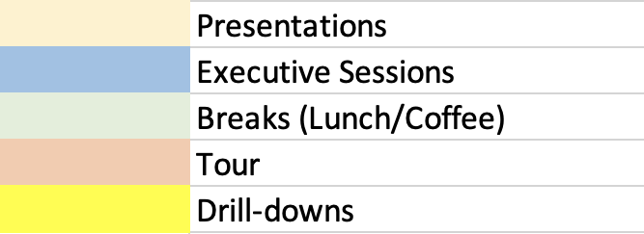
Proposed Agenda@IPR (Jul. 2024)

Slide 7
General Points
The AUP Rebaseline request was reviewed by DOE on Dec. 12th – 15th 2022, and approved on March 20th 2023.
There have been no DOE reviews since then.
This is a DOE “Independent Project Review” (IPR), and the purpose is to assess status and progress since the last DOE review.
There will not be a Director’s review in preparation for this review. It is important to allocate adequate time for documentation updates, presentation preparations, and rehearsals.
We need to conduct the annual CAM training and bottom-up ETC exercise prior to the review. Lorri will coordinate with CAMs.
We need to show that production is under control, highlight technical achievements and deliverables, and show that we are on track to complete the project within the cost and schedule contingency.
We should not hide that significant risks remain, but those are properly captured in the Risk Register.
We should also highlight major QA/QC issues and the prompt incorporation of Lessons Learned in the manufacturing flow.
We should take credit for ES&H safety record in many areas, and in areas where there were incidents, we need to own the event and show the Lessons Learned. Make sure to emphasize adequate “Work Planning and Control” practices.
See following slides on Presentation Template and additional guidance on L2/L3s presentation content.

Slide 8
System or Sub-system 302.X.YY Please use these slides as template
Speaker - Lab
HL-LHC AUP DOE IPR – July 23rd–25th 2024

Slide 9
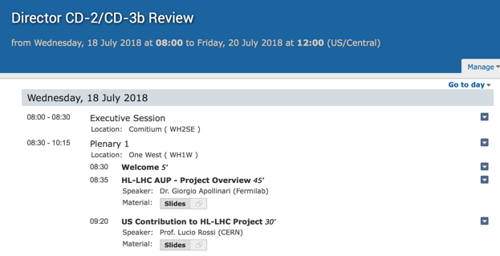
Housekeeping
The title of the presentation, the name of the file and the agenda title shall be the same (modulo version #) !
Presentation Title
File Name
Agenda Title
!! Make the page
# white !!!

Slide 10
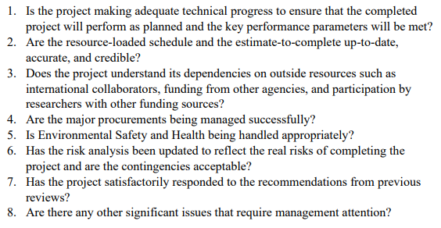
Charges

Slide 11
The following slides are “outline slides” for the various L2/L3/CAMs presentations

Slide 12
Proposed Outline for L2/L3 Presentations
Charge #
If a slide is addressing a specific charge, write
the Charge # on the top of the slide.
If all activities you are discussing are concentrated
in a Lab, you can use a Lab logo here
Lab
Logo

Slide 13
General Outline
Scope, Interfaces, Dependencies & Team
Achievements since Rebaseline Review
Procurement Status
Schedule
Cost and Schedule Performance & VAR Reports
BCRs since Rebaseline Review
Estimate at Completion and EAC Manual Adjustments
QA/QC
Risks
ES&H
Summary
Lab
Logo

Slide 14
WBS 302.X.YY: Scope and Interfaces
Charge #2, #3
List all CERN-approved FRS, Acceptance Criteria, Material Lists, Interfaces that allow you to define your WBS scope.
Mention upcoming updates, if/when applicable
Use snapshots from WBS dictionary
US-HiLumi-doc-39 (update your WBS entry if needed!)
Use picture/drawings of your scope (if they exist) and status (several L3 should be close to completion)
If applicable, highlight production yield assumptions, observation and deliverables quantities
Show Interface Matrix and List Interface Control Documents, mention any ICD reviews that took place
Message: WBS scope remains clearly defined and well understood; Interfaces are defined and controlled

Slide 15
WBS 302.X.YY: External Dependencies
Charge #3
List any external dependencies (from CERN, FNAL, etc.), include agreements and status with links to documents if applicable
Mention changes after Rebaseline with Response actions (if any).
Describe how External Dependencies have impacted or have a potential to impact Cost and Schedule. Examples:
Delivery of Kits/parts from CERN
CERN Metrology approvals on Cavities parts
Message: WBS understands its dependencies on outside resources, external dependencies are captured in the P6 RLS, risks associated with external dependencies are identified and understood.

Slide 16
WBS 302.X.YY: Team
Charge #2
Organization chart including management and major subsystem, and your place in it.
Down to L3-L4, use official Org structure in US-HiLumi-Docdb 104, then expand to include Team members (available or needed) as you see fit
Message: WBS team in place, there are clear roles and responsibilities
Lab
Logo

Slide 17
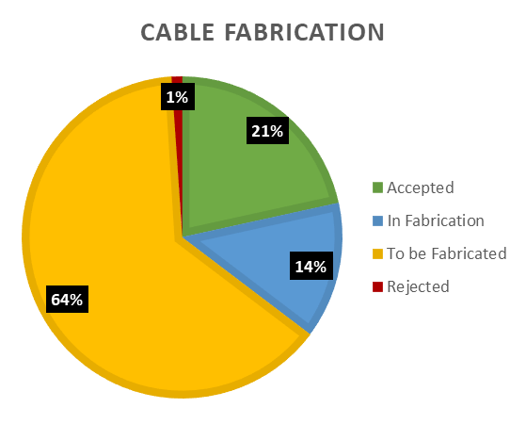
WBS 302.X.YY: Achievements since Rebaseline
Charge #1
If applicable, include summary Fabrication Status Pie Chart from the “Parts Status” Excel file in FermiPoint (update as needed, information there is from the last Review. CAM is responsible for updating the numbers in Fermipoint, and keep using the same format).
Describe your pre-series and series scope.
List of achieved technical milestones since Rebaseline review
List any Design Review, PRR reviews, outcome, links to report, etc.
Include infrastructure developments, fabrication status, test results
For fabricated items, include actual vs planned production yield
Include delivered items (e.g., LQXFA/B-01 to CERN, (hopefully) Dressed prototype cavity to TRIUMF
For Magnets, highlight achievement such as “Fast Training” in #07b and #15 and demonstrated ability to repair magnets by swapping limiting coil(s). Also mentioned problems/solutions such as MQXFA17 splice, etc.
Message: project has made adequate technical progress. Production is well underway and nearly complete for some WBS elements. Highlight achievements and problems/solutions.

Slide 18
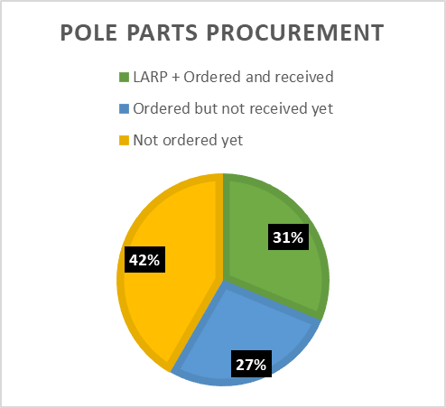
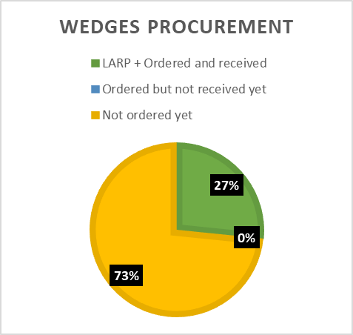
WBS 302.X.YY: Procurement Status
Charge #4
If applicable, include summary Procurement Status Pie Charts from the “Parts Status” Excel file in FermiPoint (update as needed, information there is from last Review)
List status of important WBS procurements:
Completed and executed
Upcoming
Mention exposure to Supply Chain Risks, Abnormal Escalation for upcoming procurements (if applicable) or issues with vendors (shipment?) with investigated solutions
Message: WBS procurements are on-track and being managed successfully; WBS procurement plan is clear, risk due to world-situation are understood; most procurements are done with fixed-price contracts in place.

Slide 19
WBS 302.X.YY: Schedule
Charge #2
A “Schedule Cartoon” will be provided for the overall L2 activity (Magnets and Cavities). Highlight where your L3 activities fit in the overall schedule.
Be prepared to defend critical dates
Completion of Prototypes, Start of Production, Completion of Production, DOE milestones (CD-1, CD-3a, CD-2, CD-3b, CD-3, “Project” CD-4, DOE ”CD-4”)
Be aware and highlight critical milestones (see next slide), show ownership and explain significant slippages.
Should you be part of the Critical Path (ask your L2) show that you know and understand the implications.
Message: WBS schedule is clear and consistent with overall schedule. You are aware of Critical Path and major milestones and can explain slippages (if applicable).
Lab
Logo

Slide 20
WBS 302.X.YY: Milestones
Charge #2
T1/T2 Remaining Milestones | PEP Date
T1:Shipment of 08 Dressed Cavities to CERN Completed | 15-Aug-25
T1:Shipment of 10 Dressed Cavities to CERN Completed | 26-Nov-25
T1:Shipment Q1/Q3 Cryo Ass'y 08 to CERN Completed | 12-Nov-26
T1:Shipment Q1/Q3 Cryo Ass'y 10 to CERN Completed | 13-Aug-27
T1:CD-4:Approve Project Completion | 04-Jan-28
T2:Receipt of Bare Cavity Series | 26-Jun-2024
T2:Bare Cavities Fab Complete | 26-Jun-2024
T2:Bare Cavities Processing & Test Complete | 18-Nov-2024
T2:Coil Production Complete | 10-Apr-2024
T2:Shipment of 08 Dressed Cavities to TRIUMF Completed | 17-Feb-2025
T2:Dressed Cavities Fab Complete | 17-Mar-2025
T2:Dressed Cavities Processing & Test Complete | 29-Apr-2025
T2:Shipment of 10 Dressed Cavities to TRIUMF Completed | 27-May-2025
T2:Magnet Production Complete | 3-Mar-2025
T2:Key Performance Parameters for Crab Cavities Achieved | 30-Jul-2025
T2:Cold Mass Production Complete | 7-Jul-2025
T2:Shipment Q1/Q3 Cryo Ass'y 08 to CERN Completed | 12-May-2026
T2:Cryo Ass'y Testing Complete | 17-Dec-2026
T2:Shipment Q1/Q3 Cryo Ass'y to CERN Completed | 15-Feb-2027
T2:Shipment Q1/Q3 Cryo Ass'y 10 to CERN Completed | 15-Feb-2027
T2:Key Performance Parameters for Q1/Q3 Cryo-Assemblies Achieved | 9-Apr-2027
T2:CD-4:Approve Project Completion | 6-Jul-2027
In L2 Presentations, mention any PEP T1/T2 Milestones that have been breached in the working schedule in your WBS (see table), explain reasons and expectations of further delays going forward.
Remember, T2 Milestones are Federal Project Director Milestones and had a 6-month reporting float at the time of rebaseline. T1 Milestones are DOE Program Milestones and had a 12-month reporting float.
Differentiate between delays due to activities added to the WBS (e.g., coils/magnet added for CA01 acceptance) and delays due to WBS execution performance (e.g., CM02 capillary reworks).

Slide 21
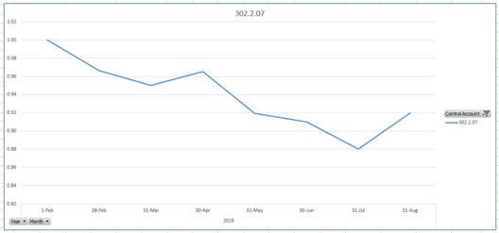
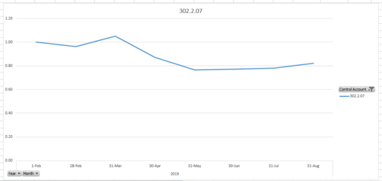
WBS 302.X.YY: Cost and Schedule Performance & VAR Reports
Charge #2
Include cumulative
table from CAM e-Toolbox
Turn on “green” to show where you are doing fine !
Plot of historical control account CPI, SPI from FermiPoint Excel file. Example: CA 302.2.07:
Describe Variances (understand Yellow/Red Thresholds, list of VARs from CAM e-Toolbox) and your plan to bring back to ~ 1.0 (if applicable)
Standard Plots will be distributed by Project Office
CPI
SPI
Message: Control Account/WBS cost and schedule historical performance is reasonable and under control; variances well understood and documented; plan to recover (if applicable) is sound and credible

Slide 22
WBS 302.X.YY: BCRs Approved Since Baseline
Charge #2
List the BCRs submitted and approved for this WBS since the Rebaseline. Briefly explain any major BCRs. Example:
BCR # | Description | Cost ($k) | Sch. (days)
348 | Magnet Spare Parts Order | 327k | 0
350 | Probe Orientation Measurement with a Single Mirror Target | 52k | 0
351 | IFS Bundle Rework on CM02, 03, and 3 magnets at FNAL and Associated Delays | 2,118k | 4 mos.
352 | Critical DR on MQXFA-17 and other Schedule Impacts to WBS 302.2 | 136k | 0
Message: Formal Change Control Process is strictly followed for any changes needed in WBS activities. Full traceability of changes.

Slide 23
WBS 302.X.YY: Estimate at Completion
Charge #2
Include At Complete table from CAM e-Toolbox
Talk about:
Your CA Variance at Completion (BAC- EAC) and explain the difference
Explain any manual EAC adjustment (see next slide)
What is the impact on your EAC coming from other Control Accounts (e.g., production yield impact from other CAs), etc.
In some cases an EAC table might help (use the information from the P6 Status Sheets “EAC” tab in FermiPoint)
L2s should show credit for lessons learned, show how they have informed the updated BOEs/ETC. Include a slide summarizing remaining scope and any changes implemented based on actuals and lessons learned.
Message: ETC is reasonably up-to-date, accurate, and credible. You are aware of how performance of other control accounts is impacting your ETC. Actuals and lessons learned have informed the ETC.

Slide 24
WBS 302.X.YY: EAC Manual Adjustments
Charge #2
List any EAC Manual Adjustment Entries for this WBS (if applicable). Explain why major adjustments have not been turned into BCRs yet. Example for 302.1:
WBS | EAC Manual Adjustment Description | Cost ($k)
302.1 | New FNAL charging practices, general training and conferences | $1,000k
302.1 | Additional Costs for Shipment of Assemblies to CERN ($67.5k for travel with each shipment, 10k for improvements to the shipping container, $36k for accelerometers) | $89.5k
302.1 | FNAL balance in CERN Exchange Document | $611k
Message: Proactive use of EAC manual adjustments to assess realistic amount of EAC-based remaining contingency.

Slide 25
WBS 302.X.YY: QA/QC
Charge #1
List any approved CERN MIPs with links for your WBS (show an example)
List any NCRs, for major ones explain root causes and corrective actions
Important topic for Coils and Magnet Fabrication WBSs because of potential for lower yield than assumed
DON’T MAKE THIS CHEESY !
DON’T REPEAT BOILERPLATE INFO
IT MIGHT APPLY ONLY TO SOME CA
Message: WBS follows project QA/QC processes; NCRs corrective actions are effective (problems are not repeated); lessons learned shared; etc.

Slide 26
WBS 302.X.YY: Risks
Charge #6
List WBS risks, risks updates since Rebaseline
Retired risks, realized risks (managed or closed), updated risks, new identified risk, etc
Describe your WBS top risks
Include a slide in each presentation detailing risks/challenges that are “keeping folks up at night”. Avoid perception of easy road ahead (if applicable)
L2s should address the Estimate Uncertainty for the remaining scope to better communicate/address the remaining challenges. Include Estimate Type pie chart.
Message: WBS risks are identified, up to date, and are being actively managed. In some WBSs, Significant challenges remain that require healthy contingency (EU, Discrete Risks).

Slide 27
WBS 302.X.YY: ES&H
Charge #5
Any safety reviews? Any Safety incidents?
If there were OPRs in your area of responsibility, demonstrate ownership and mention lessons learned.
Highlight reporting promptness and “erring on the side of safety”
Take credit for great safety record if applicable. Mention number of worked hours without DARTs
For fabrication activities, include links to approved equipment ORCs, Hazard Analysis, etc.
For the ES&H breakout presentation, add more details and examples of implementation at the different sites (Work Planning and Control, Org Charts, Partner Lab summary of discussions and salient issues)
DON’T MAKE THIS CHEESY !
DON’T REPEAT BOILERPLATE INFO
SHOW SPECIFIC EXAMPLES (IF YOU HAVE ANY)
Message: WBS ES&H is being handled appropriately; you are aware of ORPs/Lessons Learned in your area of responsibility

Slide 28
WBS 302.X.YY: Summary
Summarize the main points you made before directly supporting the review charge.
Avoid too many details about numbers (“bureaucratic” stuff). Emphasize status and challenges of project.
Message: Execution of this WBS is proceeding according to the baseline plan, adequate technical progress, cost and schedule are credible and in control, risks are understood and actively managed.
Lab
Logo

Slide 29
Backup Slides
You should keep the pie-charts and tables from the CAM e-Toolbox as backup slides in case someone asks questions

Slide 30
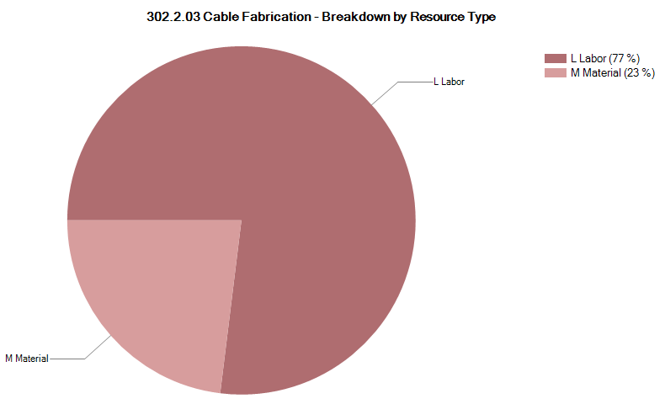
302.2.03 Resource Type Breakdown
Charge #2
77% Labor, 23% M&S
M&S Includes contractors (braiding vendor), travel, shipment, etc.
To be Updated
Example from 302.2.03
Plots to be provided by PO
Lab
Logo

Slide 31
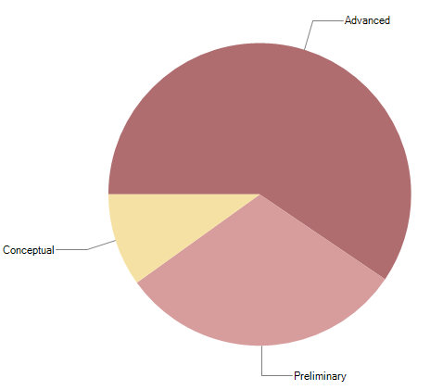
302.2.03 Estimate Quality
Charge #2
Conceptual is related to the RRR measurements
FNAL has been measuring RRR up to earlier this year
LBNL’s new system is undergoing benchmarking approval
Preliminary is mostly related to Insulation
Master Agreement is being placed to lock down the price throughout AUP
The quality of estimate has been updated for CD-2/3b
To be Updated
Example from 302.2.03
Plots to be provided by PO
Lab
Logo

Slide 32
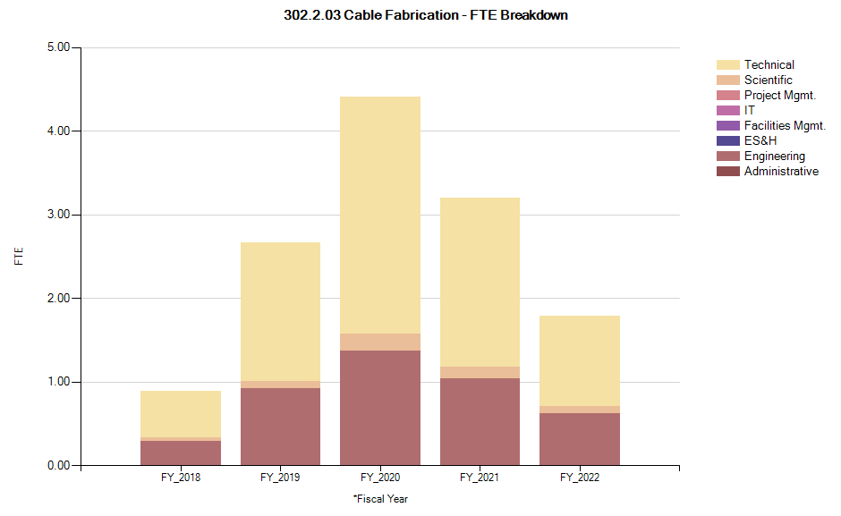
302.2.03 FTE Breakdown
Charge #2
From 5/31/18 forward
Does not include FY18 Actuals
To be Updated
Example from 302.2.03
Plots to be provided by PO
Lab
Logo

Slide 33
302.2.03 Cost Performance Report
Charge #2
BAC = $5.658M
No thresholds crossed in Current Period Cost
No thresholds crossed in Cumulative to Date
Cumulative SPI = 0.9, CPI = 1.05
To be Updated
Example from 302.2.03
Plots to be provided by PO

