Slide 1
302.4.01 - Magnet Vertical Test
AUP DOE IPR July 23-35, 2024
Piyush Joshi – Brookhaven National Laboratory
L3 and CAM for Vertical Magnet Test at BNL
HL-LHC AUP DOE IPR – July 23–25, 2024

Slide 2
Outline
Scope, Interfaces, Dependencies & Team
Achievements since Rebaseline.
Procurement Status
Schedule
Cost and Schedule Performance & VAR Reports
Estimate at Completion
QA/QC
Risks
ES&H
Summary
HL-LHC AUP DOE IPR – July 23–25, 2024

Slide 3
WBS 302.4.01: Scope
Charge #2,#3
Scope
Receive MQXFA magnets from LBNL
Prepare magnet for test at 1.9K in vertical test cryostat
Test magnet and analyze results
Ship magnet to FNAL
Deliverables:
23 magnet tests.
WBS Code | WBS Name | Control Account
302.4.01 | Magnets Vertical Test | Yes
WBS Description
Scope of Work Test 23 magnets at the BNL vertical test facility: 2 prototypes, 5 pre-series, and 16 series production. Includes test preparation, magnet test, and magnet shipment to LBNL or FNAL. Includes procurement and fabrication of a second top plate and minor infrastructure upgrades to meet test production throughput. Scope Assumptions/Exclusions The BNL vertical test facility is assumed to be available from LARP, installed and fully functional in BNL Building 902 of the BNL Superconducting Magnet Division. 15% of the magnets (3 out of 20) are assumed to not pass vertical testing and sent back to LBNL for re-work. The last 4 Magnets for the two cryo-assembly CERN spares are not vertically tested. They are installed directly in the cold mass and trained at the FNAL Horizontal Test Facility WBS Deliverables A total of 23 magnet tests with their corresponding Test Reports
HL-LHC AUP DOE IPR – July 23–25, 2024

Slide 4
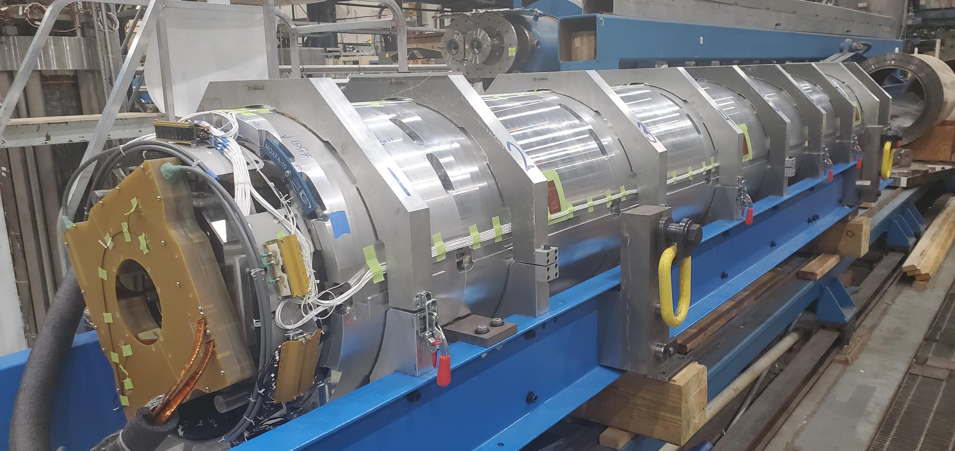
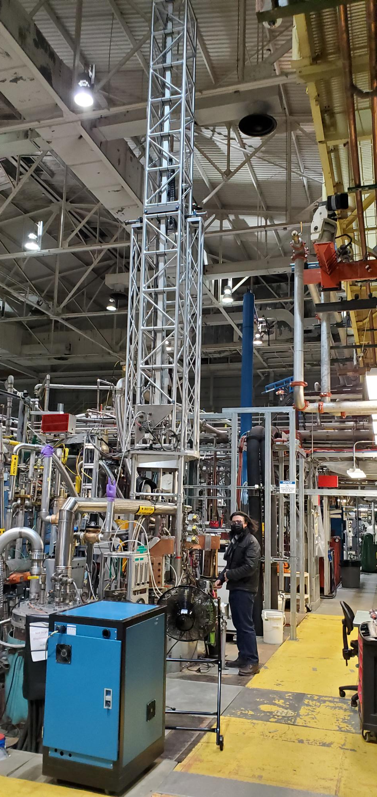
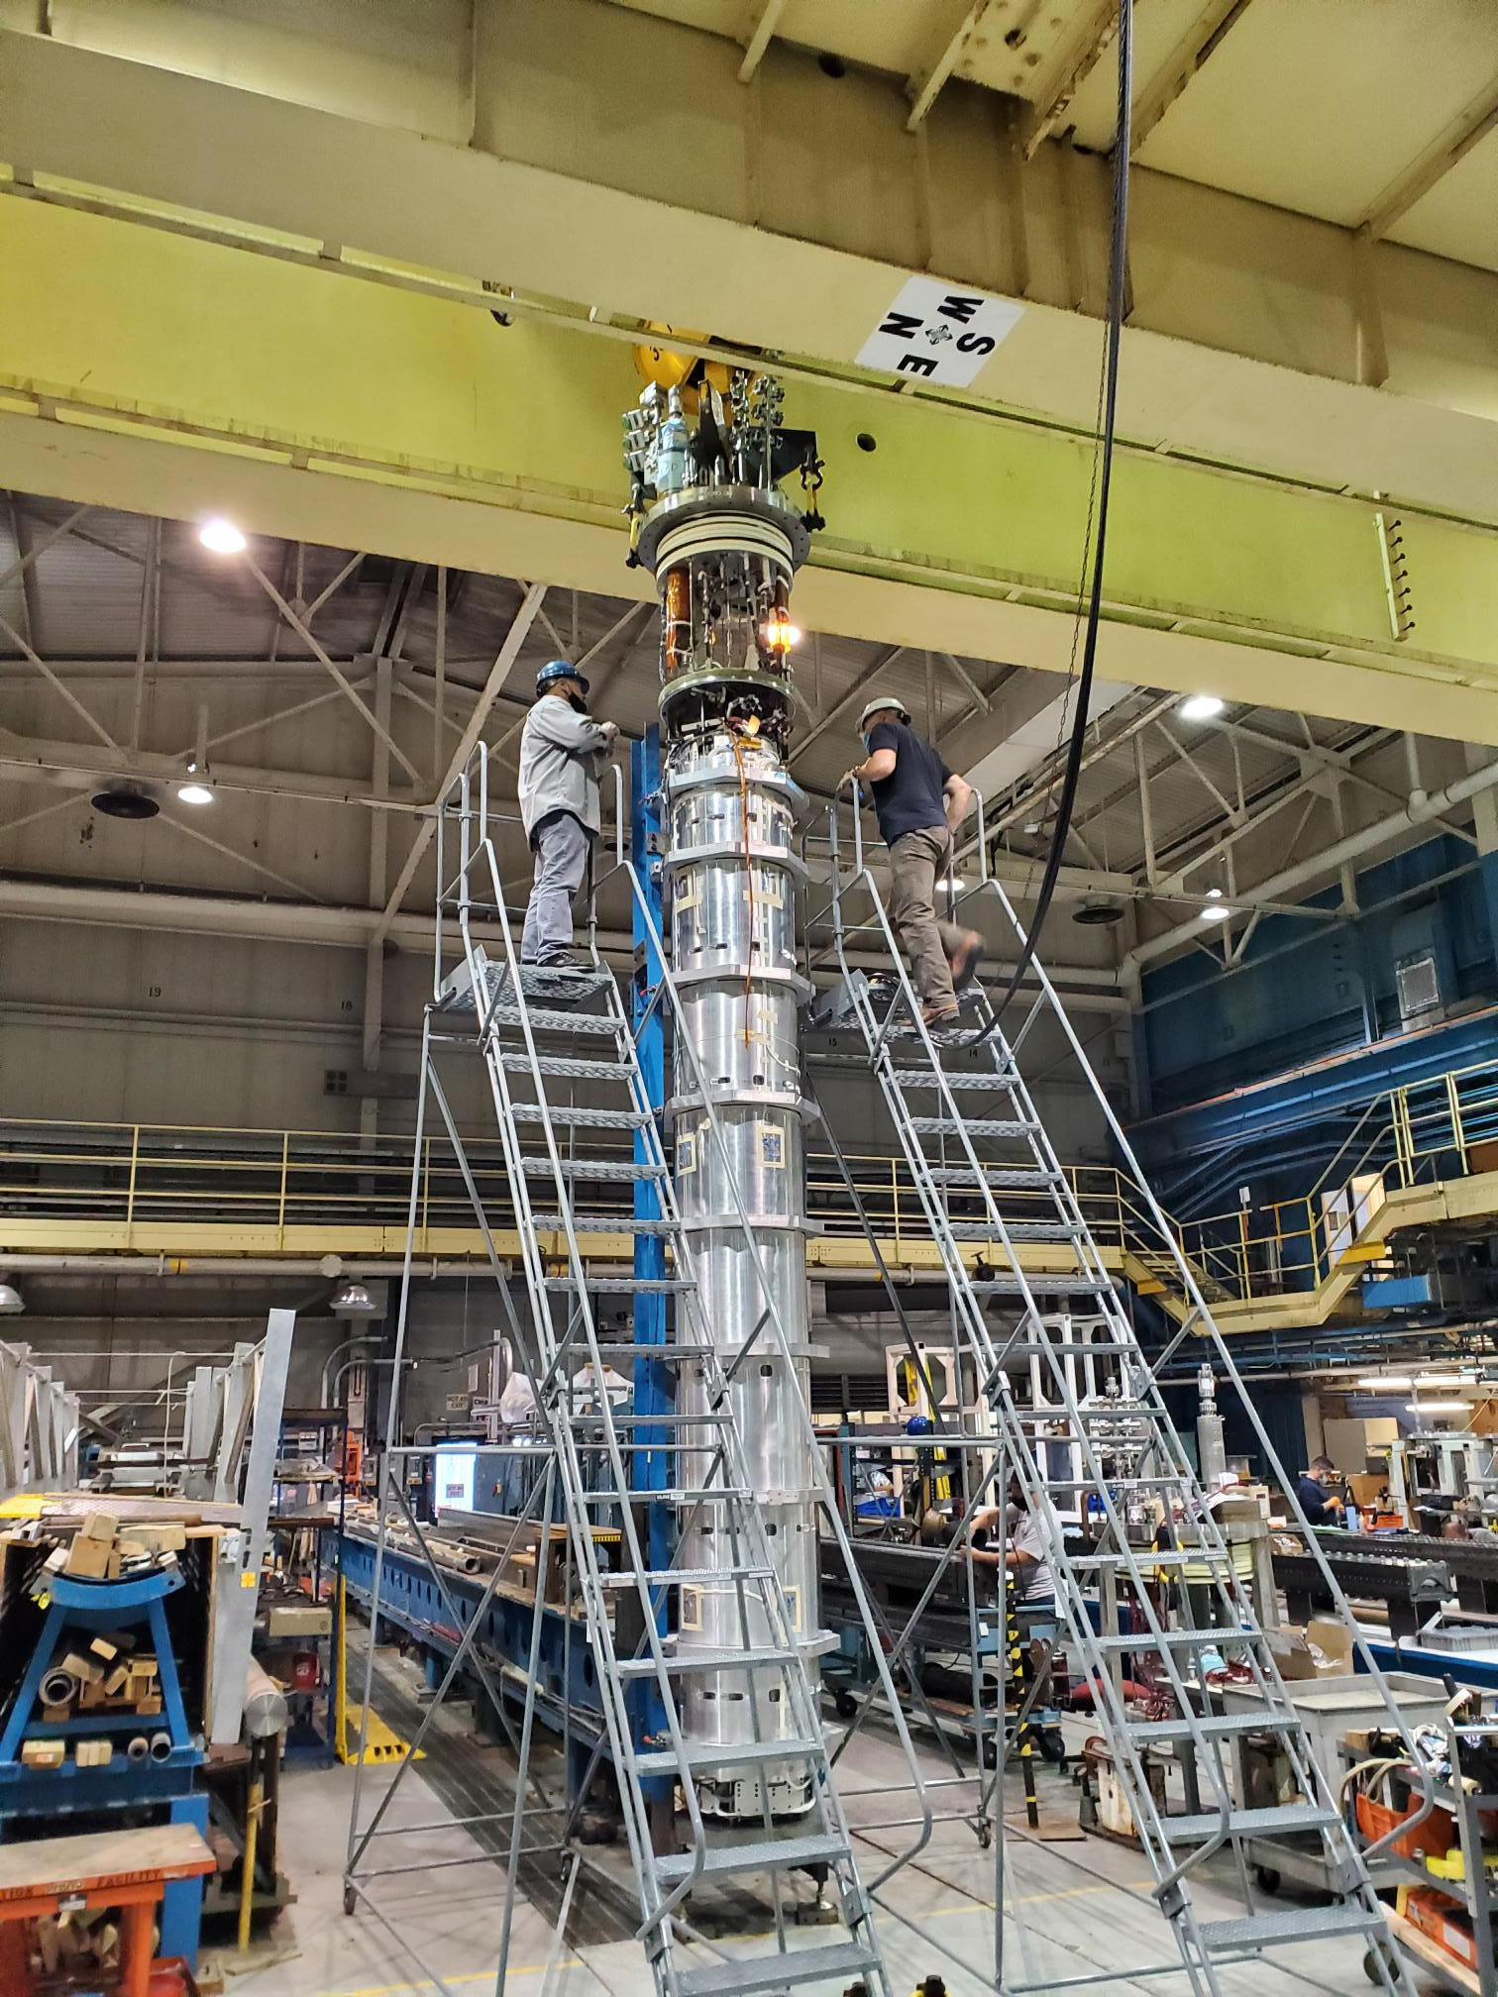
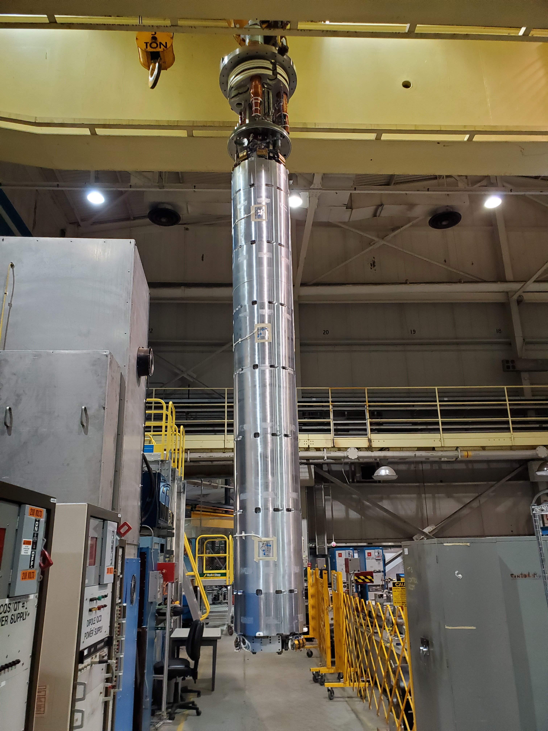
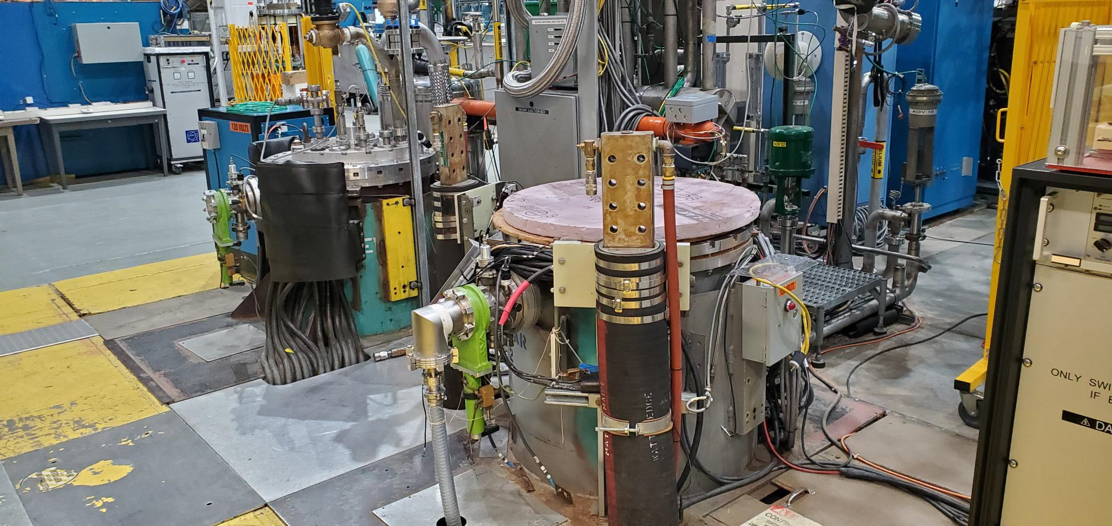
Typical Magnet Test Sequence (Scope)
Charge #2,#3
Incoming inspection of Magnet
(Warm measurements)
Magnet is Upright and attached to top hat
Prepared magnet with all power and instrumentation connection transported to test Dewar
Magnet in Test Dewar with Field Measurement Probe
HL-LHC AUP DOE IPR – July 23–25, 2024

Slide 5
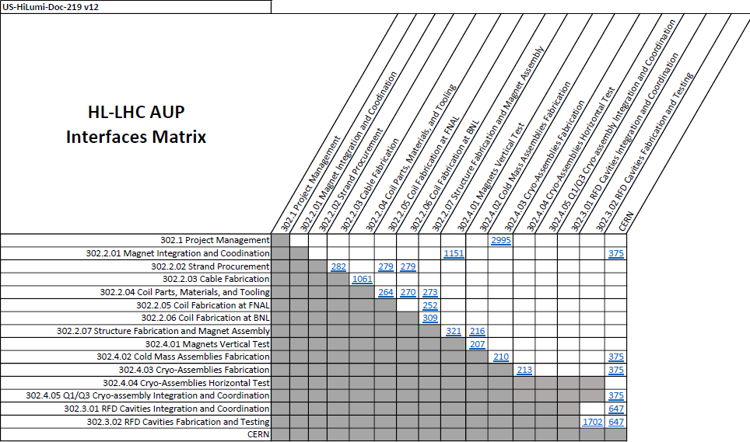
WBS 302.4.01: Interfaces
Charge #2,#3
Interface Control Matrix is from: US-HiLumi-doc-219.
302.4.01 Magnets Vertical Test has three interface documents.
US-HiLumi-doc-1151
US-HiLumi-doc-321
US-HiLumi-doc-207
HL-LHC AUP DOE IPR – July 23–25, 2024

Slide 6
WBS 302.4.01: External Dependencies
Charge #3
Receiving magnet for testing from LBNL.
Receiving helium gas and liquid nitrogen from vendors (Air Gas and Messer).
Storing tested magnets before being shipped to Fermi Lab.
HL-LHC AUP DOE IPR – July 23–25, 2024

Slide 7
WBS 302.4.01: Team
Charge #2
302.4
Q1/Q3 Cryo-assemblies Fabrication
L2: S. Feher
(T. Strauss)
302.4.02
Cold Mass Assemblies Fabrication
L3/CAM: F. Nobrega.
(A . Vouris)
302.4.03
Cryo-Assemblies Fabrication
L3/CAM: F. Nobrega.
(R. Rabehl)
302.4.04
Cryo-Assemblies Horizontal Test
L3/CAM: G. Chlachidze
(S. Stoynev)
302.4.01
Magnets Vertical Test
L3: P. Joshi (F. Kurian)
CAM: P. Joshi
302.4.05
Q1/Q3 Cryo-assembly Integration and Coordination
L3/CAM S. Feher (T. Strauss)
302.4.04.03
Horizontal Test Stand Operations
L4: G. Chlachidze (S. Stoynev)
302.4.04.02
Instrumentation and Mechanical Horizontal Test Stand Upgrade
L4: G. Chlachidze (S. Stoynev)
302.4.04.01
Cryo-Mechanical Horizontal Test Stand Upgrade
L4: R. Rabehl
302.4.04.99
L3 Management Cryo-assemblies Horizontal Test
L3: G. Chlachidze (S. Stoynev)
Control Account
Experienced Team:
Piyush Joshi
Febin Kurian
Bill McKeon
Frank Brandi
Justin Amari
Pat Doutney
Pete Galioto
James Bush
Brandon Kelly
HL-LHC AUP DOE IPR – July 23–25, 2024

Slide 8
WBS 302.4.01: Achievements since Rebaseline
Charge #1
Six Magnets tested at Brookhaven National Laboratory:
MQXFA-8b: Retest of MQXFA-08 after repair. Magnet successfully trained to operate at nominal current.
MQXFA-13: Magnet did not reach stable operating current
MQXFA-14b:Magnet successfully trained to operate at nominal current.
MQXFA-7b: Retest of MQXFA-07 after repair. Magnet successfully trained to operate at nominal current
MQXFA-15: Magnet successfully trained to operate at nominal current.
MQXFA-17: Magnet did not reach stable operating current.
High current successful ramps (16230A and above) performed at the facility=78
High current unsuccessful ramps (quenches below 16530A)=80
Total high current ramps performed at this facility=158.
Magnet Facility improvements and repairs:
DI cooling water upgrade to chiller-based system from water tower-based system for continues operation through hot summer days.
New helium purifier installed - To be commissioned in mid August.
New Linde 1630 liquefier with capacity of 70 liters/hour installed. Commissioning starting on September 18th.
New Linde 1430 liquefier with capacity of 40 liters/hour installed. Commissioning starting on September 18th.
Existing liquefaction capacity is 310 liters/hour.
Total liquefaction capacity increased to 420 liters/hour
Magnetic measurement probe system repaired.
Splicing fixture repaired.
HL-LHC AUP DOE IPR – July 23–25, 2024

Slide 9
Achievements since Rebaseline
Charge #1
Magnets Tested after Rebaseline
MQXFA-8b | Reached acceptance current
MQXFA-13 | Did not reach acceptance current
MQXFA-14b | Reached acceptance current
MQXFA-7b | Reached acceptance current
MQXFA-15 | Reached acceptance current
MQXFA-17 | Did not reach acceptance current
Magnets to be tested
MQXFA-13b
MQXFA-12b
MQXFA-19
MQXFA-20
MQXFA-21
MQXFA-22
MQXFA-23
* Magnets MQXFA-16 and MQXFA-18 will not be tested vertically at BNL
HL-LHC AUP DOE IPR – July 23–25, 2024

Slide 10
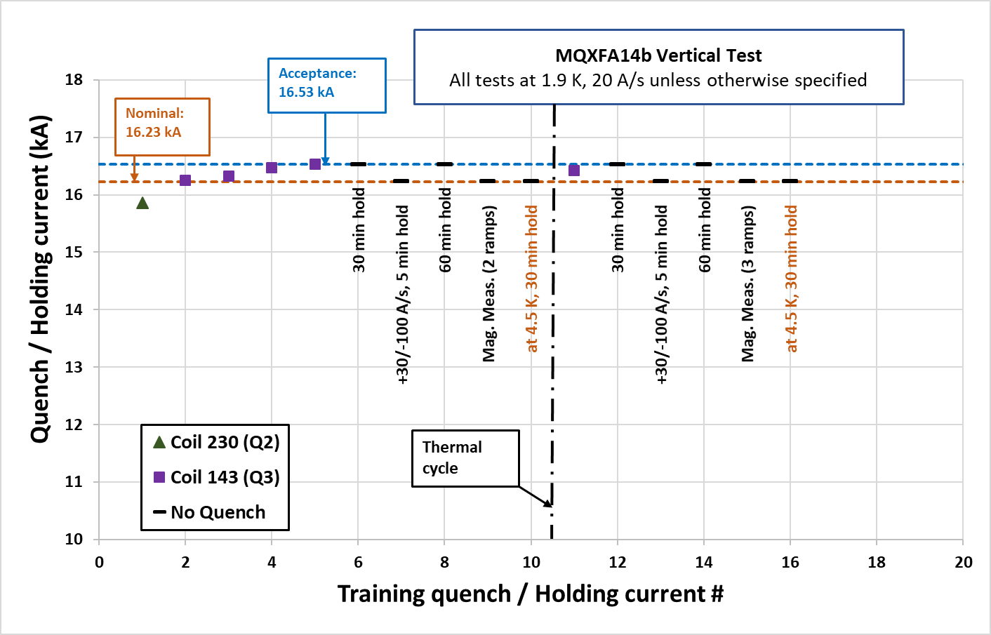
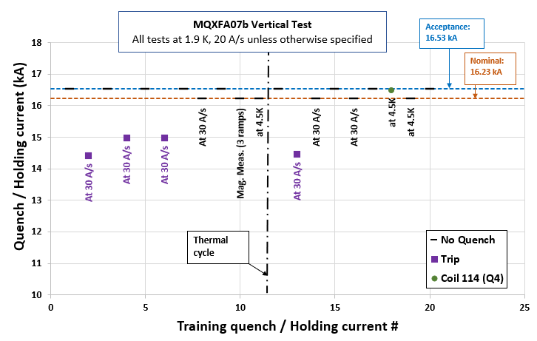
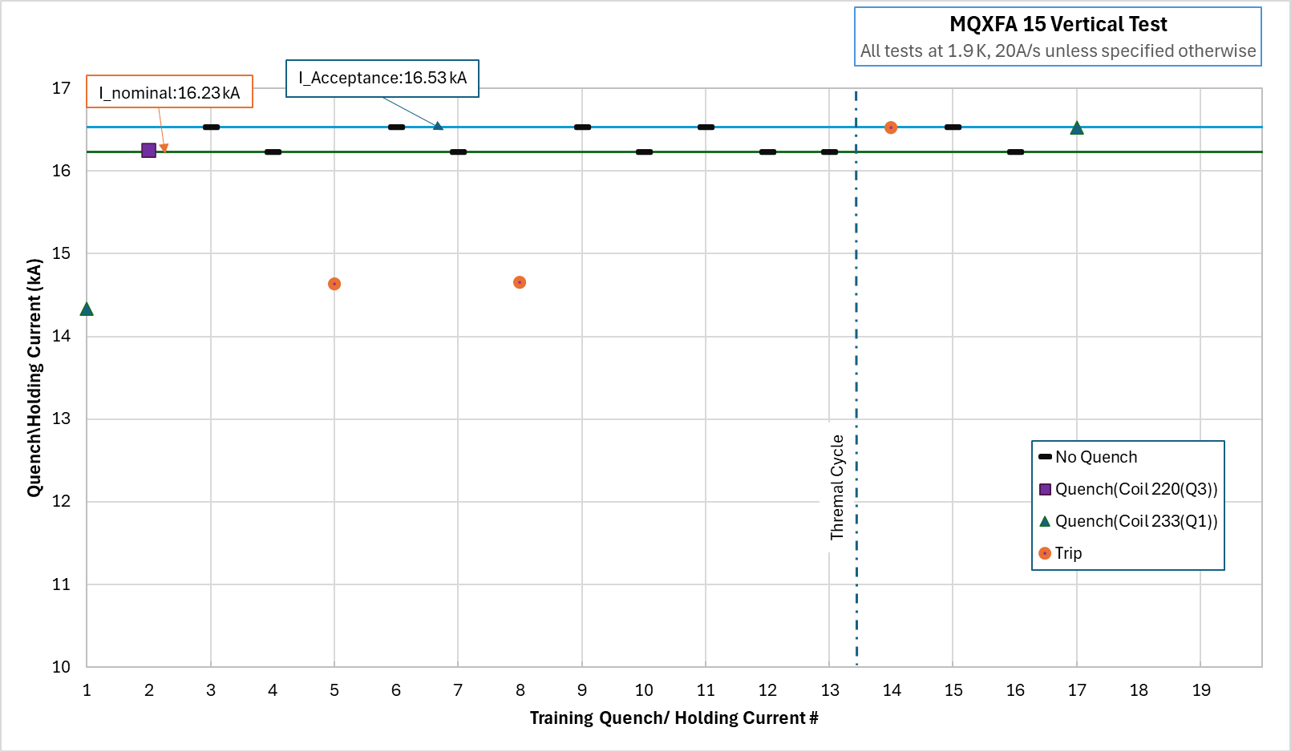
WBS 302.4.01: Achievements since Rebaseline
Charge #1
Training plots of successful Magnets
HL-LHC AUP DOE IPR – July 23–25, 2024

Slide 11
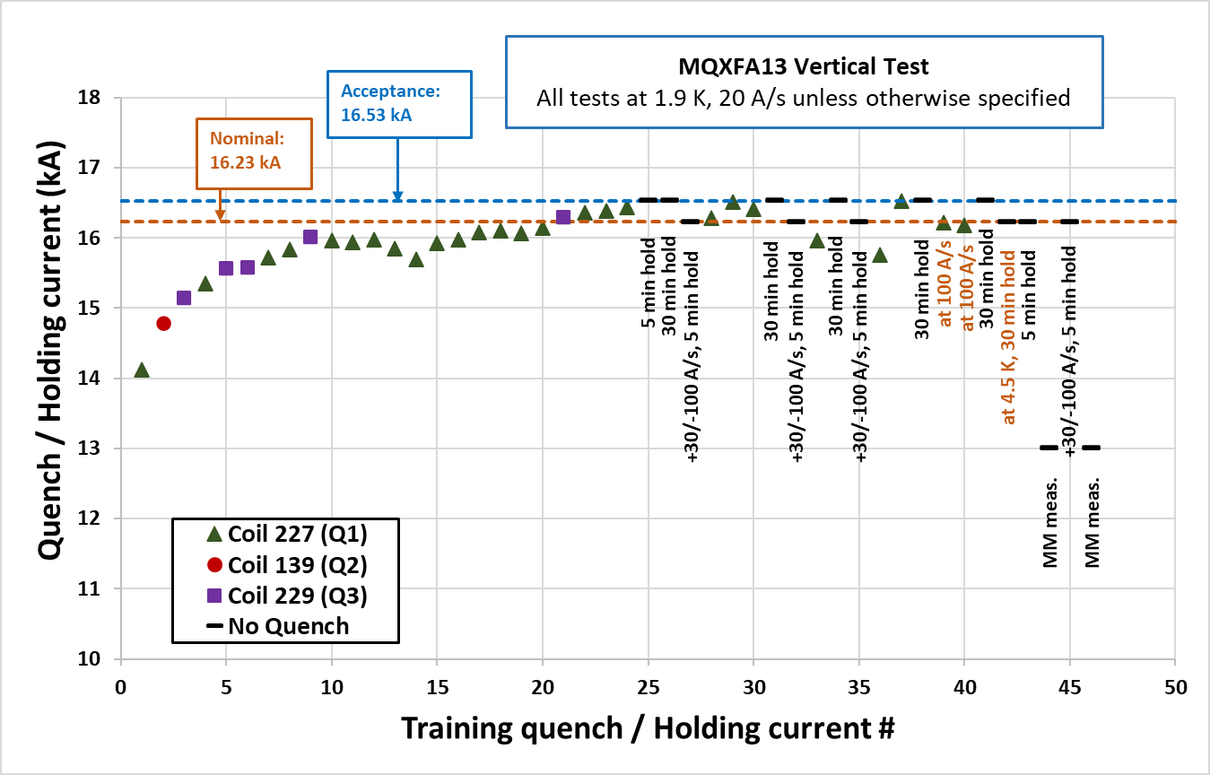
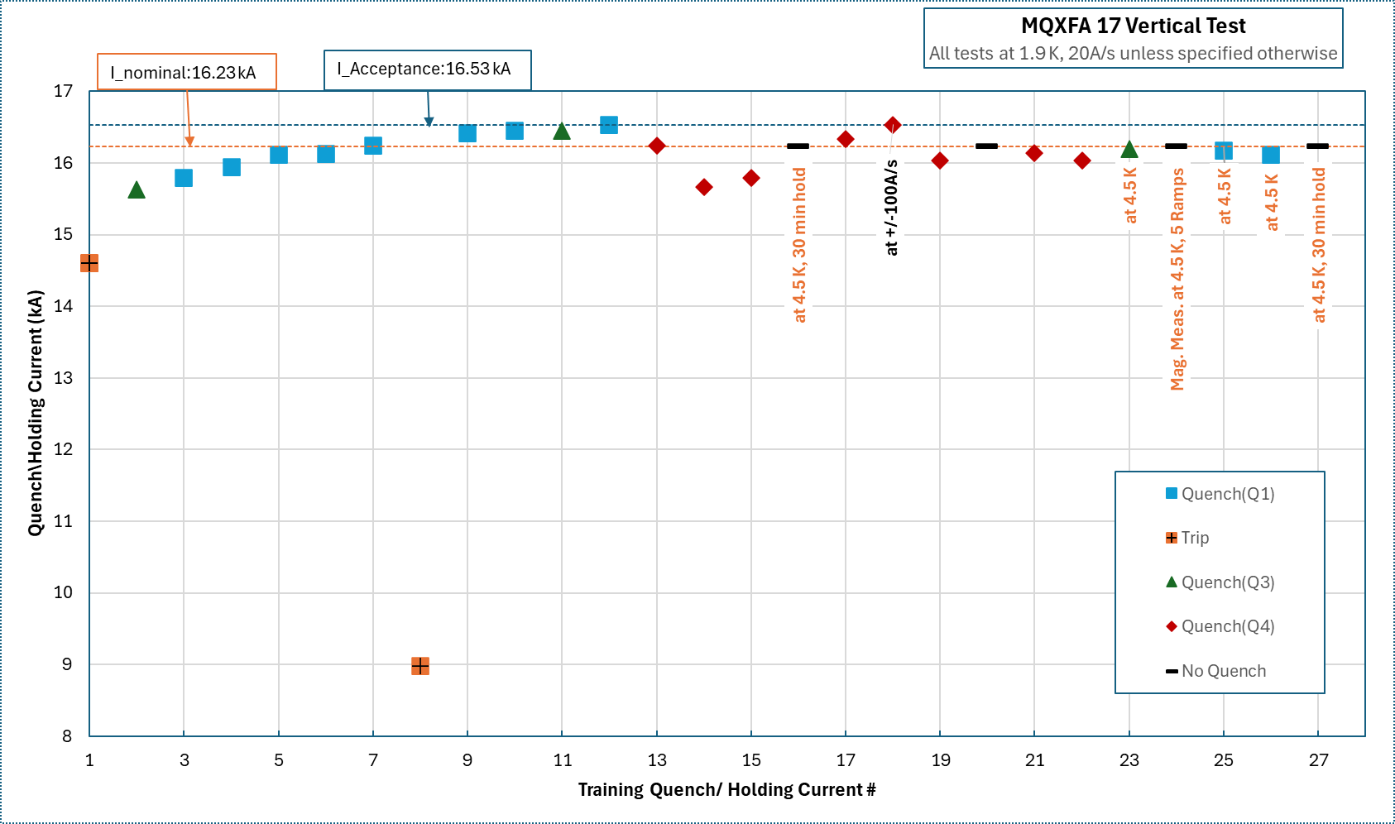
WBS 302.4.01: Achievements since Rebaseline
Charge #1
Training plots of unsuccessful Magnets
HL-LHC AUP DOE IPR – July 23–25, 2024

Slide 12
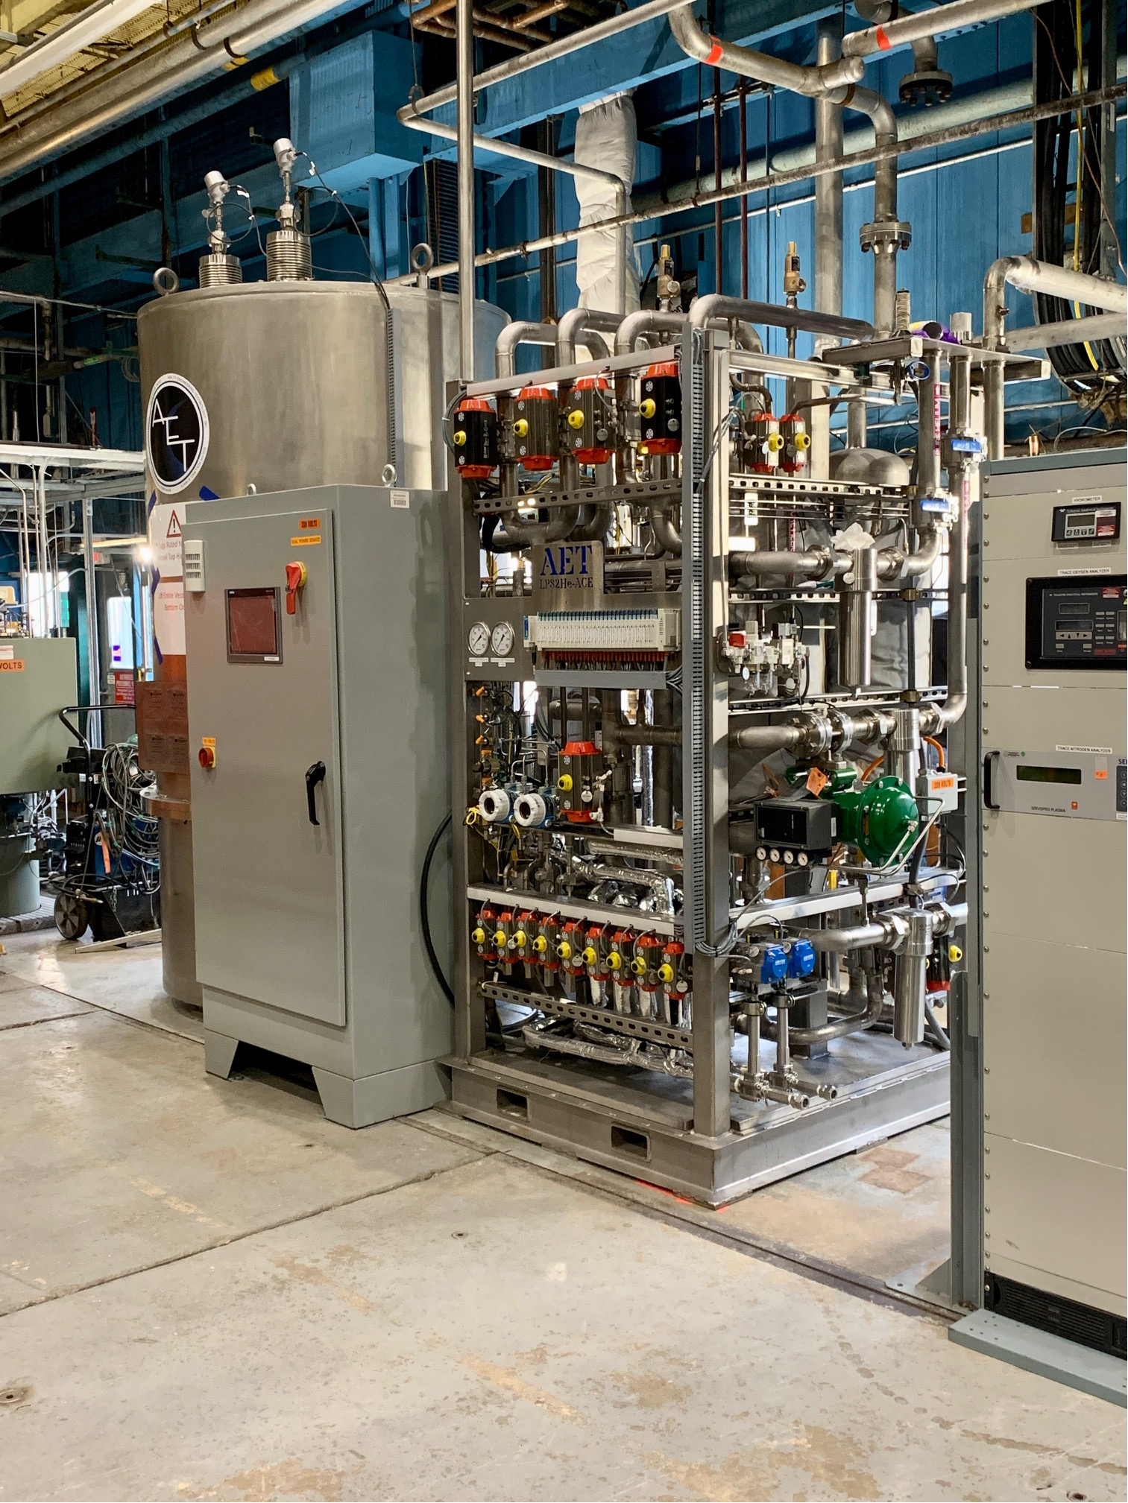
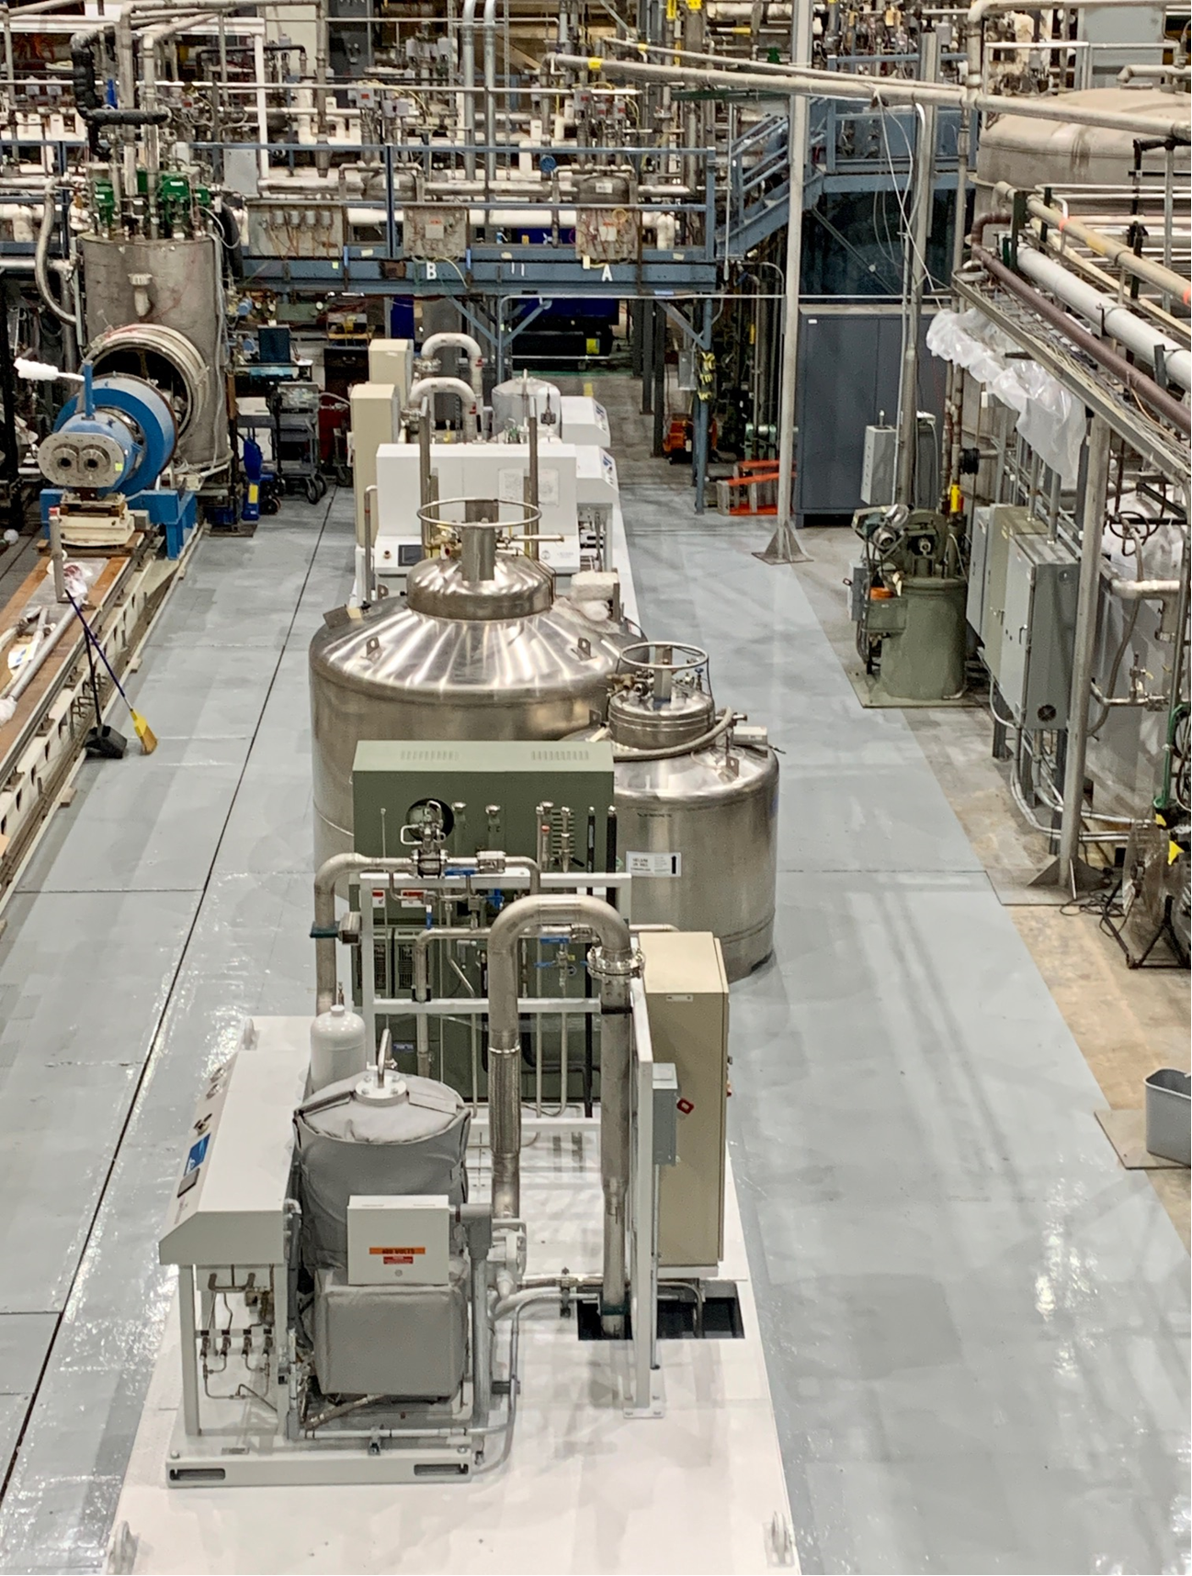
WBS 302.4.01: Achievements since Rebaseline
Charge #1
Installation of New Purifier
Installation of New Linde 1630 (70l/h)
and 1430(40l/h)
HL-LHC AUP DOE IPR – July 23–25, 2024

Slide 13
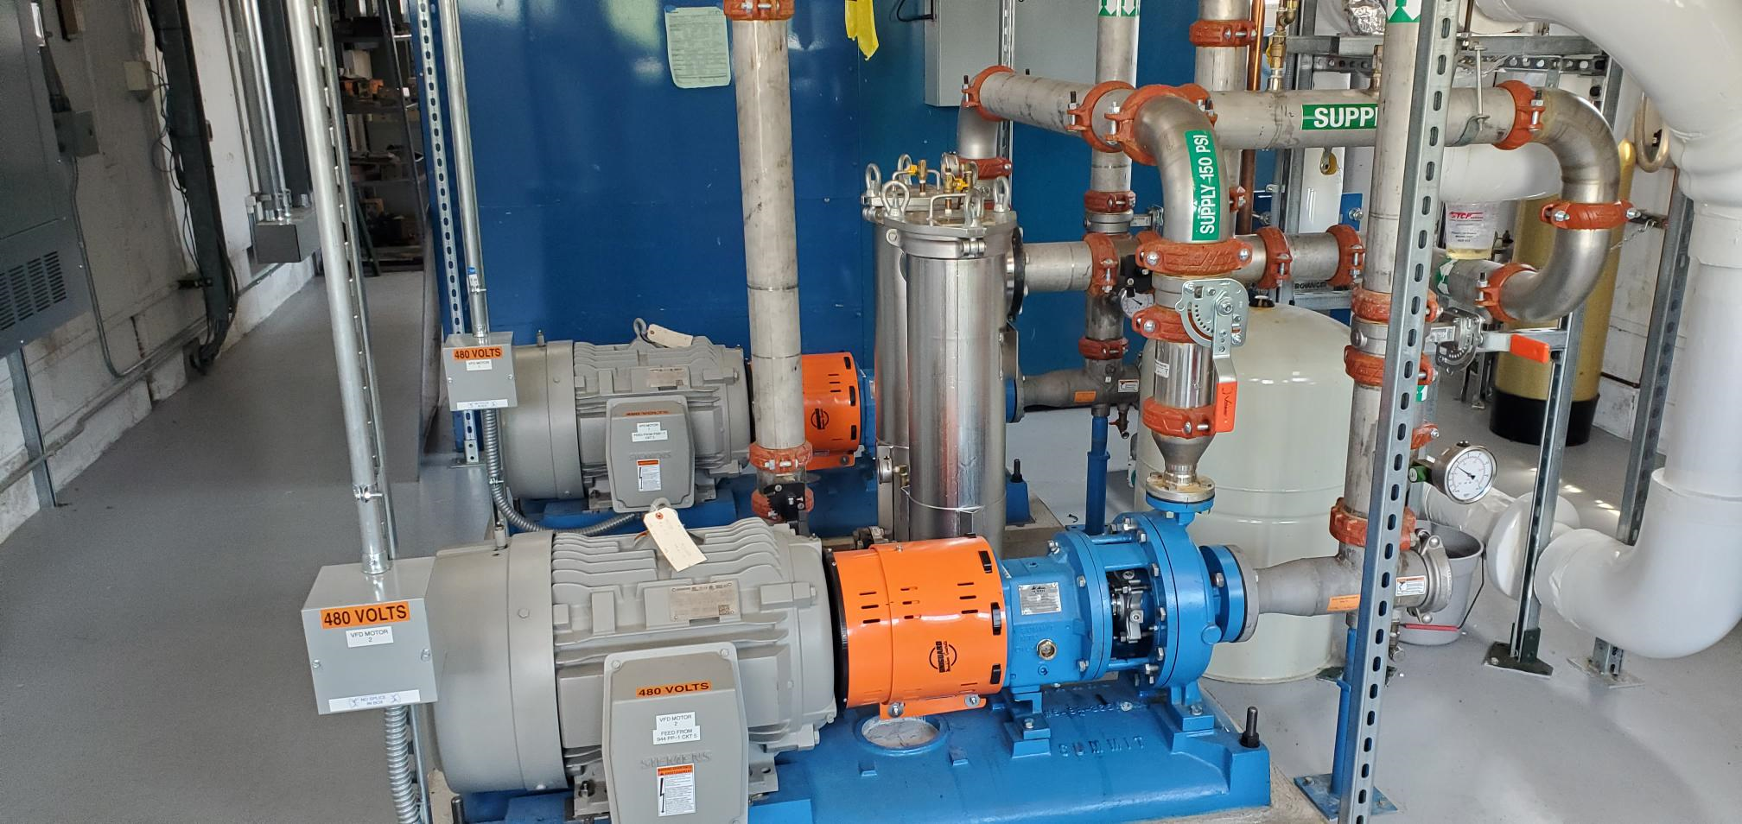
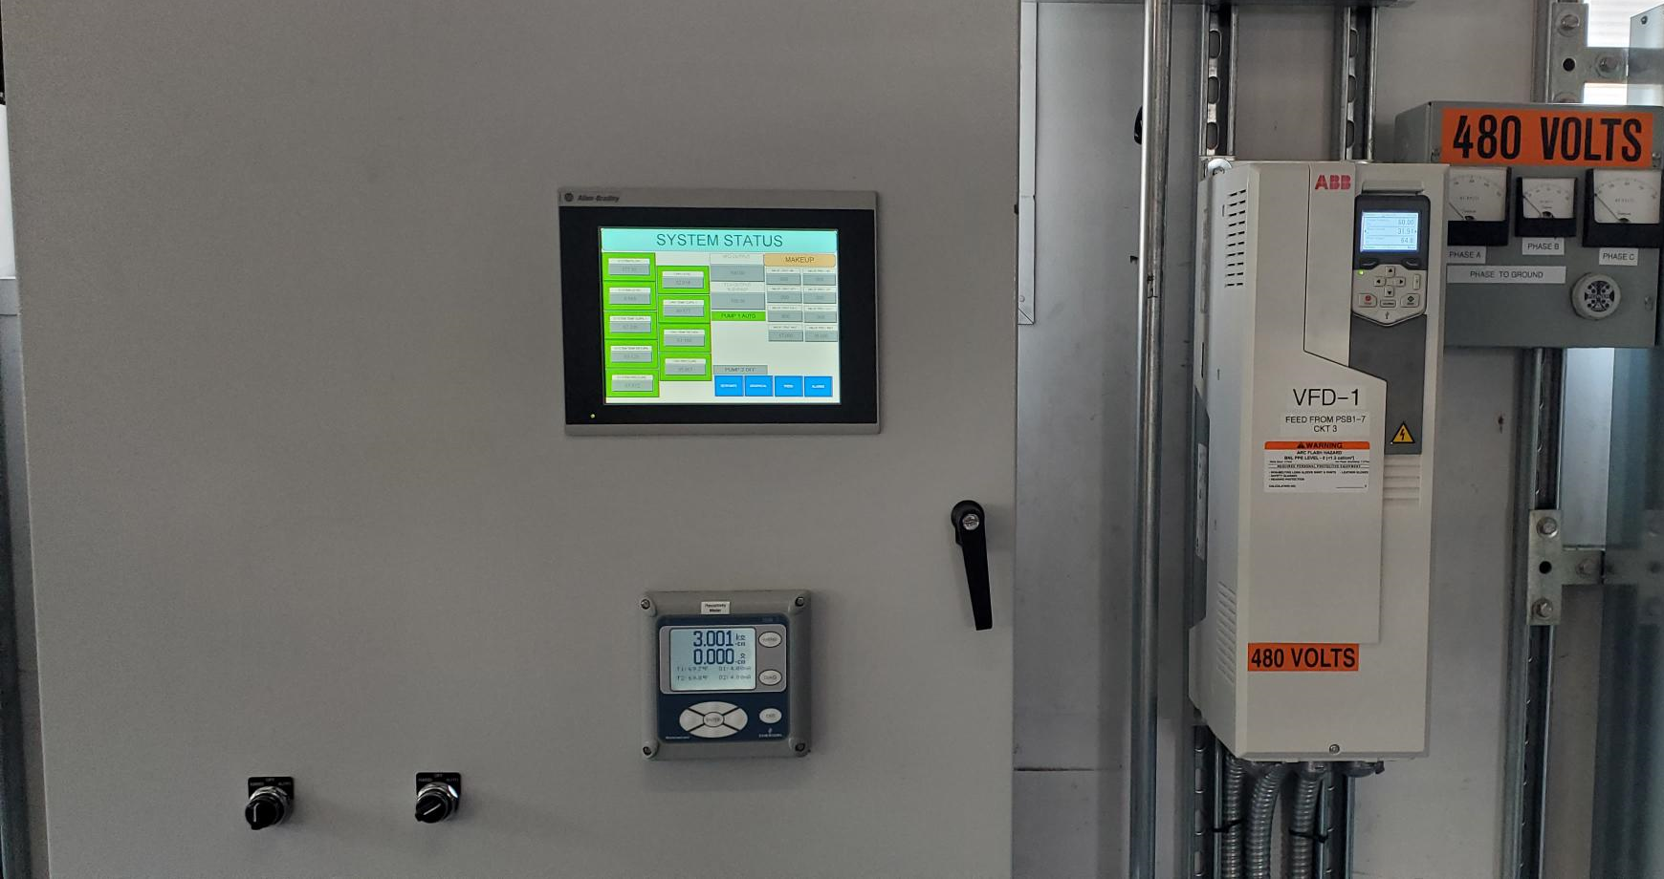
WBS 302.4.01: Achievements since Rebaseline
Charge #1
New DI water system and controls.
500kW cooling capacity
300GPM
Pumps and heat exchanger
Chiller
Controls and VFD
HL-LHC AUP DOE IPR – July 23–25, 2024

Slide 14
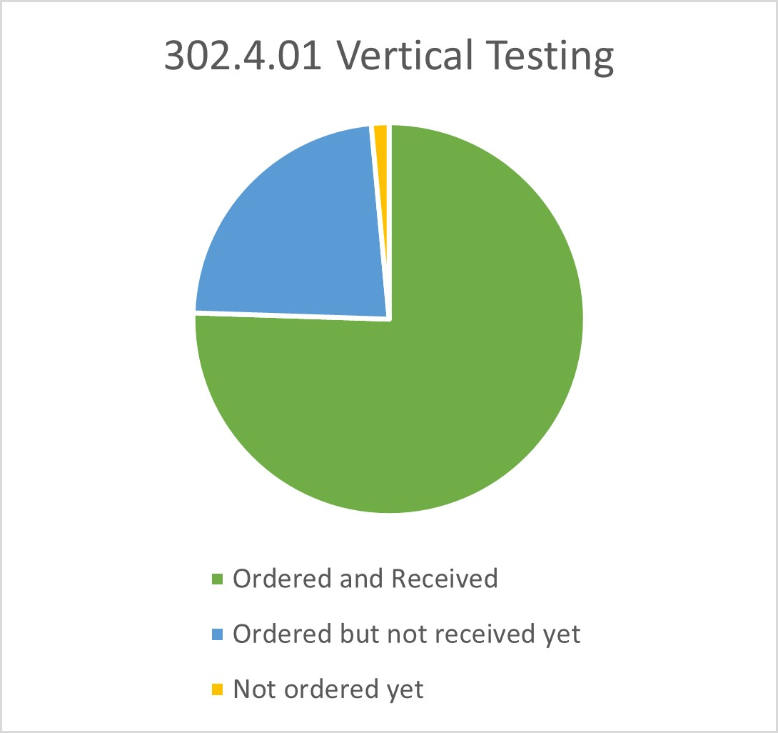
WBS 302.4.01: Procurement Status
Charge #4
Ordered but not received are Cryogenic Gases and electric power.
Not ordered yet: Shipping cost of tested magnets.
HL-LHC AUP DOE IPR – July 23–25, 2024

Slide 15
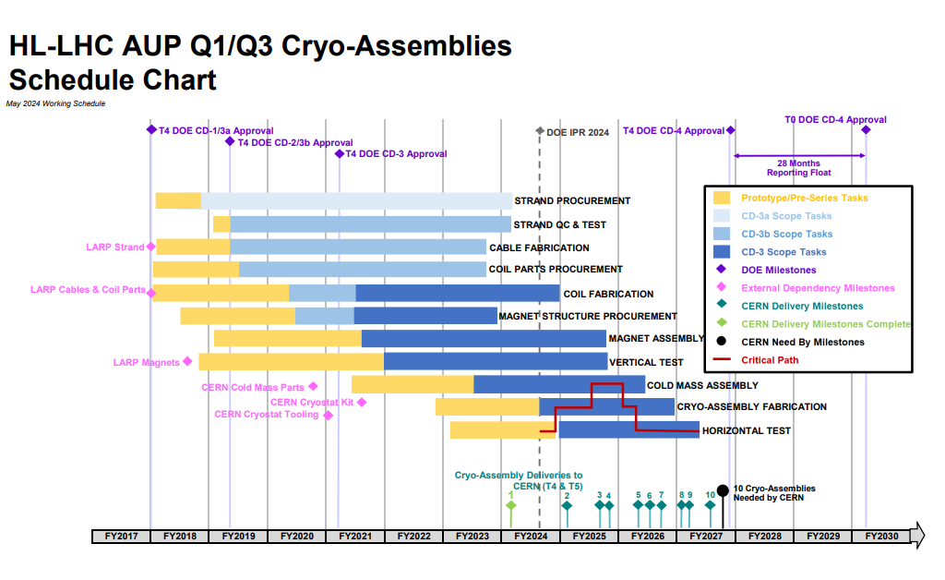
WBS 302.4.01: Schedule
Charge #2
Magnet Vertical Testing is not in critical path
HL-LHC AUP DOE IPR – July 23–25, 2024

Slide 16
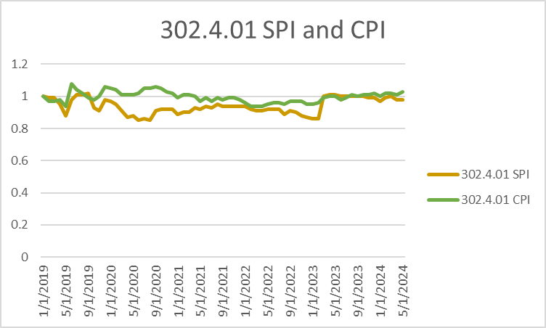
WBS 302.4.01: Cost and Schedule Performance & VAR Reports
Charge #2
Budget | Earned | Actuals | SV | SV (%) | CV | CV (%) | SPI | CPI
$21,501,381.88 | $21,059,914.65 | $20,493,650.88 | ($441,467.23) | -2.1 % | $566,263.77 | 2.7 % | 0.98 | 1.03
SPI and CPI are stable and well behaved. No cumulative variances beyond threshold.
HL-LHC AUP DOE IPR – July 23–25, 2024

Slide 17
WBS 302.4.01:BCRs approved since Rebaseline
Charge #2
BCR# | BCR TITLE | Cost Impact | Schedule Impact
BCR311 | AUP Project Rebaseline after March 2023 ESAAB Approval | $914,361 | 91
BCR313 | FY23 BNL and LBNL Rate Adjustments | $628,298 | 0
BCR315 | Using Vertically Untested Magnets in Cold Mass 05 Rather than Cold Mass 09 | $30,633 | 0
BCR324 | Disassembly of Magnet MQXFA13 before Assembly of Magnet MQXFA16 | $3,215 | 0
BCR333 | Split Year-long LOE Activities into Quarter-long Activities | $0 | 0
BCR334 | Adjust Magnet Vertical Testing Activities for Sept-Oct '23 Cryo Facility Maintenance | $18,125 | 0
BCR332 | Rework MQXFA15 to Adjust Preload | $16,421 | 0
BCR336 | CERN Acceptance to Ship Cryo-assembly LQXFA/B 01 | $1,061,862 | 91
BCR341 | Increased Cost of Helium for Vertical Testing at BNL | $320,579 | 0
BCR349 | BNL and LBNL FY24 Rate Adjustments | -$174,261 | 0
BCR351 | IFS Bundle Rework Labor and associated Schedule Delays | $133,122 | 92
TOTAL |  | $2,952,356
$2,037,995
HL-LHC AUP DOE IPR – July 23–25, 2024

Slide 18
WBS 302.4.01: Estimate at Completion
Charge #2
VAC of -$361k is due to projection of current cost variance
HL-LHC AUP DOE IPR – July 23–25, 2024

Slide 19
WBS 302.4.01: QA/QC
Charge #1
HL-LHC-AUP QA manager is James Blowers.
AUP Quality Assurance Plan is US-HiLumi-doc-80.
BNL Quality Assurance Plan is US-HiLumi-doc-945.
AUP also follows CERN HL-LHC Quality Assurance Management Plan (EDMS 1513591).
QA is facilitated by documentation during all phases of the magnet handling and testing activities at BNL, as it is project-wide.
Each magnet has a complete documentation package called a traveler, which includes work procedures, test plans, test results, and discrepancy reports, if any.
BNL Magnet Division (MD) has QA expert who reviews and controls documents, such as work planning sheets and magnet travelers. SMD QA Manager is H. Hocker.
HL-LHC AUP DOE IPR – July 23–25, 2024

Slide 20
WBS 302.4.01: Risks
Charge# 6
6 risks have been identified and analyzed.
All risks are actively managed via monthly Risk Management Board meetings.
No new risks.
No risks have been retired.
One risks evaluated as medium. None are high.
HL-LHC AUP DOE IPR – July 23–25, 2024

Slide 21
WBS 302.4.01: ES&H
Charge #5
Project-wide standards are given in the AUP Hazard Analysis Report (HAR) (US-HiLumi-doc-1121).
All work at BNL must comply with the Standards-Based Management System (SBMS), which provides procedures and protocols to identify and control hazards to environment, safety, and health.
Hazards for magnet handling and testing have been identified, and procedures for their control are in place. These include:
Magnet lifting and up-righting with cranes and special fixtures;
Handling of cryogens (liquid N₂ and liquid He);
High voltage withstand (hipot) tests;
High current up to 20 kA;
High, He gas pressures.
Personnel are required to be up-to-date on all safety training and use the appropriate personal protection equipment.
Work is planned beforehand and coordinated with ES&H staff.
Frequent safety walk-throughs of work areas are conducted by ES&H staff and supervisors.
HL-LHC AUP DOE IPR – July 23–25, 2024

Slide 22
WBS 302.4.01: Summary
The vertical testing WBS scope is clearly defined and well understood.
Interfaces are defined and controlled.
We have successfully completed testing of 6 magnet tests
after new baseline since March 2023.
Regular maintenance, upgraded control and monitoring system has improved the performance of our main helium liquefier plant.
Addition of Linde 1630 and Linde 1430 helium liquefiers will add liquifying capacity of 110 liters/hour after commissioning.
Variances have not been significant, CPI/SPI are reasonably well-behaved and understood.
Risks continue to be managed and mitigated.
HL-LHC AUP DOE IPR – July 23–25, 2024

Slide 23
Backup Slides

Slide 24
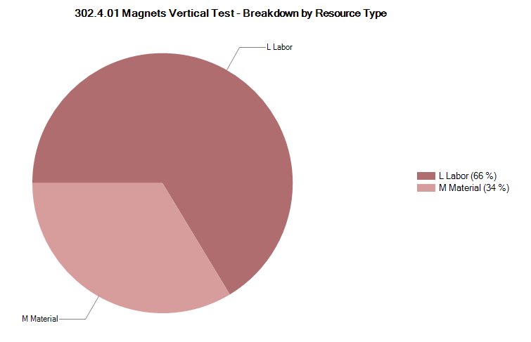
302.4.01: Resource Type Breakdown
Charge #2
70% Labor, 30% M&S.
M&S Includes electrical power, Cryogens, and shipping to FNAL.
Needs Correction

Slide 25
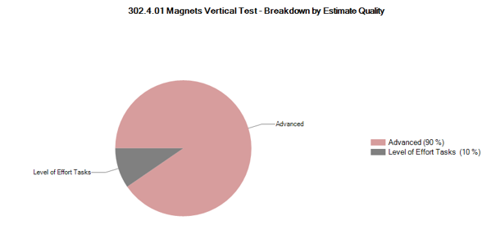
302.4.01: Estimate Quality
The Vertical Testing is in production mode, making future predictions clearly understood.
HL-LHC AUP DOE IPR – July 23–25, 2024

Slide 26
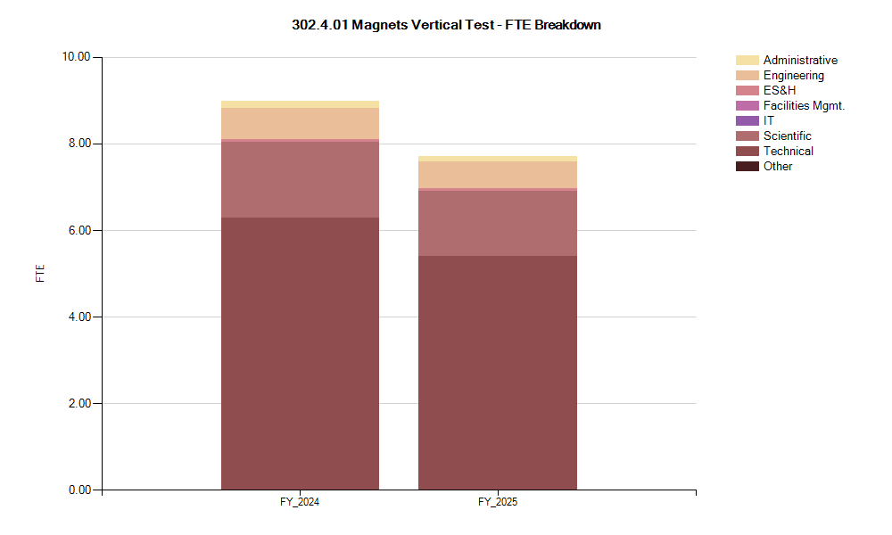
302.4.01: FTE Breakdown
Charge #4

Slide 27
CPR as of 5/24
No cumulative variances above threshold

Slide 28
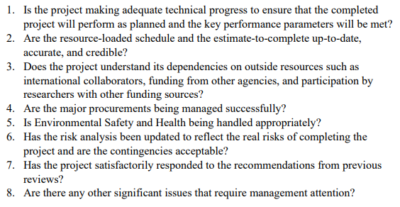
Charges

