Slide 1


Cryo-assemblies Horizontal Test 302.4.04
Guram Chlachidze - Fermilab
HL-LHC AUP DOE IPR – July 23rd–25th 2024

Slide 2
Outline
Scope, Interfaces & Team
Achievements since Rebaseline Review
Procurement Status
Schedule
Cost and Schedule Performance
BCRs since Rebaseline Review
Estimate at Completion and EAC Manual Adjustments
Risks
ES&H
Summary

Slide 3
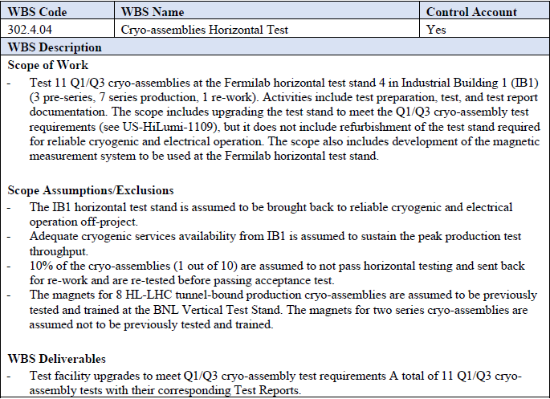
WBS 302.4.04: Scope
Charge #2, #3
Scope of work is the horizontal test of 11 cryo-assemblies
  3 pre-series, 7 series production and 1 re-works
  Upgrade of the existing horizontal test facility to meet the Q1/Q3 cryo-assembly test requirements. Development of the magnetic measurement systems
WBS Deliverables are Test Facility Upgrade, a total of 11 cryo-assembly tests and test reports
See details in WBS Dictionary
US-HiLumi-doc-39

Slide 4
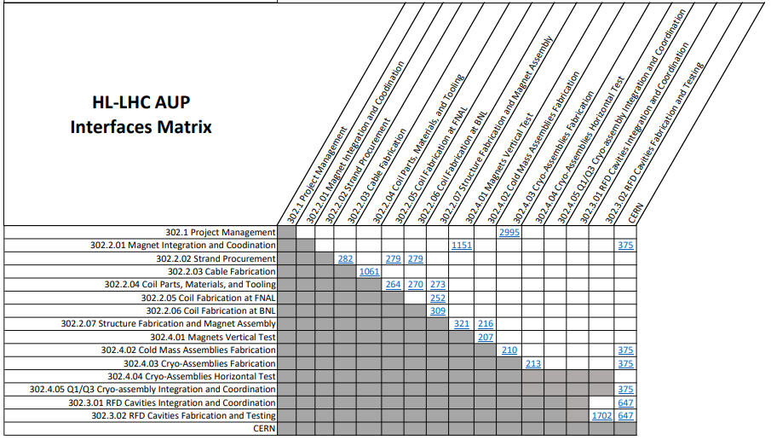
WBS 302.4.04: Interfaces
Charge #2, #3
According to HL-LHC AUP Interfaces Matrix Interfaces have been established with 302.4.03 Cryo-Assemblies Fabrication
Interface Control Documents are described in US-HiLumi-doc-213
US-HiLumi-doc-219

Slide 5
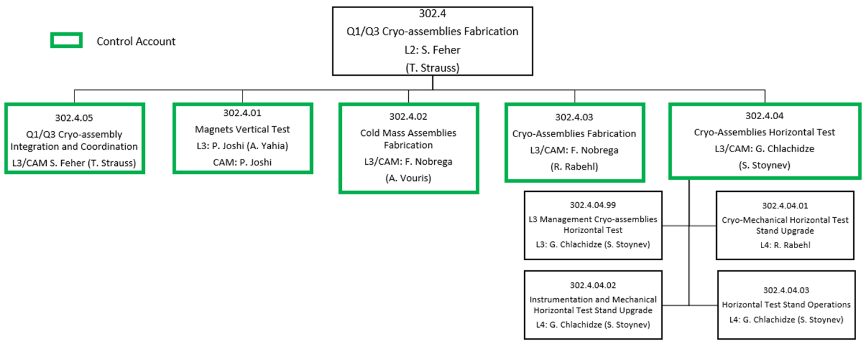

WBS 302.4.04: Team
Charge #2
302.4.04
Cryo-Assemblies Horizontal Test
L3/CAM: G. Chlachidze
(S. Stoynev)
Guram Chlachidze - L3 and CAM
Stoyan Stoynev - L3 Deputy
Experienced team members participating in the project for many years:
R. Rabehl, S. Feher, V. Nikolic, D. Orris,
J. DiMarco, T. Cummings, C. Arcola, O. Kiemschies, P. Thompson, D. Eddy,
R. Milholland, T. Zolli, A. Saracino, etc.
Fermilab and APS-TD provide the adequate support and infrastructure

Slide 6
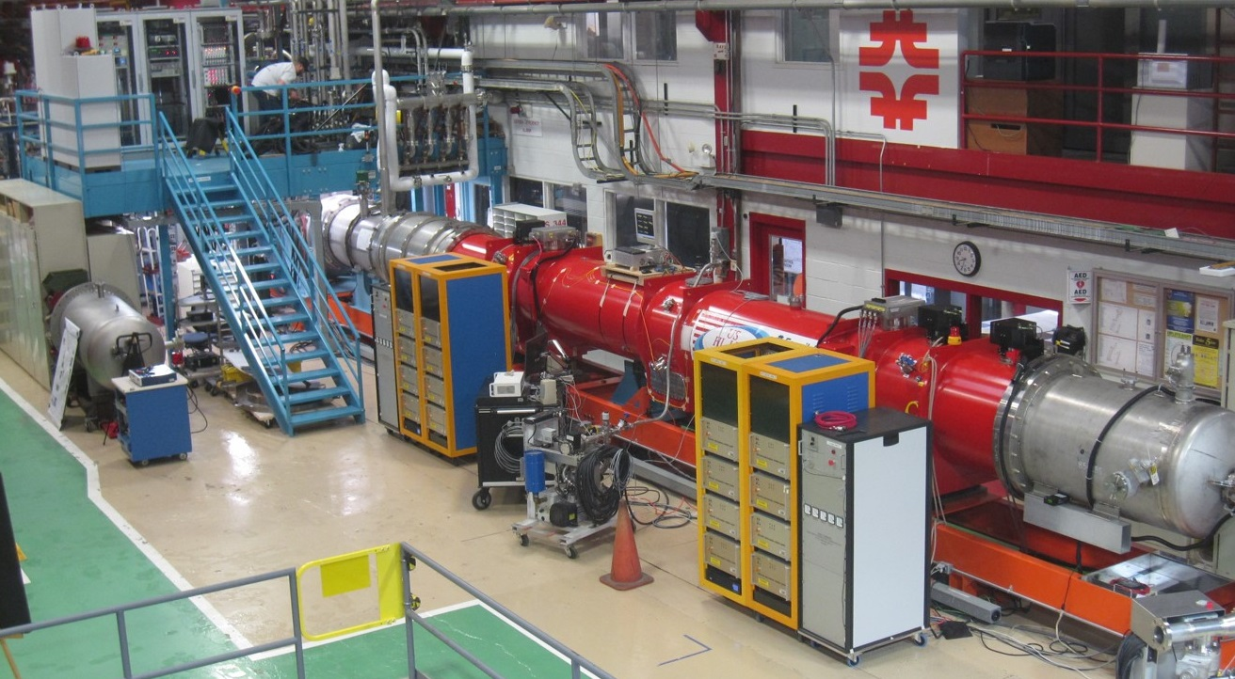
Achievements since Rebaseline Review
- Horizontal Test Facility at Fermilab
Charge #1
The only test facility in the USA capable to test the HL-LHC AUP Q1/Q3 cryo-assemblies
  Horizontal test facility (Stand 4) previously was used for testing the present LHC inner triplet quadrupoles at Fermilab in 2001-2006
Refurbishment of Stand 4 has been successfully completed
  Test Facility commissioning included Zero-magnet test in 2020 and LQXFA-01 test in 2023
First pre-series cryo-assembly at Stand 4

Slide 7
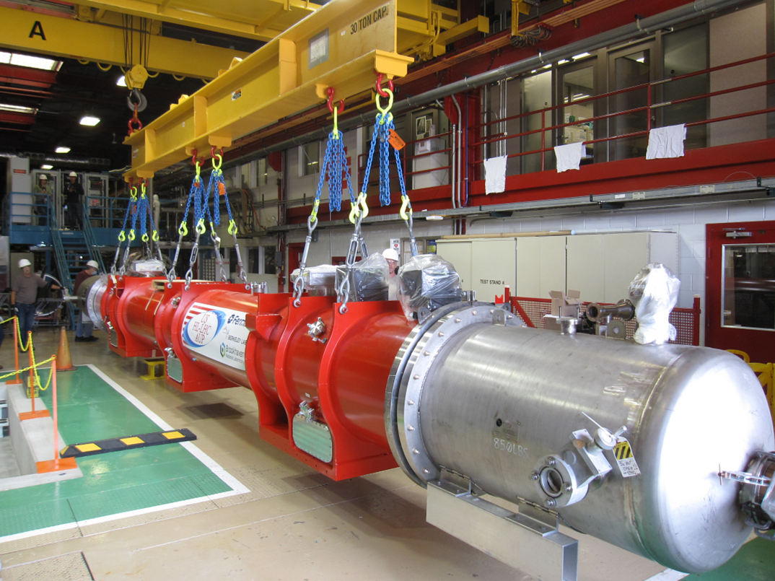
Achievements since Rebaseline Review
- First cryo-assembly test at Fermilab
Charge #1
LQXFA/B-01 - the first pre-series cryo-assembly with MQXFA03 and MQXFA04 magnets successfully tested at Fermilab’s Horizontal test facility in 2023
  Two synchronized 25-T cranes are used for lifting the cryo-assemblies at Horizontal Test Facility

Slide 8
Achievements since Rebaseline Review
- First cryo-assembly test at Fermilab
Charge #1
Automated controlled cooldown process was verified
  Temperature difference between the magnet ends must not exceed 50 K
  The first cold test demonstrated that cryogenic system improvements are required to optimize the cooldown and warmup processes
Cooldown comparison in two test cycles

Slide 9
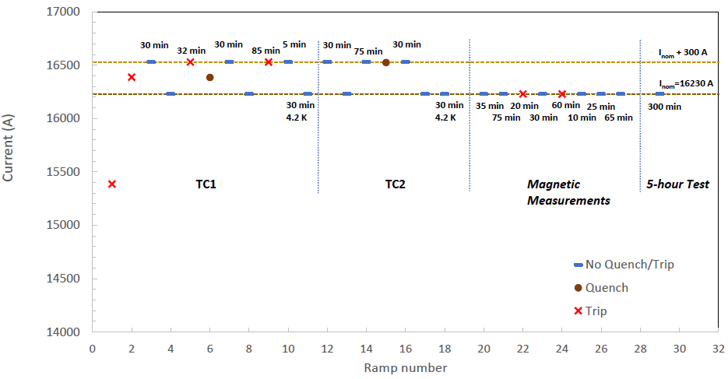
Achievements since Rebaseline Review
- First cryo-assembly test at Fermilab
Charge #1
The acceptance current of 16530 A (nominal current plus 300 A) was reached w/o a quench
  High ramp rate test was successful (30 A/s ramp up & 150 A/s down)
  Several trips experienced due to LHe stability issue. The problem was identified and successfully fixed
LQXFA/B01 performance in two test cycles

Slide 10
Achievements since Rebaseline Review
- First cryo-assembly test at Fermilab
Charge #1
The first pre-series cryo-assembly LQXFA/B-01 successfully tested at Fermilab’s horizontal test stand
    The test facility upgrades successfully commissioned with a cryo-assembly for the first time
    Magnetic measurement systems were successfully commissioned for field quality measurements
    Liquid level instabilities, as well as Lab-wide safety pause made the commissioning and test longer than expected
    The cryogenic issue related with the LHe stability was identified and fixed
LQXFA/B-01 test goals have been achieved
    Magnets survived a maximum temperature gradient of 50 K during a controlled warm-up and cool-down
    The acceptance current reached w/o a quench in both test cycles
    High ramp rate test requirements are met
    Splice resistance requirements are met
    Nominal current was successfully held for 5 hours

Slide 11
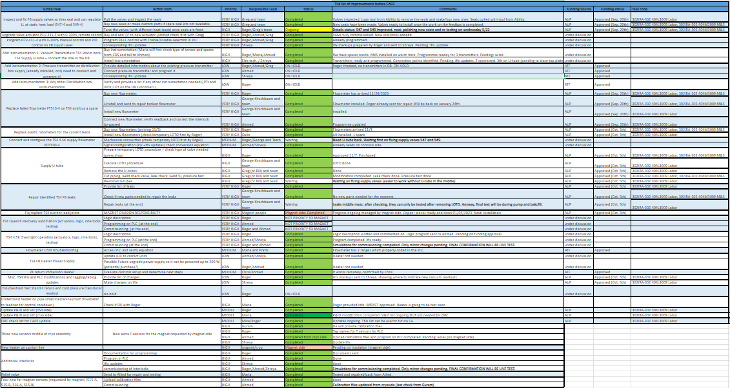
Achievements since Rebaseline review
- Cryogenic System Improvements
Charge #1
Cryogenic system improvements were necessary to meet the Cryo-assembly horizontal test requirements and expedite the cooldown and warmup processes at Stand 4

Slide 12
Achievements since Rebaseline review
- Cryogenic System Improvements
Charge #1
Various monitoring instrumentation have been added for improvement of the controlled cooldown and warmup of the cryo-assembly
Quench recovery automation was improved
Fully automated 4.5 K overnight operation has been implemented
Helium line heaters are installed to expedite the cooldown and warmup processes
Most of the failed instrumentation was replaced or repaired (pressure transmitters, flowmeters and rotameters, leaking valves)
Current lead joint improvement has been implemented

Slide 13
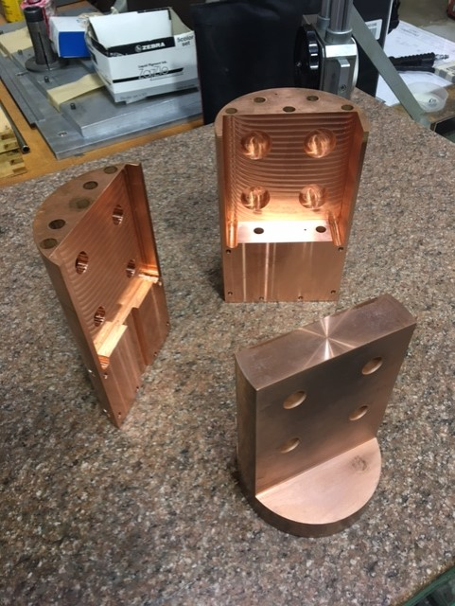
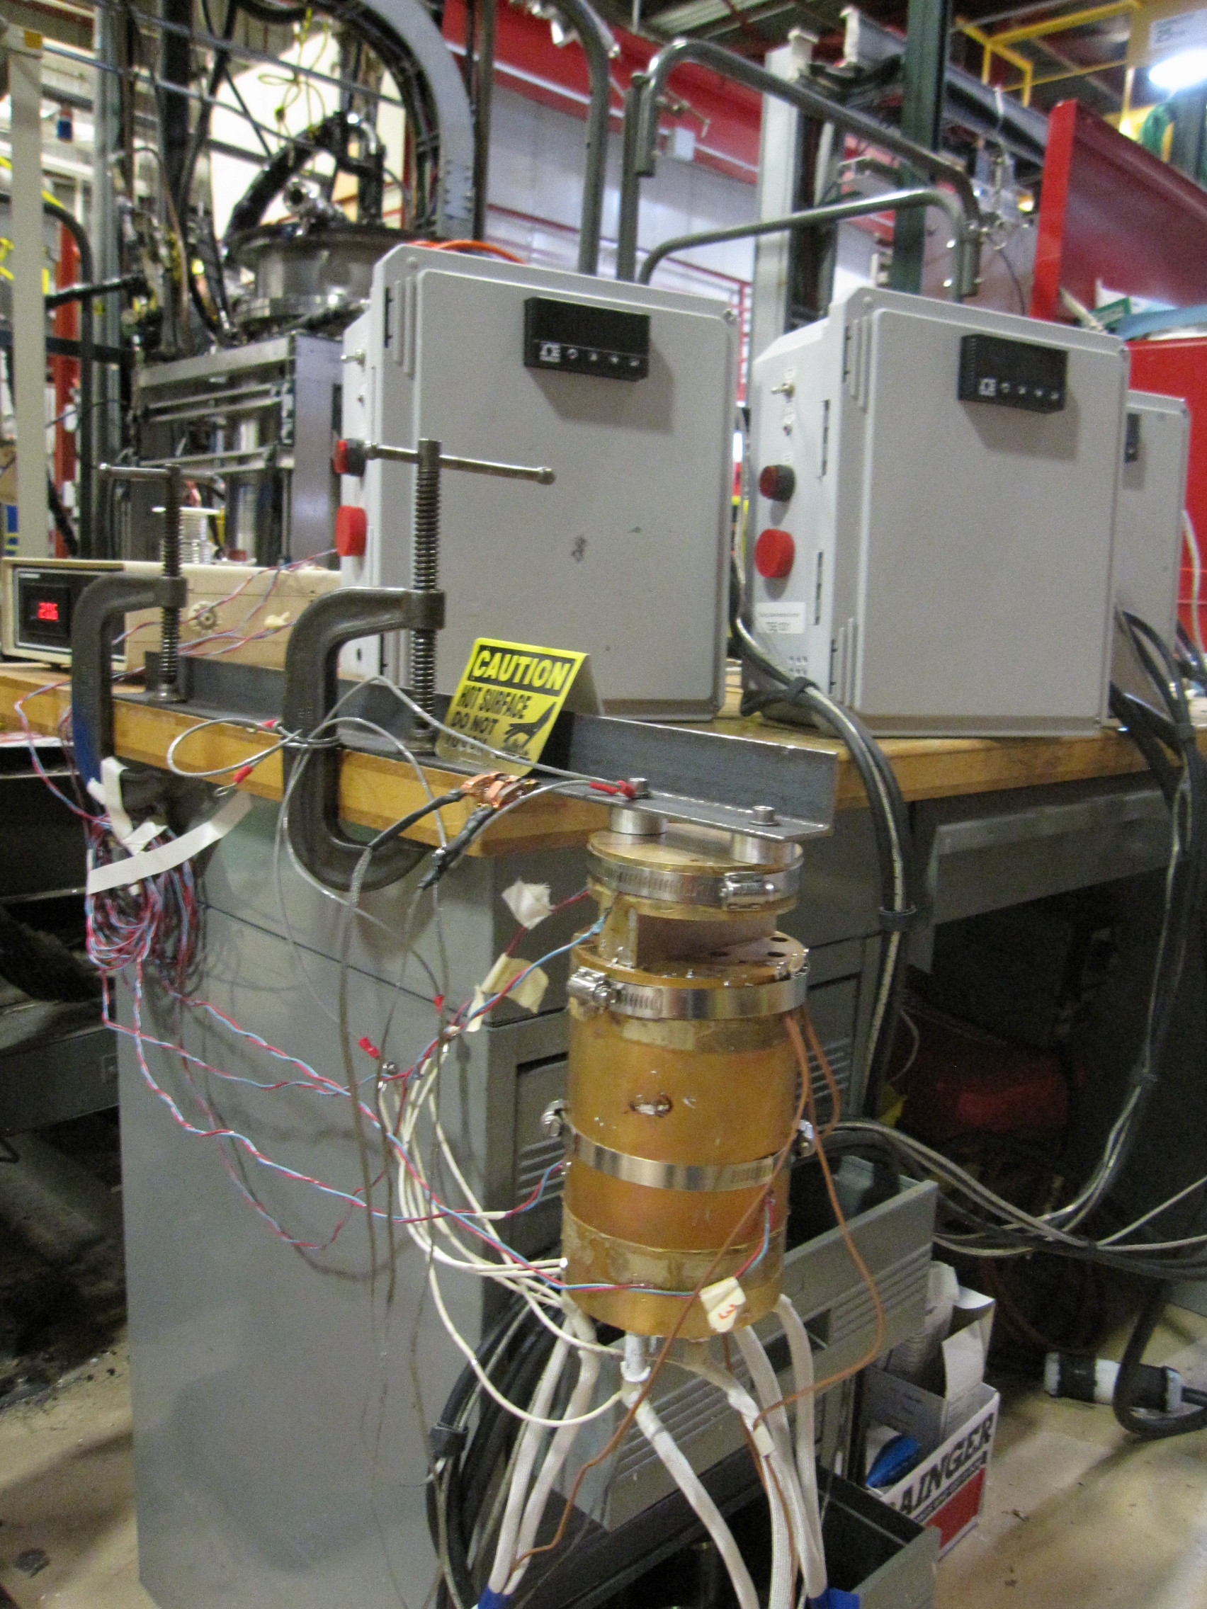
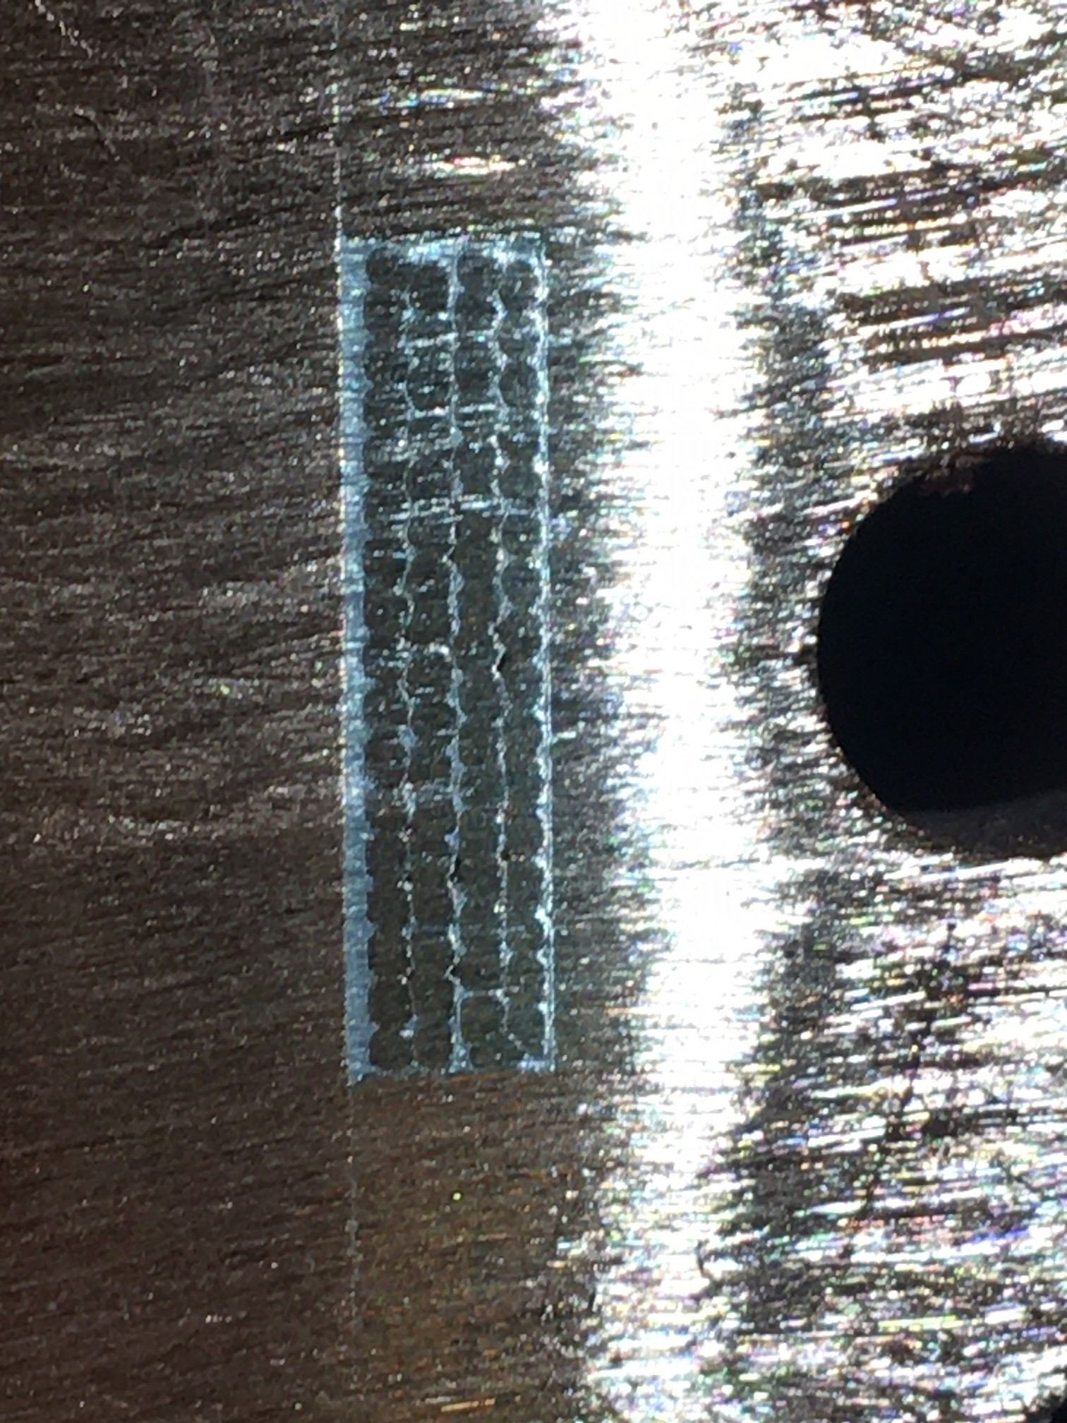
Achievements since Rebaseline review
- Current lead joint improvement
Charge #1
One of the current lead joints at Stand 4 exhibited increased resistance
  To avoid overheating of the superconducting bus, the helium liquid level was elevated accordingly
New copper fixture was designed, fabricated and tested to improve the cooling conditions of the lead joint
New copper fixture
Practice soldering setup
Practice lead joint cross-section

Slide 14
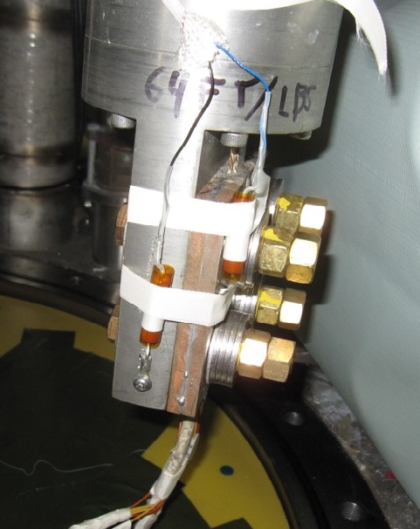
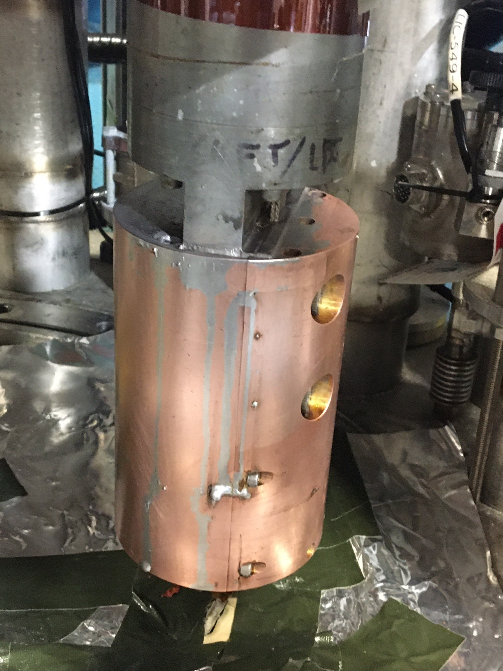
Achievements since Rebaseline review
- Current lead joint improvement
Charge #1
The lead joint with increased resistance was modified with the newly developed fixture
  After the lead joint improvement is demonstrated in CA02 cryo-assembly test, the other two lead joints will be modified as well
Lead joint with increased resistance
Modified lead joint at Stand 4

Slide 15

WBS 302.4.04: Procurement Status
Charge #4
All major procurements are completed
  Includes the second set of interconnect components, the lead and return end cans
Remaining procurement is only cryogens (Helium and Nitrogen) required for supporting “cold” testing at Fermilab’s horizontal test facility
Fermilab’s gas supplier contracts were signed recently for liquid and gaseous Nitrogen (end of 2022) and Helium (beginning of 2023)
  Cryogens cost level and annual escalation is fixed till 2026

Slide 16
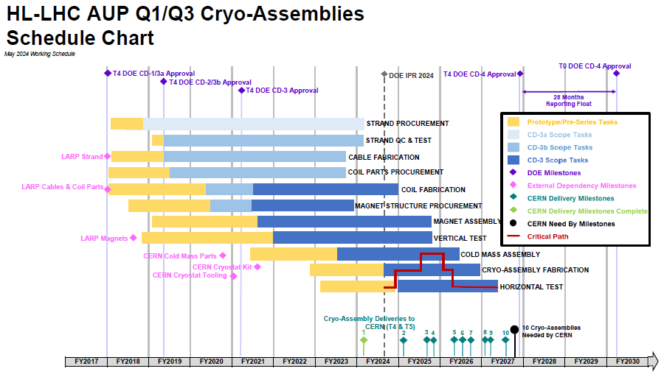
WBS 302.4.04: Schedule
Charge #2
Cryo-assemblies Horizontal Test, the last activity before shipment, becomes critical path upon Cryo-assembly # 5 until end of the project
2nd pre-series CA Horizontal test will be completed in FY24

Slide 17

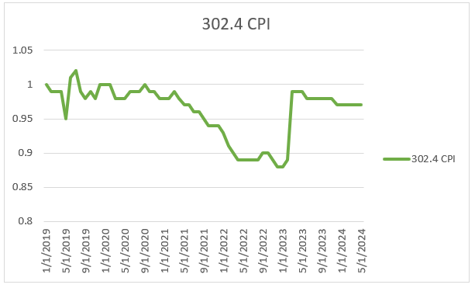
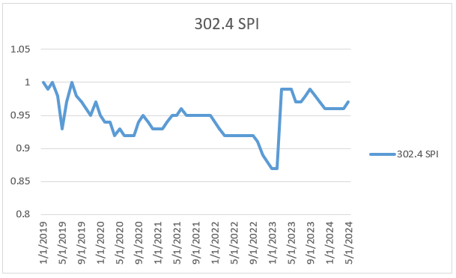
WBS 302.4.04: Cost and Schedule Performance
Charge #2
Work progress mostly according to plan
Negative CV due to underestimated efforts for Stand 4 cryogenic operation and cryo-assembly test itself
  Stand 4 cryogenic support during the test requires more efforts than it was expected, and there are no available off-project funds to cover these expenses as it was planned previously
  These additional expenses are included in Manual EAC Adjustments
CPI = 0.90
SPI = 0.94

Slide 18
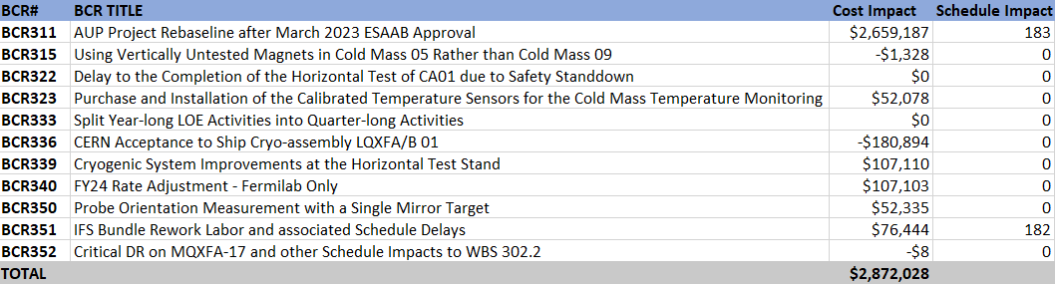

WBS 302.4.04: BCRs Approved since Rebaseline Review
Charge #2
BCR323 – Purchase and Installation of the Calibrated Temperature Sensors for the CM Temperature Monitoring, cost impact $52k
  Required for a better control of the cooldown and warmup processes
BCR339 – Cryogenic System Improvements at the Horizontal Test Stand, cost impact $107k
BCR350 – Probe Orientation Measurement with a Single Mirror Target, cost impact $52k
  Will reduce time required for magnetic measurements
BCR340 – FY24 Rate Adjustment, cost impact $107k
BCR351 – IFS bundle rework, cost/schedule impact $76k/182 days
$212,840

Slide 19

WBS 302.4.04: Estimate at Completion
Charge #2
Variance at Completion (VAC) includes $1M manual adjustment to EAC
  We expect the CV stabilized after testing of the pre-series cryo-assemblies are complete
Manual EAC adjustments include:
  Additional labor anticipated for testing production cryo-assemblies
  M&S due to cost increase of cryogens
  Additional LOE to finish the control account activities

Slide 20
WBS 302.4.04: Risks
Charge #6
Two risks are closed since the re-baseline review in 2022
  RT-302-4-04-007 - Excessive heat load to 1.9 K cooldown
  RT-302-4-04-011 - Price of cryogens is higher than expected
One high-rank risk remains: RT-302-4-04-003 – Horizontal test takes longer than expected
  Cooldown and warmup time will be reduced after recently implemented cryogenic system improvements and further optimization of the cryogenic processes
RI-ID | Title | Risk Rank
RT-302-4-04-003 | Horizontal test takes longer than expected | 3 (High)
RT-302-4-04-001 | Horizontal Test Facility - Non-Cryogenic System Failure | 1 (Low)
RT-302-4-04-002 | Horizontal Test Facility - Cryogenic System Failure | 1 (Low)
RT-302-4-04-004 | Horizontal Test Facility - Magnetic Measurement System Failure | 1 (Low)

Slide 21
WBS 302.4.04: ES&H
Charge #5
Cryo-assembly support deflection was observed after installation of LQXFA/B-01 on the horizontal test stand
  Comprehensive investigation has been performed and lessons learned have been documented
  New supports were designed, fabricated and installed at Stand 4. Modified supports proved to be safe and adequate
Operation Readiness Clearance (ORC) has been obtained for recently installed Helium line heaters
  These heaters will help to expedite the cooldown and warmup process
No other safety issues were observed

Slide 22
WBS 302.4.04: Summary
First pre-series cryo-assembly successfully was tested at Stand 4
  All the test goals have been achieved
  The test facility upgrades successfully commissioned with a cryo-assembly for the first time
  Magnetic measurement systems were successfully commissioned for field quality measurements
  The second pre-series cryo-assembly test currently in progress
Cryogenic system improvements will help to optimize the cooldown and warmup processes
Cost & schedule elements are well understood, EAC is up-to-date
Risks have been identified and actively managed
ES&H fully incorporated into planning
We are ready for the production cryo-assemblies horizontal test

Slide 23
Backup Slides

Slide 24
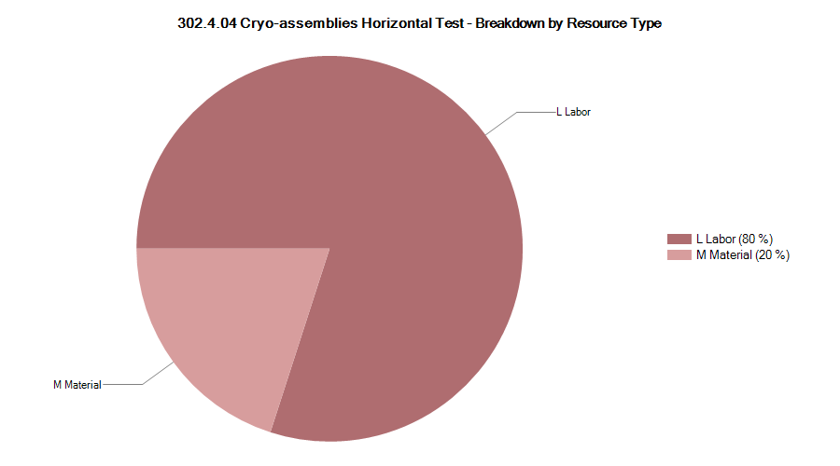

302.4.04 Resource Type Breakdown
Charge #2
80% Labor, 20% M&S (mostly cryogens)

Slide 25
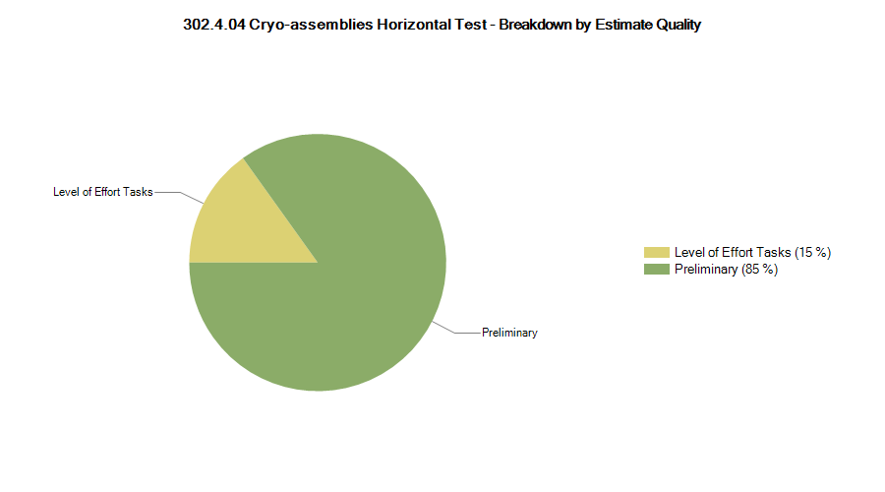

302.4.04 Estimate Quality
Charge #2
Preliminary is related to production cryo-assemblies horizontal tests

Slide 26
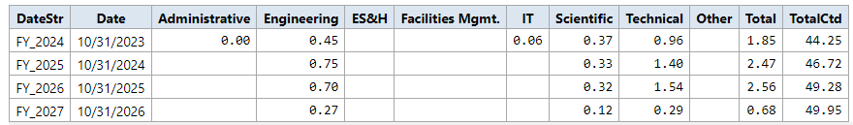
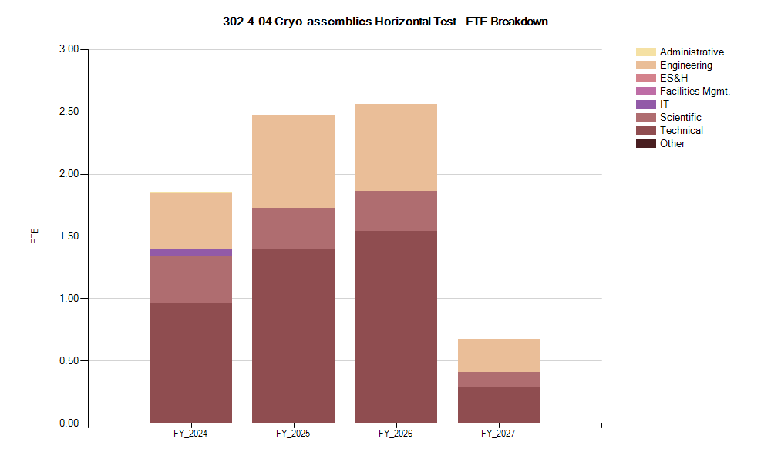
302.4.04 FTE Breakdown
Charge #2

Slide 27

302.4.04 Cost Performance Report
Charge #2
BAC = $13.33M
EAC = $15.42M
Cumulative SPI = 0.94, CPI = 0.90

