Slide 1
302.4.05 - Q1(Q3) Cryo-Assembly Integration and Coordination
Sandor Feher – FNAL
L3/CAM - Q1/Q3 Cry-Assembly Integration and Coordination
HL-LHC AUP DOE IPR – July 23rd–25th 2024

Slide 2
Outline
Scope, Interfaces, Dependencies & Team
Achievements since Rebaseline Review
Procurement Status
Schedule
Cost and Schedule Performance & VAR Reports
Estimate at Completion and EAC Manual
Risks
QA/QC
Summary

Slide 3
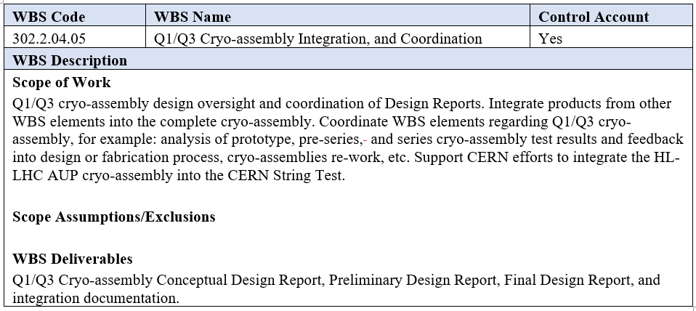
WBS 302.4.05: Scope
Charge #2, #3
Scope is defined in the WBS dictionary - US-HiLumi-doc-39

Slide 4
HL-LHC String Test
Charge #2, #3
String Mezzanine (~ part of HL-LHC UR Gallery)
WCC: Water-Cooled Cables
GMS: Gas Management System
SQXL: String Cryogenic Line
DFHX/DFX: HTS/LTS Electrical Feedbox
SC link: Superconducting Link
CDB: Circuit Disconnector Boxes
AUP participation is planned – this task is part of 302.4.05

Slide 5
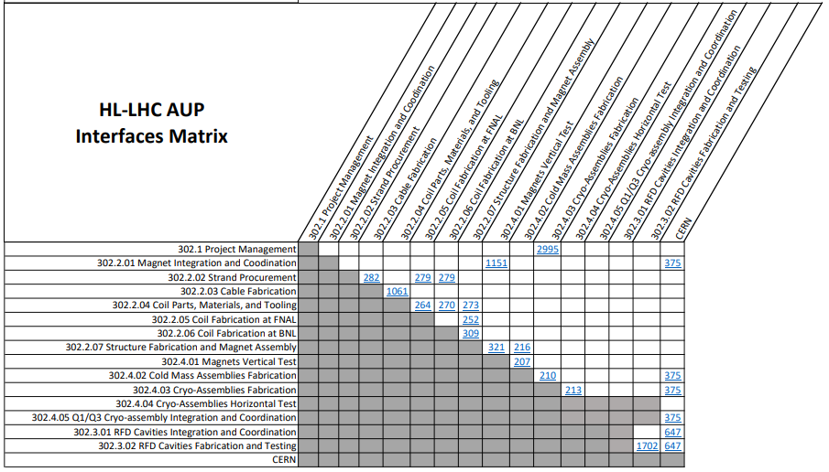
WBS 302.4.05: Interfaces
Charge #2, #3
Q1/Q3 Cryo-assembly Interface Control Matrix
Reference to Interface Control Document for each interface
In each ICD we have identified and list all the interfaces
Integration and coordination has interfaces with all the L3 elements and with CERN
Interface Matrix US-HiLumi-doc-219

Slide 6
WBS 302.4.05: External Dependencies
Charge #2, #3
This part of the project is dealing with most of 302.4 interfaces
Interfaces Internal to AUP
Magnet Fabrication; magnet delivery schedule and magnet non-conformities that are repaired by 302.4
Change in the Magnet-Cold Mass Interface induced schedule delay and cost overrun
Interfaces External to AUP mainly related to CERN but also to procurement. Past examples:
CERN introduced a new Pressure Wave requirement
There were several other minor changes in the specifications as well (like alignment and survey specs)
Several nonconformities discovered in the delivered products from CERN as part of the parts exchange

Slide 7
WBS 302.4.05: Organization
Charge #2
302.4
Q1/Q3 Cryo-assemblies Fabrication
L2: S. Feher
(T. Strauss)
302.4.02
Cold Mass Assemblies Fabrication
L3/CAM: F. Nobrega (A. Vouris)
302.4.03
Cryo-Assemblies Fabrication
L3-CAM: F. Nobrega (R. Rabehl)
302.4.04
Cryo-Assemblies Horizontal Test
L3/CAM: G. Chlachidze
(S. Stoynev)
302.4.01
Magnets Vertical Test
L3/CAM: P. Joshi (F. Kurian)
302.4.05
Q1/Q3 Cryo-assembly Integration and Coordination
L3/CAM S. Feher (T. Strauss)
302.4.04.03
Horizontal Test Stand Operations
L4: G. Chlachidze (S. Stoynev)
302.4.04.02
Instrumentation and Mechanical Horizontal Test Stand Upgrade
L4: G. Chlachidze (S. Stoynev)
302.4.04.01
Cryo-Mechanical Horizontal Test Stand Upgrade
L4: R. Rabehl
302.4.04.99
L3 Management Cryo-assemblies Horizontal Test
L3: G. Chlachidze (S. Stoynev)
Control Account
Sandor Feher L3/CAM
Thomas Strauss L3 Deputy
Experienced Team from
BNL and FNAL
Fermilab and BNL provide the appropriate support and infrastructure

Slide 8
WBS 302.4.05: Achievements since re-baseline
Charge #1
Worked on the pre-series and first series CM and Cryo-assembly production
Several magnet, Cold Mass and Cryo-assembly related DRs and NCRs have been worked on and resolved
Documentation - drawing and traveler updates; developed combination pressure and leak check procedure
Several studies related to Cryo-assembly safety have been updated as the procedures have been improved

Slide 9
WBS 302.4.05: Procurement Status
Charge #4
Remaining Procurements are mostly travel to and from CERN and travel to Collaboration Meetings.

Slide 10
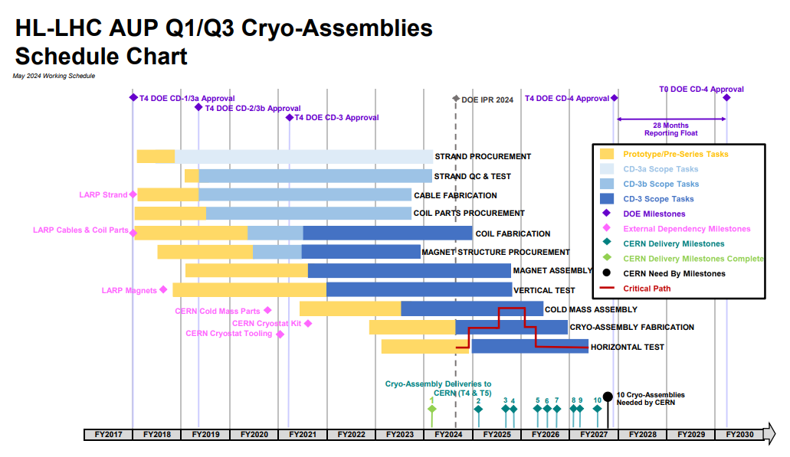
WBS 302.4.05: Schedule
Charge #2

Slide 11
WBS 302.4.05: Cost and Schedule Performance & VAR Reports
Charge #2
Cost variance fluctuates depending on which phase the project is in.
CPI is expected to fluctuate around 1.

Slide 12
WBS 302.4.05: Estimate at Completion and EAC Manual
Charge #2
VAC ($137.9k) is from current cost variance
No manual adjustment

Slide 13
WBS 302.4.05: Risks
Charge #6
Risks are updated regularly – Risk Management Board
Since re-baseline, we have retired/closed 2 risks
The highest risk (threat) is RT-302-4-05-002
RT-302-4-05-002 | Issues with untrained magnet in a cryo-assembly during horizontal testing | High
RT-302-4-05-003 | Damage to Cryo-assembly in shipping from FNAL to CERN | Medium

Slide 14
WBS 302.4.05: Summary
This control account covers the necessary coordination and integration part of the WBS 302.4 sub-project
The tasks covered by this CA have been executed as planned
Risks are actively managed

Slide 15
Backup Slides

Slide 16
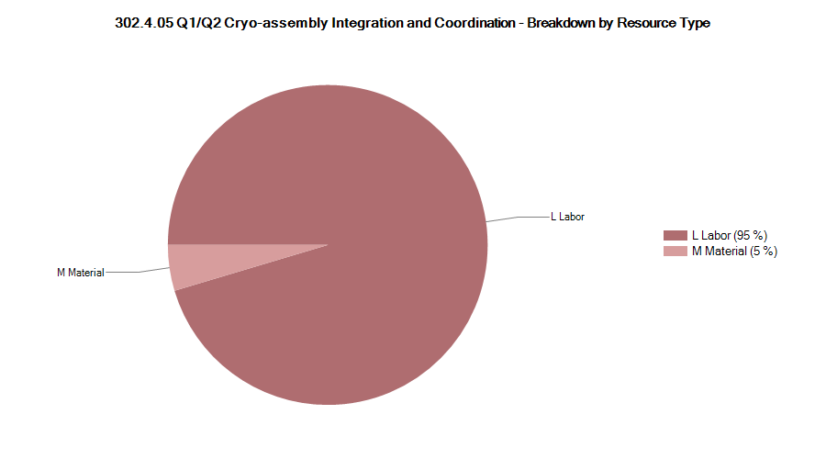
302.4.05: Resource Type Breakdown
Charge #4
96% Labor, 4% M&S
M&S Includes travel

Slide 17
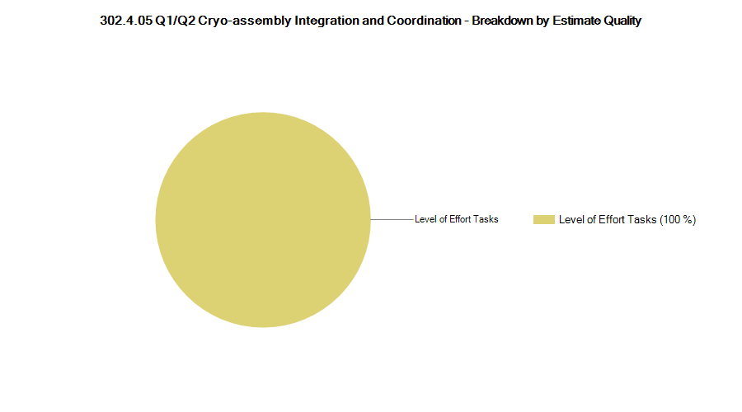
302.4.05: Estimate Quality
Charge #4
This is a pure LOE account

Slide 18
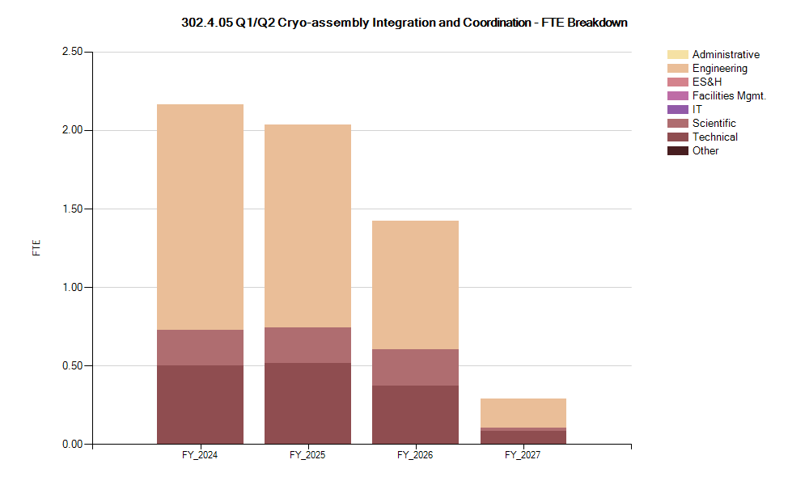
302.4.05: FTE Breakdown
Charge #4

Slide 19
302.4.05: Cost Performance Report
Charge #4
BAC = $6.017M
No thresholds crossed in Current Period Cost
Cost thresholds crossed in Cumulative to Date
Cumulative SPI = 1.0, CPI = 0.97
The progress is as anticipated

