Slide 1
302.4.02 - Cold Mass Assembly Fabrication
Fred Nobrega– FNAL
L3/CAM - Q1/Q3 Cold Mass Assembly Fabrication
HL-LHC AUP DOE IPR – July 23rd–25th 2024

Slide 2
Outline
Scope, Interfaces, Dependencies & Team
Achievements since Rebaseline Review
Procurement Status
Schedule
Cost and Schedule Performance & VAR Reports
BCRs since Rebaseline Review
Estimate at Completion and EAC Manual Adjustments
QA/QC
Risks
ES&H
Summary

Slide 3
WBS 302.4.02: Scope and Interfaces
Charge #2, #3
Scope of Work and Deliverables
10 Q1/Q3 Cold Masses
(3 pre-series, 7 series production)
QC & Safety Reports
1 Cold Mass assembly re-work
Design & Fabrication of Cold Mass Tooling
Design & Fabrication of 12 Q2 Busbar assemblies
See WBS Dictionary: US-HiLumi-doc-39
WBS Code | WBS Name | Control Account
302.4.02 | Cold Mass Assemblies Fabrication | Yes
WBS Description
Scope of Work Final design and fabrication of 10 Q1/Q3 Cold Masses (3 pre-series, 7 series production), including final design and fabrication of the Q1/Q3 Cold Mass fabrication tooling. The scope includes 1 cold mass assembly re-work. Some cold mass parts are provided by CERN and the scope includes design verification of these components. Scope Assumptions/Exclusions Fermilab is responsible and accountable for the Cold Mass design. The complete list of CERN provided components can be found in “Exchange of components between HL LHC AUP and CERN for the triplet”, CERN EDMS 1825173. AUP provided components to CERN includes fabrication of Q2 busbar assemblies. WBS Deliverables 10 Q1/Q3 Cold Masses (3 pre-series, 7 series production) with their corresponding QC and safety reports and 12 Q2 busbars assemblies.

Slide 4
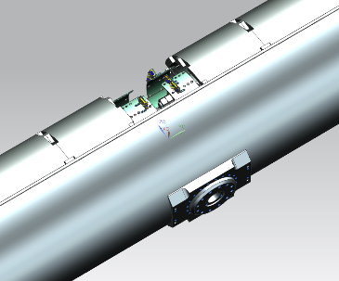
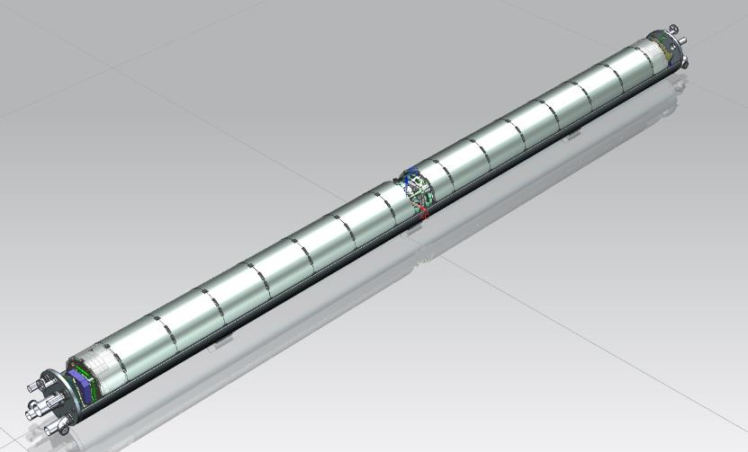
WBS 302.4.02: Scope and Interfaces
Charge #2, #3
The LMQXFA Cold Mass is the He pressure vessel assembly containing 2 MQXFA magnets
MQXFA Magnets
Cold Mass Supports
End Cover
Heat Exchangers
Cold Mass Supports
Beam Tube
IFS Port
CLIQ/K-Mod Port

Slide 5
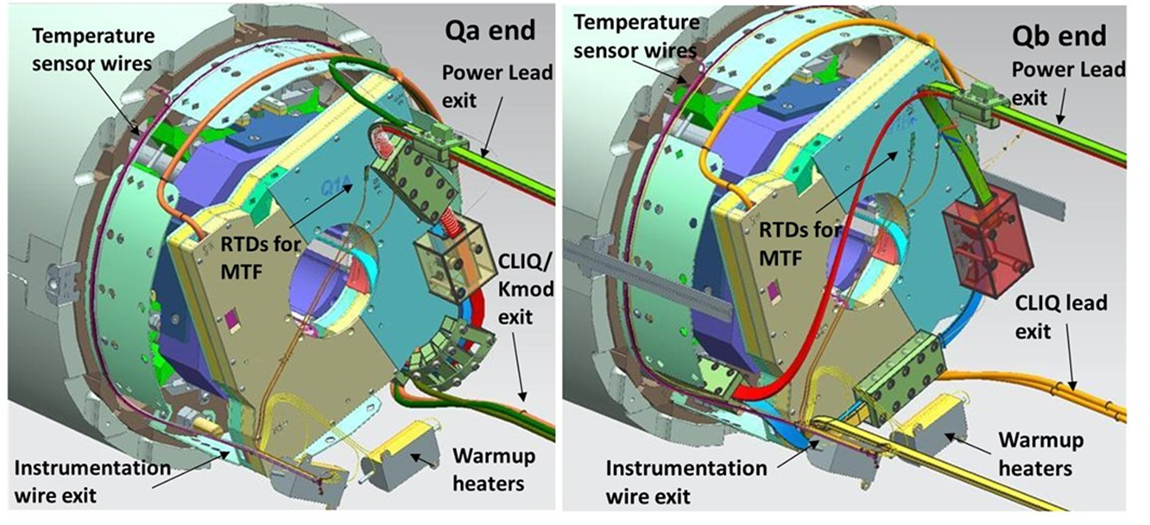
WBS 302.4.02: Scope and Interfaces
Charge #2, #3
Bus assembly with housing
Upper and Lower Expansion loops
Lead and expansion loop hold-down parts
Splices from “A” leads to local bus
Kmod (Trim Leads)
CLIQ lead routing
Instrumentation
Cryo Heaters (Warmup Heaters)
Temperature Sensors
MTF temperature sensors
Quench Detection Voltage Taps
Coil Voltage Tap Routing
Coil Protection Heater wire routing

Slide 6
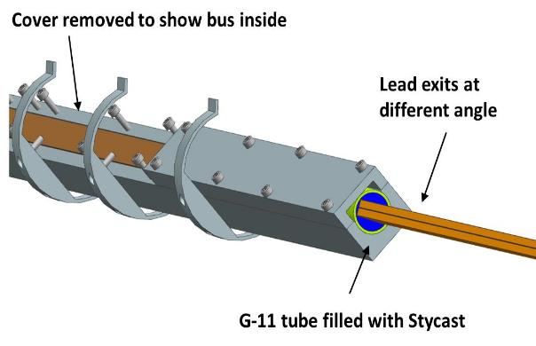
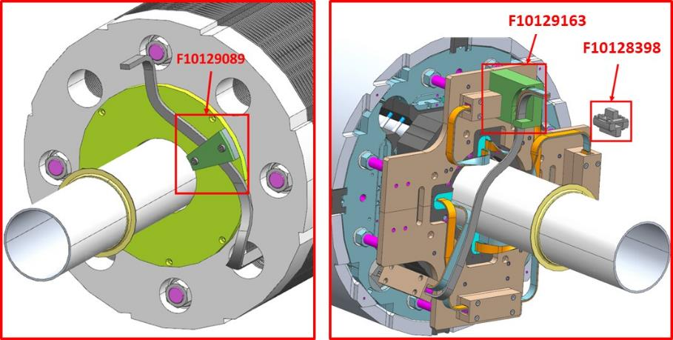
WBS 302.4.02: Scope and Interfaces
Charge #2, #3
Fermilab is contributing some of the Bus and Interconnection parts to the Q2 magnet.
List of items in scope of Q2 magnet Bus and Expansion loops:
Bus assembly with housing
Design of Upper and Lower Expansion loops
Lead and Expansion loop hold-down parts
Splices are not included in scope
Instrumentation is not included in scope

Slide 7
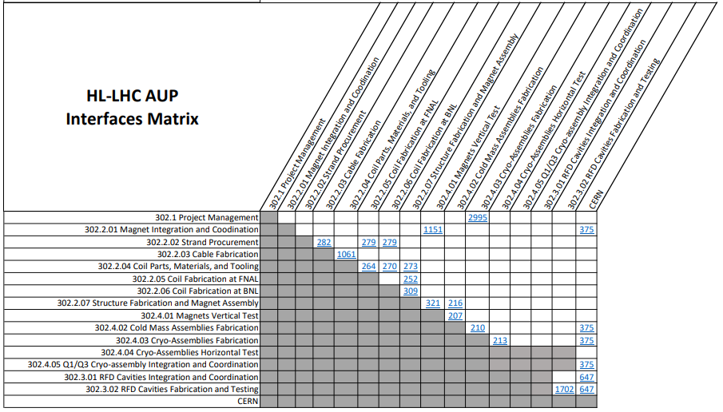
WBS 302.4.02: Scope and Interfaces
Charge #2, #3
There are 3 Internal Cold Mass Interface Control Documents & 1 External
Detailed interface documentation can be accessed at:
US HiLumi-doc-207, 210, 216 & 375
Interface Matrix US-HiLumi-doc-219

Slide 8
WBS 302.4.02: Documents
Charge #2, #3
Project Documents | US-HiLumi-doc-
WBS Dictionary | 39
Risk Registry | 79
HL-LHC AUP Quality Assurance Plan | 80
Functional Requirements Specification | 64
Parts Exchange Agreement | 844
Hazard Analysis Report | 1121
Acceptance Criteria | 1127
AUP Q1/Q3 Cryostat Assembly and Horizontal Test Final Design Report | 2882
Interface Control Documents | US-HiLumi-doc-
Magnet Vertical Test/Cold Mass Assemblies Fabrication ICD | 207
Cold Mass Assemblies Fabrication/Cryo-Assemblies Fabrication ICD | 210
Structure Fabrication and Magnet Assembly/Cold Mass Assemblies Fabrication ICD | 216
Cryo-Assemblies Fabrication/CERN ICD | 375
Assembly Documents | US-HiLumi-doc-
LMQXFA Cold Mass Assembly Manufacturing and Inspection Plan (MIP) | 3301
AUP CM01 Cold Mass Welding Readiness Review | 4300
Record of Decision: Welding of LMQXF01 | 4301
Ultrasonic Phased Array Examination of Welds in the AUP LMQXFA Cold Mass | 3755
Analysis of Shell Pressure Components for LMQXF | 2934
AUP Cold Mass Rework & Magnet Removal Procedure | 5158
Wiring Splice Modification Procedure for MQXFA Magnets | 4974

Slide 9
WBS 302.4.02: External Dependencies
Charge #3
Cold Mass Fabrication is dependent on delivery of components
MQXFA Magnets – are assembled at LBNL, tested at BNL and delivered to FNAL. Cold Mass production is dependent on a supply of MQXFA magnets
CERN provided components:
Wrapped Beam Tubes
End Covers
Nozzles & Fittings
Heat Exchangers
External Piping/Tubing and mounting hardware (includes N-lines)

Slide 10
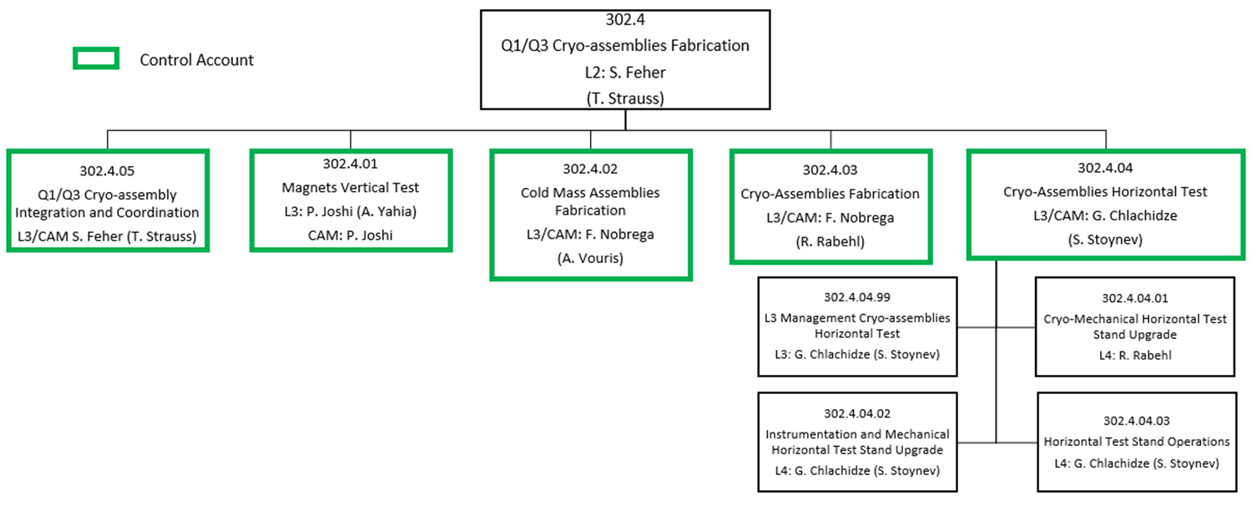
WBS 302.4.02: Team
Charge #2
Experienced Team:
Sandor Feher
Fred Nobrega
Antonios Vouris – Lead Engineer
Rodger Bossert
Luke Martin
Charles Wilson
Anthony Lake
Scott Klema
Matthew Larson
Marlon Jamison
Thea Fisk
Deonte Davis
Robert Diamond
Oscar Madera
Fermilab and APS-TD provide the appropriate support and infrastructure.

Slide 11
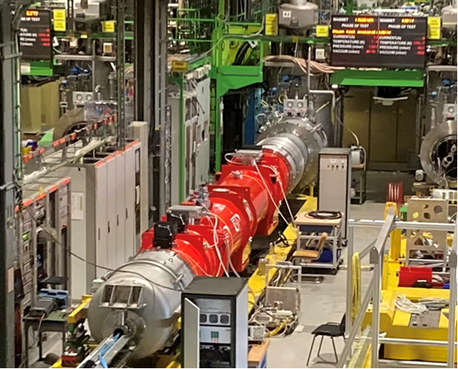
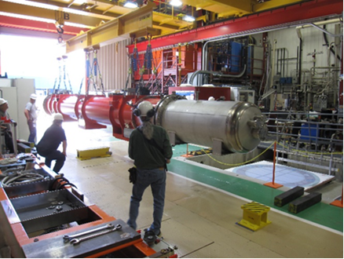
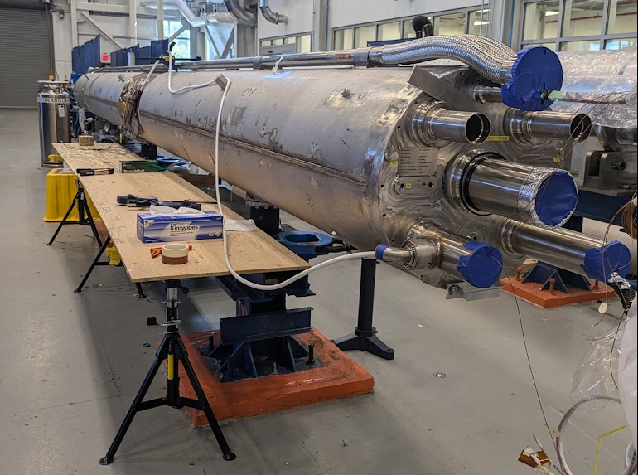
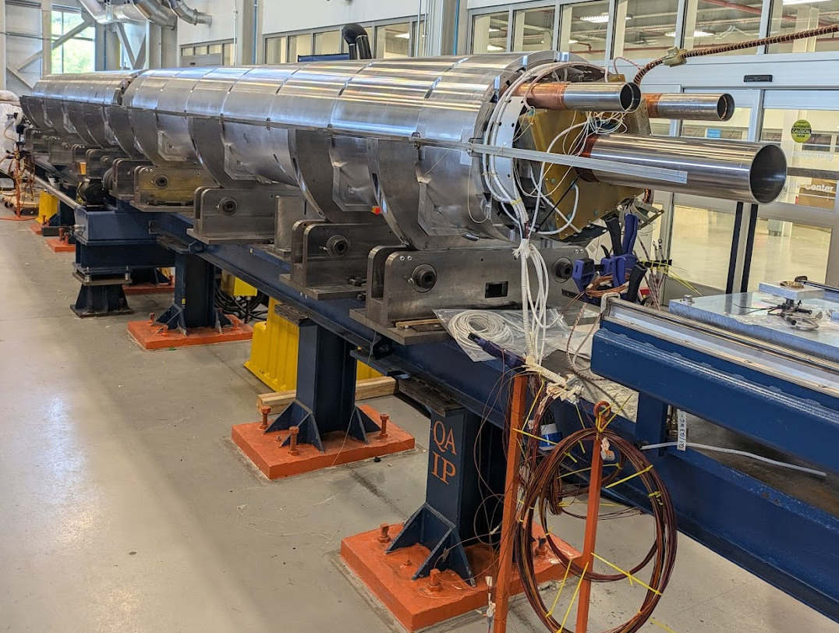
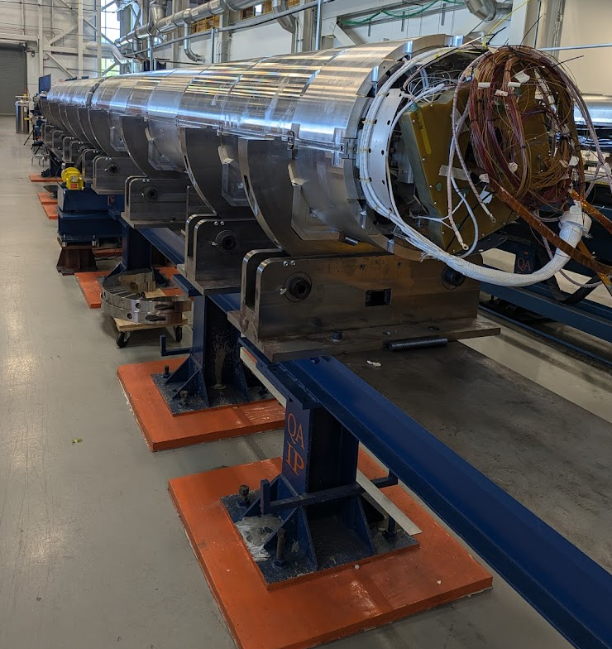
WBS 302.4.02: Achievements Since Rebaseline
Charge #1
CA01 (includes CM01) accepted by CERN.
CA02 (includes CM02) complete, being transported to IB1 test stand.
CM03 Mostly complete, ~ready for cryoassembly.
CM04 ready for He shells installation.
CM05 in process on 2nd alignment station.
 | Qa | Qb | Weld | Cryo | Test | Ship
CA01
CA02
CA03
CA04
CA05
CA06
CA07
R1
CA08
CA09
CA10
Within ICBA
1.
2.
3.
4.
5.

Slide 12
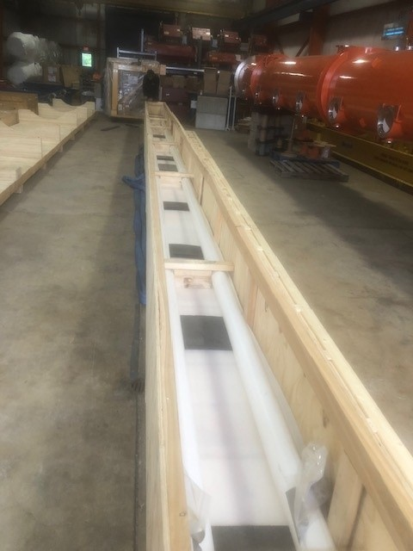
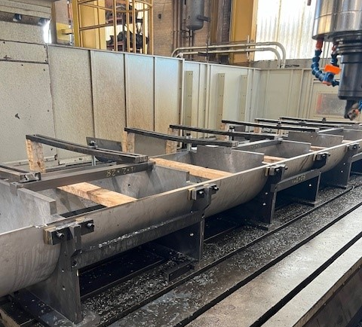
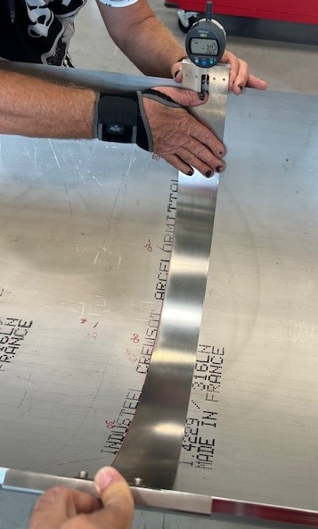
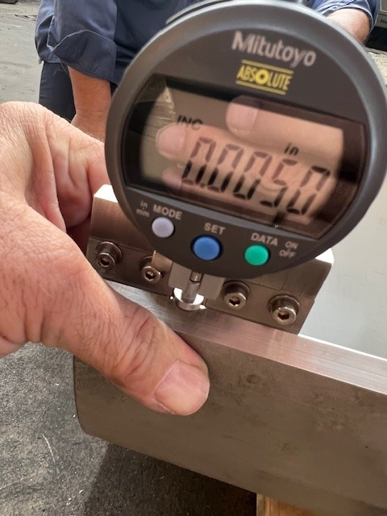
WBS 302.4.02: Achievements Since Rebaseline
Charge #1
Lessons Learned & Achievements
Shell machining process updates resulting in consistent & accurate arc length dimensions.
Using vertical mill with more rigid fixturing.
New shell forming & machining inspection tooling has been incorporated
Bus Shipment
Shell Machining
Shell Inspection

Slide 13
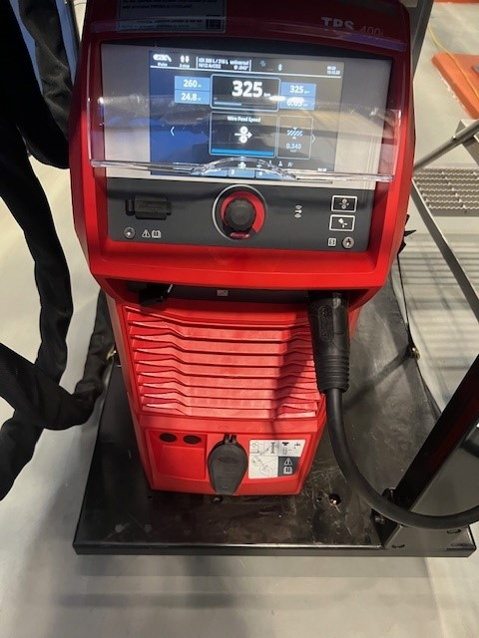
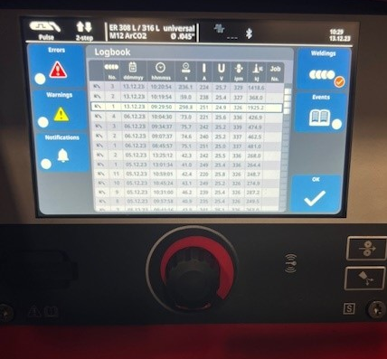
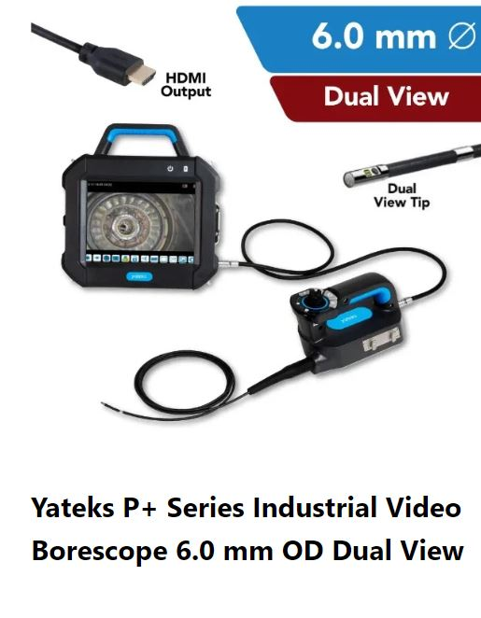
WBS 302.4.02: Achievements Since Rebaseline
Charge #1
Lessons Learned & Achievements
Shell Welding Procedure Approved by CERN: samples submitted to CERN with test report – additional testing verification by CERN passed and approved.
Welding process updates – Fronius power supplies are better suited for the foreign weld wire (stable arc) & provides a data log.
Ultrasonic Test (UT) results have been exceptionally better since updates. CM-02 & CM-03 passed with minimum to no weld repairs.
Internal Weld Inspections are now completed with an inspection Borescope by a Certified Weld Inspector (CWI).
Fronius Readout

Slide 14
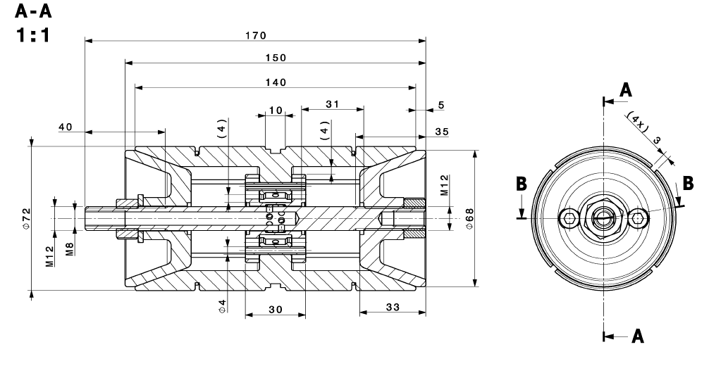
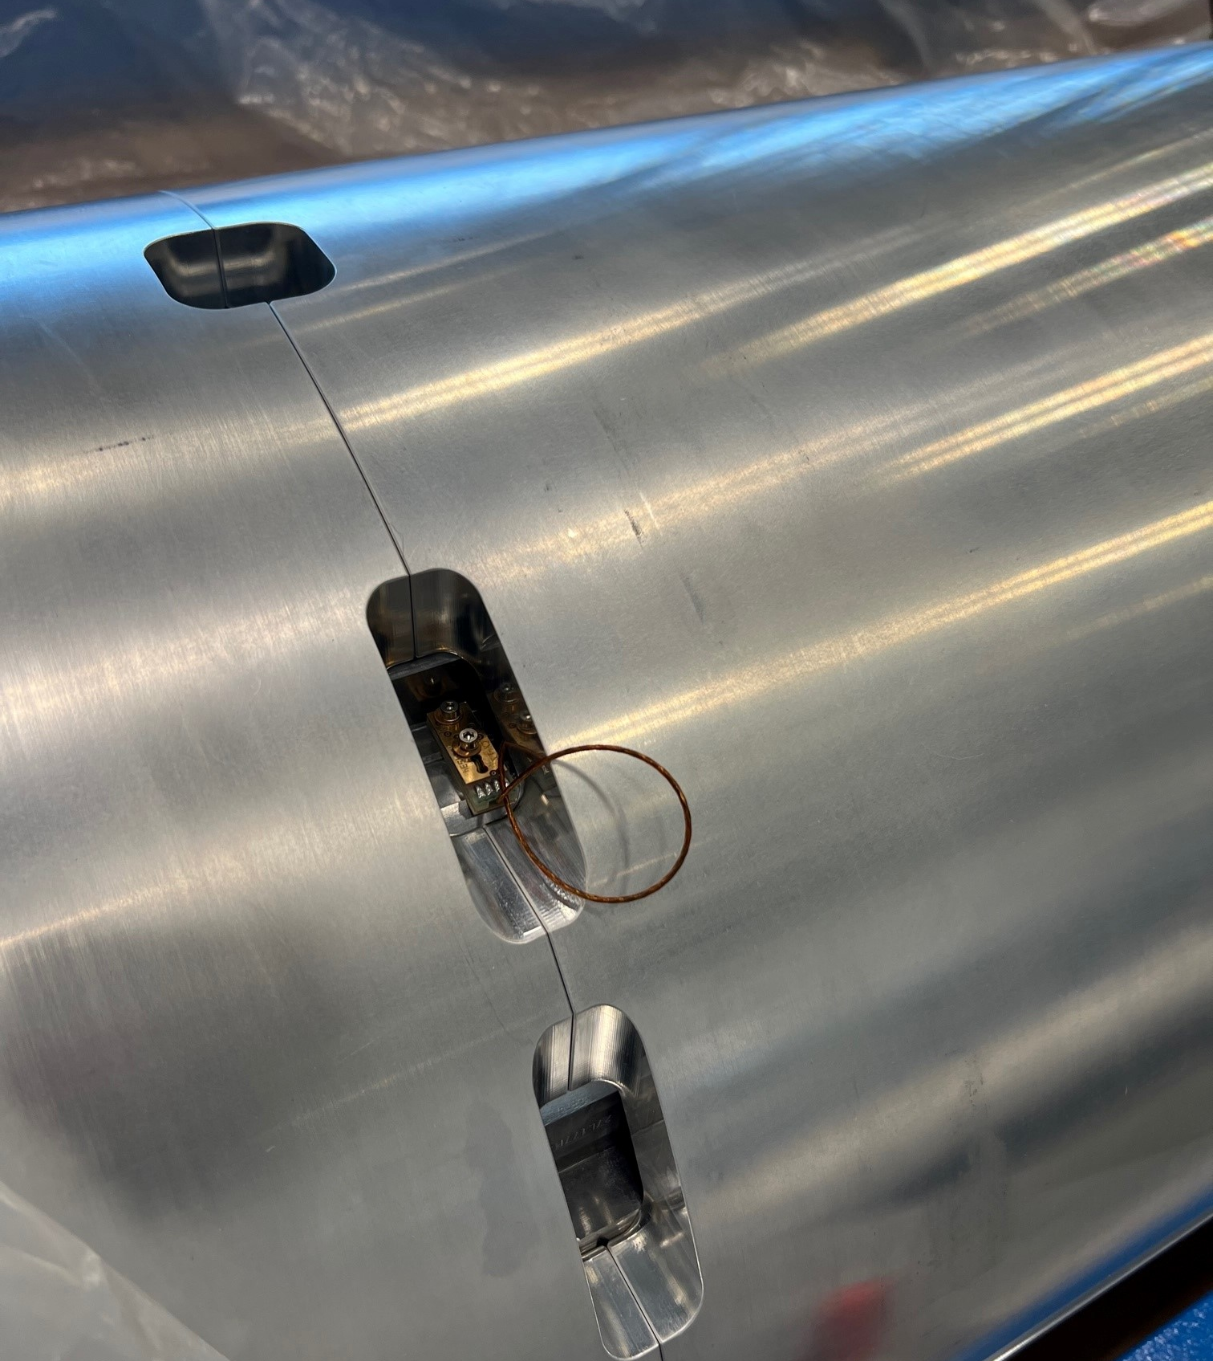
WBS 302.4.02: Achievements Since Rebaseline
Charge #1
Lessons Learned & Achievements
Beam Tube flare flange weld tooling
used to draw away heat & minimize weld distortion during welding of the beam tube
Heat exchanger installation & gauges used to verify clearance through magnets during fabrication
CERN RTD Mounting
Magnets provided to FNAL with pre-drilled mounting holes for RTD’s
CERN RTD’s Mounted
Welding Heat Sink Fixture

Slide 15
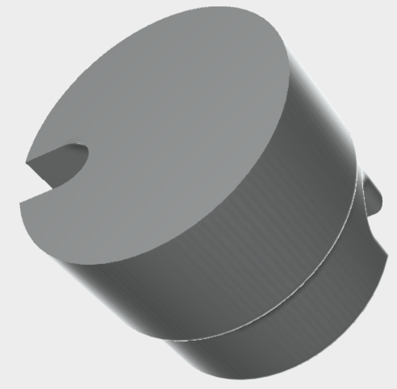
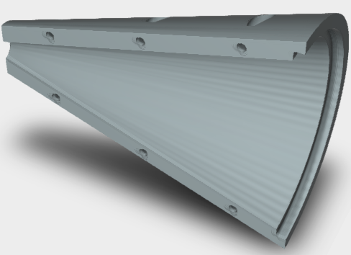
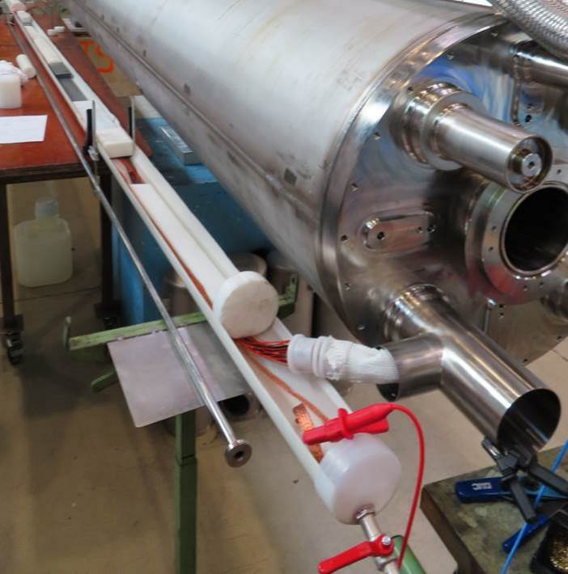
WBS 302.4.02: Achievements Since Rebaseline
Charge #1
Lessons Learned & Achievements
Capillary tube – too many wires for tube diameter made it difficult to pull the wires through the 4 m long capillary causing the splice plug to be out of position in the cold mass tee.
Re-routed RTD instrumentation wires to reduce wire count in capillary tube.
Developed 3D printed tools to aid in wire alignment and wire pulling through the capillary tube.
Improved the wire splice robustness using barrel splice design, DocDb-4974.
Adopted CERN’s water hipot procedure to test wire insulation integrity.
Barrel Splice
splice plug
3D printed tools for wires
Capillary Tube
Water Hipot

Slide 16
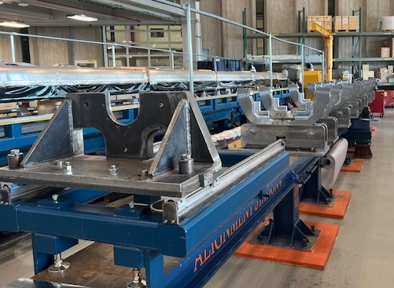
WBS 302.4.02: Achievements Since Rebaseline
Charge #1
Lessons Learned & Achievements
All 12 Q2 Bus Assemblies were completed & shipped to CERN
Updated/Revised Traveler and Procedures
Cold Mass Rework Contingency Plan DocDB-5158
2023 Series Production Readiness Review Recommendation
Fully functional Second Alignment Station with added crane access and custom roller drives.
Second Alignment Station

Slide 17
WBS 302.4.02: Procurement
Charge #4
Production Components procured
Formed & machined He shells
Shell forming & machining is provided by an FNAL outside vendor.
Forming up to LMQXFA-10 is complete.
Machining up to LMQXFA-05 is received and in QC inspection process. LMQXFA-06 is presently being machined.
Backing Strips machined complete and in storage.
Tack Blocks – all items received/inspected & in storage.
Lower Saddles (Cryostat interface) – Received. Subset of parts rejected and reworked to drawing requirements.
Not Ordered Yet
UT weld testing
Balance of forming shells
Shop floor consumables

Slide 18
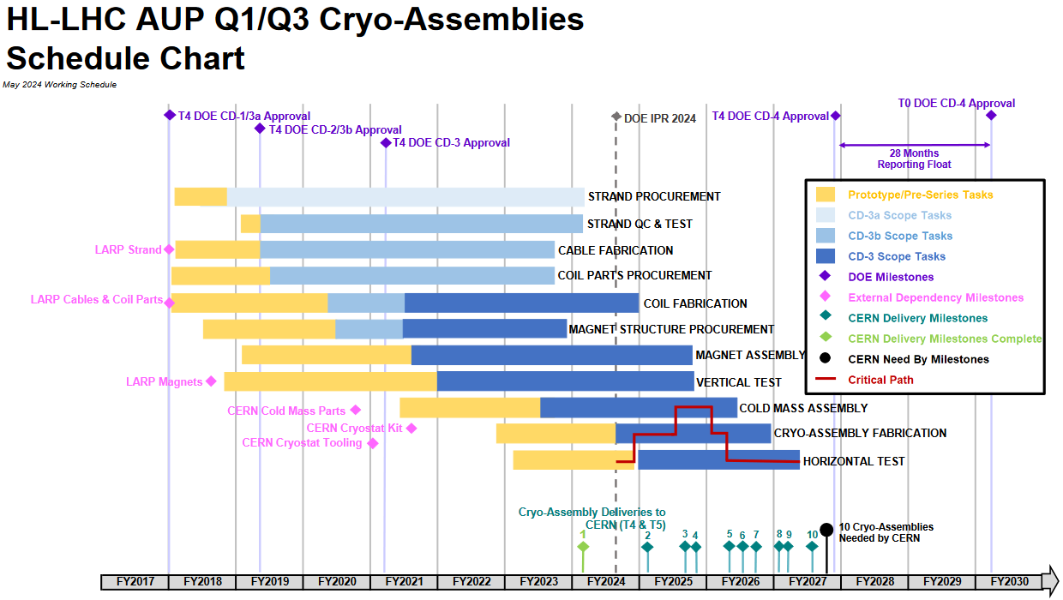
WBS 302.4.02: Schedule
Charge #2
The critical path runs through Cold Mass Assembly for production of the cold mass rework.
Shift work & overtime available for schedule recovery & was used on capillary rework.

Slide 19
WBS 302.4.02: Milestones
Charge #2
Activity ID | Milestone Name | PEP Date | Current Status Date | Difference (calendar days) | Difference (Months)
A205570 | T2:Cold Mass Production Complete | 7-Jul-25 | 4-Sep-25 | -59 | -2.0
A203416 | EX:AVAIL Receipt of CERN Cold Mass Ass'y Parts LMQXFA-08 to 10 + R2 | 1-Jun-23 | 26-Jan-2024 A
T2 milestone slipped with delays in CM fabrication major impacts:
Shell machining – 8 week of delay
Inspection table alignment issue – 5 weeks of delay
Instrumentation wiring installation (IFS capillary) – 6 weeks of delay
More stringent visual inspection and weld repair – 1 week of delay
External Milestone achieved, but some components were found damaged; replacement parts are on the way in coordination with CERN.

Slide 20
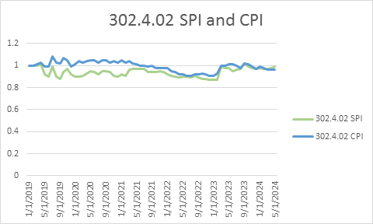
WBS 302.4.02: Cost and Schedule Performance
Charge #2
We were behind in the past due to delays on CM01 and CM02, valuable lessons learned helped improve tooling and QC processes, feedback from acceptance testing of CM01 at CERN led to improvement on CM02. (Recall from the WBS that CM01-03 are pre-series assemblies.)
Hired additional technician contractors to maintain schedule, currently working on CM03, 04, 05 & 06.
Cost are slightly above plan as we keep metrology on-call and a dedicated welder on payroll to prevent costlier schedule slips as well as increased LOE oversight.

Slide 21
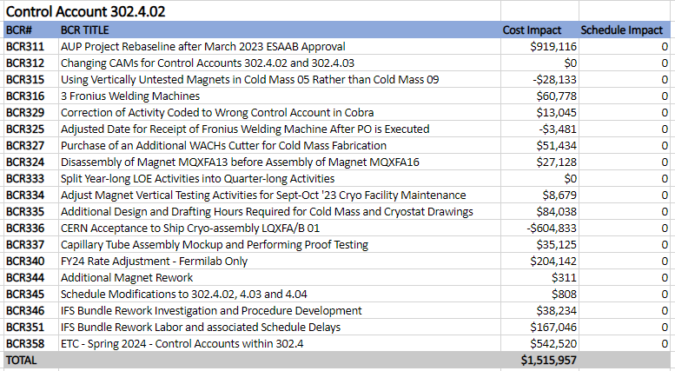
WBS 302.4.02: BCRs Approved Since Rebaseline
Charge #2
With success of CA01 we removed the CM rework in BCR336.
Added LOE in ETC’24 (New CAM, added LOE) BCR358.
FY24 Overhead Rate change had a large impact on CTC, BCR340.
Extra costs incurred due to the IFS repair effort BCR351.
$597,841

Slide 22
WBS 302.4.02: Estimate at Completion
Charge #2
The difference between EAC & BAC is $765k of which $206k is from EAC Manual Adjustments (see next slide). The remaining portion of $559k is due to the extra LOE used so far and the cost of having a dedicated welder and metrology on-call, a small price compared to the potential schedule delays.
We have 2 full assemblies completed, none in the estimated timeframe due to lessons learned, we are however confident that with unit #4 (start of series CM production) we will be on track with our schedule and cost estimates.

Slide 23
WBS 302.4.02: EAC Manual Adjustments
Charge #2
WBS | EAC Manual Adjustment Description | Cost ($k)
302.4 | Cost for potential new pair of stainless steel shells for CM-10 if R2 is necessary. | $150k
302.1 | SS Shell forming cost increase | $56k
We added the cost of new stainless shells, as requirements on the prestress changed after the first set were formed. We might not utilize these shells as we removed a rework from the baseline.
We have increased costs on the shell forming, compared to initial estimates.

Slide 24
WBS 302.4.02: QA/QC
Charge #1
This L2 sub-project follows HL-LHC AUP Quality Assurance Plan.
Project Quality Assurance Plan is described in US-HiLumi-doc-80.
A Manufacturing and Inspection Plan (MIP) is developed to monitor quality control and acceptance testing. The MIP documents critical inspection points and level of inspection.
QC is incorporated into the production of the Cold Mass through the released travelers. The travelers include discrepancy reports (DR’s), in-process inspections points, and management hold points per the FNAL and CERN approved MIP.
Test and Inspection reports for the Cold Mass will be uploaded to the traveler as identified in the traveler steps and can easily be accessed when required.

Slide 25
WBS 302.4.02: Risks
Charge #6
RI-ID | Title | Risk Rank
RT-302-4-02-005 | CM/CA fabrication issue causes component rework and schedule delay | 3 (High)
RT-302-4-02-002 | CERN fails to supply cold mass components for production on schedule | 2 (Medium)
Two risks remain: One high risk and one medium risk.
The high risk is due to the delays in fabrication driving the project timeline, as recently seen with the IFS capillary.
The medium risk is the availability of the CERN components. We currently have inventory and are in contact with CERN on the remaining items to prevent the occurrence.

Slide 26
WBS 302.4.02: ES&H
Charge #5
Operational hazards during Cold Mass assembly include Mechanical, Electrical, Welding and Pressure hazards
The risk categories of identified hazards are summarized in US-HiLumi-doc-1121
Use of overhead crane and lifting fixtures
High voltage tests
Welding: burns, UV flashing and Hexavalent Chrome inhalation
Documents:
AUP Hazard Analysis Report (HAR)
CERN’s Launch Safety Agreement (LSA) for IR Magnets (WP3) (see US-HiLumi-doc-234)
Document with CERN completed: Agreement on Compliance with the CERN Safety Regulation for Mechanics (SR-M) including Pressure Equipment Directive (PED-2014/68/EU) of LMQXFA Magnets from the US HL-LHC-AUP
FNAL pressure vessel FESHM chapter 5031 is addressed through ASME Section VIII Div. 2 Analysis.
ORPS, Group 2, Subgroup D for uncontrolled release of nitrogen gas.
No injuries and the event was promptly reported within an hour. Personnel were performing a test on a capillary tube assembly connected to a liquid nitrogen dewar in ICBA. After slowly opening the dewar valve, a loud pop occurred due to the sudden release of nitrogen gas from the test set up.
Corrective actions include management review of requirements and importance of work planning for new systems, ensure training compliance before setting up new systems, and determine if frequency of Cryogenic Safety training is appropriate.
HPI (Human Performance Improvement) ICBA Pipe Stand Hand Injury
Technicians hand pinched when loosening pipe stand used to support 40 ft beam tube. The upper portion of the pipe stand suddenly dropped more quickly than expected pinching the hand between the upper and lower collar of the stand.
Added pinch hazard labels to all pipe stands in ICBA.

Slide 27
WBS 302.4.02: Summary
LMQXFA-02 fabrication is complete. Pressure Tested to ASME and PED Specifications and transferred to cryostating.
LMQXFA-03 fabrication is nearly complete.
LMQXFA-04 & 05 fabrication are in progress.
WBS 302.4.02 is 70% complete. Cost and schedule are actively monitored with SPI & CPI near 1.
Assembly steps & tooling have been updated with additional fixtures, gauges and tooling with updated travelers and procedures.
Procurements of all production components are complete.
MIPs, Travelers, and DR’s utilized for fabrication process.
QA/QC & ESH&Q are fully incorporated.

Slide 28
Backup Slides

Slide 29
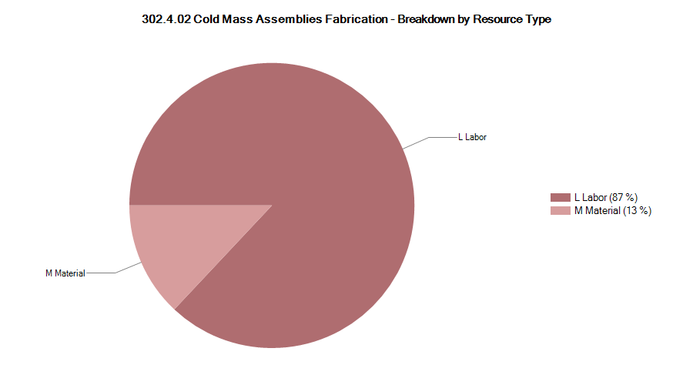
302.4.02 Resource Type Breakdown Slides
87% Labor, 13% M&S
M&S Includes UT testing, parts & components, production aids and shipping/tariff from CERN

Slide 30
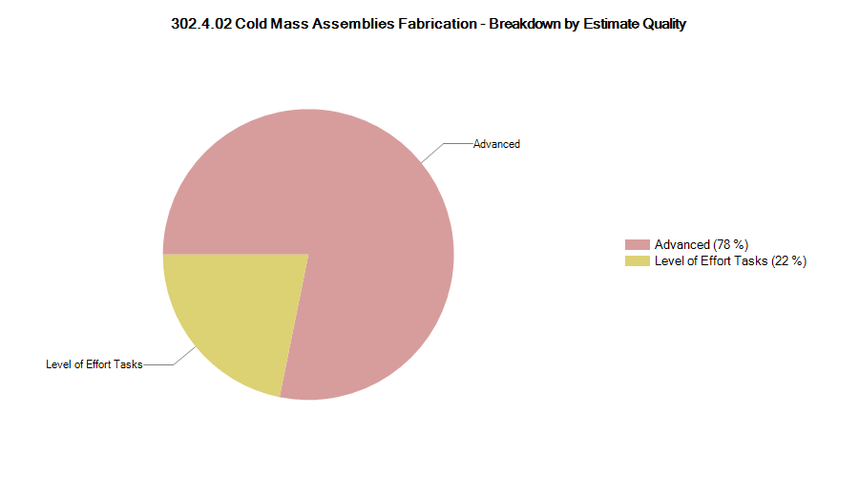
302.4.02 Estimate Quality
Charge #2
We have had 3 units to understand the required effort, and as such have no ‘unknown’ work as preliminary.
We determined that any rework would require a full disassembly and re-assembly and planned accordingly

Slide 31
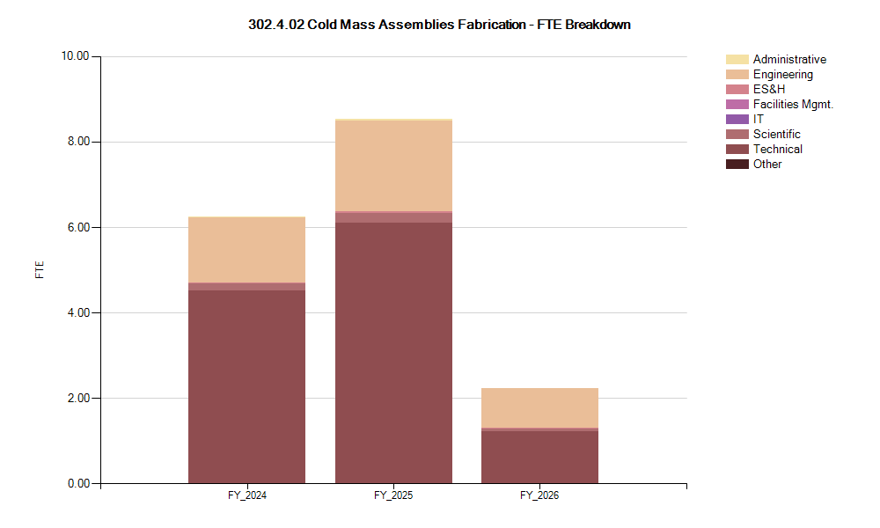
302.4.02 FTE Breakdown
Charge #2
We require a large workforce for the next two year

Slide 32
302.4.02 Cost Performance Report
Charge #2
BAC = $18.385M
Thresholds crossed in Current Period Cost – higher cost for welder and LOE
Thresholds crossed in Cumulative to Date – catching up on late work
Cumulative SPI = 0.99, CPI = 0.96

