Slide 1
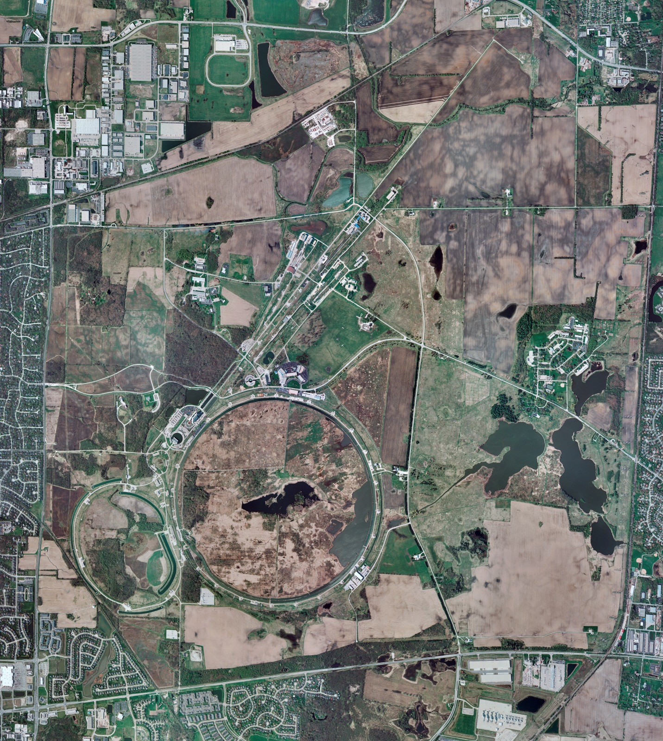
Helium Cryogenics
Status 5/24/2024 J.Makara
CMTF: SCP is cold running fine
CMTS: HECM29 operating fine at 2K for RF testing
PIP2IT: South CM stand being modified for SSR2 pCM
North CM pHB650 operating fine at 2 K
MCTF: cryo system being cooled down
MDB/HTS: at RT
MDB/STC: at RT but will be cooled down soon
MDB Magnet: at RT
NML/FAST: Cryo system is shut down and isolated for extended shutdown period;
CC1: at RT
CC2: at RT
CM: at RT
IB1: cryo system cold at 5 K and 2 K operations with ALAT Coldbox
Muon Campus: at RT with comprs off and system depressurized; LN2 off
Misc:…

