Slide 1
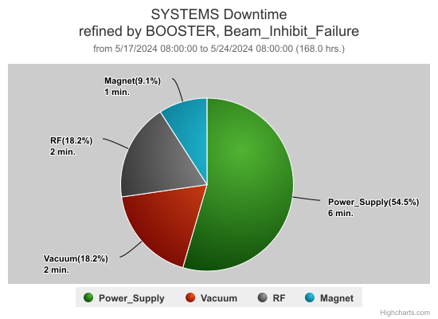
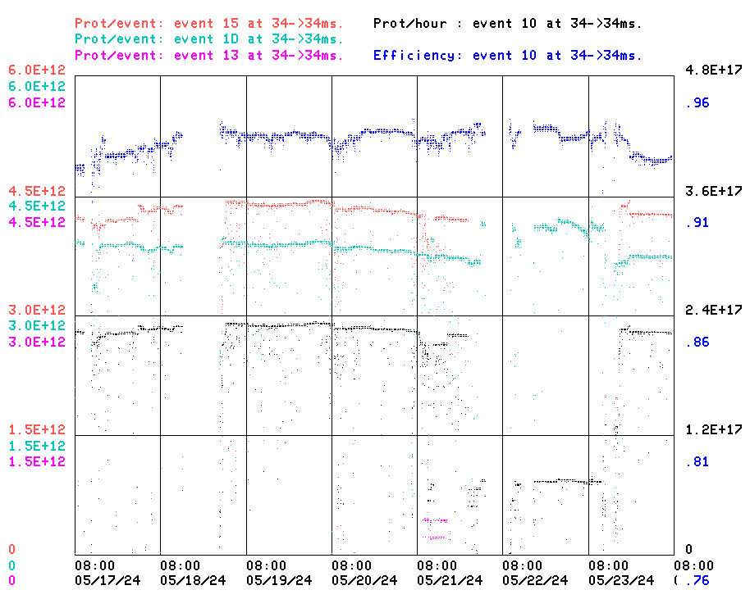
Booster Operations 05/17/24 – 05/24/24
F
F
Sa
Su
M
Tu
W
Th
F
Downtime this week: 11 minutes
Booster Studies w Kiyomi
2 min: A few minor RF related trips
2 min: Vacuum trip (IPDEB2, IPQ16)
6 min: Power Supply…MI8 Coll losses
1 min: HL9 ground fault tip, changed regulator
Opportunistic Booster Studies
MI8 Collimator Losses
Also:
Rooftop AC maintenance on Monday BGE
MI8 Collimator losses on occasion, sometimes suddenly, hard to pin down
Thanks to Linac folks for steering adjustments & tuning this week
Narrow bunch quick check for possible Neutrino applications
20Hz upgrade effort at E4R continues.
Partial Discharge detection continues on spare magnets
VGCBD2 activity at Linac Dump
Thanks to Ops for diligence & tuning on the off shifts
This week:
Beam to BNB ~3.7 -4.2E12 per pulse, variable turns
Beam to NuMI, ~ 4.3E12 per pulse, variable turns
Beam to SY as requested 2T, ~ 5E11 per pulse
BLLRF studies on Friday (scheduled), and Wednesday (opportunistic)
MW803 had to be put into local control

