Slide 1
Muon Campus Operation Report
Jim Morgan
Friday 09:00 Operations Meeting
May 24, 2024

Slide 2
Muon Campus status
Received permission for beam operation
Signing “party” Tuesday afternoon
Delivery Ring access period in progress, driven by ESS1 installation
Still have one more significant LCW leak on a Delivery Ring header
Quad shunt problems on QS219 and QS319 traced to CAMAC card connection
Most remaining Muon tunnel enclosures put into Supervised Access Monday
Needed to secure Delivery Ring Enclosure last night, related to PESD D:IB LOTO for repairs performed May 15 and desire to turn on next week
ESS1 Electrostatic Septum installation
ESS1 moved from NWA to Delivery Ring on Wednesday
Installation into Delivery Ring was on Thursday
Alignment Crew defined D30 centerline Wednesday, aligned septum on Thursday
Upstream vacuum spool fabricated and leak-checked Thursday afternoon
Surge resistor support installed Thursday afternoon
ESS2 subassembly work continues at A0 Clean Room
Cathode straightened by Machine Shop, gets sent out for polishing next
AP-0 A/C work continues to be stalled (now at 57 weeks)
Waiting for controls sub-contractor to be badged and then show up
Study – M1-M3 Optics
Study – Alternative M5 optics

Slide 3
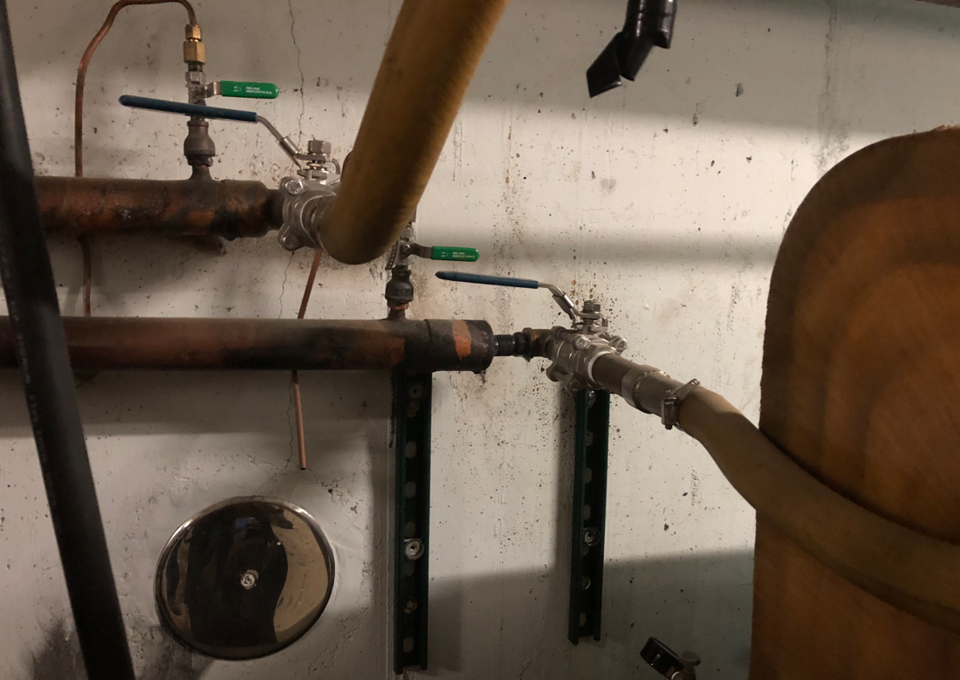
Remaining significant LCW leak in Delivery Ring Enclosure
Leaking header fitting behind H619

Slide 4
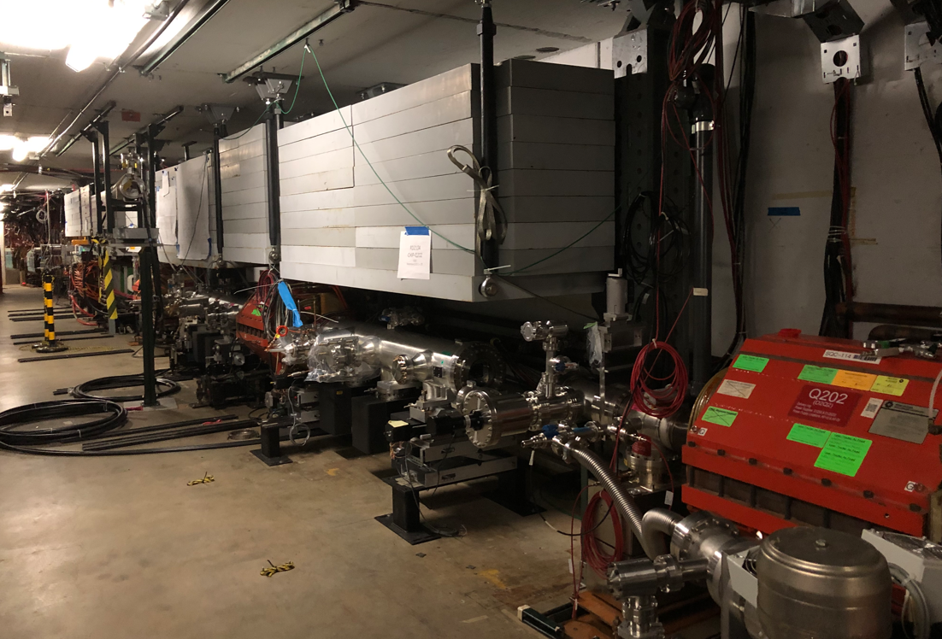
ESS1 installed in Delivery Ring
ESS2
ESS1

Slide 5
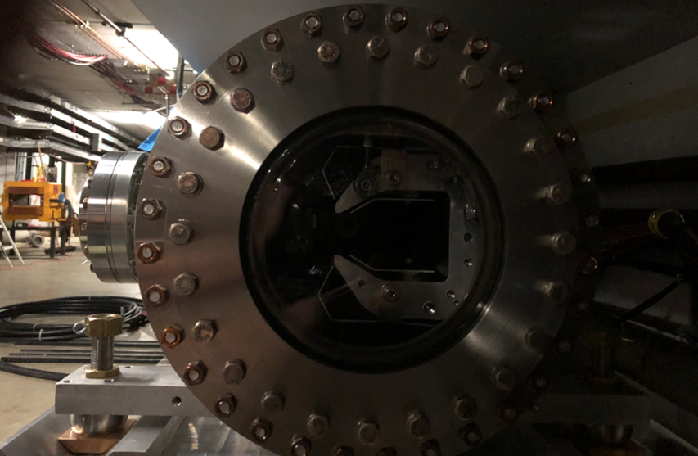
ESS1 view through upstream quartz window

Slide 6
Upcoming work
ESS1 installation
Expect to install vacuum spool and begin pumping down today
Vacuum leak check next week
Some power supply work today, hope to have ORC next week
Motion-control check-out on Tuesday
ESS2
ESS2 cathode polishing (outside vendor), followed by assembly into tank
Additional issues and tunnel work
LCW leak on header fitting near H619
Two closed vacuum valves in M4 Line have control cables disconnected
AP-0 A/C work paused while awaiting controls sub-contractor
Will need access to AP-0 Water Cage and rad fence area, turns off beam to Muon
Purchasing is being asked to encourage contractor to finish work
Estimate six days of work needed for system to be operational
Expect to resume use of portable A/C unit in near future

