Slide 1
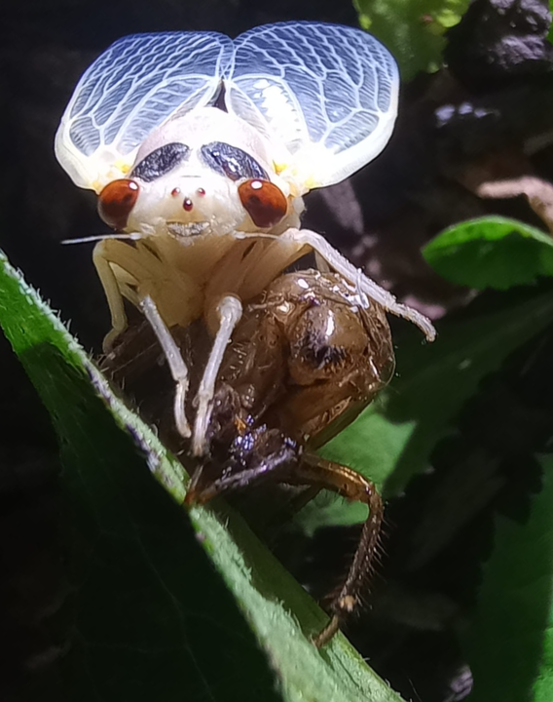
Main Injector / Recycler
Phil Adamson
24th May 2024
1974
Cicada after 17 low-tempo years
1947

Slide 2
Beam to NuMI

Slide 3
A series of unfortunate events
Tuesday afternoon / evening: Two MI rf cavities (1 and 18) fault off on water leak indications
Tuesday evening: MIBS failure at MI60N inhibits NuMI beam
MIBS believed resolved Wednesday morning
Access on Wednesday. Both were actual leaks; Two PAs replaced
Trying to turn on, MI50L VCB would not close
Investigation was deemed high hazard, so began at 6am Thursday
VCB was determined to need replacing. Replaced and on by noon
Note that MI60Q VCB showed fast bypass fault during this process, but reset OK. This is the fault that held us off after last week’s access

Slide 4
A series of unfortunate events
On turning back on, encountered a problem with MECAR.
Same fault on Wednesday morning when turning on from halted ramp
Some software switch gets confused in MECAR, and regulation wasn’t working
Toggling software bits on the Crate Selection page puts it back in a good state (prescription in Elog).
Cause currently uncertain
NuMI kickers and E:TOR101 weren’t getting triggers
Holdover from MIBS problems the previous day. Now fixed.
MI60N BLMs also failed in an unusual way.
R:LI* worked, I:LI* didn’t.
Bad TCLK at MI60N: (new) McClure box replaced.

Slide 5
Issues
MI31 Chiller:
Now working on backup pump. Replacement pump motor for primary pump on order.
MECAR
Fix for bypass mode issue ready to go, but not installing on Friday before everyone takes vacation for a week
New issue with regulation failure coming out of ramp halt. Prescription to get working again in Elog, and known by machine experts.
A couple of other rare, intermittent issues we’re trying to understand.

Slide 6
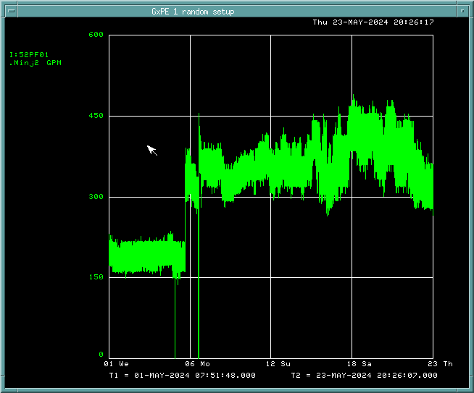
MI52 pond flow
Pond flow at MI52 trending slowly downward since (presumably) pond treatment
Flushing strainers turns off LCW.
PLC trips at 150 gpm

