Slide 1
Switchyard & Meson Report
Michael K. Olander
AD 9:00 Meeting
23 May 2024

Slide 2
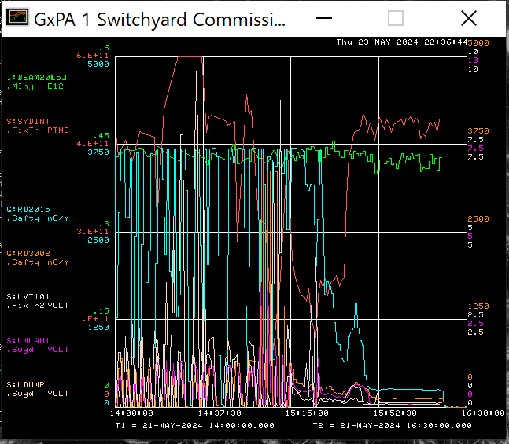
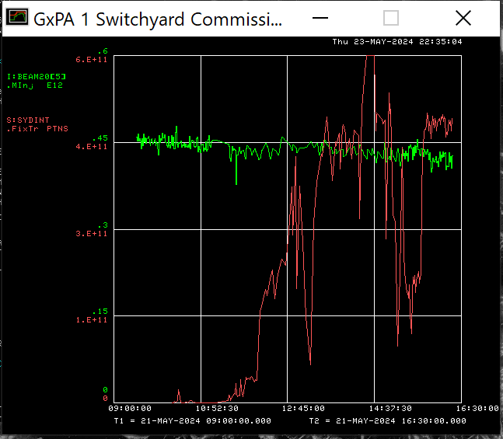
Beam to Switchyard Dump
Cyan = Enclosure B TLM (Lower is better!)
Plot of SY Beam at end of shift 5/21.
Note: S:SYDINT is an Ion Chamber.
From Start of Commissioning to End of Day.

Slide 3
Current Plan
Despite the machine’s best efforts, we are commissioning Meson and NM in the MCR.

