Slide 1
Cost and Schedule
D. Sherese Humphrey
PIP-II RFPI Final Design Review
June 14, 2024

Slide 2
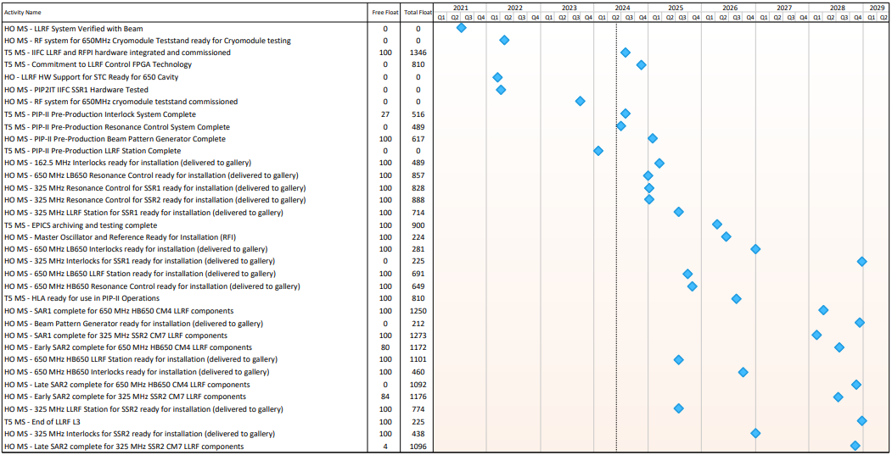
Summary Schedule
Sufficient total float to accomplish milestones associated with the RFPI.

Slide 3
Resources
RFPI effort of order 1.3 FTE [engineer and technician]
Resource negotiations occur annually with the AD
QC, Assembly, and Testing will be performed in-house

Slide 4
RFPI Procurement Planning
Production Path Forward
Estimates received – June 2024
Paperwork Finalized [BCR and requisition]
~ Three-month lead time for approvals
RFPI System Hardware
325MHz Interlock System [SSR1 & SSR2]
HB 650MHz Interlock System
LB 650MHz Interlock System
Orders exceeding >$250K and/or requiring fabrication will require a Procurement Readiness Review (PRR)

Slide 5
Summary
Resources available to perform production activities
Production estimates will be used to finalize planning assumptions
Work expected to be completed well in advance of hand-off milestones

