Slide 1
PIP-II Low Level RF System Overview
P. Varghese, L3 – LLRF/RFPI
PIP-II RFPI Final Design Review
June 14, 2024

Slide 2
About Me:
Philip Varghese
L3 Manager for LLRF and RFPI
Ph.D. Electrical Engineering
30+ Years Experience, 22 Years in FNAL LLRF Group
>7 years of direct involvement with PIP-II
Relevant Experience
Principal Engineer, LLRF Group Leader
Lead Engineer: PIP-II IT LLRF System design/testing
Lead Engineer: Design of 3 generations of FPGA
based LLRF Hardware for SRF cavity control
Resonance control studies on LCLS-II cavities
FAST/IOTA cryomodule LLRF system design/commissioning
Experience working with various collaboration teams for PIP-II and LCLS-II Projects
Extensive experience developing various LLRF systems
for normal and superconducting cavities
Previous Relevant Experience
12 years, Embedded Systems, Industrial Controls, Automotive Electronics

Slide 3
DOE LLRF and International Collaborations
LLRF Teams from FNAL, JLab, SLAC and LBNL have been collaborating for the past 9 years in the context of LCLS-II and now PIP-II. We are integrating DAE and TUL into this collaboration.
TUL
DAE LLRF and RFPI systems for 325 MHz and 650 MHz cavities have been
Received at FNAL and have completed preliminary testing
DAE Team is arriving at FNAL this year to complete testing with cavities

Slide 4
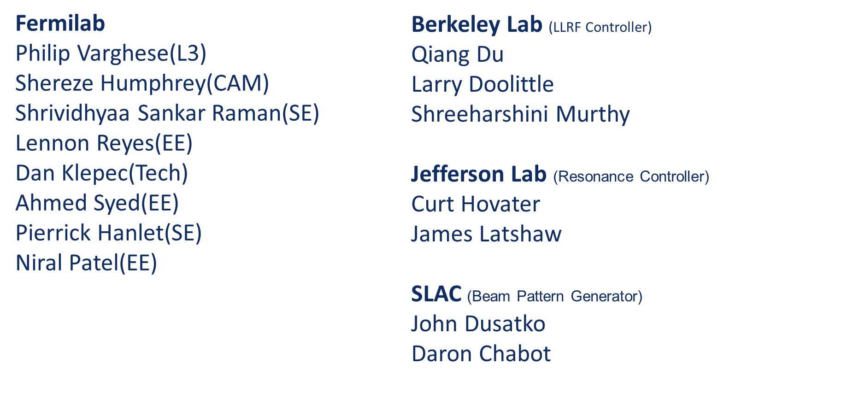
PIP-II LLRF Collaborations

Slide 5
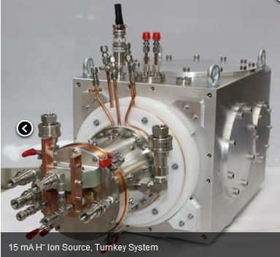
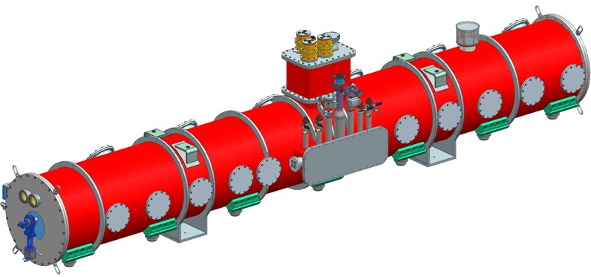
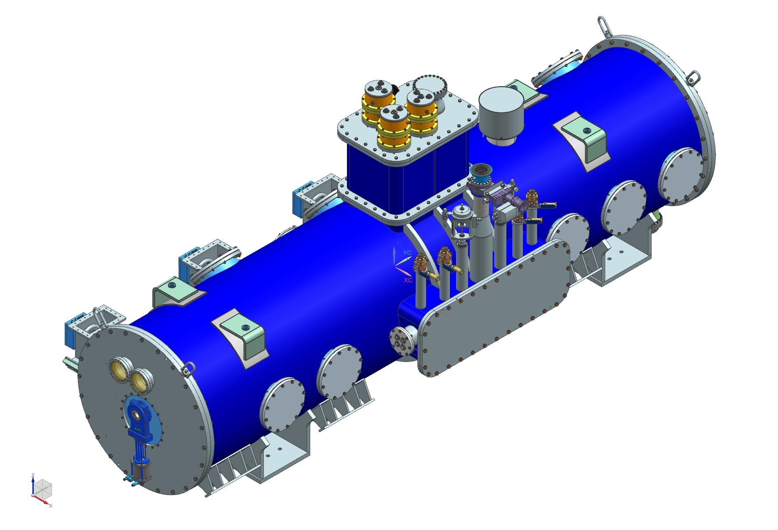
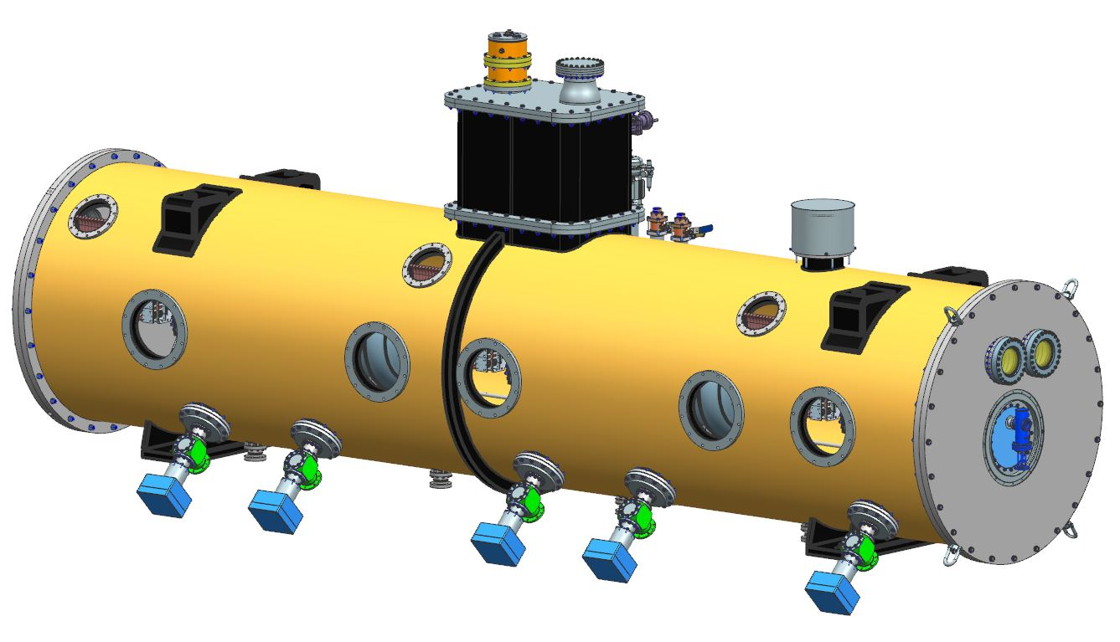
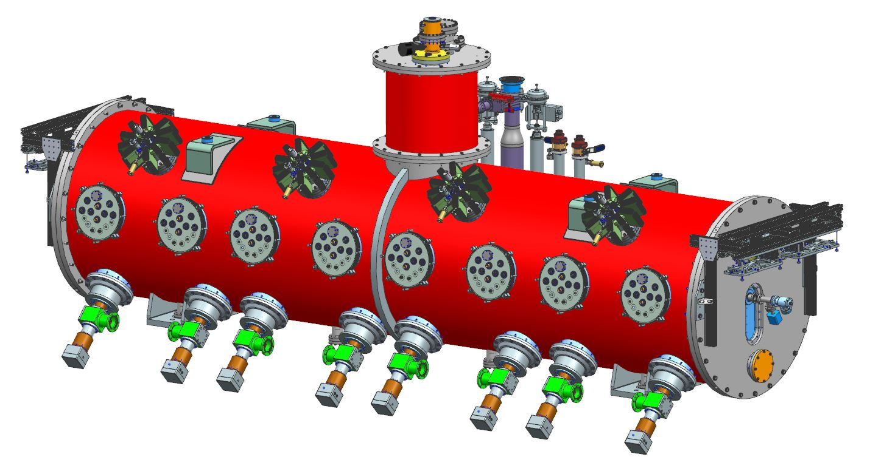
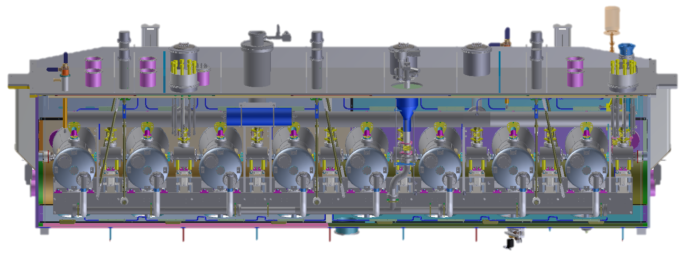
PIP-II Superconducting RF CW Linac
H- Ion source
Elliptical
HB650 X 4
24 Cavities
650 MHz
Elliptical
LB650 X 9
36 Cavities
650 MHz
Single Spoke
SSR2 X 7
35 Cavities
325 MHz
Single Spoke
SSR1 X 2
16 Cavities
325 MHz
HWR
8 Cavities
162.5 MHz
833 MeV
516 MeV
177 MeV
Superconducting
RFQ
10 MeV
32 MeV
2.1 MeV
Room Temperature

Slide 6
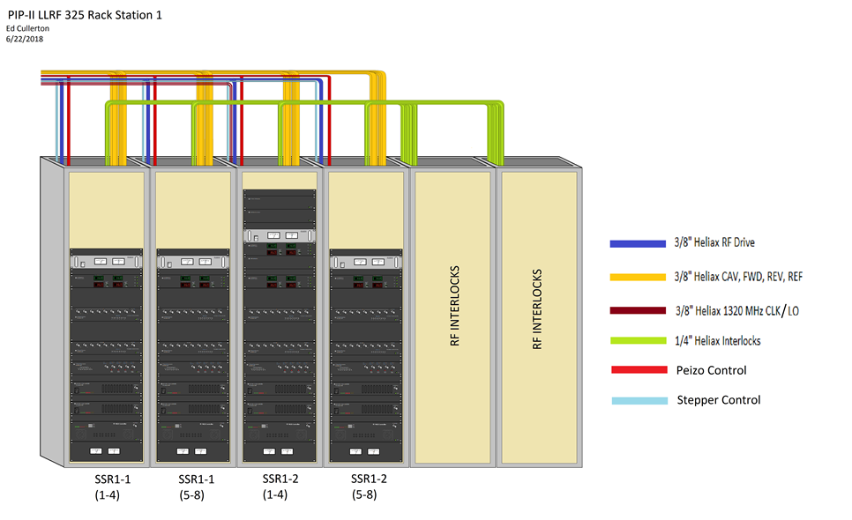
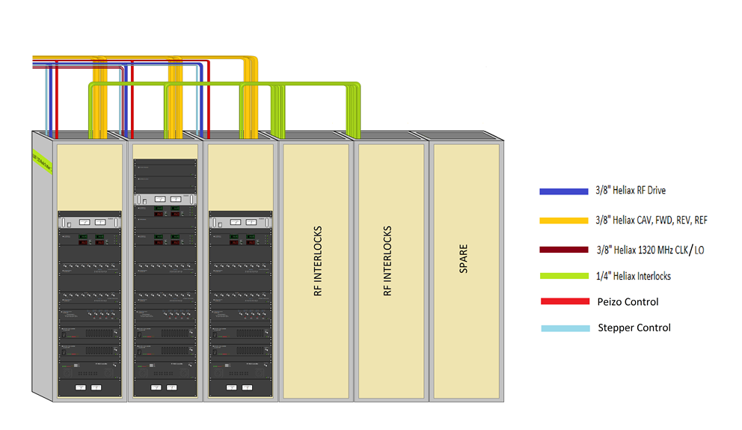
PIP2 LLRF Systems
 | Station1 | Station2 | Station3 | Station4 | Station 5 | Station6 | Station7 | Station8 | Station9 | Station10 | Station11 | Total
 | RFQ, B1-4 | HWR | SSR1-1,2 | SSR2-1,2,3 | SSR2-4,5 | SSR2-6,7 | LB650-1,2,3 | LB650-4,5,6 | LB650-7,8,9 | HB650-1,2 | HB650-3,4
Number of cavities | 6 | 8 | 16 | 15 | 10 | 10 | 12 | 12 | 12 | 12 | 12 | 125
RF Freq (MHz) | 162.5 | 162.5 | 325 | 325 | 325 | 325 | 650 | 650 | 650 | 650 | 650
S3 – SSR1-1,SSR1-2
S4-S11 – SSR2 (7),
LB650 (9), HB650 (4)

Slide 7
LLRF Systems Diagram

Slide 8
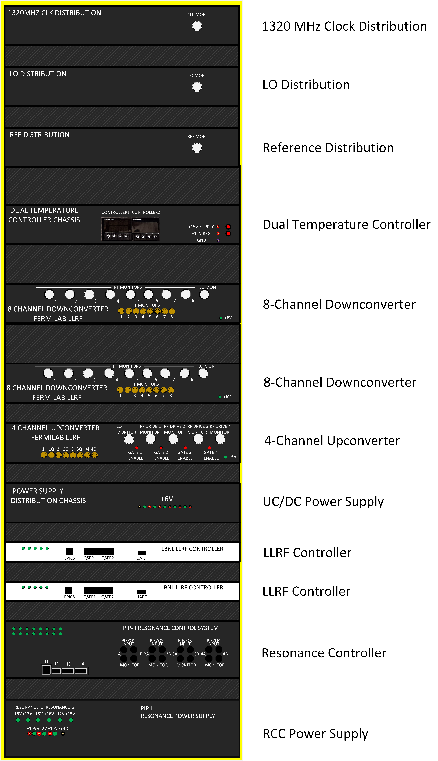
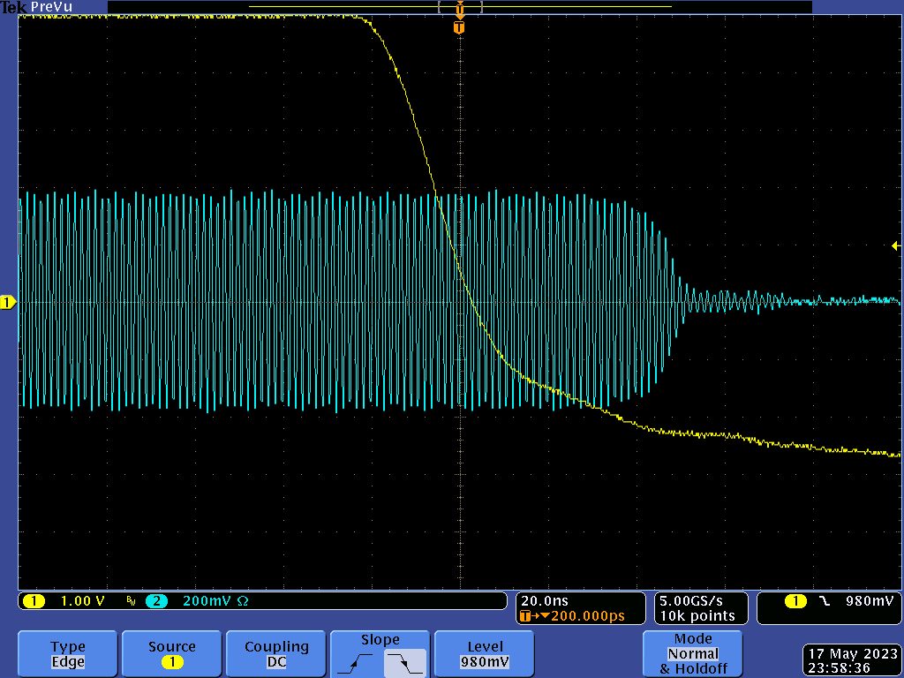
Four Cavity LLRF Rack
4 Cavity modular architecture aligns well with 4 cavity RFPI module
RFPI Permit gates the RF signal out
of the upconverter
RF turnoff response time < 70 ns
LLRF controller will send gradient, forward and reflected power data to RFPI over a fiber link

Slide 9
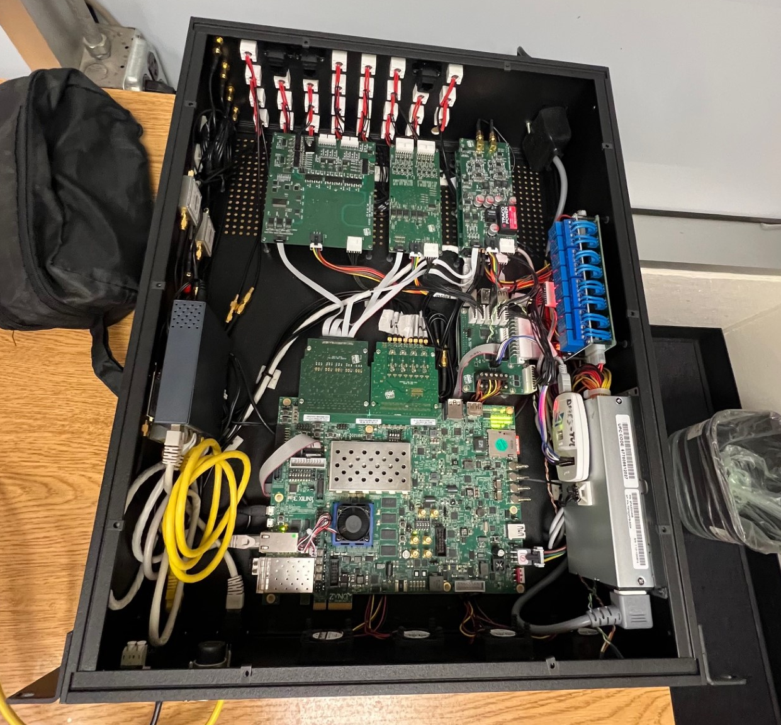
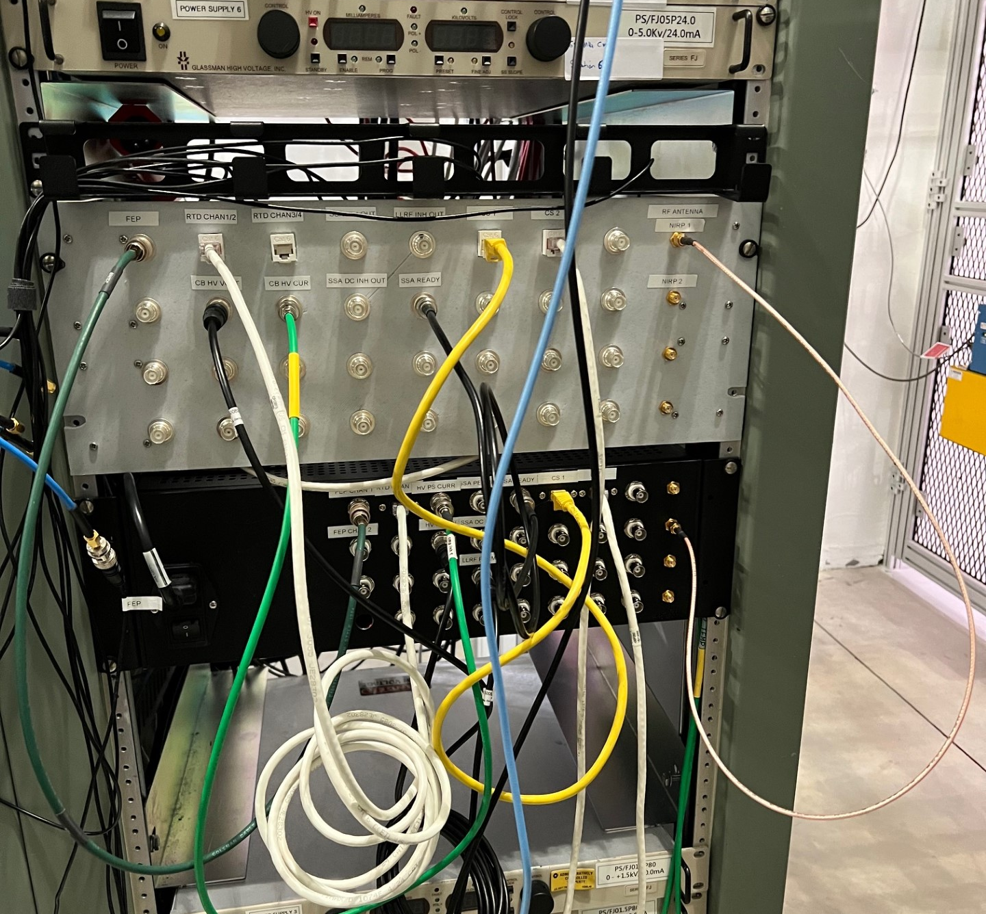
Initial Prototype Tested at CMTF
Following the PDR in December 2022, a prototype system was installed in May 2023 and tested with pHB650 cavities
The EPICS user interface was integrated into the cryomodule EPICS GUI
The one channel RFPI system performed well in the testing and has been used as the default system since last summer.
The 4-cavity final prototype is installed and undergoing testing at CMTF

Slide 10
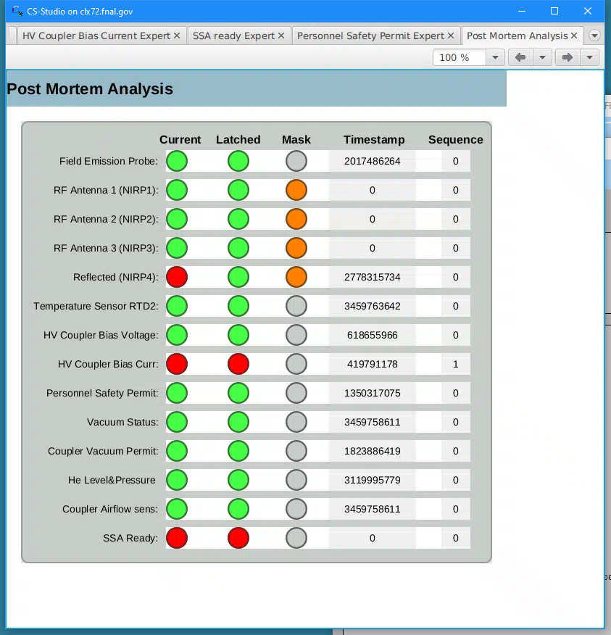
EPICS User Interface (POC)
Single cavity design
In use since last spring
Has worked well so far
Many features for post
-mortem analysis
Features will be further refined in the 4-cavity
final prototype

