Slide 1
PIP-II RF Protection Interlocks (RFPI)
N. Patel
PIP-II RFPI Final Design Review
June 14, 2024

Slide 2
Outline
Introduction/Scope
System Design
Requirements
Current Status

Slide 3
Common Acronyms Used
RFPI – RF Protection Interlocks
MPS – Machine Protection System
SSA – Solid State Amplifier
LLRF – Low Level RF
HLRF – High Level RF
PSS – Personnel Safety System
NIRP – Non-ionizing Radiation Protection
FEP – Field Emission Probe

Slide 4
Introduction
The RF Protection Interlocks (RFPI) will perform several roles in the PIPII accelerator:
  protect the cryomodule and its RF components. The RFPI system monitors signals associated with the SRF cavity system and inhibits the low-level RF drive under fault conditions. It provides the SSA permits.
  provide a status to the accelerator machine protection system (MPS).
  provide diagnostic information (waveforms and status bits) to the control system in real-time during operation of each SSA-Coupler-Cavity being monitored

Slide 5
Overview
PIPII RFPI system will be based on an entirely new design
  Replaces obsolescent RFPI system
  Legacy systems is very complex and cost prohibitive from a scalability standpoint
Over the past several years the requirements for the RFPI for the PIPII Accelerator have been carefully developed.
  The functionality has been successfully proved out during the PIP2IT program with a legacy RFPI system (hardware & software) throughout the duration of the run.
    As a result the functional design with largely remain similar
    Various lessons learned have been documented, including the user interface and experience
Input for the requirements have been developed in collaboration with many teams
  PIP2IT
    LLRF, HLRF, MPS, Control System, Cryomodule (including Vacuum, Cryogenics), Safety Interlock
  Other labs
    Curt Hovater & Ramakrishna Bachimanchi (Jefferson Lab)
  Team from Poland (Wojtek Cichalewski, Wojtek Jalmuzna and team)
With the testing of the first prototype design, the newer architecture with EPICS interface has been evaluated over the past year.

Slide 6
System Block Diagram
One RFPI System will interface with a total of 4 Cavity/Coupler systems as shown in the block diagram below
MPS
Timing/Controls
RFPI
Personnel Safety
LLRF
SSA1
SSA2
SSA3
SSA4
Cryomodule
Cavity 1
Cavity 2
Cavity 3
Cavity 4
…
Cryo, Airflow and Vacuum Systems
HV Coupler Bias Power Supply

Slide 7
RFPI System Design
The RFPI is designed to interface with many systems which will provide inputs to the RFPI systems. The parameters of all these systems are shown below. The SSA, LLRF and MPS systems will receive permits from the RFPI system and these are also listed below.
The functionality of this system design was tested throughout the PIP2IT run.
Inputs
Outputs

Slide 8
RFPI Functional Diagram
Table below shows how the permits from RFPI are made up
 | Output Permits from RFPI (LB/HB)
Inputs to RFPI | LLRF permit | SSA Permit | SSA_DC Permit | MPS
FEP | x | x |  | x
RF antenna (NIRP) | x | x |  | x
Personnel Safety Permit | x | x | x | x
Vacuum Status | x | x |  | x
Coupler Vacuum Permit (Multipacting) | x | x |  | x
He Level & Pressure (Cryo) | x | x |  | x
Temperature Sensors (RTD 1& 2) | x | x |  | x
Coupler Airflow Sensor | x | x |  | x
HV Coupler Bias voltage | x | x |  | x
HV Coupler Bias current | x | x |  | x
SSA Ready | x |  |  | x

Slide 9
Parameter Requirements

Slide 10
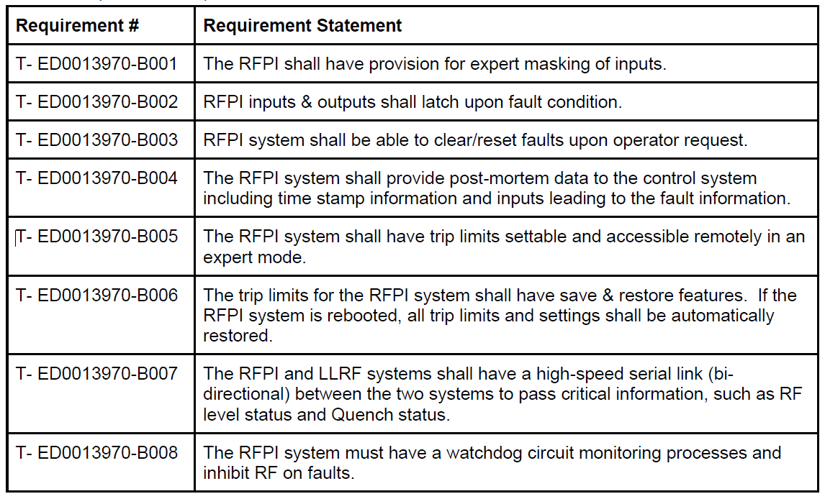
Operation Requirements

Slide 11
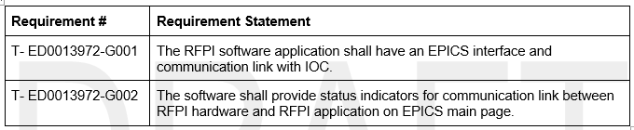
EPICS Interface

Slide 12
Current work in progress
Working in collaboration to assist with evaluation of prototype
EPICS Interface development
Recent Completion of requirements for new HV Coupler Bias Power Supply development

