Slide 1
9 AM Meeting
Nathan Ruffatti
MCR Crew Chief
Wednesday, May 29, 2024

Slide 2
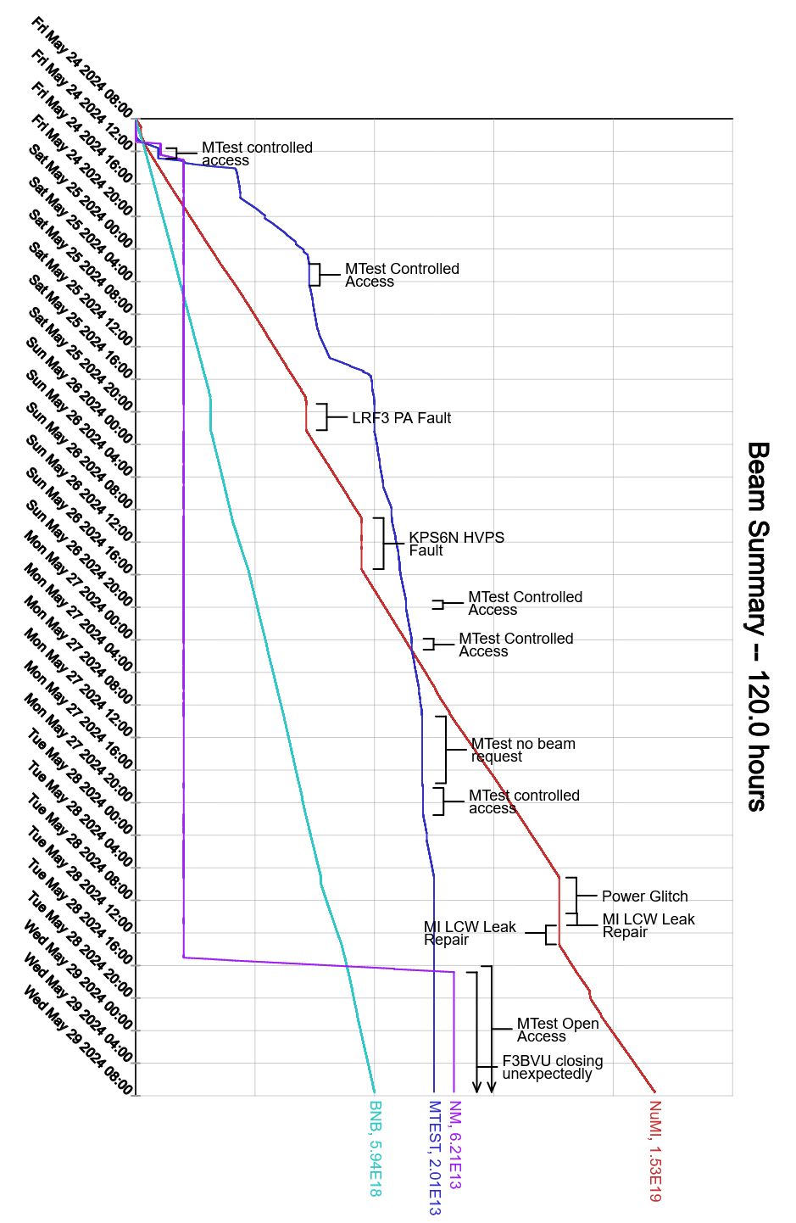
Since Friday…
MI-10 LCW Pump #1 tripped off
Experts are aware and a plan is being made for when its best to work on it
LRF3 spark trip had issues recovering.
Experts walked operators through recovery and were able to establish beam into the next shift
I:KPS6N recovery issues
Was able to get the kicker online after a few hours with the help of technicians
M:F3BV3U valve continuously closing
High losses resulting from the valve. Experts will continue to troubleshoot
MIRF14 had many high voltage deck interlock trips
Main Injector MI-3 Section interlocks dropped due to power glitch
Replaced a leaky hose after Search and Secure was completed
Beam to NuMI, BNB

