Slide 1
Accelerator Status
Jason Crnkovic & George Deinlein
Proton PMG/AEM:
June 6, 2024

Slide 2
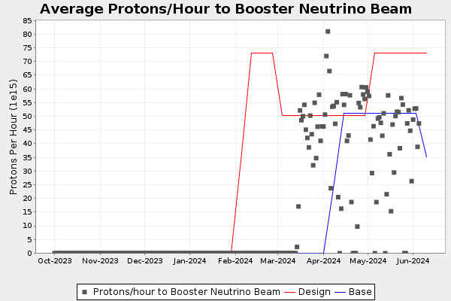
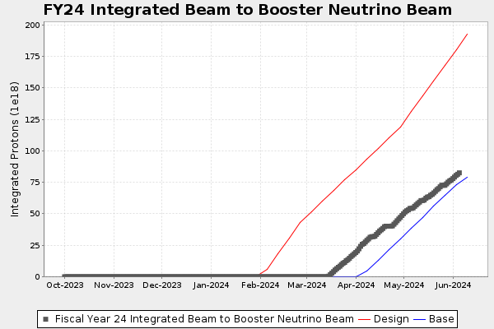
Recent Activities
Linac:
Running well.
Efficiency around 91% (G:LINEFF).
MTA:
Expecting users June 13.
Booster:
Running well.
Efficiency around 94% (B:BOOEFF).
BNB:
Running well for the most part.
E:MBRATE is now working.
E:TOR875 is now being displayed on ifbeam webpage.
BNB Integral: 8.45E19 protons @ June 5 00:00

Slide 3
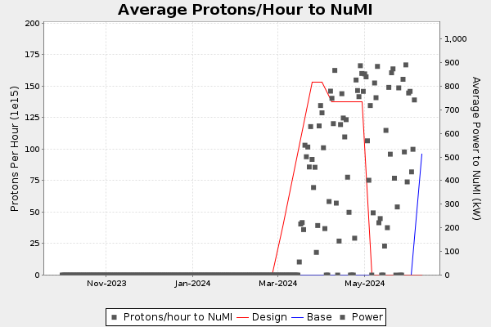
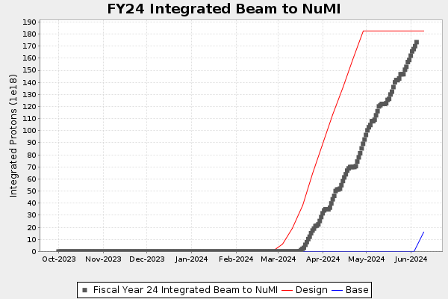
Recent Activities
MI & RR:
Running well for the most part.
Sorting out beam position monitor issues
NuMI:
Running well for the most part.
Sorting out beam position monitor issues and will work on target & baffle RAW flow.
Waiting on Tritium approval for 1 MW running.
NuMI Integral: 1.74E20 protons @ June 5 00:00

Slide 4
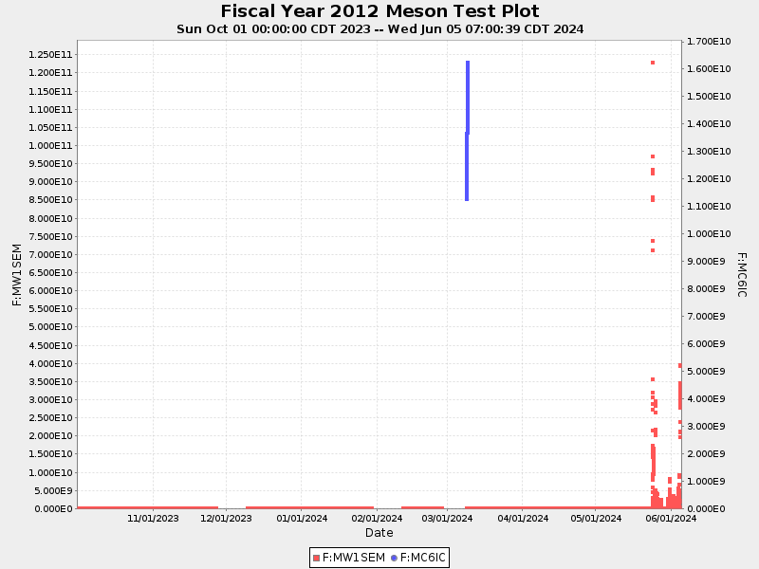
Recent Activities
Muon Campus:
Commissioning work.
Switchyard:
Delivering beam to experiments.
Neutrino Muon:
Working with SpinQuest to center beam on target.
Meson:
Waiting for MTest users.
Waiting for MCenter beam request
SpinQuest Integral: 2.22E15 protons @ June 5 00:00
MTest Integral: 3.97E13 protons @ June 5 00:00
(Meson Test)
(Meson Center)

Slide 5
Any Questions?

