Slide 1
Tapered Key Load Test Using MQXFA12b
G. Vallone, G. Ambrosio, D. Cheng, P. Ferracin, L. Garcia Fajardo, J. Herrera
May 23, 2024
MQXF Structural Working Group Meeting

Slide 2
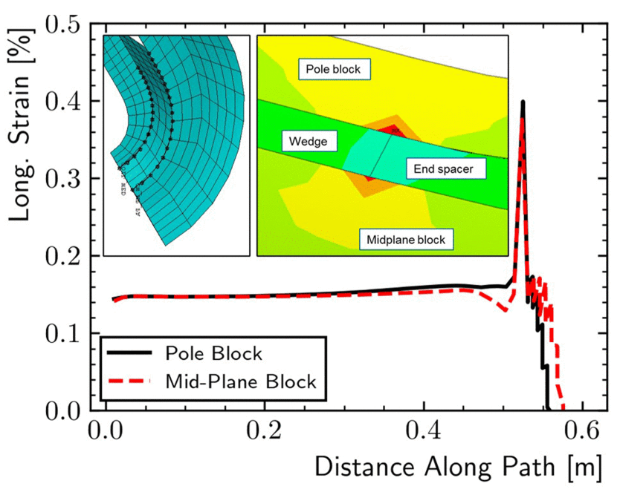
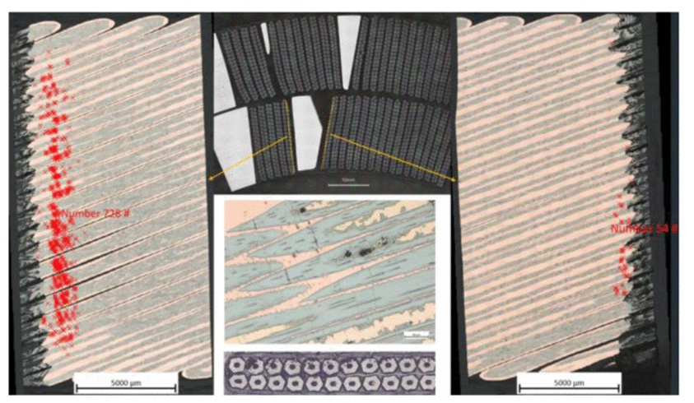
Introduction
An investigation started after MQXFA07 test discovered that localized strain spikes at the inner layer wedge/end-spacer interface can cause filament failures
The analysis suggested that this was due to the low azimuthal prestress experienced by the failed coil (closed pole key ‘gaps’)
More details here: G. Ambrosio et al., 10.1109/TASC.2023.3261842
Similar damages were found in MQXFA13 coils
This time, the azimuthal prestress reduction was only local, and due to the small coil ends
This suggests that we should avoid using coils with ‘small’ ends
Here we explore a potential shimming strategy to avoid wasting these coils

Slide 3
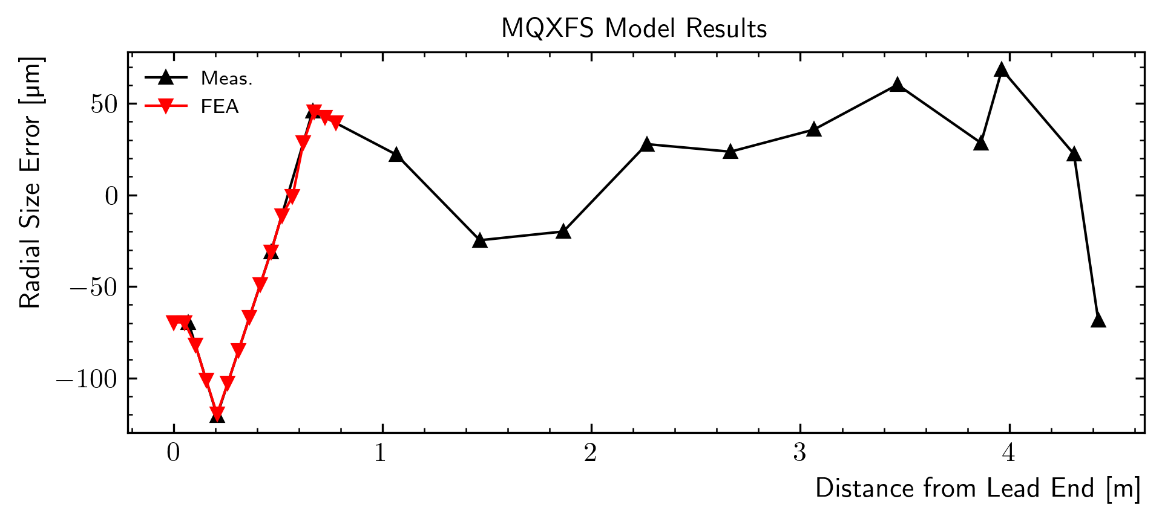
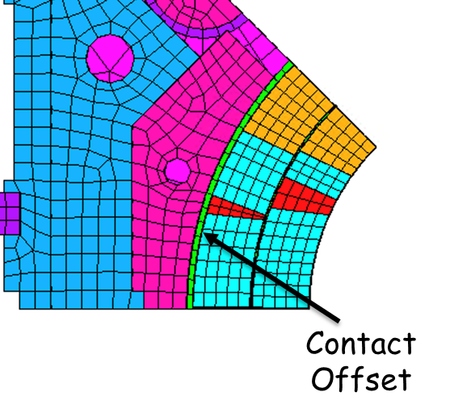
Modeling - Summary
MQXFS octant model
Contact offset on the coil/filler contact
All coil components bonded but:
Separation allowed between the wedge and the spacer
and the coil and the winding pole
Model shows strain spikes at the wedge/end-spacer interface under certain conditions…

Slide 4
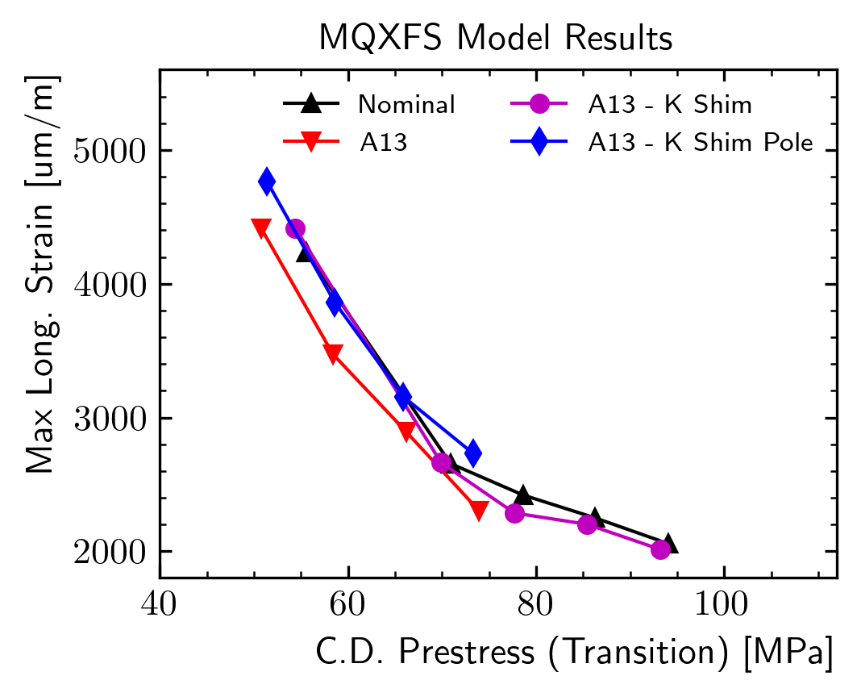
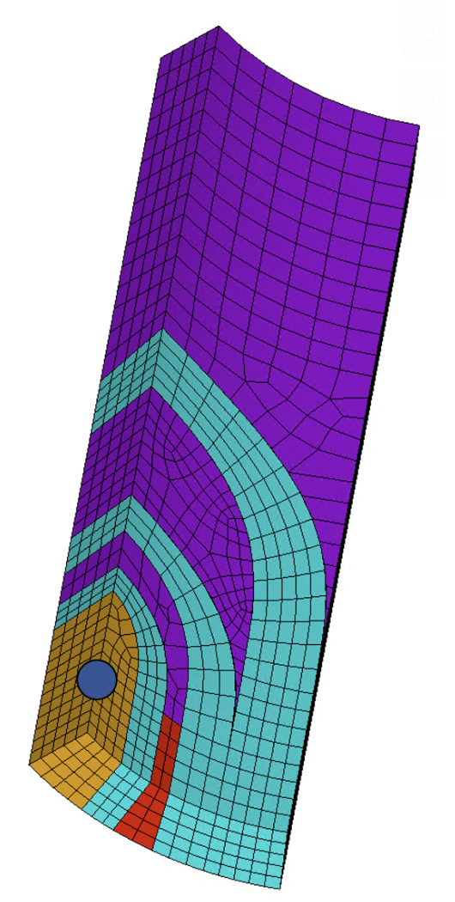
Why the strain increases?
Pole stress at cold computed on the same z location of the wedge/end-spacer transition
Blue/magenta lines represent end-region modifications
All the points are on the same lines!
The effect seems to be controlled by a local prestress loss

Slide 5
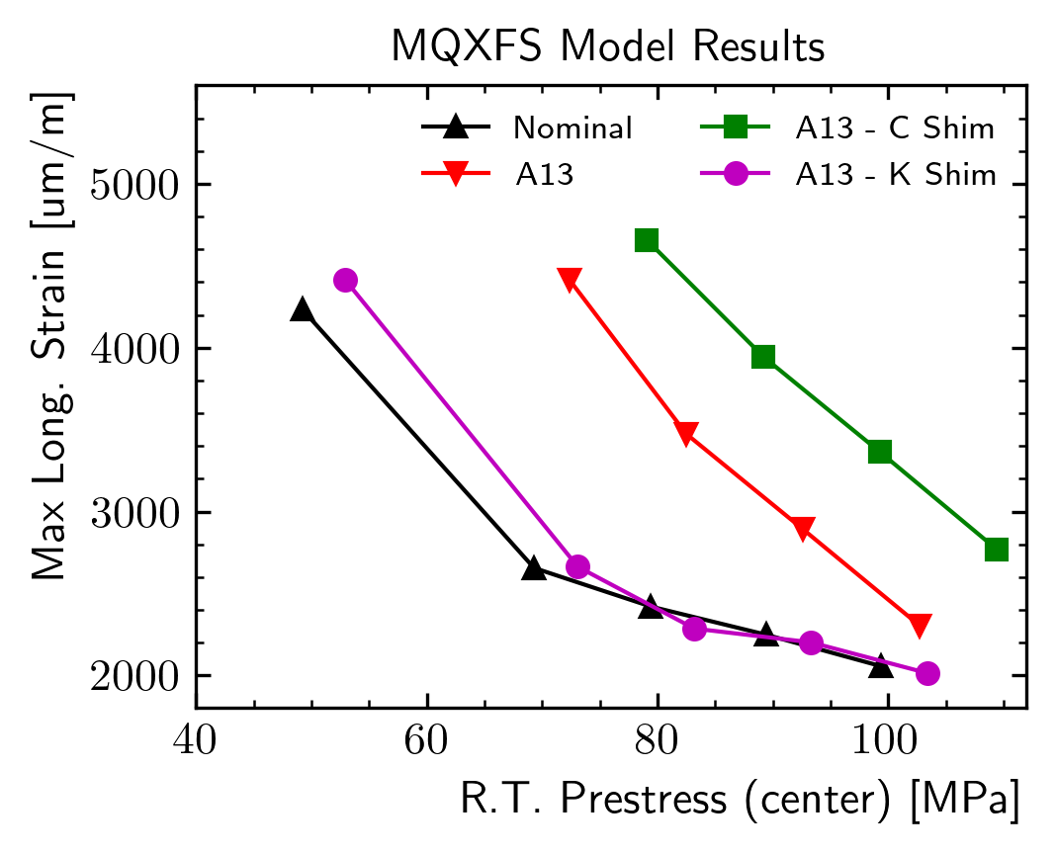
Local Prestress Modifiers - Results
Coil/Collar Shimming
Key Shimming
Increasing the ‘global’ prestress might ‘push’ the coil stress over the project-defined limits
Alternatively, we could act on ‘local’ modifiers. Two strategies were explored:
Radial shimming of the coil pack
Available shimming region relatively small, as we do not want steps close to the cable
Goes in the wrong direction - LQ effect, decreases the prestress locally
Increasing the key size in the coil end region
Key size increased (100 µm) along the whole ‘short’ shell
Can remove completely the effect of the undersized coil ends (considering the A13 case)

Slide 6
Load Key Configuration - Proposal
Lshim
Lshim
Shim 2
Shim 1
Full Load Key
Magnet
Center
Wedge
Transition
The key solution works, but introduces a sharp transition in the key size
We can create a ‘tapered’ key using 2 mils shim
Assuming an additional interference of ~100 µm, we can stagger two shims
Not clear how long they should be to reach the desired effect: lowering the max strain and the strain in the transition region during magnet powering

Slide 7
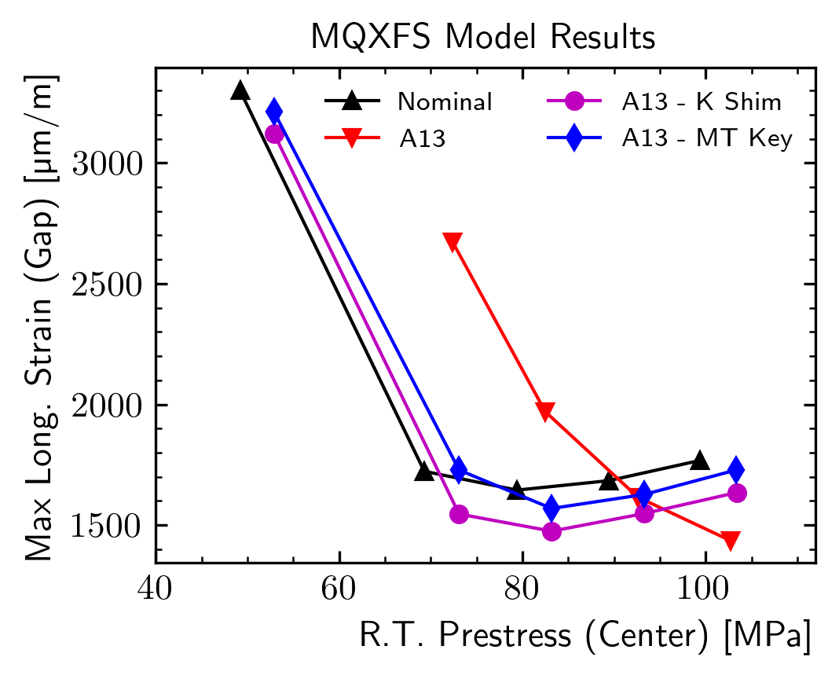
Load Key Configuration - Proposal
Additional Key | Staggering Distance | Shell Center | Shell End | Pole Center | Pole Transition | Strain Max | Strain Transition
um | Inches | MPa | MPa | MPa | MPa | um/m | um/m
0 | / | 100.7 | 103.7 | 101 | 40.6 | 5164 | 2742
100 | 1 | 100 | 119 | 101.9 | 64.4 | 4378 | 3380
100 | 1.5 | 99.7 | 119.7 | 102 | 61.4 | 3300 | 4044
100 | 2 | 99.9 | 120 | 102 | 60.9 | 3820 | 2981
100 | 3 | 99.9 | 120.4 | 101.8 | 59 | 3553 | 2141
100 | 4 | 100.1 | 120.6 | 101.3 | 57.4 | 3577 | 1874
Parametric study changing the length of the shim and its distance from the wedge transition
For a ‘MQXFA13’ coil pack, we need to extend the key for at least 3 inches after the transition (total length 6 inches)
For lower values, the peak strain decreases, but the one at the transition increases!
The effect should be visible on shell and/or pole gauges: ~20 MPa stress increase on both

Slide 8
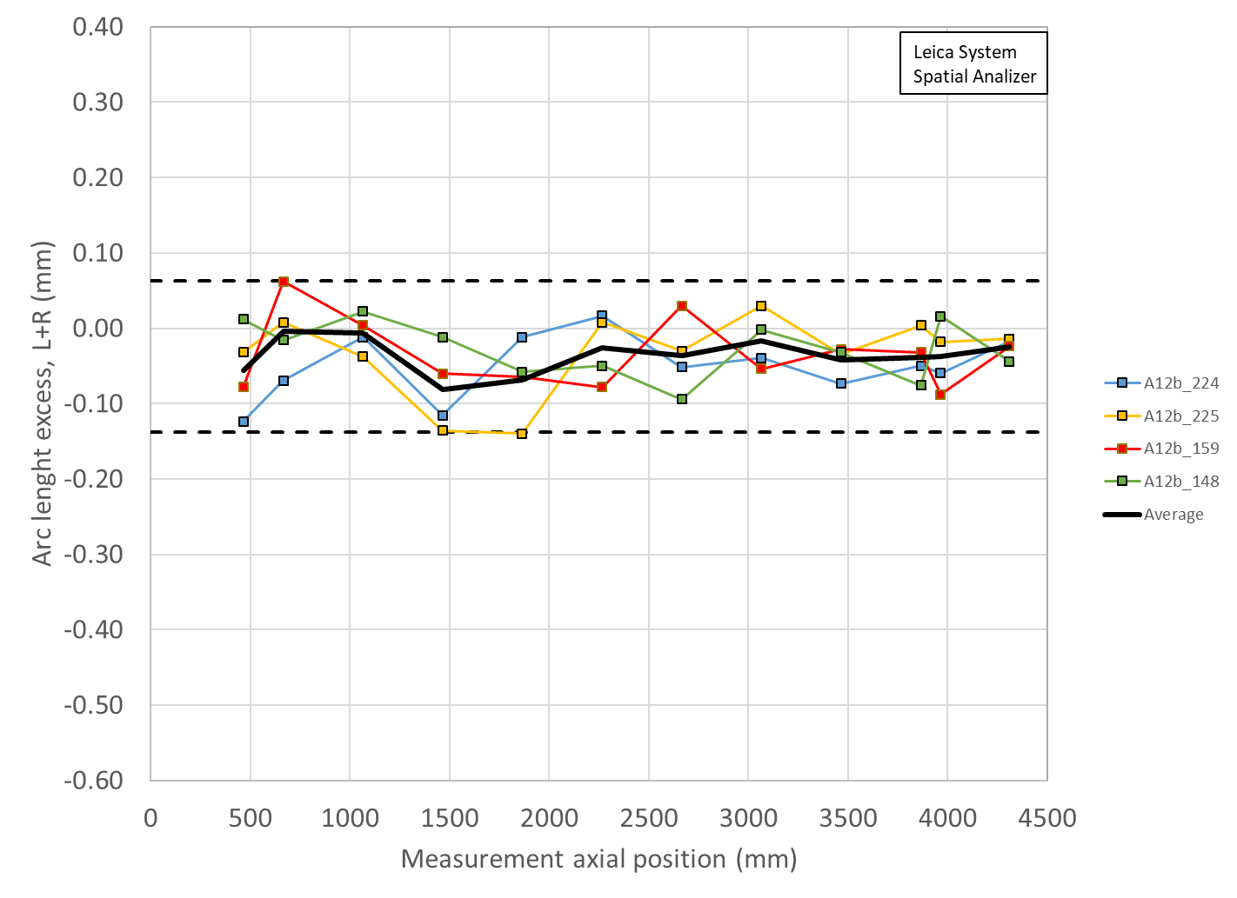
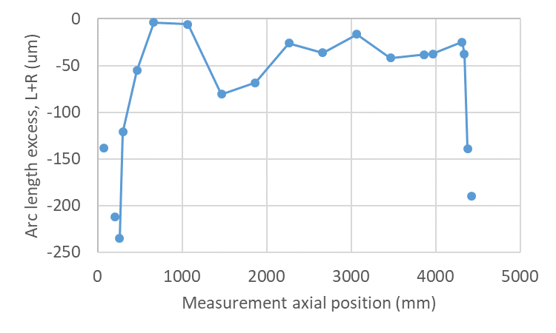
MQXFA12b – Assembly Test
Simulated
Non-simulated
We wanted to test the shimming strategy during MQXFA12b assembly
However, we first checked that the test will not put in danger the coil/structure
Simulation steps
Complete the first half of the loading
Insert the ‘custom’ key
Remove the custom key
Complete loading

Slide 9
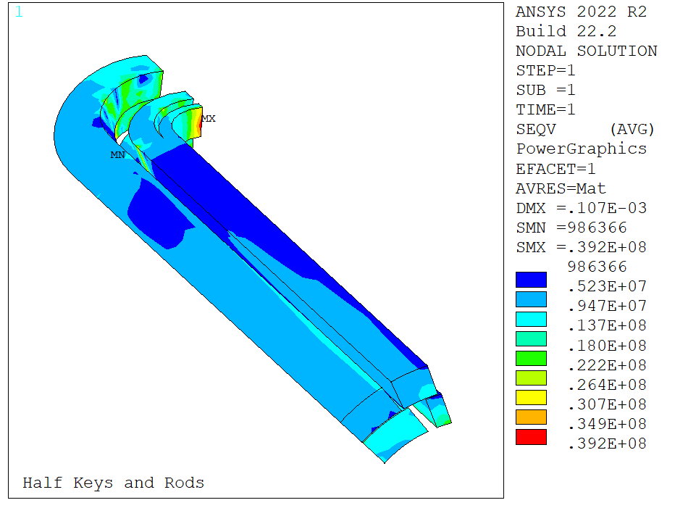
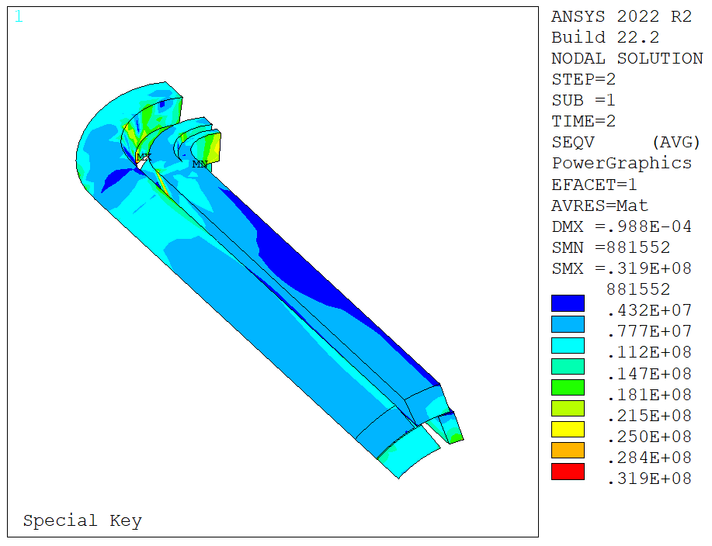
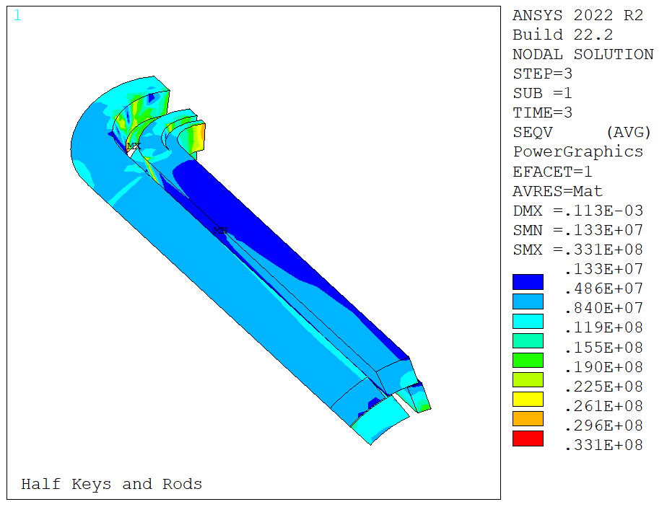
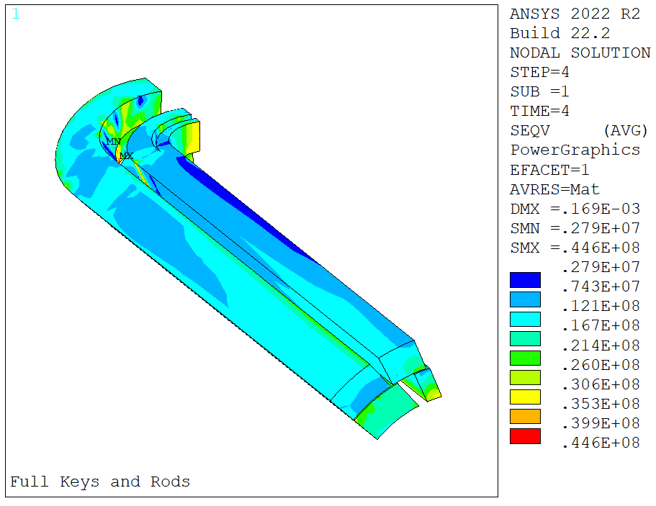
MQXFA12b Testing – Coil Stress
Model target interference 300 um
Peak stress during ‘special key’ step is not larger than after full loading
Slight stress redistribution in the ends after special key unloading
Peak stress not higher
Frictional effects, difficult to predict and probably dependent on bladder operation sequence (e.g. if a bladder operation is interrupted we would also see a small stress redistribution)
MQXFB experience suggests that these effects disappear during cooldown

Slide 10
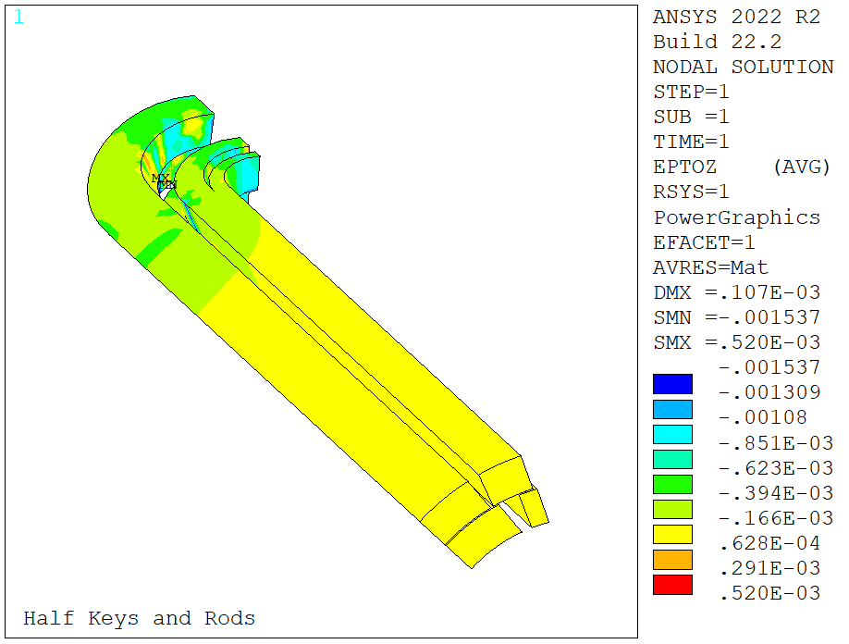
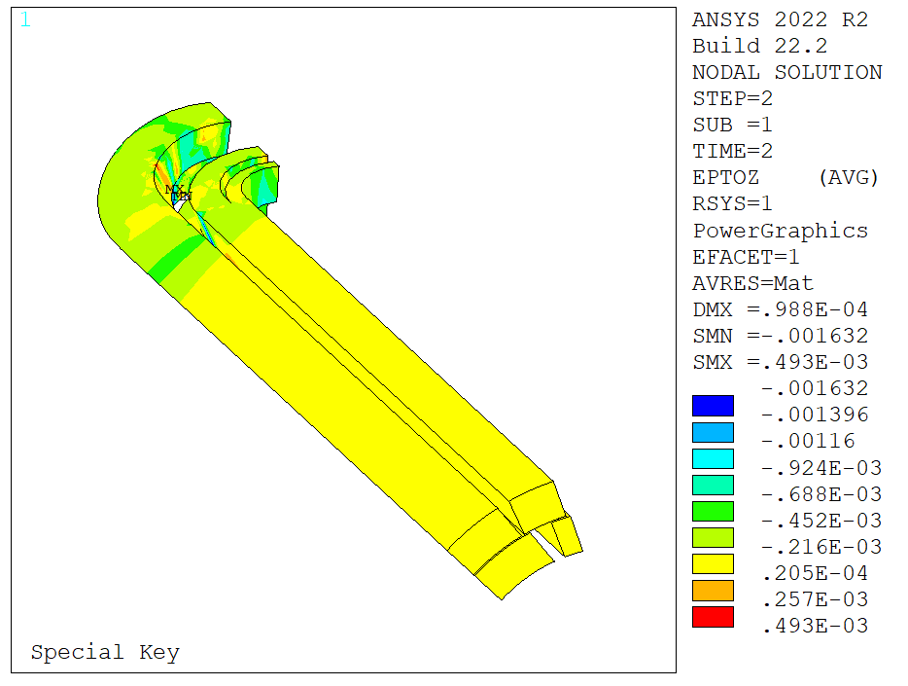
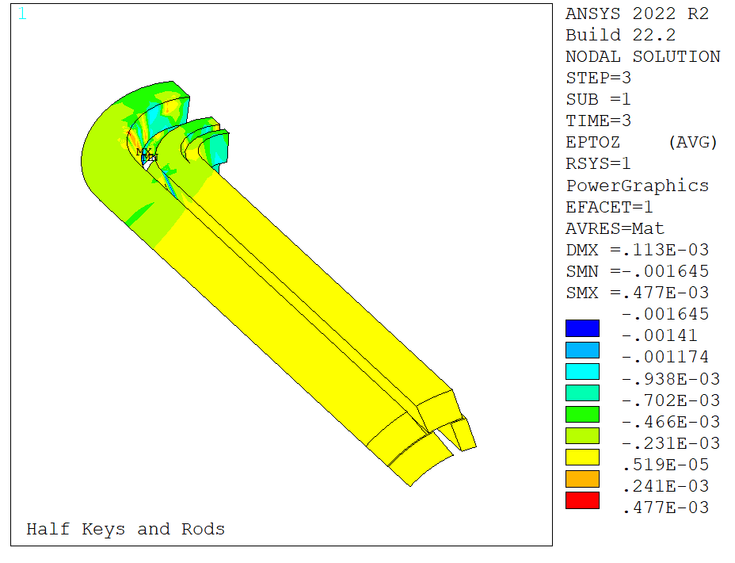
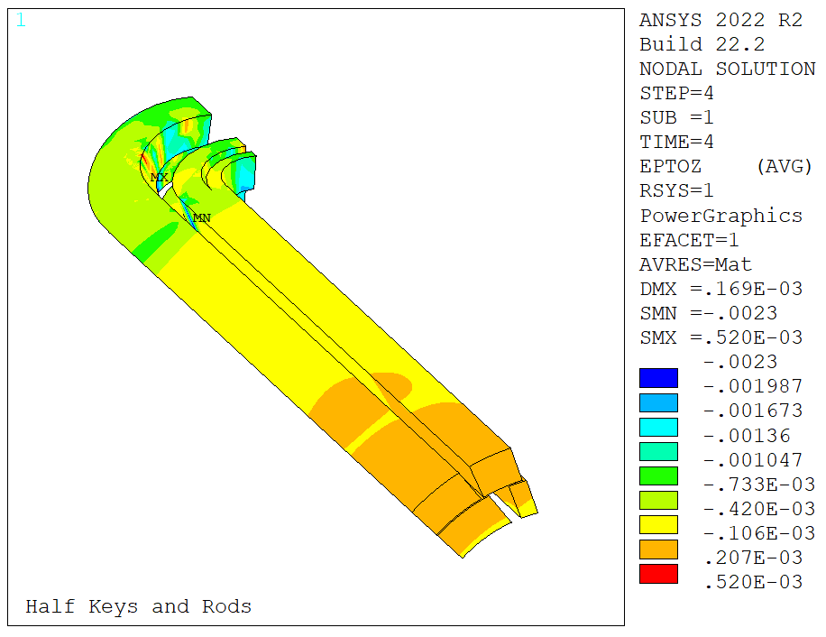
MQXFA12b Testing – Coil Strain
Longitudinal strain in the coil:
Same considerations as for the peak stress
Structure checks in the back up slides

Slide 11
Assembly Test – Chronology
Standard loading operations up to a 30 mils shim stack (12.75 mm + 0.762 mm)
Operations stopped for one week – MPD collab. Meeting
Tapered key test:
Inserted the tapered keys on the lead end side
Deflated bladders and recorded strain gauge readings
Returned to constant thickness keys
Complete loading (41 mils) (same day)
Additional measurement stations installed on the LE shell (center) and on the pole, at the transition longitudinal location

Slide 12
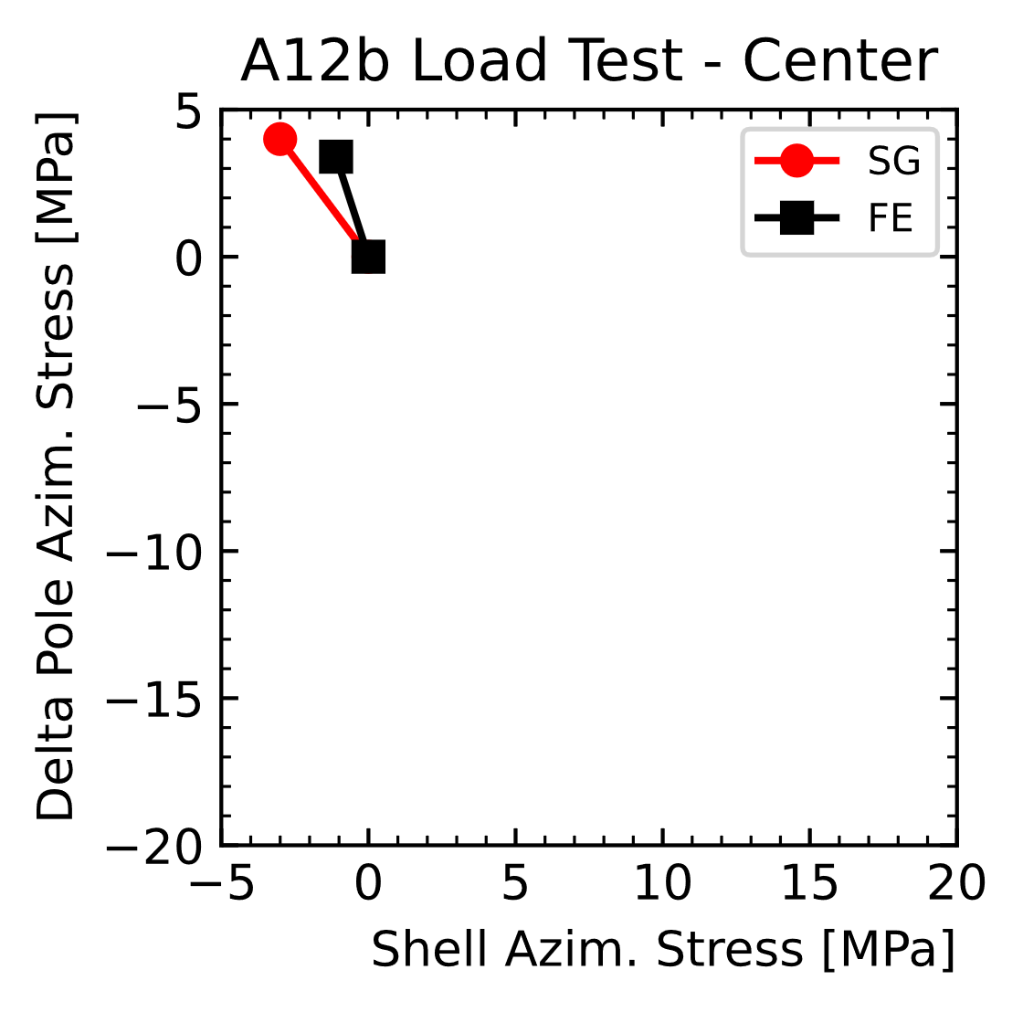
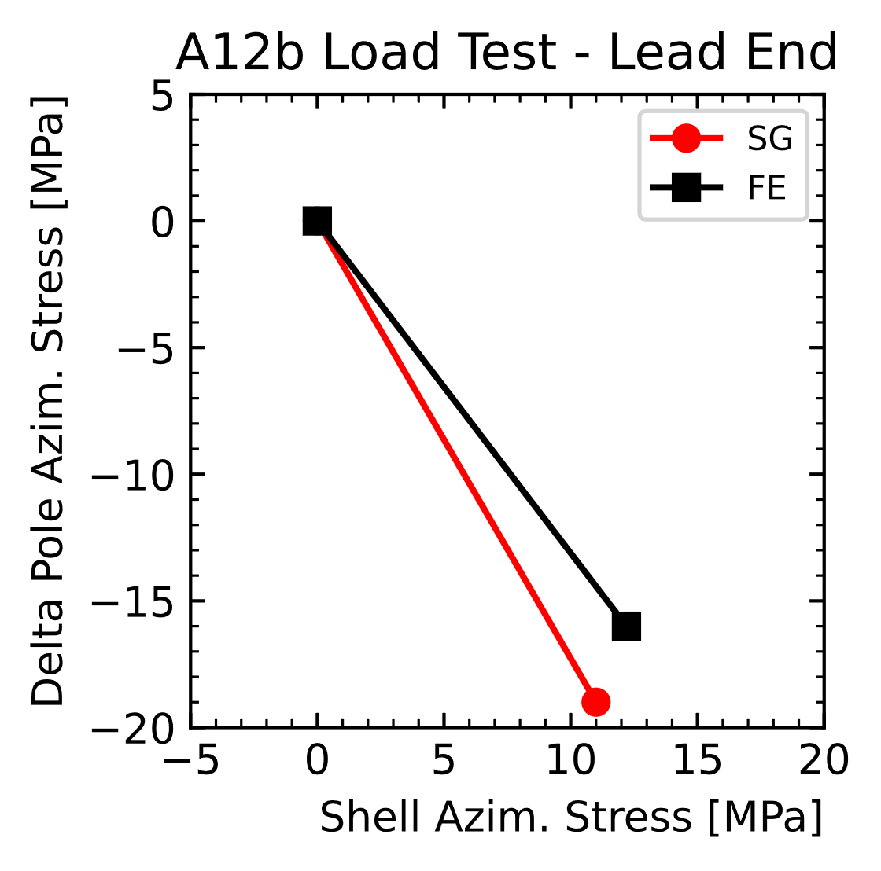
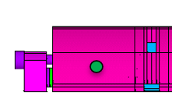
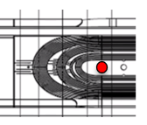
Assembly Test - Results
Looking only at the delta during tapered key test:
Slight unloading in the center
Load variation at the lead end gauge close to predictions (expected/measured):
12/11 MPa on the shell
-16/-19 MPa on the pole

Slide 13
Conclusion
Local size variations can cause filament failure in the coil ends
This means that we need a solution to use the coils with ‘small’ ends
Local prestress modifiers were investigated
Increasing the key thickness in the ends decreases the strain
A ‘practical’ tapered load key shim configuration has been proposed
Simulation results suggest that, with adequate staggering distances, the configuration can reduce the peak strain in the transition region
Introducing the key during MQXFA12b loading operations is not of any danger to the coil (lower strain and stresses than after loading is complete)
We have tested the shimming strategy during MQXFA12b assembly:
Measured prestress increase due to the tapered key close to prediction

Slide 14
Extra

Slide 15
Structure Verification
Structural checks performed comparing stress levels with A13 model results
Quicker, avoids submodeling
We can still check more in detail the magnets when we know coil dimensions and target key shape and size

Slide 16
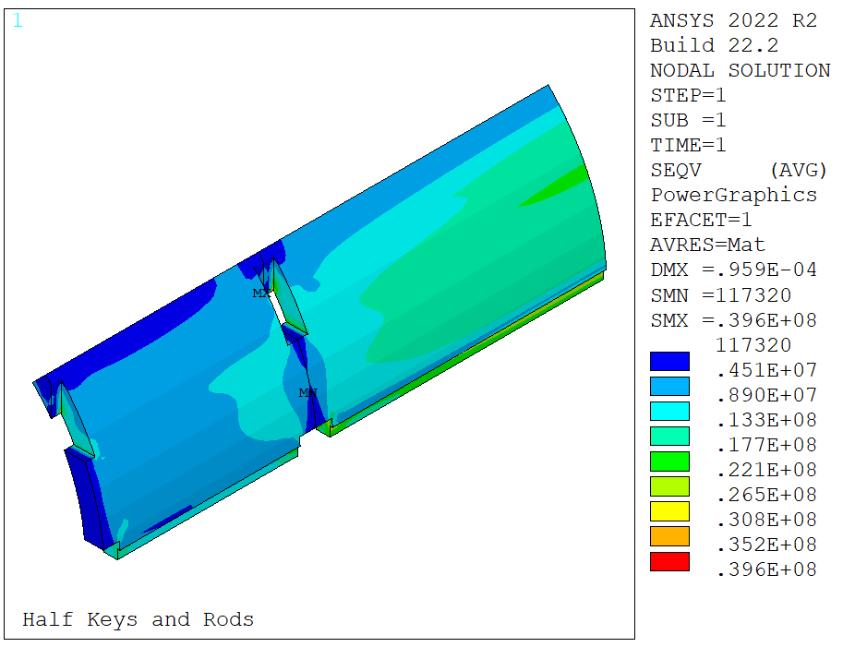
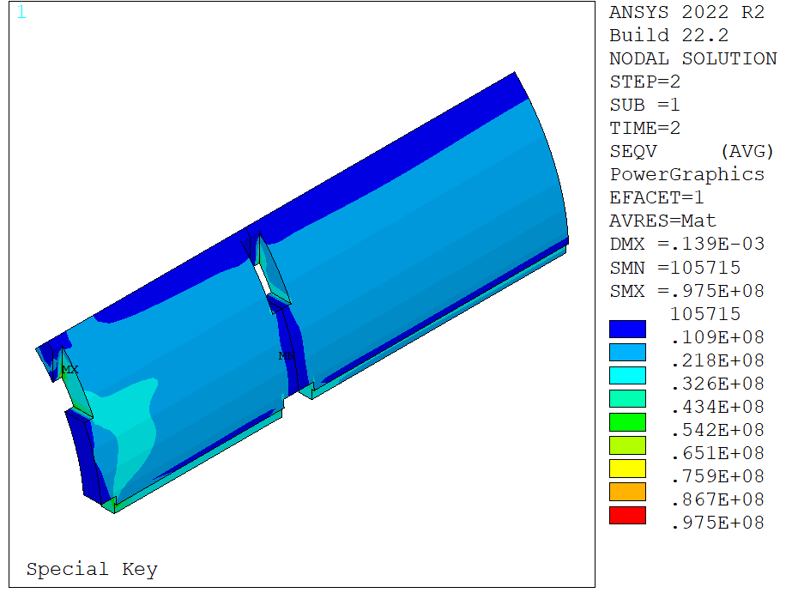
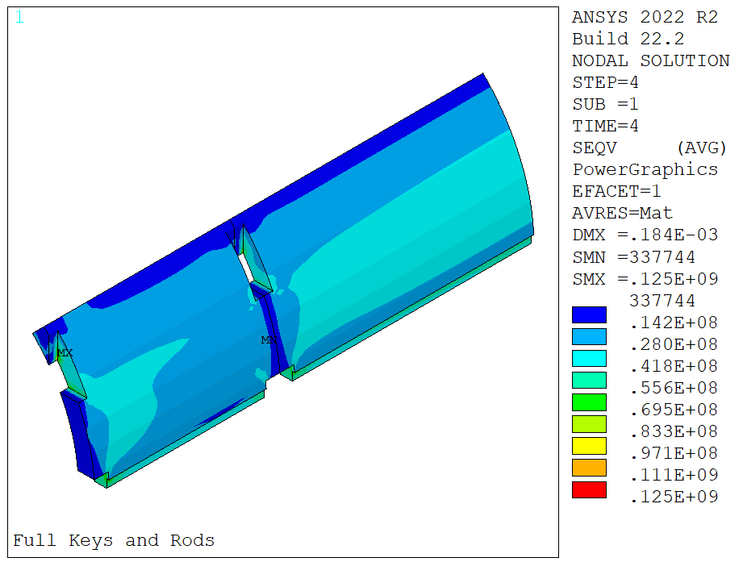
Structure Verification (1)
Special key solution has lower structure stress (~20%) w.r.t. full loading

Slide 17
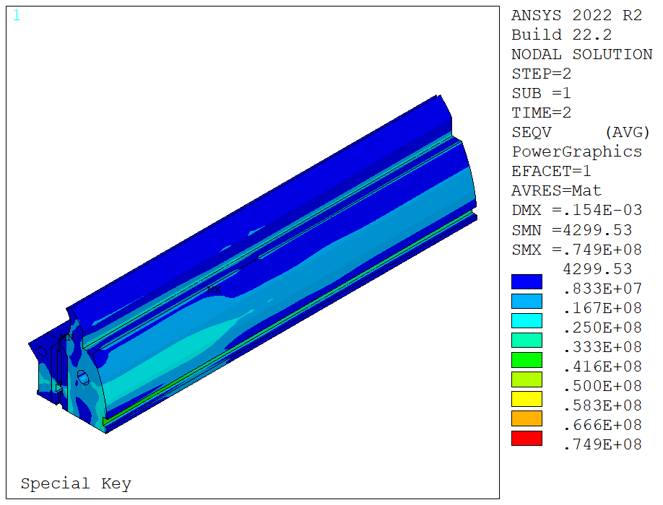
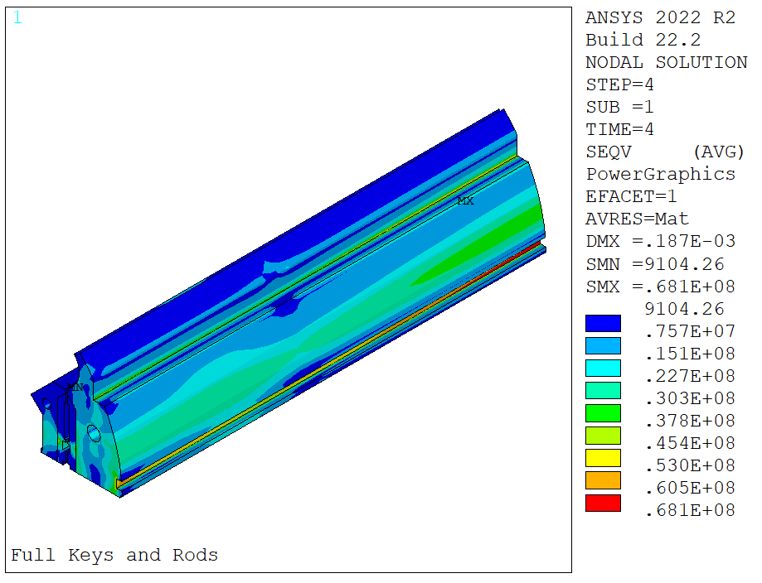
Structure Verification (2)
Yoke/pad stress slightly higher but still with very large margin over yield

Slide 18
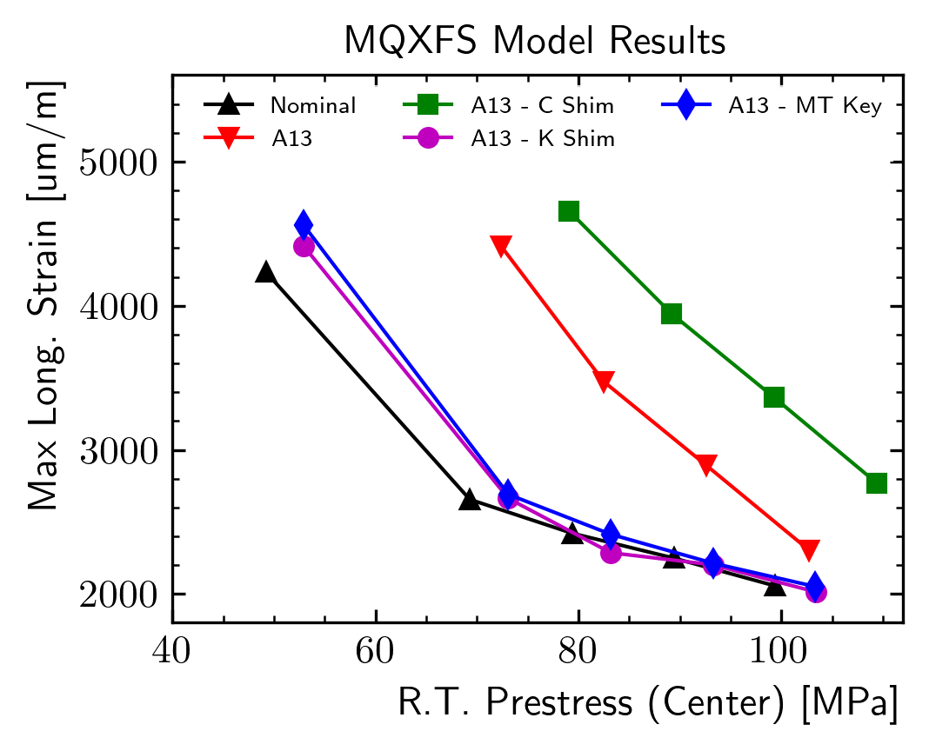
Prestress Modifiers – MT28 Key
Tapered key solution as efficient as the longer key shimming with no tapering

Slide 19
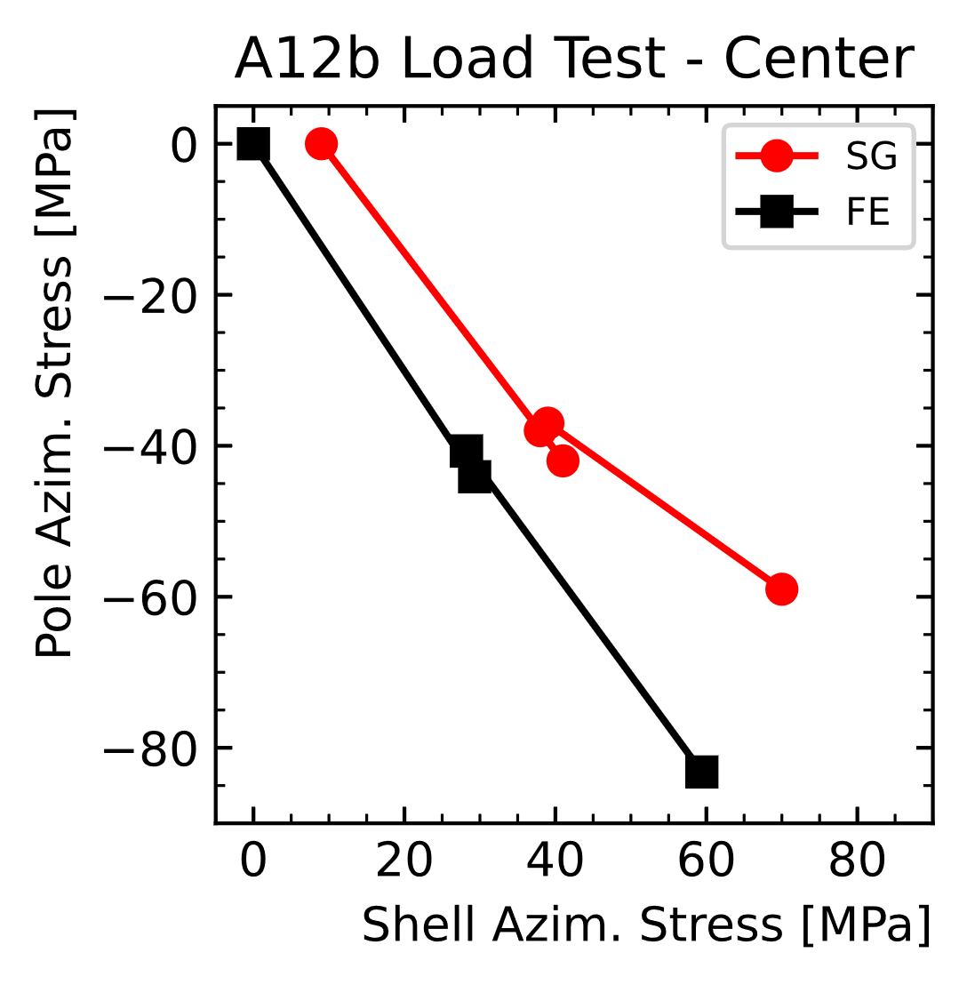
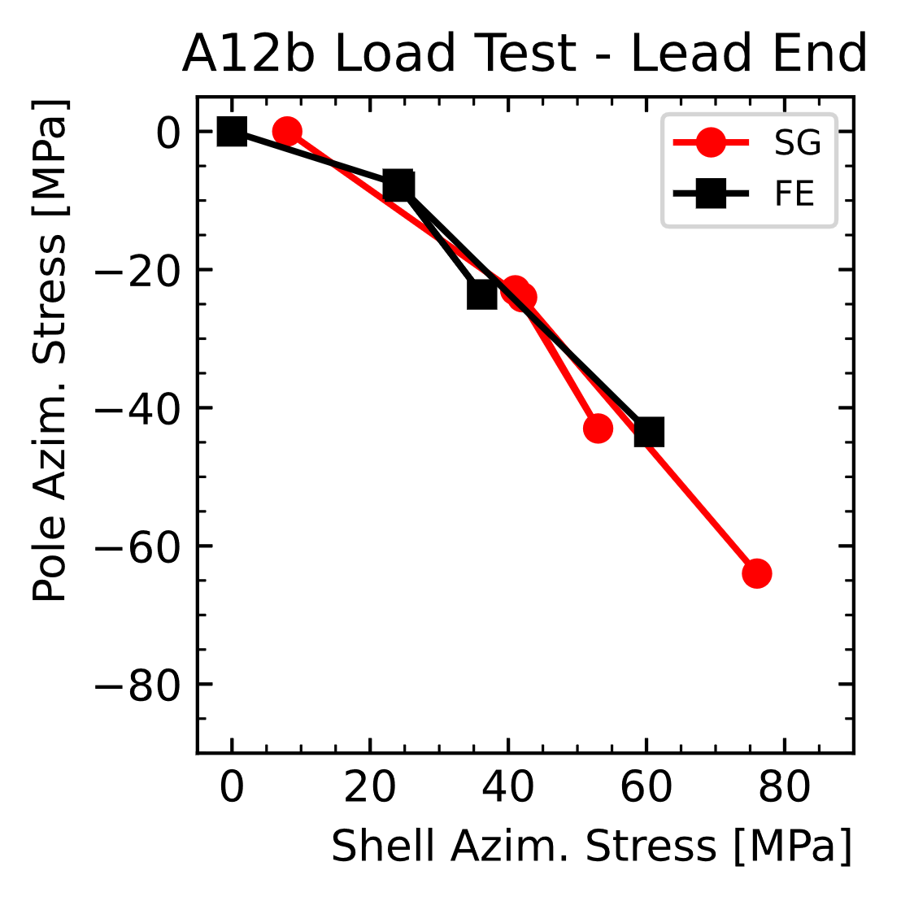
Assembly Test – Results - Center
Transfer function agreement ok overall
Small variation of center TF after tapered key test
Frictional effect? Stress relaxation?
Offset with respect to key size in the ends
Initial impact of radial size error seems lower than expected in this region
Slope similar

