Slide 1
9 O’Clock Meeting
Nathan Ruffatti
MCR Crew Chief
Friday, May 31st, 2024

Slide 2
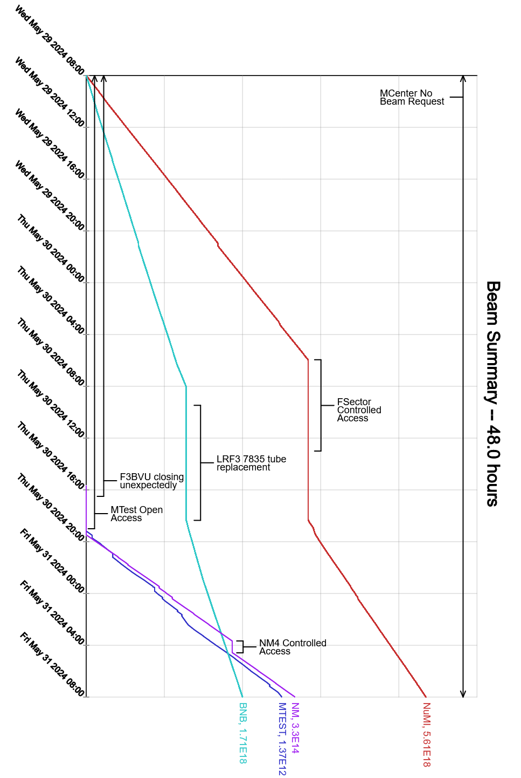
Since Wednesday…
Wednesday:
No beam to SY due to F3BV3U closing randomly
F17B3 RSO lock removed, and ESS1/2 locked with RSO lock
BRF9 tripping on BS AC OI, switched to BRF20
Thursday:
MIRF8 tripping on screen PS DC OI, station bypassed. Down 2 MIRF stations.
Access day / down day
LRF3 PA tube replacement
MI10 and MI20 LCW pump work
MI20 pump tripped off in the evening
MI10 still down 1 pump
F3BV3U pinned open, and BLMs are now input into the beam permit
MI65 access
MI12 access to recover BNB raw skid after MI LCW was turned back on
Muon S&S and LOTO unlocked
Beam re-established in the evening to NuMI, BNB and SY

