Slide 1
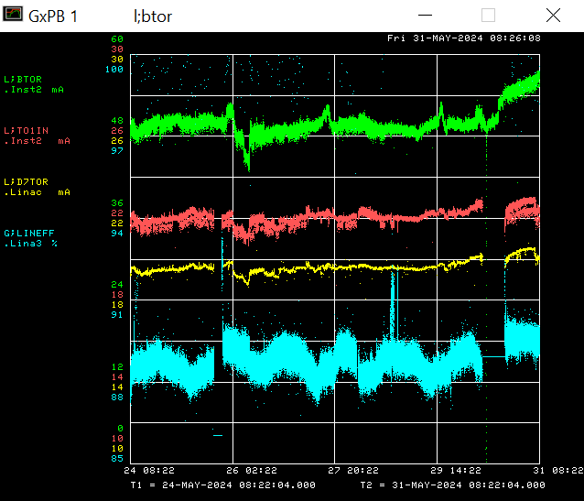
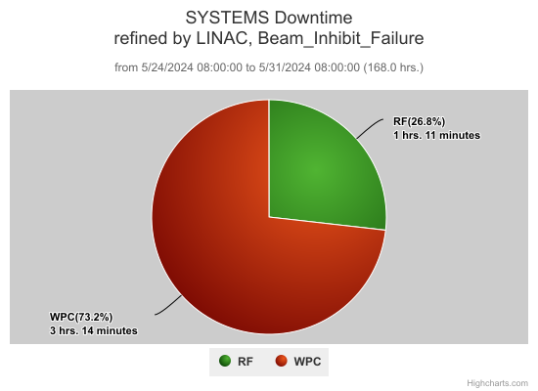
Linac/Preacc Operation May 27th – May 31st 2024
Thursday – Replaced the 7835 at LRF 3

