Slide 1
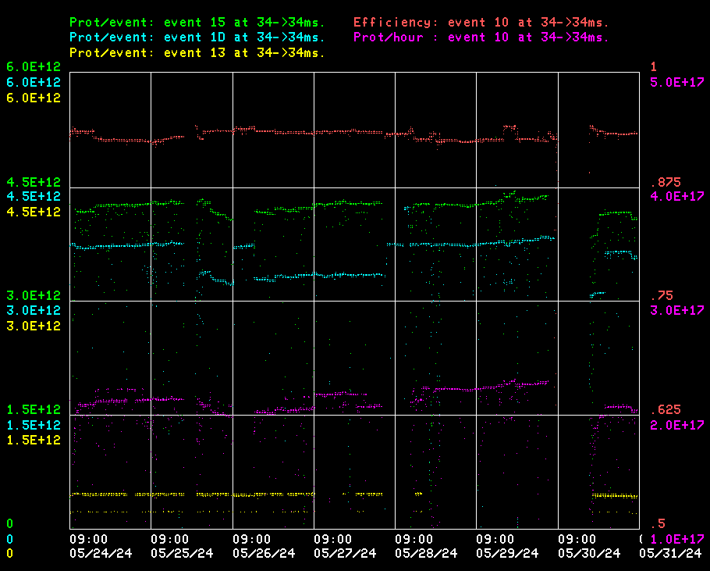
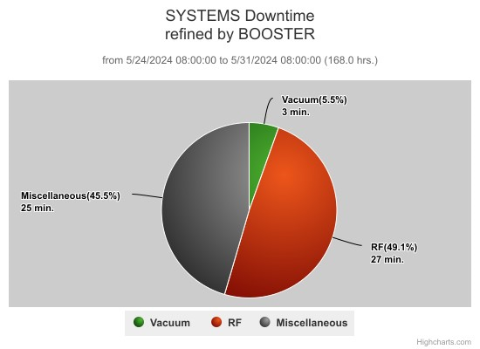
Booster Operations
Current conditions:
93% efficiency, 2.1e17 p/hr
$15: 4.0e12 p/p
$1D: 3.6e12 p/p

Slide 2
Summary
Minor RF trips
Minor vacuum trips
Periods of high extraction loss, under investigation
  Kicker misbehaving?
  Upstream energy regulation?
  Tuned up on edge?
  Combination?
Thursday: Completed 2 hours of convective instability study (parasitic)

Slide 3
Booster Studies-2024
Proposed
Title | PIs | Time , Dedicated(D), Parasitic(P)/ Opportunistic(O) | Goal (and Purpose) | Priority | Comments
Flat Injection | Kiyomi +Ralitsa | 4hr+3hr+3hr (D) | Create 300μs flat region at injection and accelerate beam to operational efficiency. (PIP-II) | 1 | Completed
Beam Intensity 6.6E12ppp | Chandra +Salah | 2hr(D), Multiple 2hr (P) /(O) | Demonstrate PIP-II beam intensity at 15 Hz and find out issues. (PIP-II) | 2 | Parasitic studies in progress
Q-Jump/gT-Jump | Jeff | 4hr+4hr (D)/(P)/(O) | Demonstrate feasibility of new gT-jump. (If it works, much less expensive than adding quads for standard gT-jump) (PIP-II) | 3 | Ongoing
Convective Instability | Michael | 2h (P)+2hr (D) (continuous) | Investigate convective instability in Booster at high beam intensities. (PIP-II) | 4 | Parasitic studies in progress

