Slide 1
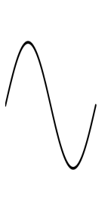
Stage 1_v1, 3.64 mA peak current
1 mA
f₀/2
1 GeV
0.91 mA
0.09 mA
1 μsec

Slide 2
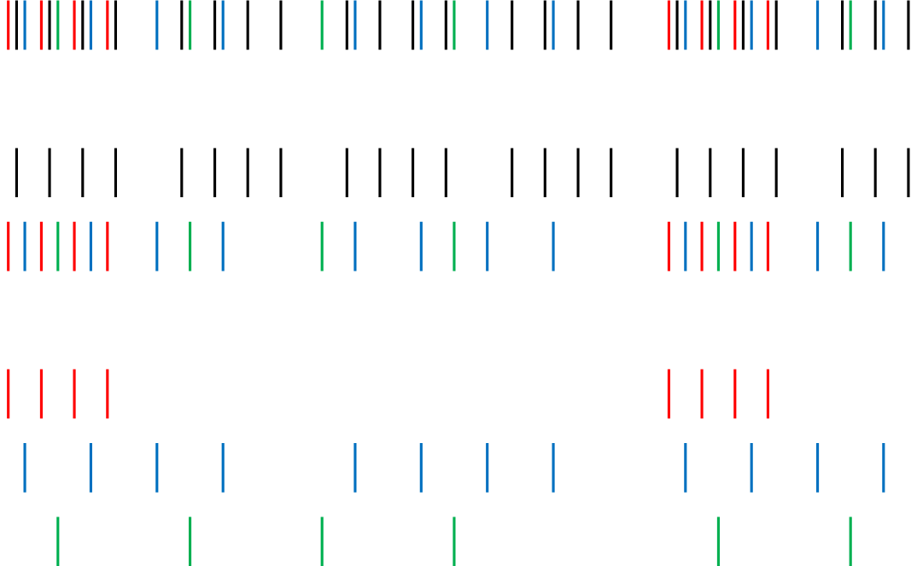
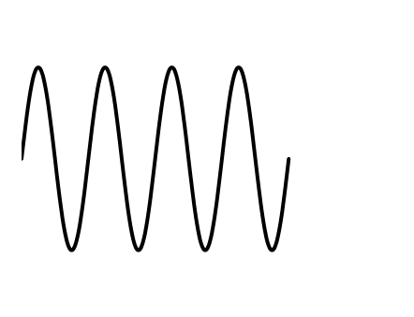
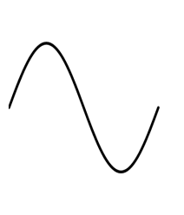
Stage 2_v3, 5 mA peak current
2 mA
f₀/2
1 GeV
1 mA
1 mA
f₀/8
3 GeV
0.25 mA
0.5 mA
0.25 mA
0.5μsec

