Slide 1
HD PDS Performance in NP04
David Warner for the PDS Consortium
HD Technical Board Meeting
June 12, 2024

Slide 2
Status summary:
We are able to operate the PDS in all APAs, with proper bias for all modules.
6 (out of 160) channels disconnected prior to filling .
All other channels operational (some still being tuned).
We have tools for quickly analysing the data, resolve bugs and optimise DAPHNE parameters.
PDS configuration and operation is fully integrated within the DAQ.
LED calibration system has been commissioned.

Slide 6
NP-04/Module 0 Lessons Learned - i
Resulted to short to ground requiring disconnecting readout channels.

Slide 7
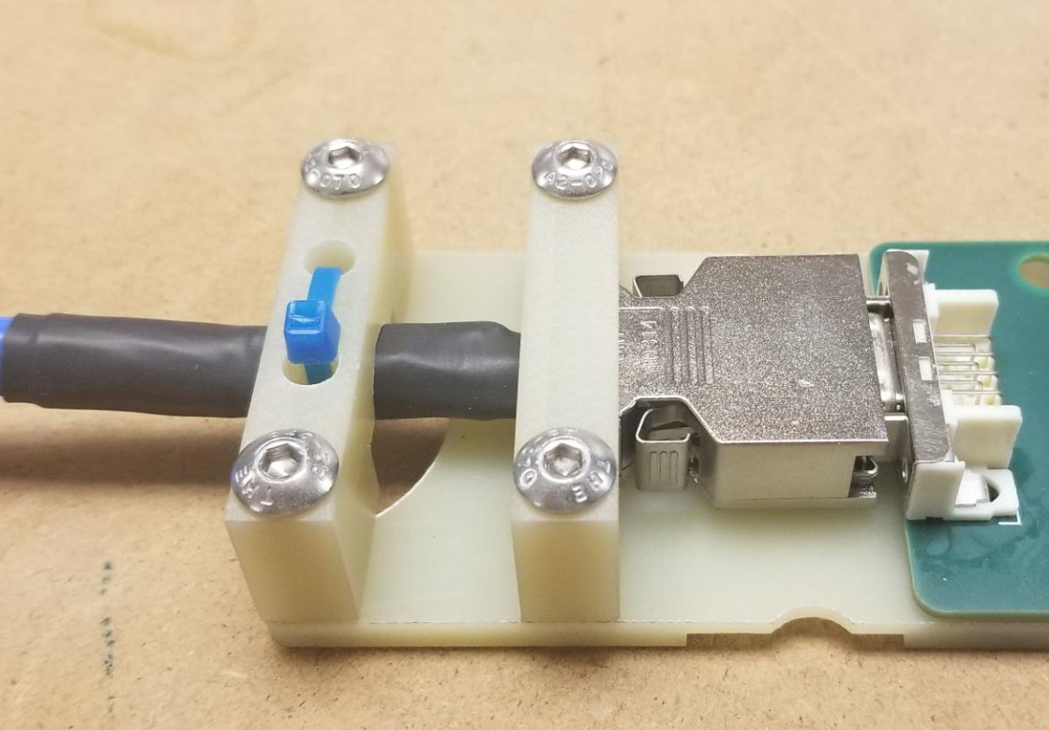
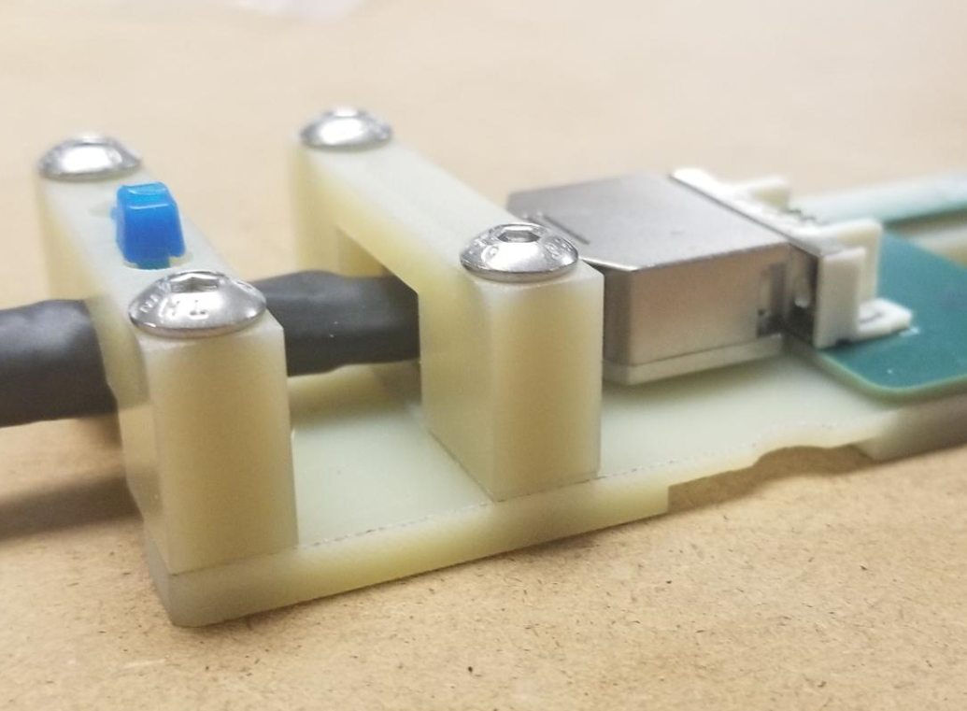
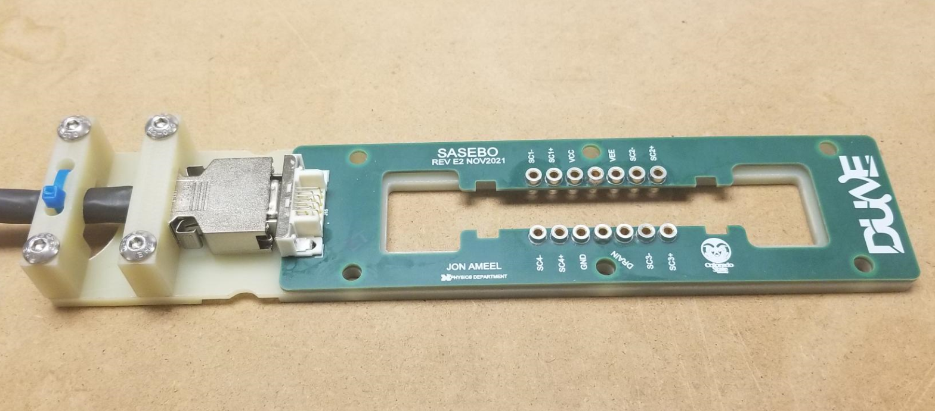
NP-04/Module 0 Lessons Learned - ii
Modified cable connection structure approved in PRR October 2022.

Slide 8
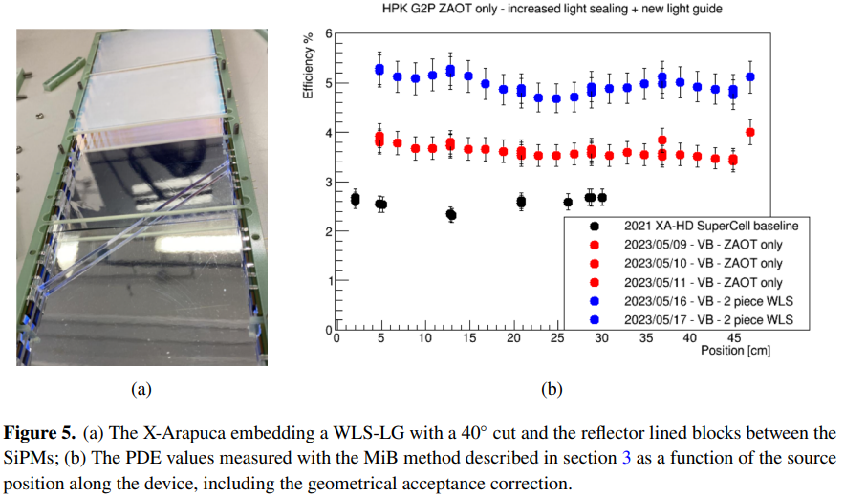
Other PDS Lessons Learned
Module testing at MiB developed simple mechanical enhancements improving detection efficiency.
Diagonal slice across WLS plate re-directs photons to SiPMs along module side.
Raised reflective surfaces between SiPMs avoid losses at edges of module.
Nearly doubles photon collection efficiency to ~5% in testing.
Testing will be duplicated and confirmed at CIEMAT in summer 2024.
Full-scale prototype will be tested in CERN cold box in fall 2024.
https://iopscience.iop.org/article/10.1088/1748-0221/19/06/C06007/pdf

Slide 9
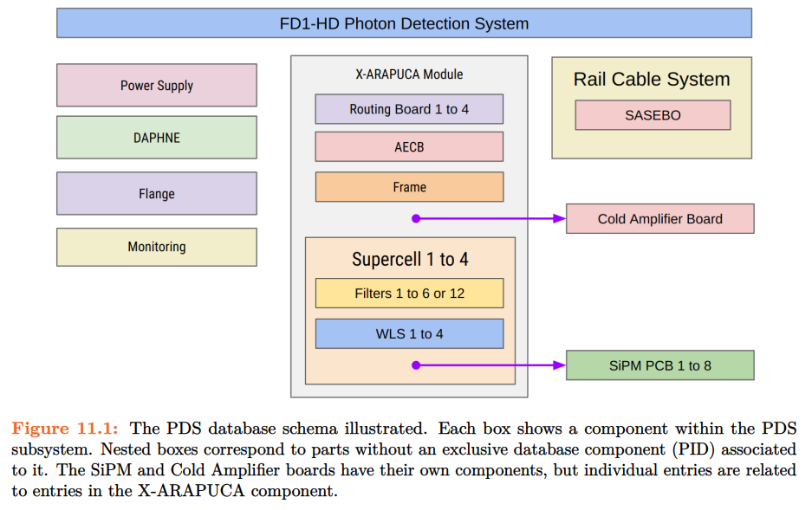
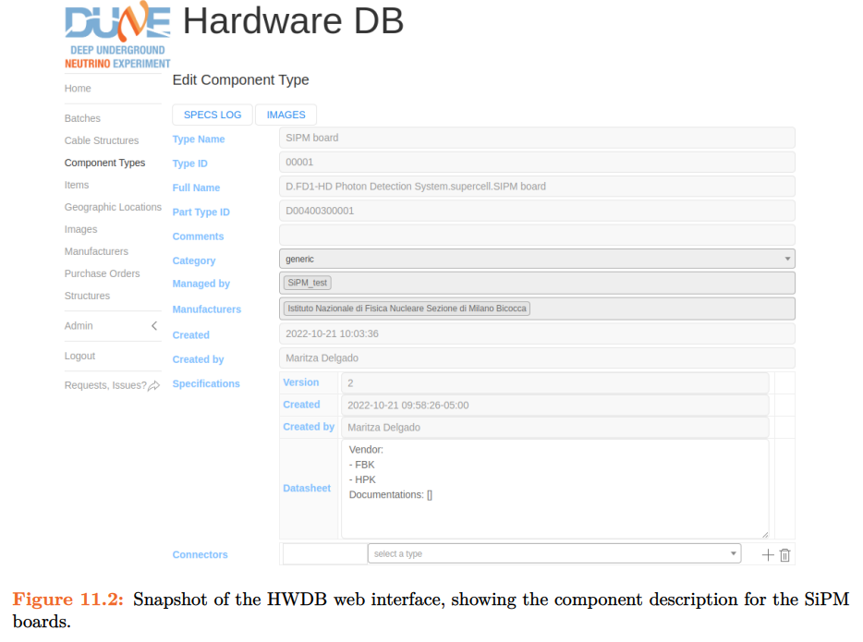
HD PDS HWDB
The primary point of contact for the HD PDS HWDB interface is Gustavo Valdiviesso (gustavo.valdiviesso@unifal-mg.edu.br )
A secondary point of contact is Mike Eads (meads@niu.edu)
We have been beginning to incorporate our extensive database of SiPM data into the HWDB. We have encountered issues, but are working with the HWDB team to resolve them.

