Slide 1
Cryostat Update
R. Rabehl
June 3, 2024

Slide 2
Cryostating – CA-02
CA-02 cryostat activities from the last two weeks.
Two 20 bar pressurized leak checks completed (Cold Mass to heat exchangers, Cold Mass to beam pipe). Formal report remains to be written.
Wiring issue with IFS-A found - orientation. Cut open, new IFS head wired and welded.
Wiring issue with FIS-A found – RTD wires swapped.
Assembly of lead (Non-IP) and return (IP) ends
Beam pipe leak check completed after installation of extensions needed for horizontal test stand
Return end helium piping installed
Helium Conflat connections bagged and sniffed
MLI blankets installed over helium piping
Thermal shields installed
Thermal shield VCR connections leak checked (pumped out and He sprayed externally)
MLI blankets installed over thermal shields
Lead End and Return End vacuum cans installed
Test fit of warm finger in progress
To do
Pump out of insulating vacuum space
Atmosphere to insulating vacuum leak check
Pressurized leak checks (7.5e-10 Torr-liter/s)
Heat exchangers (4 bar) to insulating vacuum
Cold Mass (20 bar) to insulating vacuum
25 bar pressure test
Leak check of CLIQ/KMOD/IFS warm cover welds

Slide 3
Cryostating – CA-02
CA-02 DRs
13503: Unidentified surfaced blemishes on LD pipe. Awaiting disposition.
13526: Contact between IFS capillaries and thermal shield extrusions. Awaiting disposition verification.
13527: FSI target installation screws not torqued to specified value to due lack of an appropriately-rated torque wrench. Awaiting disposition verification.
13545: Unable to install three studs attached the fixed point support post to the Cold Mass saddle. Awaiting disposition verification.
13552: Thermal shield is ~5 mm too far towards the Non-IP end such that the thermal shield support pieces cannot be installed at the fixed support post. Awaiting disposition.
13575: IFS-A wired in the wrong orientation. Awaiting disposition.
13583: IFS-A RTD miswiring. Awaiting disposition.
13584: Misalignment between new IFS-A cover and interface ring after welding. Awaiting disposition.
CA-02 NCRs
Cold Mass saddle threads/support post installation.
Thermal shield misalignment.
Central support post bearing bolts.

Slide 4
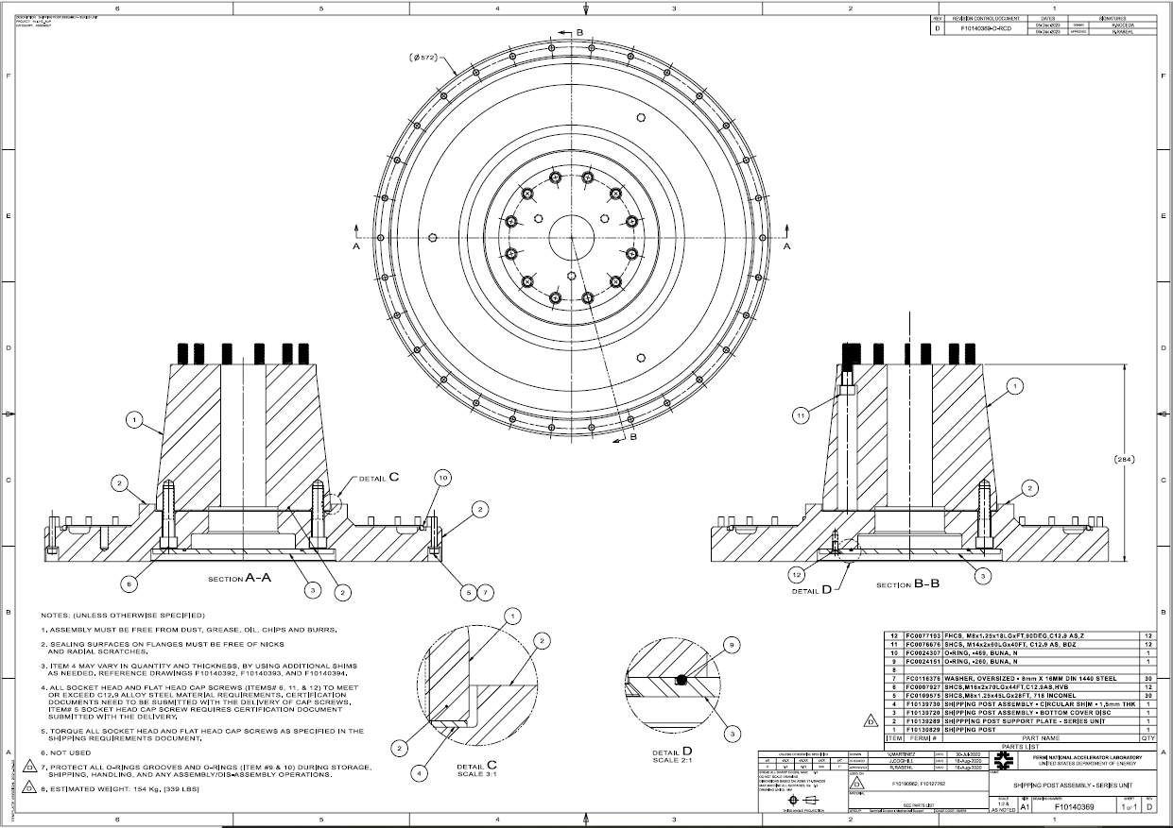
Cryostat – Shipping Posts
Teamcenter Engineering Order Form ED0033225 submitted
Remaining 2 sets of shipping posts/support plates/cover discs. (Req. 354738 / P.O. 712185)
May 10, 2024 promised date
All items received, in QC
All bolting hardware for the remainder of the project. (Req. 357424)
Placed on SAM.gov due to vendor error in indicating foreign-sourced material.
A set of bolting hardware for CA-02 has been ordered. 3-4 week lead time.

