Slide 1
Vacuum Equipment Update
R. Rabehl
June 3, 2024

Slide 2
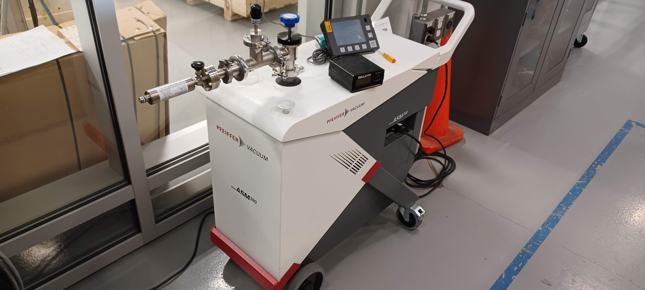
Cryostat – Leak detectors
Submitted a purchase req. for a new unit (Req. 354301, $50k, 14 weeks ARO) – P.O. 711412
New leak detector unpacked and powered up.
Chart recorder software downloaded to my laptop with Bluetooth connectivity to the leak detector.
Received a quote for evaluation of the ICBA unit ($1.6k for evaluation, up to $10k for refurbishment – Req. 354494/P.O. 710456).
Requesting Friday, May 17 crating by Basic Crating did not happen. Going through the procurement process.

Slide 3
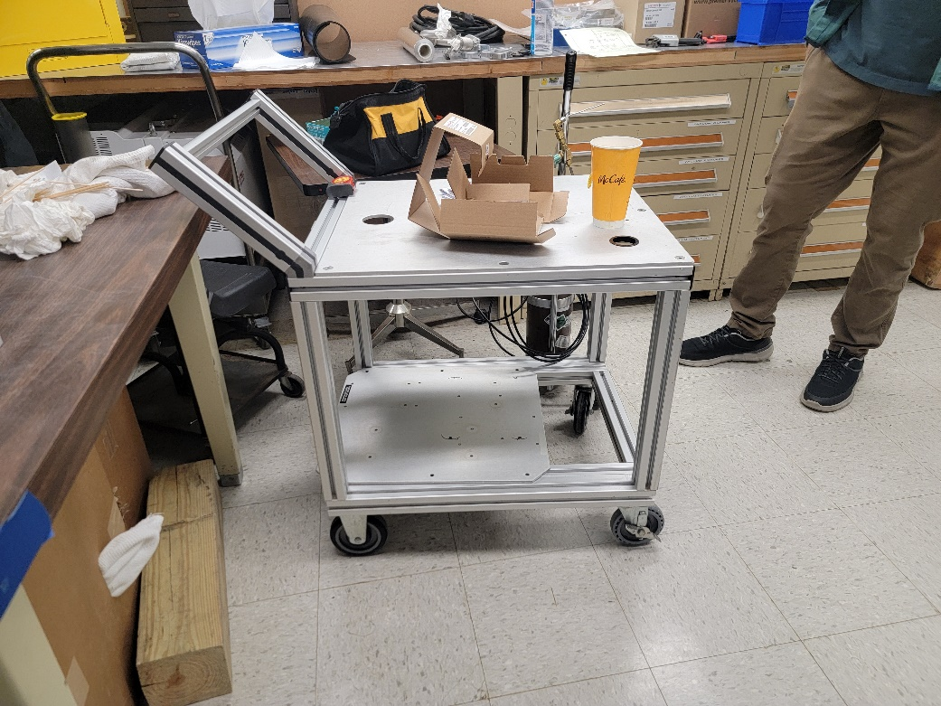
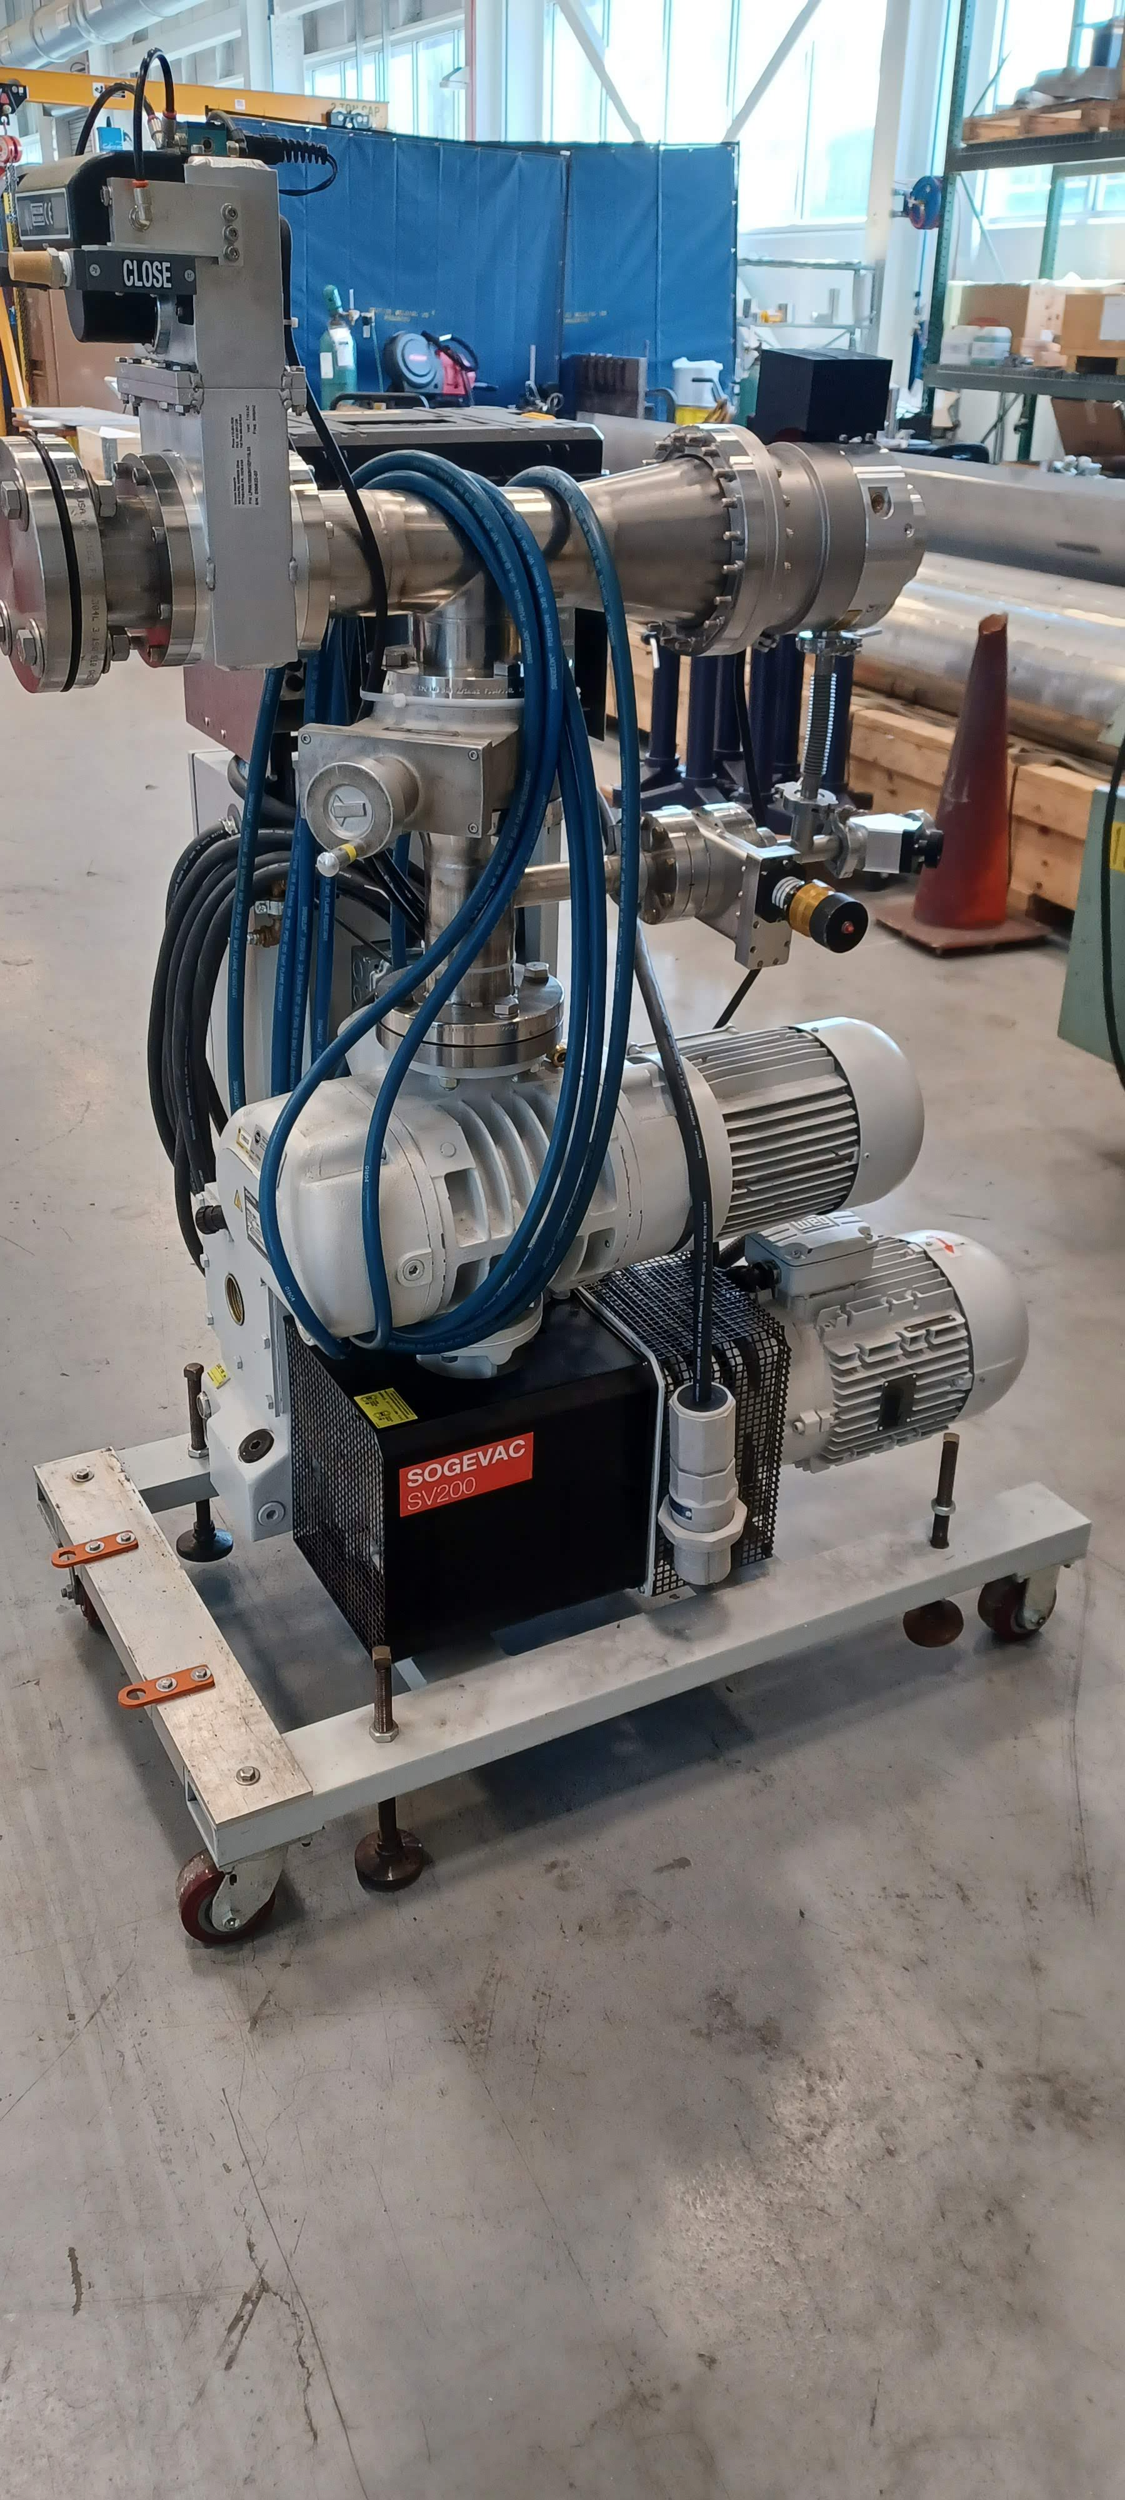
Cryostat – Combination pressure/leak test equipment
Turbo cart assembly
IB4 personnel (Elpidio, Oscar) located a more suitable cart at Site 38.
Procard orders for casters and other components (i.e., fittings, seals, clamps) have been placed.
All other equipment (i.e., pumps, controllers, instrumentation, readouts) is in the hands of IB4 personnel.
In the meantime, IB1 turbo/blower cart will be used.
Turbo used for the first two pressurized leak checks: Cold Mass to HX, Cold Mass to Beam Pipe.
Cart includes provision for connecting the leak detector at the turbo outlet.
Blower needed for the rough pump out of the insulating vacuum for the third leak check: Cold Mass to insulating vacuum.
Cart was found to introduce a high helium background into the system, so it needs to be isolated before any leak checking is performed.

Slide 4
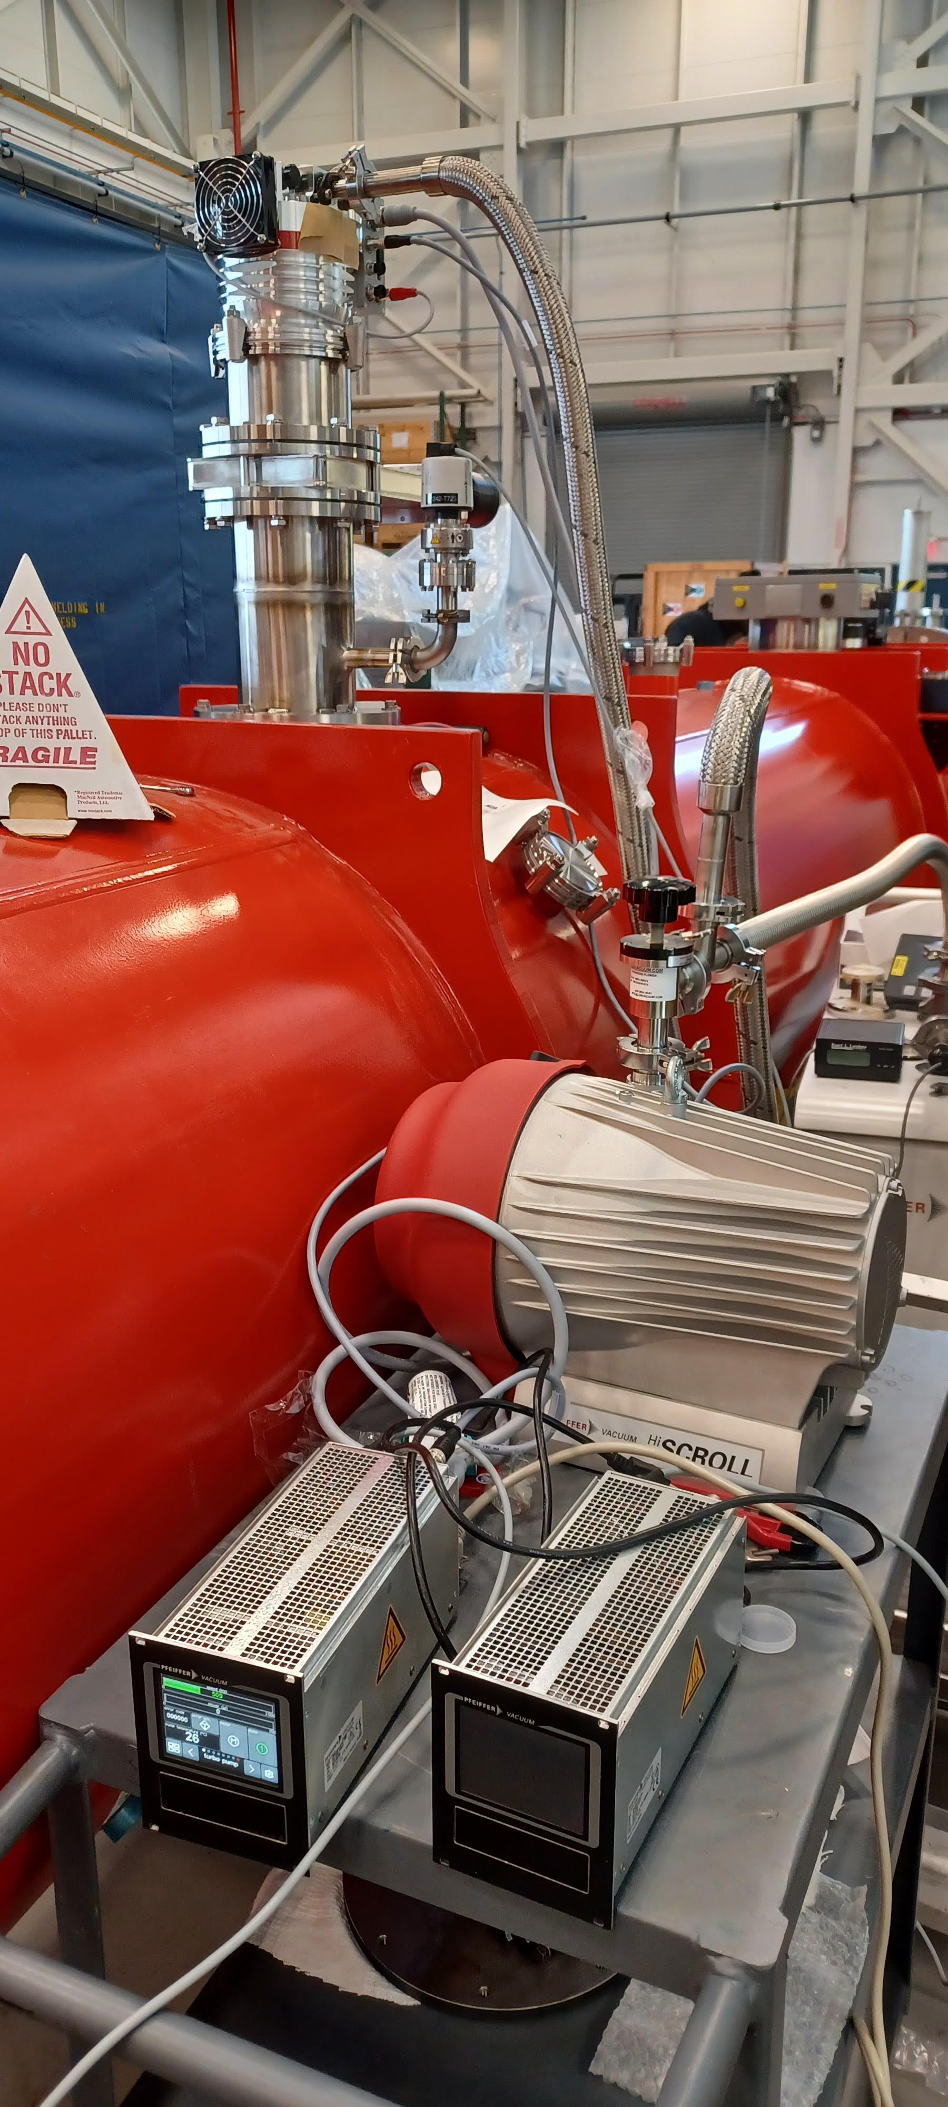
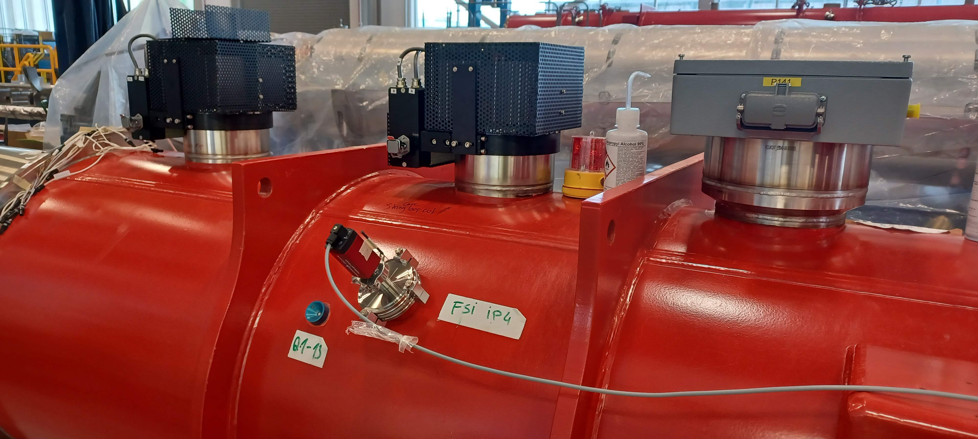
Cryostat – Combination pressure/leak test equipment
Remaining equipment (P.O. 700401)
Second vacuum gauge controller expected to ship in late June.
Two blower skids expected to ship in early July.
Vacuum equipment installed at cryostat vacuum relief port, successfully operated

