Slide 1
302.4.04 – Cryo-assemblies Horizontal Test Weekly status report
Guram Chlachidze
Jun 3rd, 2024

Slide 2
CA02 test preparations
Cryo-improvements at TS4 in progress, check work status here:
TS4 action item list - 11_30_2023.xlsx (sharepoint.com)
Stand 4 ORC/Operation status
New DSO was informed about expected CA-02 transportation early June
Stand 4 cryogenic ORC renewal
Cooldown approval received from Jacob Kintner
Need approval from the ALD (Sam Posen)
Addendum to the electrical ORC has been initiated for the helium line heater operation
Stand 4 documentation
LQXFA/B-02 horizontal test traveler (464759) has been released
Test plan will be updated this week

Slide 3
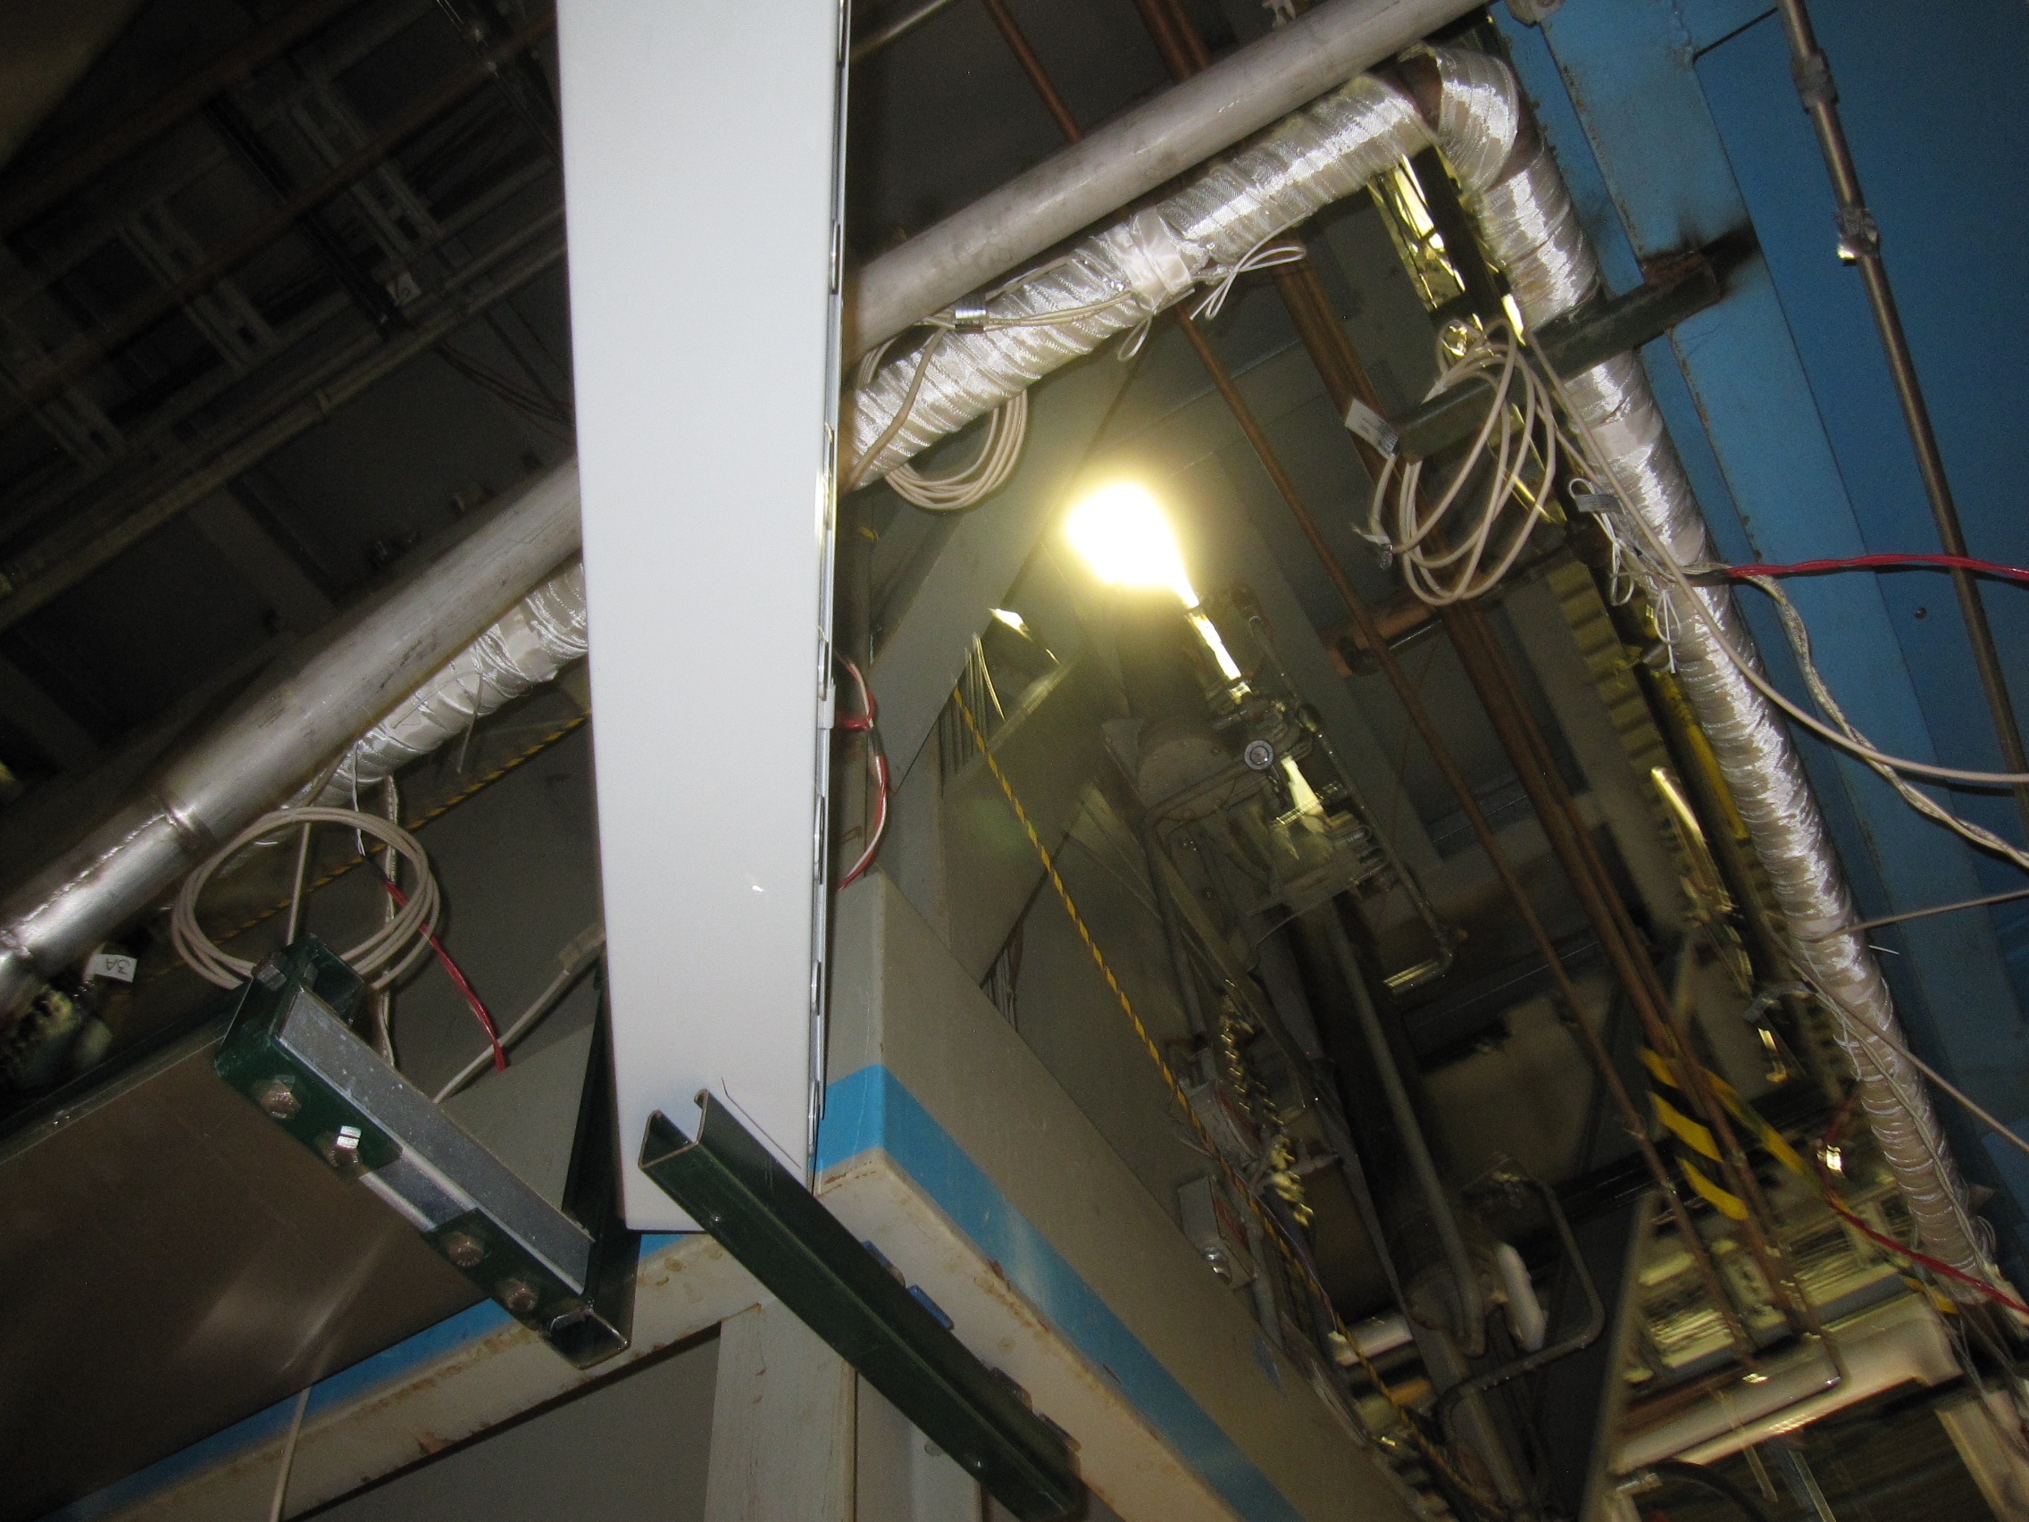
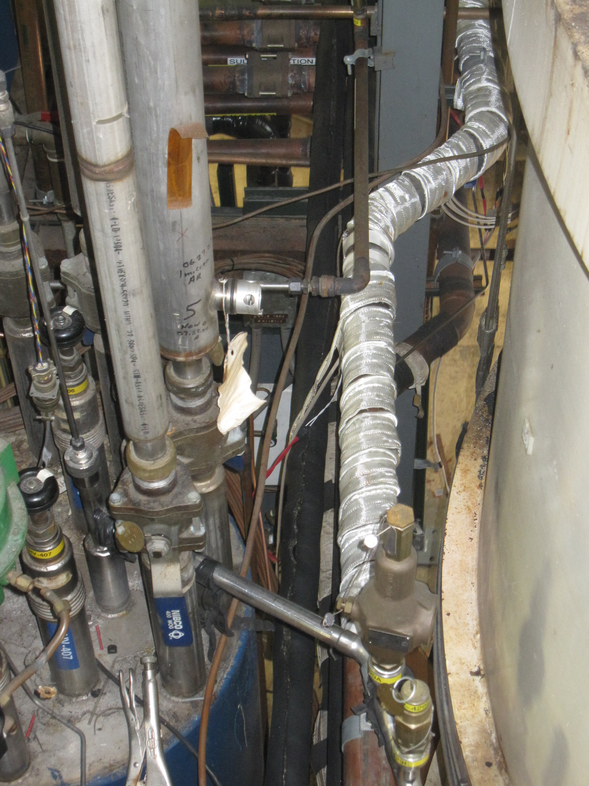
CA02 test preparations (2)
Helium line heater installation
All 10 heaters are installed (both on the supply and return lines)
All shelves installed, AC power cables routed and ready to plug in
Shelves will be grounded today, final checkout by Wed. Jun. 5
Operating procedure has been developed
Addendum to the electrical ORC has been initiated

Slide 4
CA-03 test preparations
CA components required for CA-03 transportation and testing
Return End Box – PO # 711063 awarded to Meyer Tools Inc.
Leak Test today afternoon
Will be shipped soon after the leak test is confirmed successful
Interconnect components required for CM pressure test are ready
Fabrication of the remaining interconnect components in progress at MW9 and IB1, see next slide

Slide 5
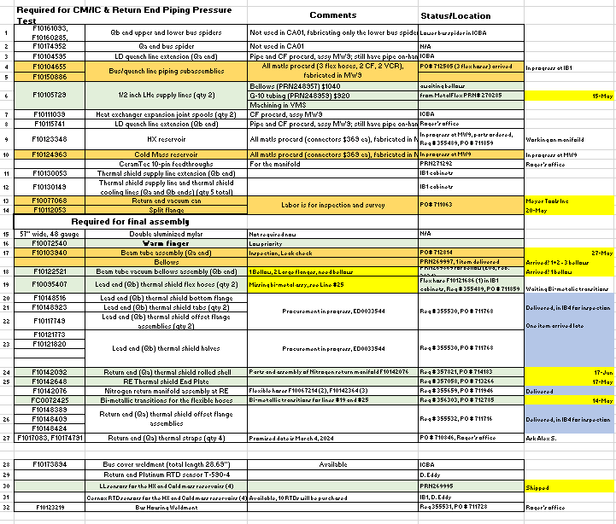
Remaining Interconnect Components for CA-03

