Slide 1
Welcome – Rebuilding Fermilab
Lia Merminga
International Muon Collider Collaboration: Demonstrator Workshop
Fermilab
October 30, 2024
Property of Fermi Research Alliance LLC | Proprietary & Confidential | Not for Distribution

Slide 2
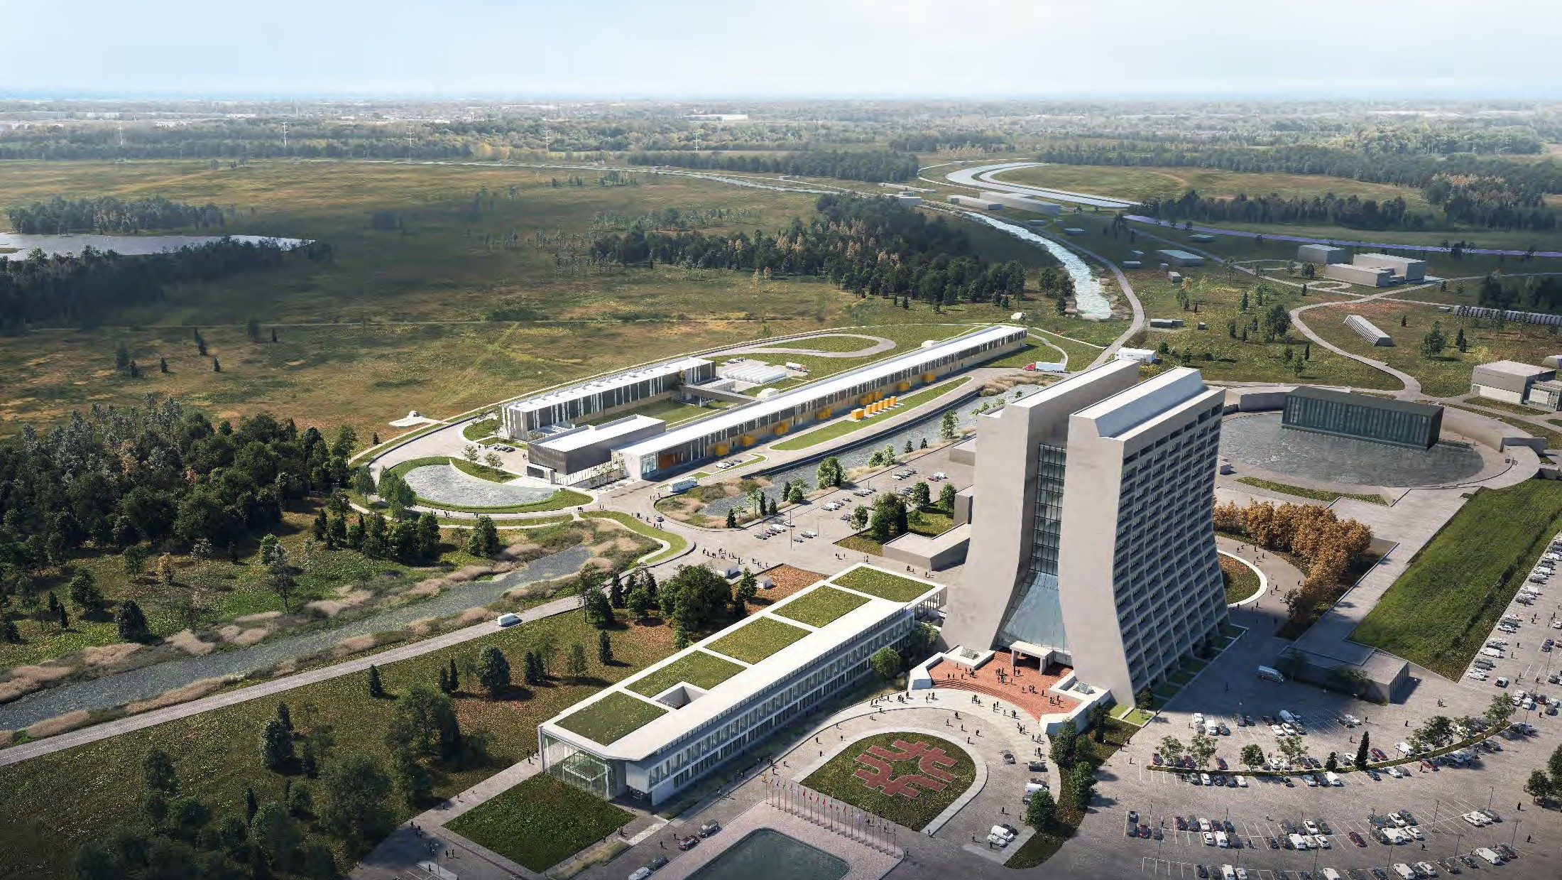
Fermilab at a glance
America's particle physics and accelerator laboratory
Operates the largest U.S. particle accelerator complex
~2,100 staff and
6,800 acres of federal land
Facilities used by 4,000 scientists from >50 countries
As we move into the next 50 years, our mission remains to solve the mysteries of matter, energy, space, and time for the benefit of all.

Slide 3
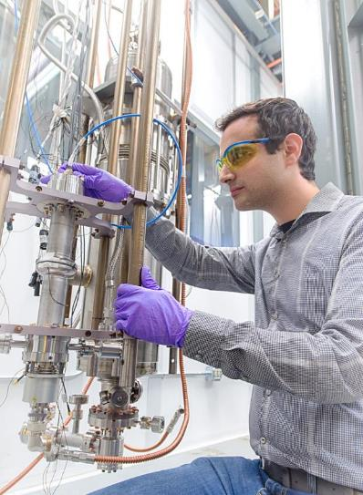
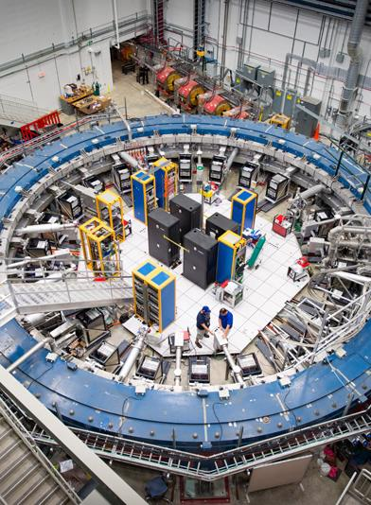
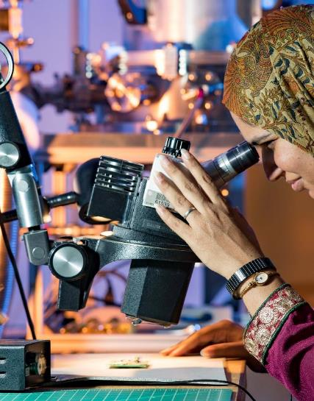
Fermilab Science and Technology Strategy
Major Particle Physics Initiatives
Emerging Technology Initiatives
User and Stakeholder Engagement Initiative
Neutrinos
Higgs and the Energy Frontier
Muons
The Dark Universe
Accelerator Science and Technology
Quantum Science and Technology
Microelectronics
Artificial Intelligence for Science
Discovery on the Prairie

Slide 4
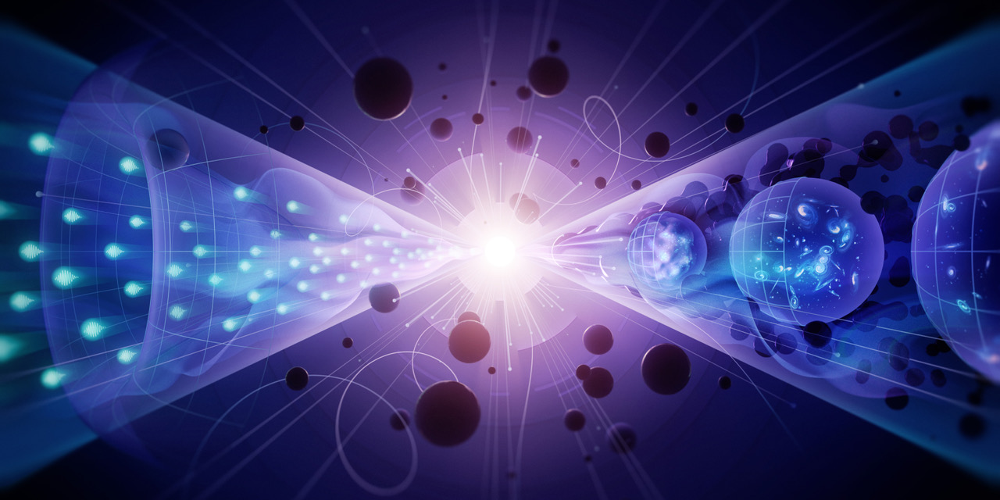
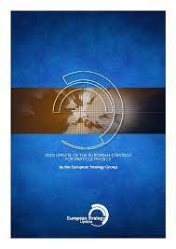
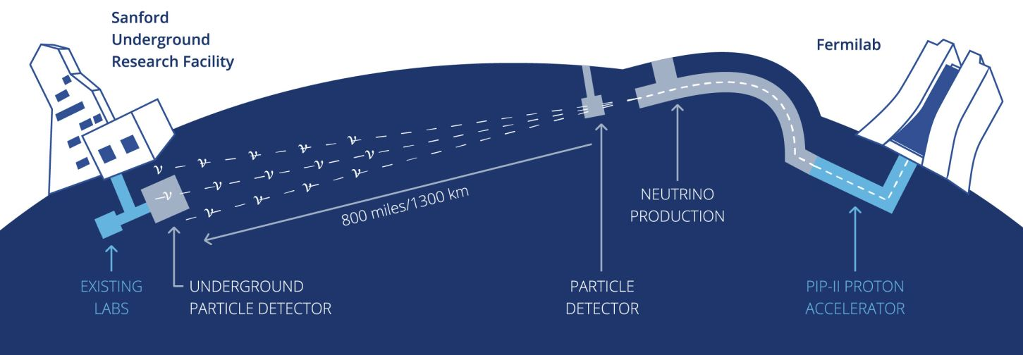
The definitive neutrino oscillation experiment, driven by LBNF and PIP-II
Neutrinos
Delivering LBNF/DUNE is Fermilab’s highest priority
Discovery Potential
Neutrino CP violation
The origin of matter in the universe
Supernova neutrinos
Origins of neutron stars and black holes
Neutrino surprises
New forces, particles, or laws of nature connected to neutrinos
Proton decay
Unified origins of particles and forces
The LBNF/DUNE project is the first internationally conceived, constructed, and operated mega-science project hosted by the Department of Energy on U.S. soil

Slide 5
LBNF far site excavation complete!
Property of Fermi Research Alliance LLC
Proprietary & Confidential | Not for Distribution

Slide 6
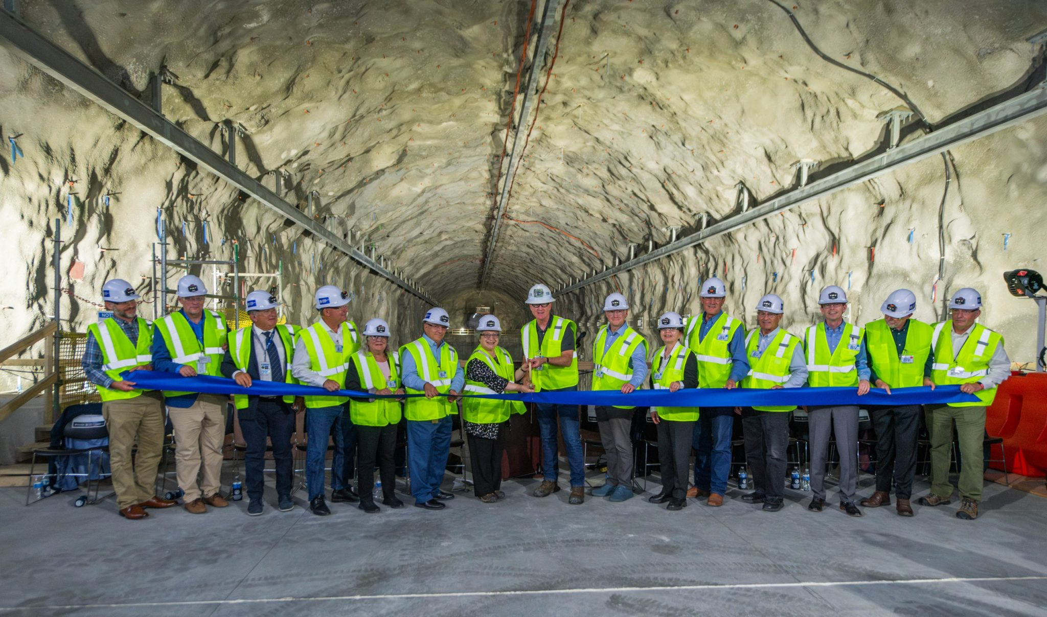
LBNF/DUNE cavern excavation celebration at SURF on Aug. 15
Transforming our understanding of the universe
Property of Fermi Research Alliance LLC
Proprietary & Confidential | Not for Distribution

Slide 7
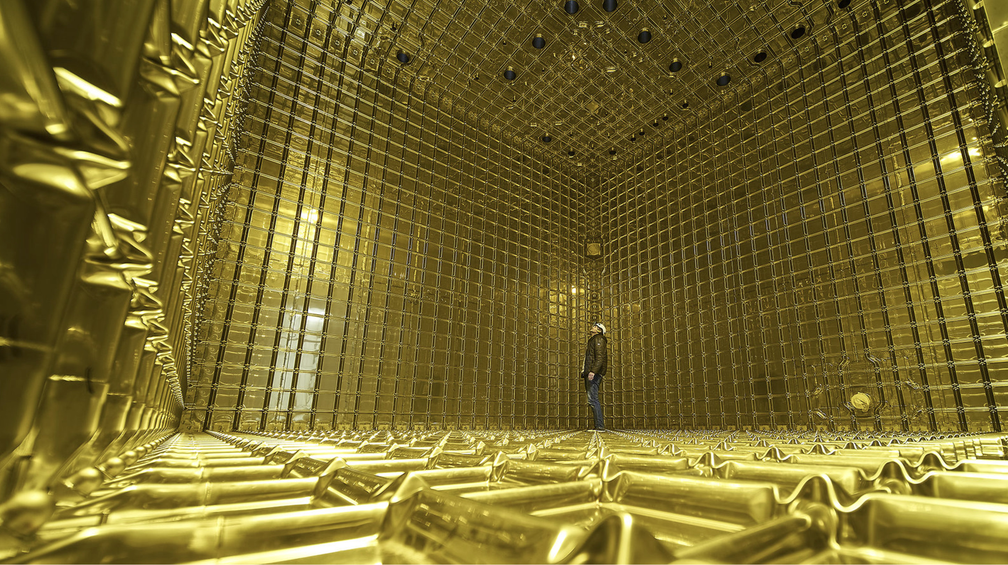
ProtoDUNE Detectors (Far Detectors 1 and 2) at CERN

Slide 8
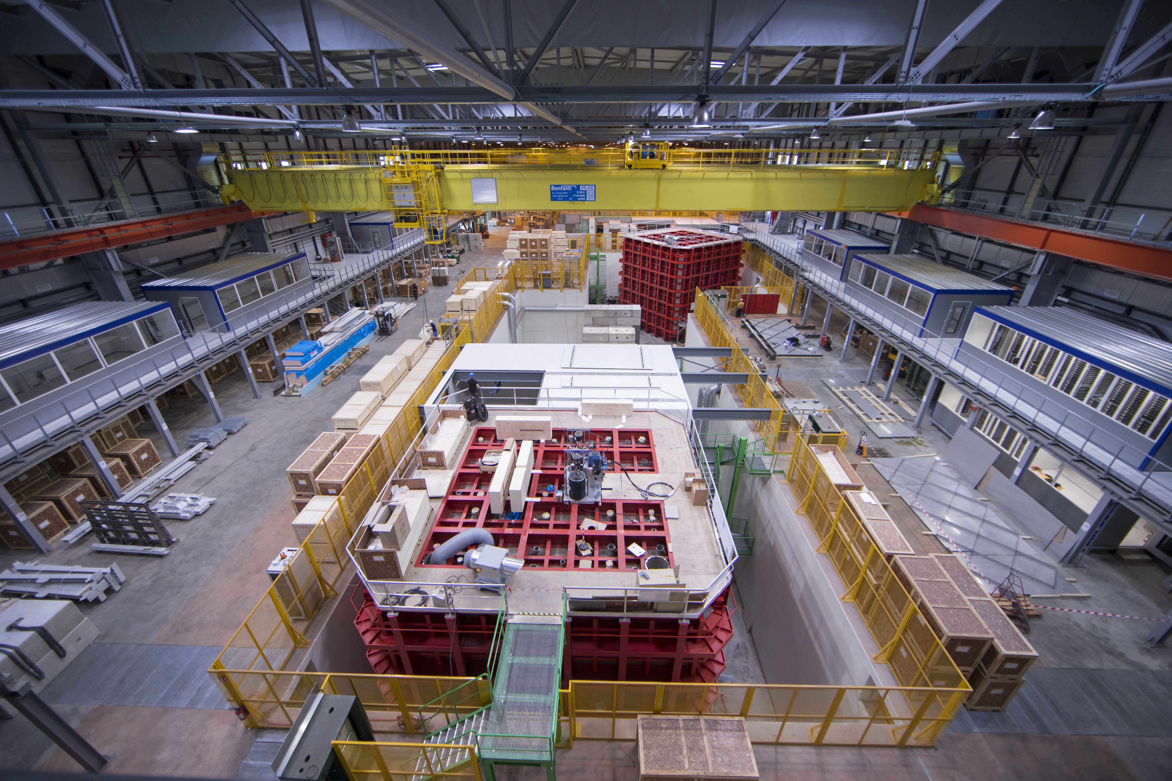
CERN Neutrino Platform: first time CERN invests outside Europe

Slide 9
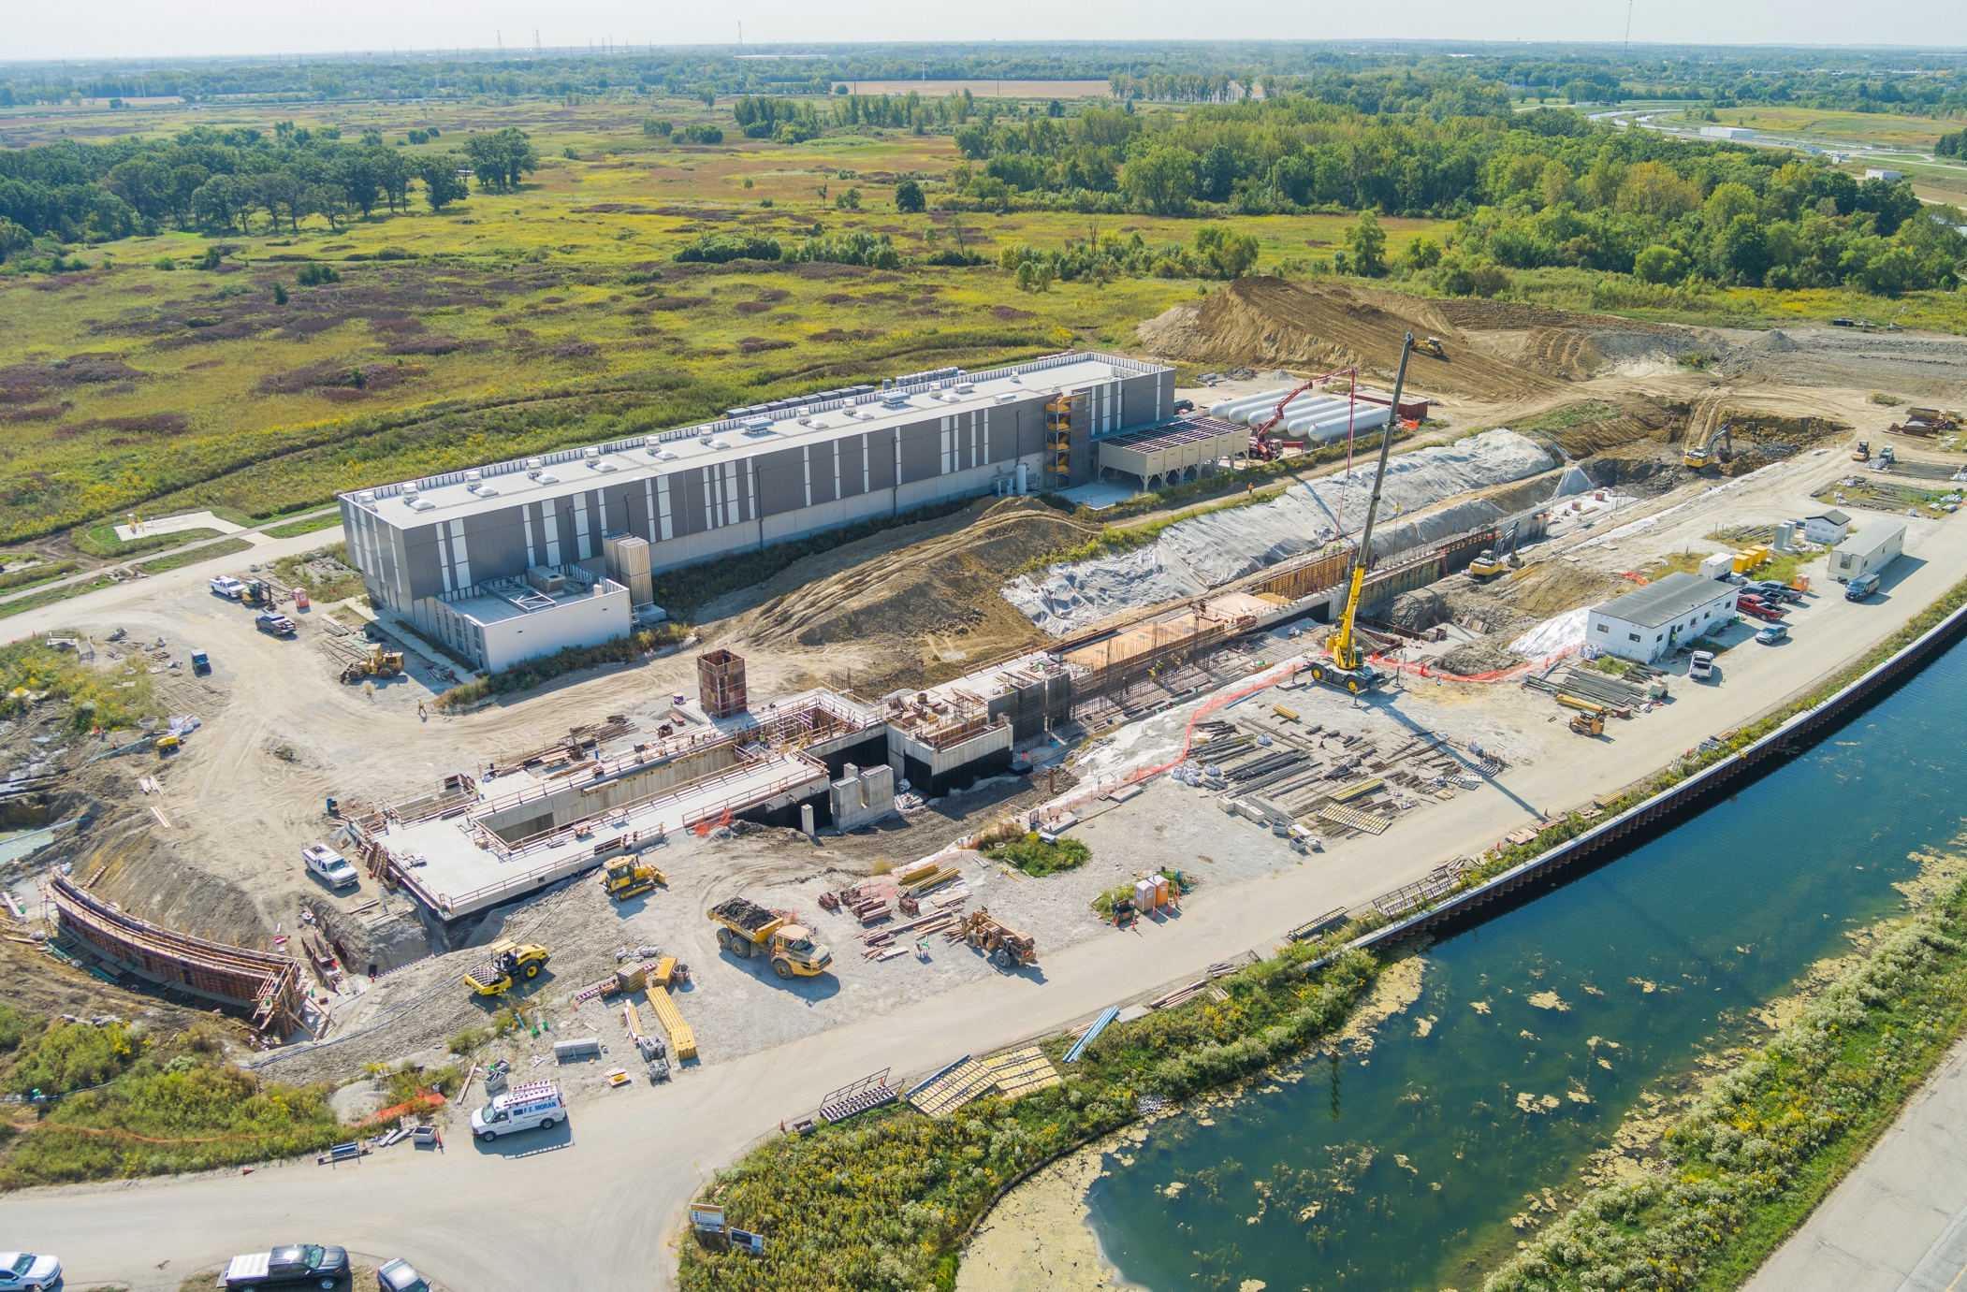
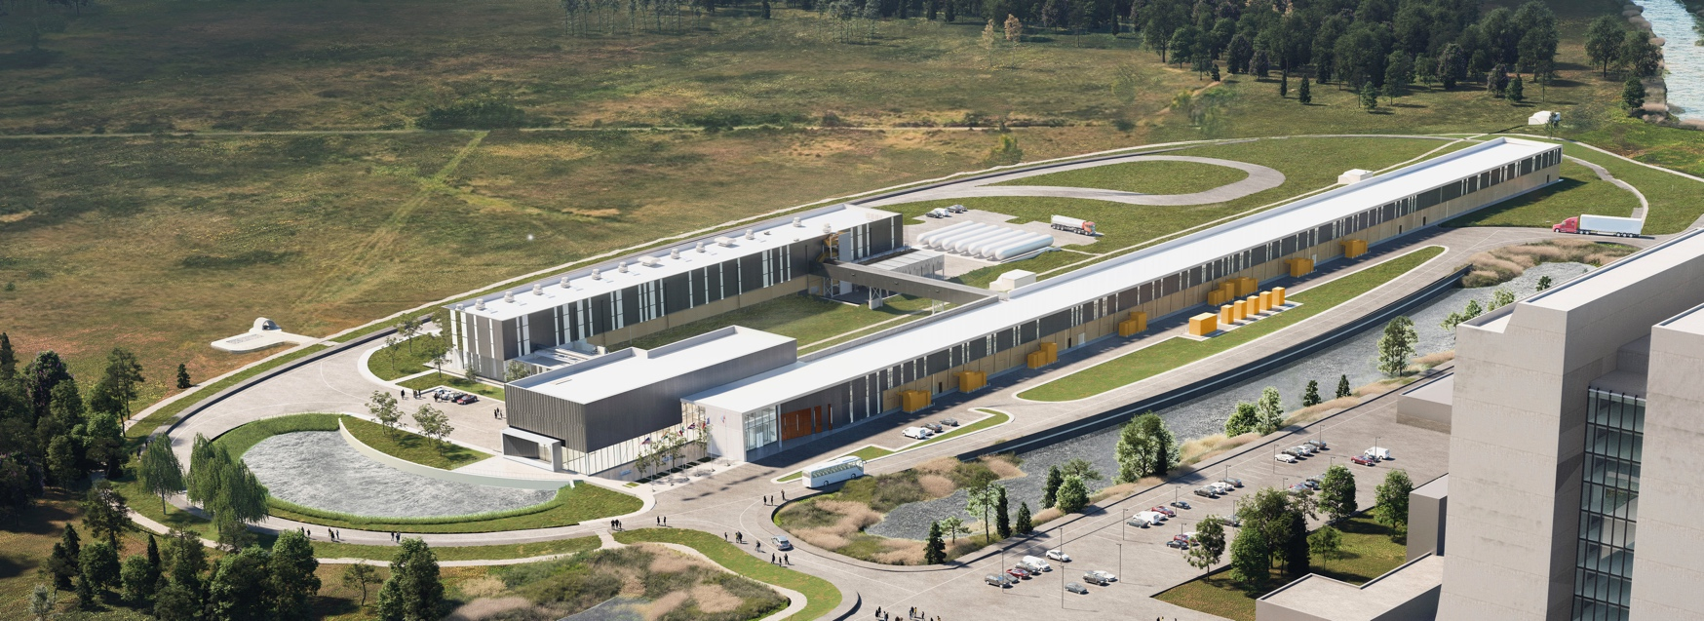
The PIP-II Project
PIP-II Design Rendering
PIP-II Construction Site, September 2024
Property of Fermi Research Alliance LLC
Proprietary & Confidential | Not for Distribution

Slide 10
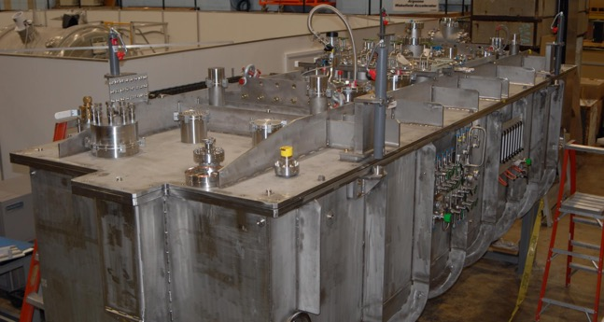
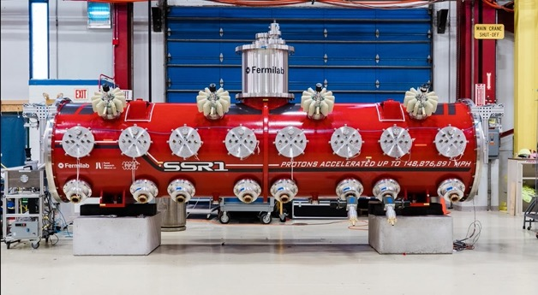
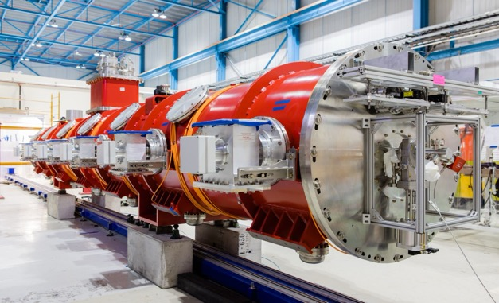
Prototype SRF Cryomodules
Prototype HWR Cryomodule
Prototype SSR1 Cryomodule
Prototype HB650 Cryomodule
2K Static Heat Load: 44W
LINAC ready after minor repairs
2K Static Heat Load: 32 W
LINAC ready after interfaces reconfiguration
2K Static Heat Load: 27.5 W
Is being rebuilt
The HWR, SSR1, and HB650 prototype cryomodules provided critical results, mitigating risks of the production phase

Slide 11
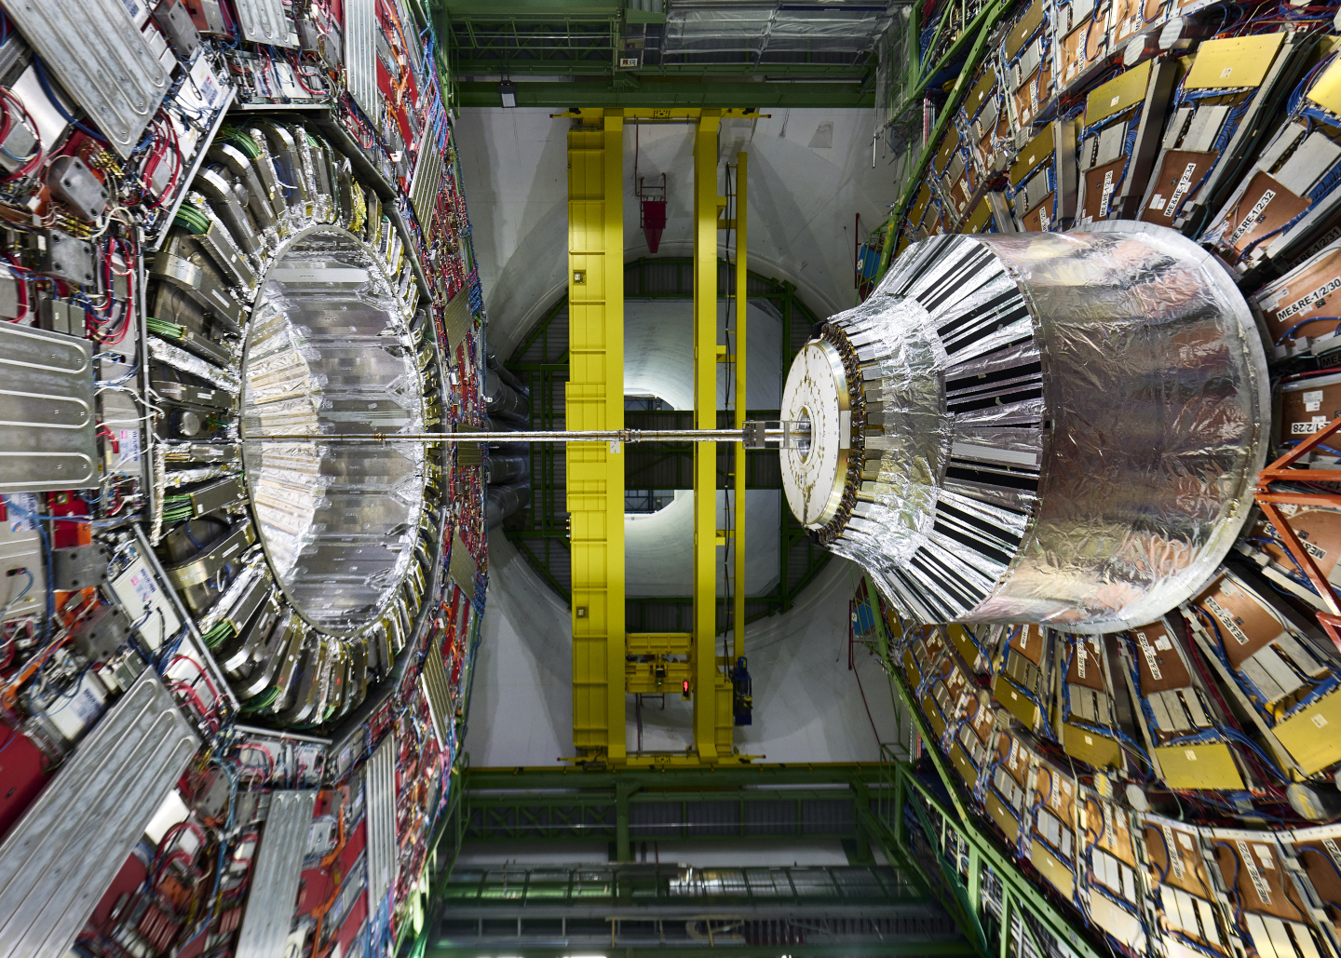
The Higgs Boson
and
Science at the Energy Frontier

Slide 12
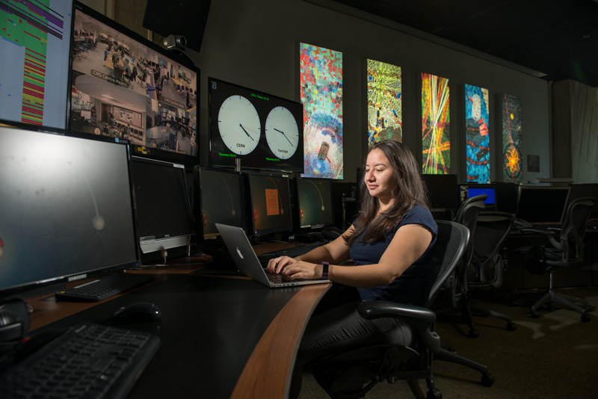
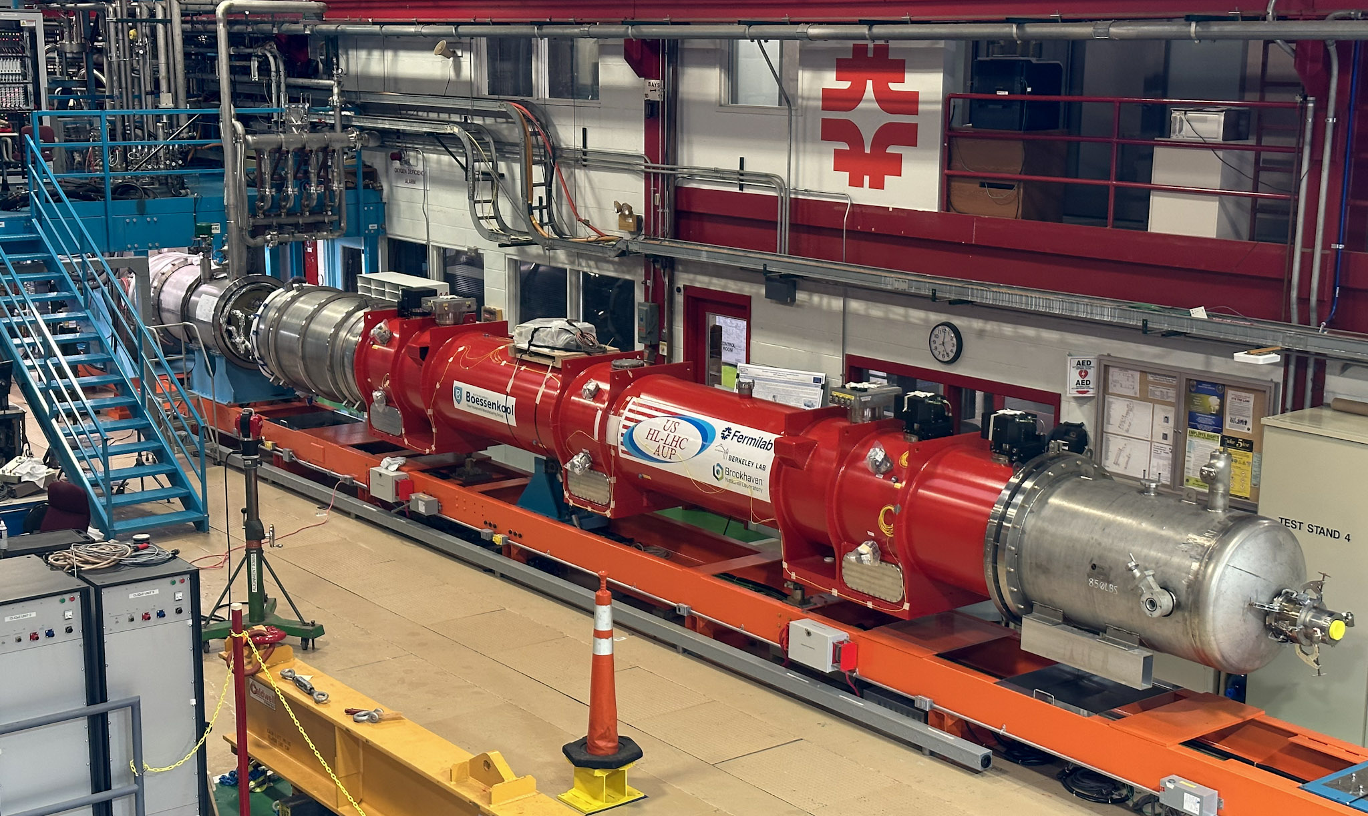
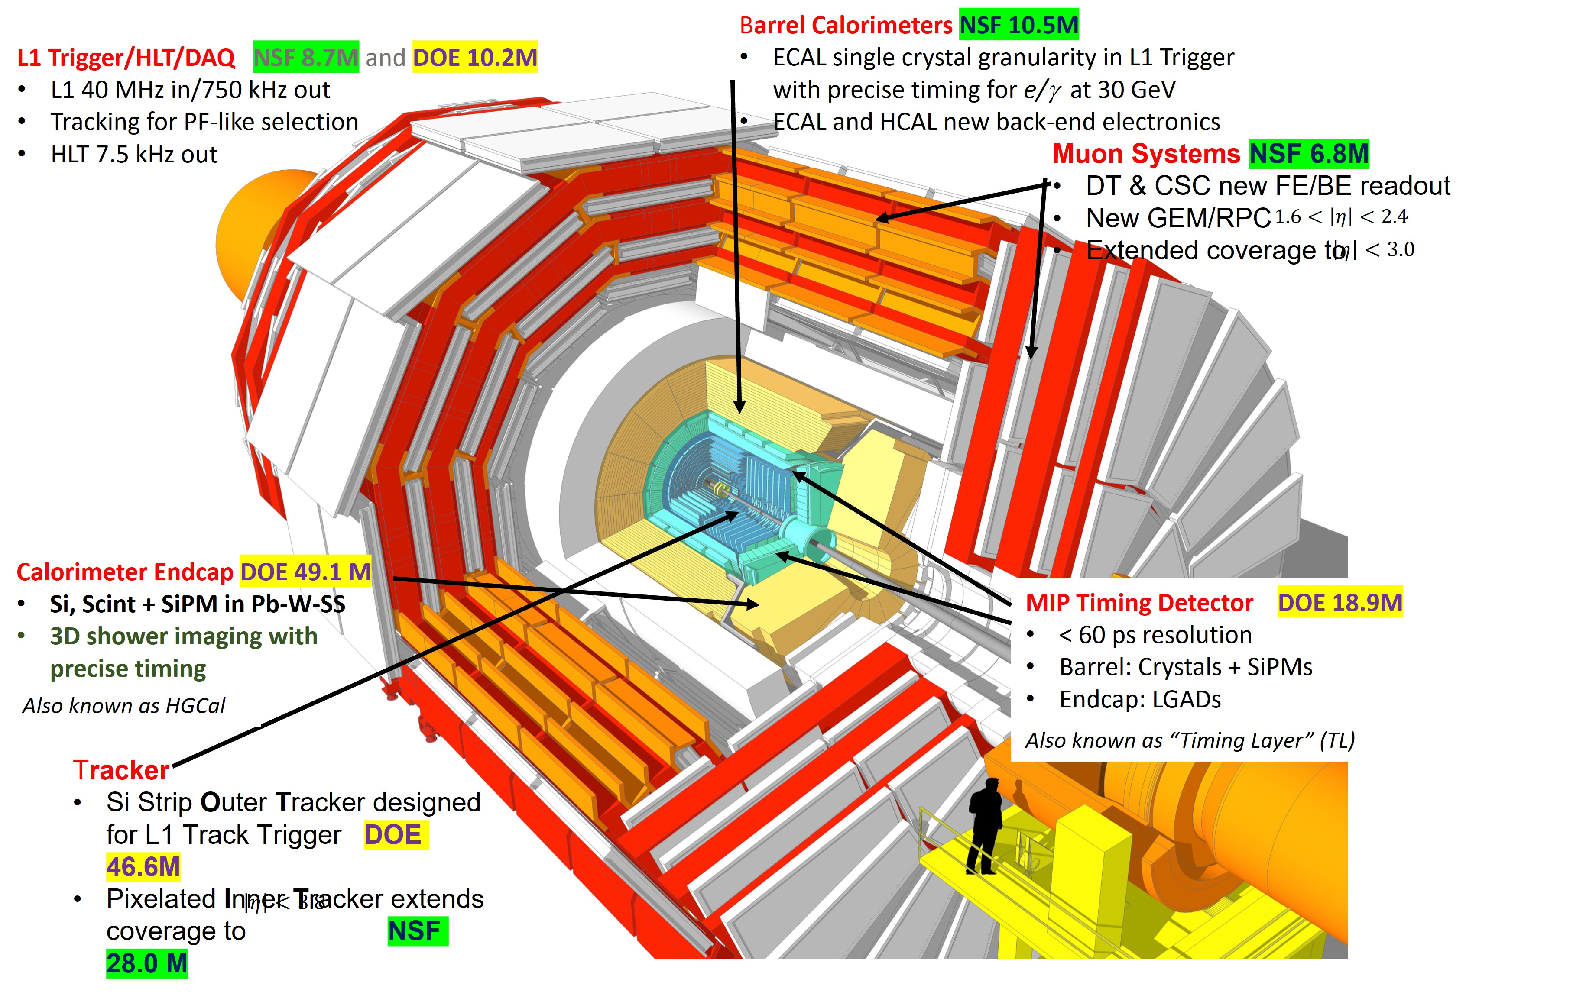
Higgs and Energy Frontier
Vision: Fermilab is the leading U.S. center for CMS and second leading center in the world after our partner CERN, and has leadership roles in off-shore Higgs Factory R&D
Major initiatives
LHC CMS operations
HL-LHC AUP and CMS Detector Upgrade Projects
FCC-ee accelerator & detector R&D
LHC Remote Operations Center (ROC) at Fermilab
CMS online shifts
HL-LHC AUP 1st CryoAssembly at Fermilab
HL-LHC CMS scope

Slide 13
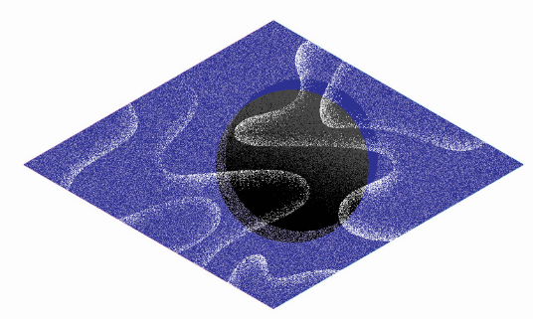
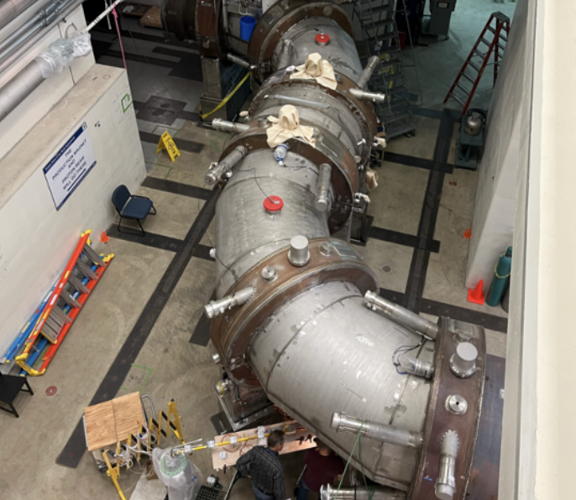
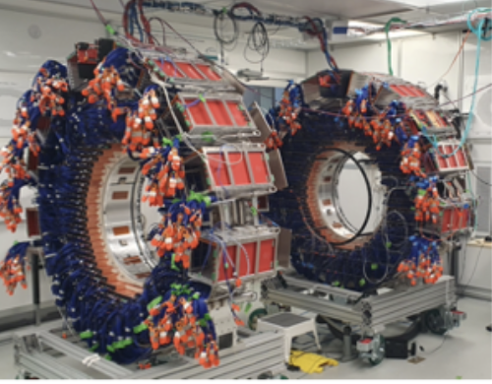
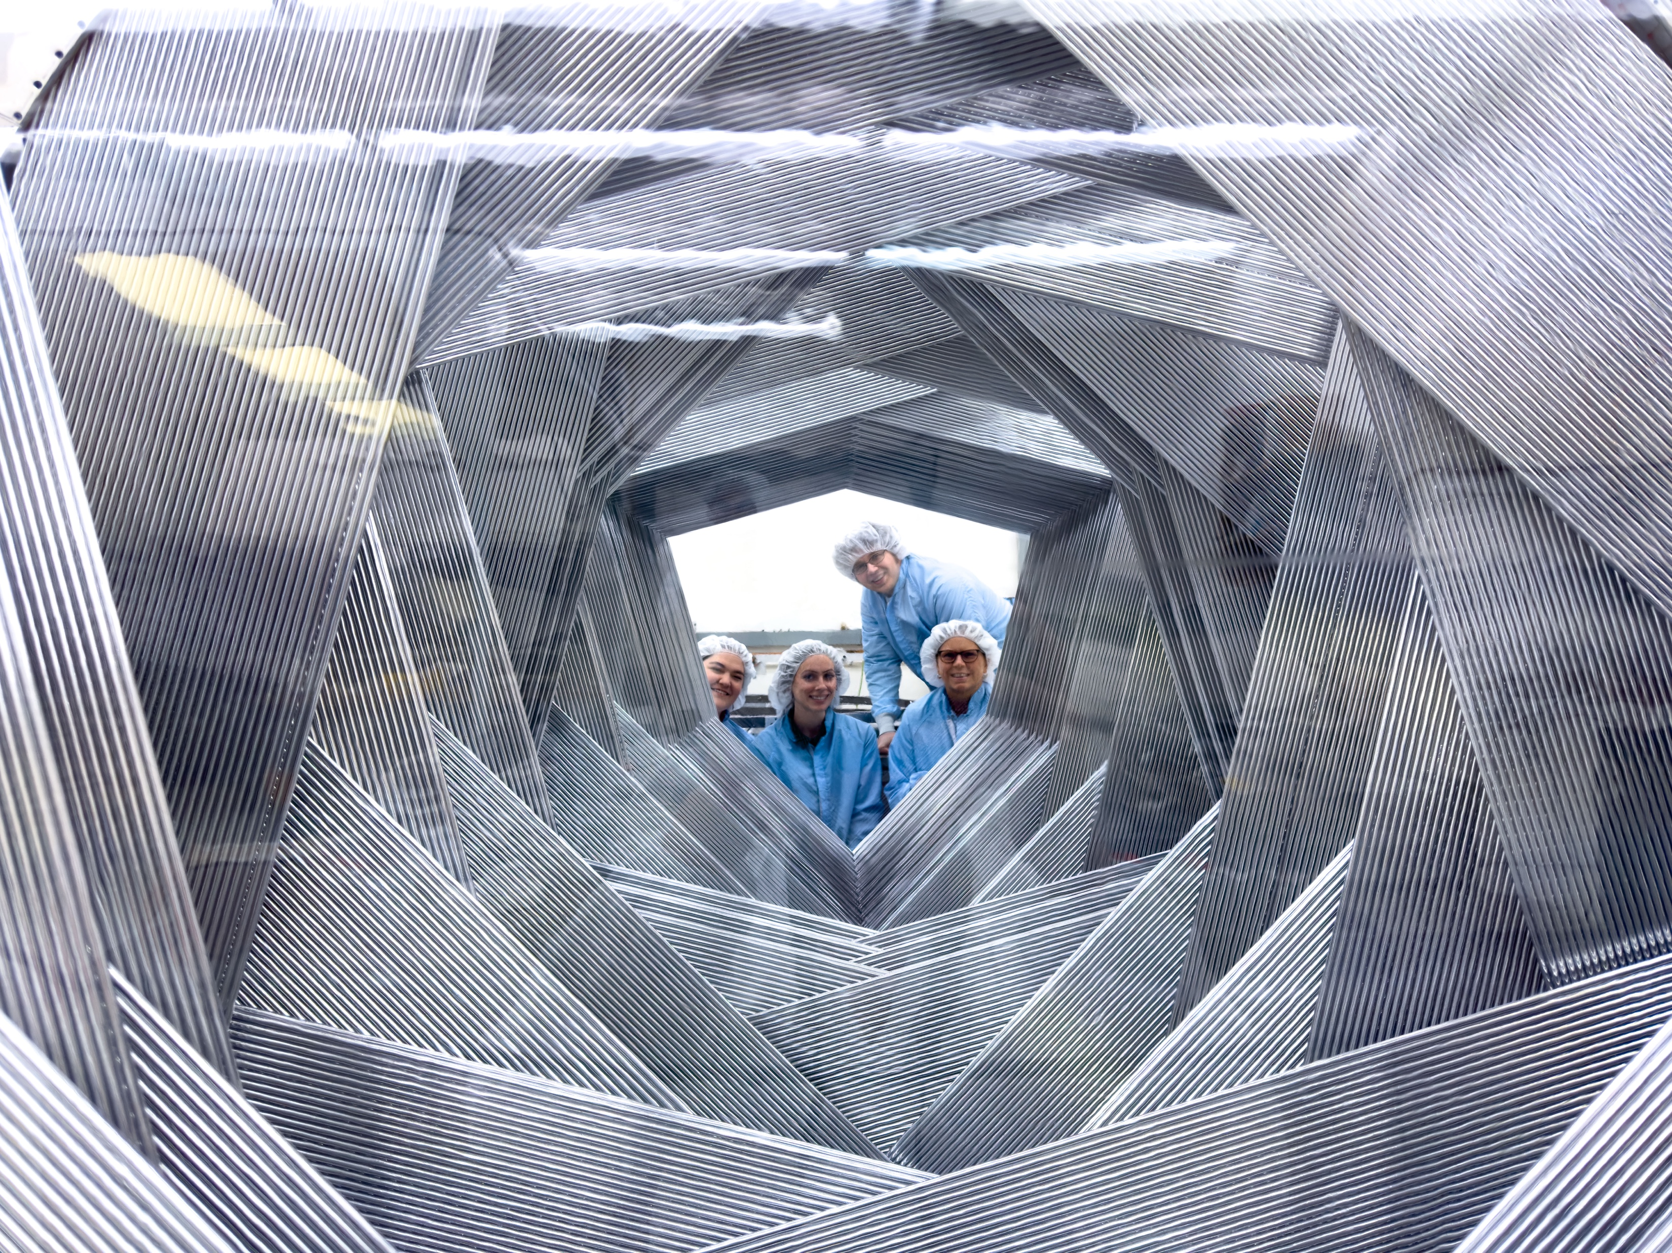
Muons
Vision: Fermilab is a world center for accelerator-based Charged-lepton flavor violation (CLFV) and Dark Matter experiments, driven by intense particles beams and PIP-II/ACE
Major initiatives
Muon g-2: Data taking concluded, statistics goal achieved!
Mu2e project: Project under construction ~91% complete, start science in 2026
Both transport solenoids in Mu2e hall
Calorimeter disks cabling complete
Tracker plane assembly

Slide 14
Accelerator S&T – World-leading Capabilities
Accelerator and Beam Physics
Superconducting Radio-frequency
High-power Targetry
IOTA/FAST beam-test facility advances critical R&D enabling next-gen accelerators for DOE/SC
Fermilab continues to produce world-class cryomodules for LCLS-II HE, PIP-II, applying developments to FCC-ee
Fermilab leads the Radiation Damage in Accelerator Target Environments (RaDIATE) collaboration
High-field Magnets
HEP and FES: New high field magnet cryogenic test stand at Fermilab to perform R&D of high-temp superconducting cables for future fusion reactors
Fermilab is addressing the needs of many
SC programs
BES
FES
NP
ASCR

Slide 15
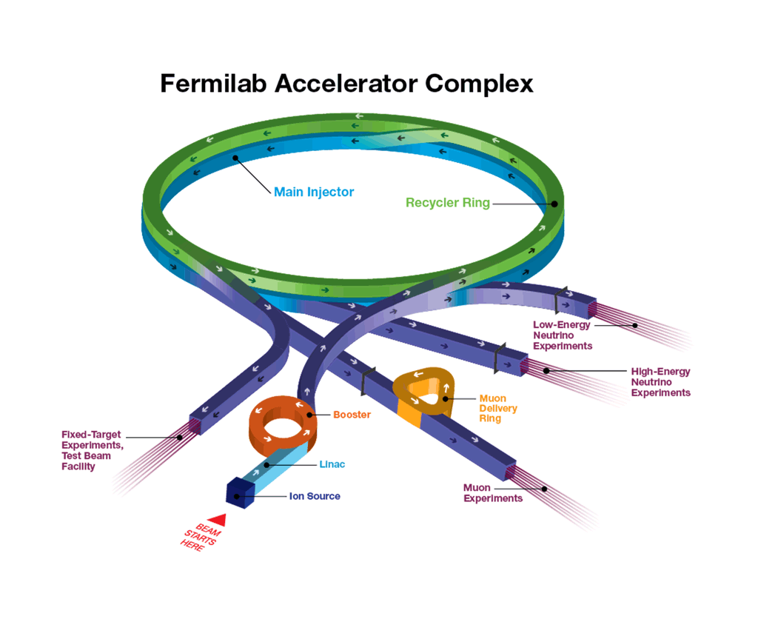
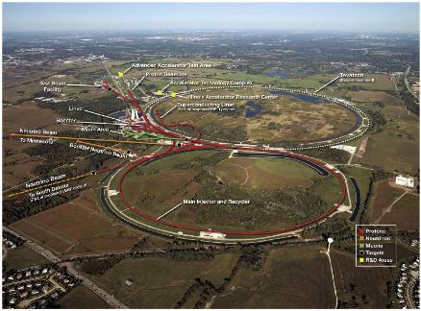
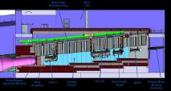
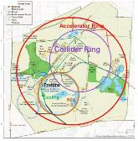
Fermilab Accelerator Complex Evolution (ACE)
Accelerator Complex
Campaign of upgrades, modernization, investments critical for the success of DUNE
PIP-II Project
Other projects, e.g. ACORN, to ensure accelerator complex is compatible with PIP-II
ACE-MIRT
Faster delivery of DUNE science: capability × capacity × reliability
Deliver groundbreaking science & technology innovation
20-year strategic plan
ACE-BR, Muon Collider Demonstrator, Muon Collider

Slide 16
Thank you and Welcome to Fermilab!
Happy Fall, Julie Vander Meulen
Property of Fermi Research Alliance LLC
Proprietary & Confidential | Not for Distribution

