Slide 1
Danaisis Vargas , Matthew Man, and William Dallaway
DUNE DAQ Core Software WG
June 5th, 2024

Slide 2
Today in the talk
AMD Zen3 Tuning: eliminating missed packets.
np04-srv-005 storage server commissioning.
Readout performance test summary.

Slide 3
AMD Zen3 Tuning: eliminating missed packets

Slide 4
Flow of data
100 Gbps data from WIBs
NIC on PCIe
No direct cache access (DCA)
Direct memory access (DMA)
Cache
DRAM Memory
CPU cores operate on cached data
Read from memory

Slide 5
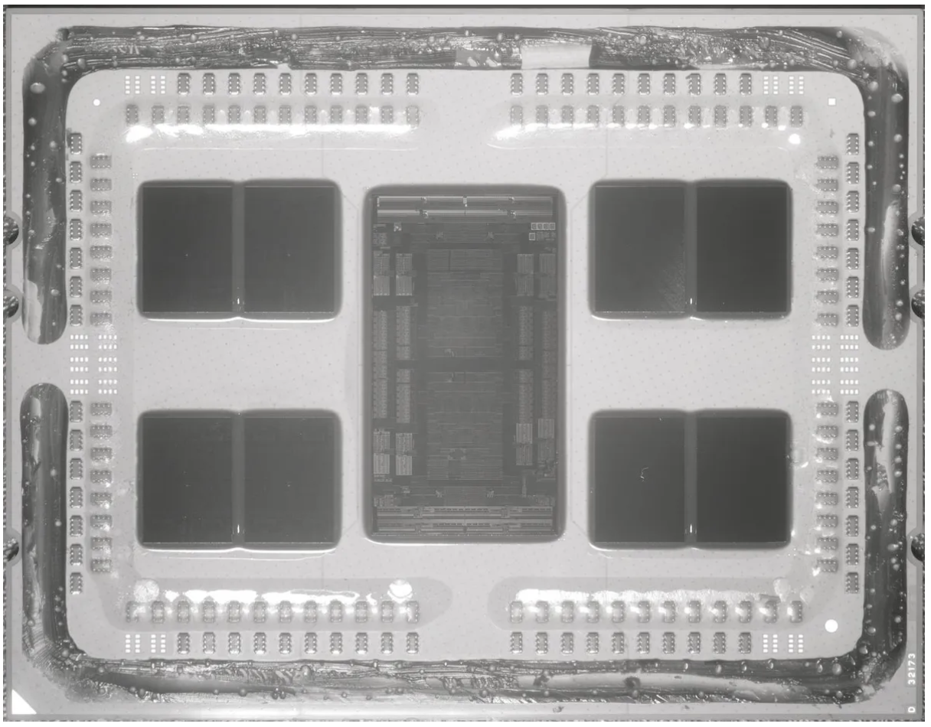
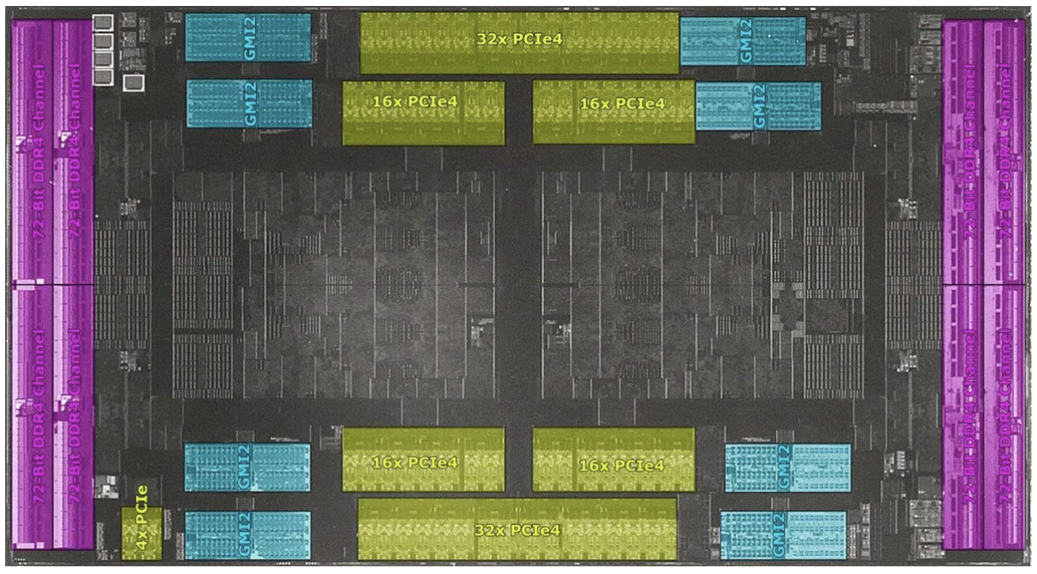
AMD Zen3 architecture
CCD
IOD
Single socket: connections Single socket: dies
Note: pictured is Zen2 architecture but at this level they’re equivalent

Slide 6
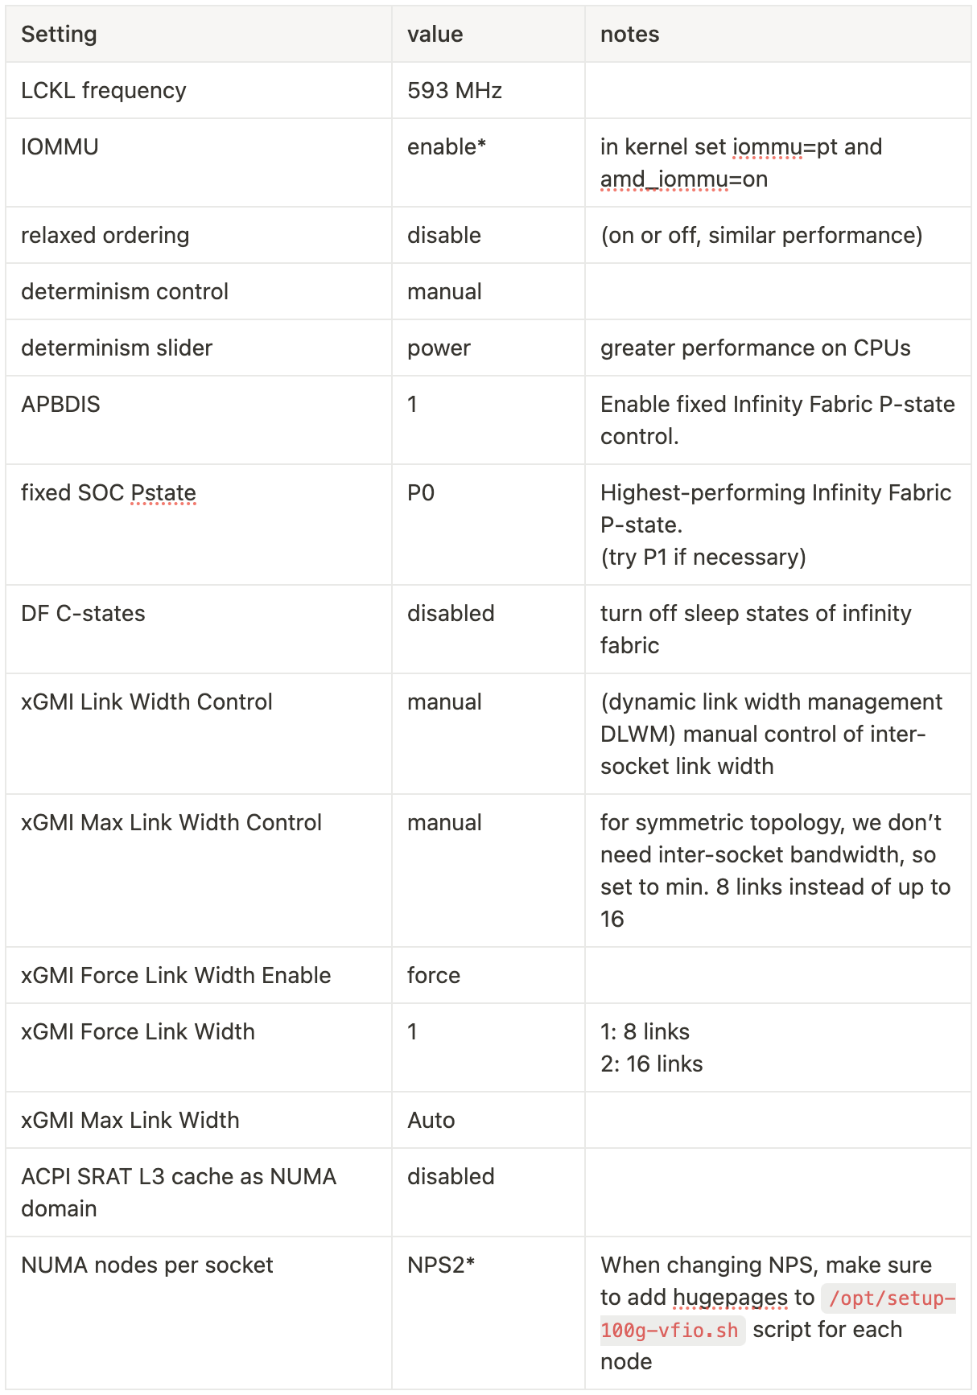
BIOS tuning
np02-srv-004 BIOS settings
np02-srv-001 and np02-srv-004 are same CPU family (Milan)
001 has 4 cores x 4 CCDs per socket
004 has 8 cores x 8 CCDs per socket
On 001 the only BIOS setting necessary was to set the LCKL frequency to maximum of 593 MHz
Improves DMA from PCIe
004 needed more tuning, see table
Targeted at reducing memory latency
I included everything I changed, and highlighted the ones I think made the difference

Slide 7
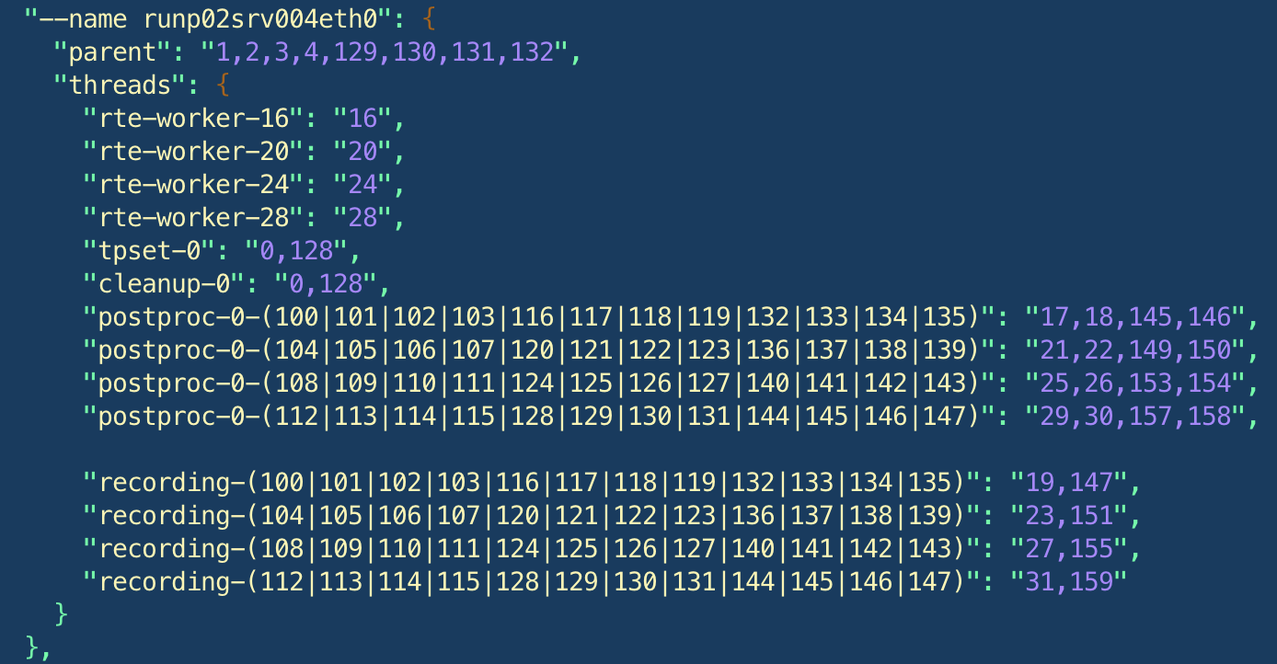
CPU pinning
NUMA0
NUMA1
Group by stream (48 WIB streams): rte-worker, post-proc, and recording handling the same streams grouped on same CCD
Parent, tpset-0, cleanup
empty
24 streams
24 streams

Slide 8
What else is there to do?
AMD Zen3 Tuning: eliminating missed packets.
Successful understanding and control of AMD architecture.
For PRR we should not be limited by Intel vs AMD CPU architectures.
I believe Intel machine 031 and AMD machine 004 are both capable of reading out 4 CRPs.
Technical point: DPDK needs to be rebuilt to allow rte-workers to use CPUs >128.
Power consumption/bare-minimum resources.
Are there BIOS settings that are unnecessary and can save power? (DF C-states, fixed P states)

Slide 9
np04-srv-005 storage server commissioning

Slide 10
Status Testing
All nvme drives prepared
4 RAID level 10 arrays
/data2, /data3, /data4, /data5
Added into fstab to persist on reboot
Kurt mentioned file-transfer metadata-creation script relies on /data0-3 pattern.
Do the RAID data directories need to be renamed?
How are /data0-1 used and how are /data2-5 used?
Tested data writing with NP02 and NP04
With four data writers we were able to sustain ~7Hz trigger rate from CRP4+5
the bottleneck is the network
We used twelve datawriters for NP04
bottlenecks were from the trigger
What else is there to do?

Slide 11
Readout performance test summary

Slide 12
Tests
Emulation
mode
Stream scaling performance tests (with scaling for 8, 16, 24, 32, 40, and 48 streams).
with TPG and raw recording enable
Reading one APA / CRP per server (using only one NUMA node) when possible.
using differents TPG methods: AbsRS, SilverBullet, and SimpleThreshold
before and after applying kernel params
Reading two APAs / CRPs per server when possible.
2 x 100 Gb NICs
Reading four APAs / CRPs.
2 x 200 Gb NICs
Stream scaling performance tests (with scaling for 8, 16, 24, 32, 40, and 48 streams).
with TPG enable
with raw recording enable
with TPG and raw recording enable
before and after applying kernel params

Slide 13
Readout performance test summary
Test | np02-srv-001 | np02-srv-002 | np02-srv-003 | np02-srv-004 | np04-srv-031 | np04-srv-021 | np04-srv-022 | np04-srv-028 | np04-srv-029
Emulation
Stream scaling w TPG | X | X | X | X
Stream scaling w raw recording |  |  | X | X
Stream scaling w TPG and recording |  |  | X | X
Stream scaling before and after applying kernel params |  |  |  | X
Data
Stream scaling w TPG and recording |  |  | X
TPG methods |  |  |  |  |  | X | X | X | X
Reading one APAs / CRPs | X | X | X | X | X | X | X | X | X
Reading two APA / CRP | possible | possible | X | X | X
Reading four APA / CRP |  |  |  | possible | possible

Slide 14
What else is there to do?
Readout performance test summary.
The performancetest app (https://github.com/DUNE-DAQ/performancetest) is up to date.
How to conduct benchmark and performance tests.
How to process and present the results.
All configuration are on np04 (https://gitlab.cern.ch/dune-daq/online/np04daq-configs.git)
Reading two APAs / CRPs. We would like to test:
np02-srv-001 (Intel) with 2 x 100 Gb NICs
np02-srv-002 (AMD) with 2 x 100 Gb NICs
Reading four APAs / CRPs. This will be possible with servers:
np04-srv-031 (Intel) with 2 x 200 Gb NICs
np02-srv-004 (AMD) with 4 x 100 Gb or 2 x 200 Gb NICs
Minimum resources test

Slide 15
References
AMD tuning guides:
https://www.amd.com/content/dam/amd/en/documents/epyc-technical-docs/tuning-guides/data-plane-development-kit-tuning-guide-amd-epyc7003-series-processors.pdf
https://www.amd.com/content/dam/amd/en/documents/epyc-technical-docs/tuning-guides/amd-epyc-7003-tg-workload-57011.pdf
AMD topology:
https://www.anandtech.com/show/16529/amd-epyc-milan-review/4
Thank you

Slide 16
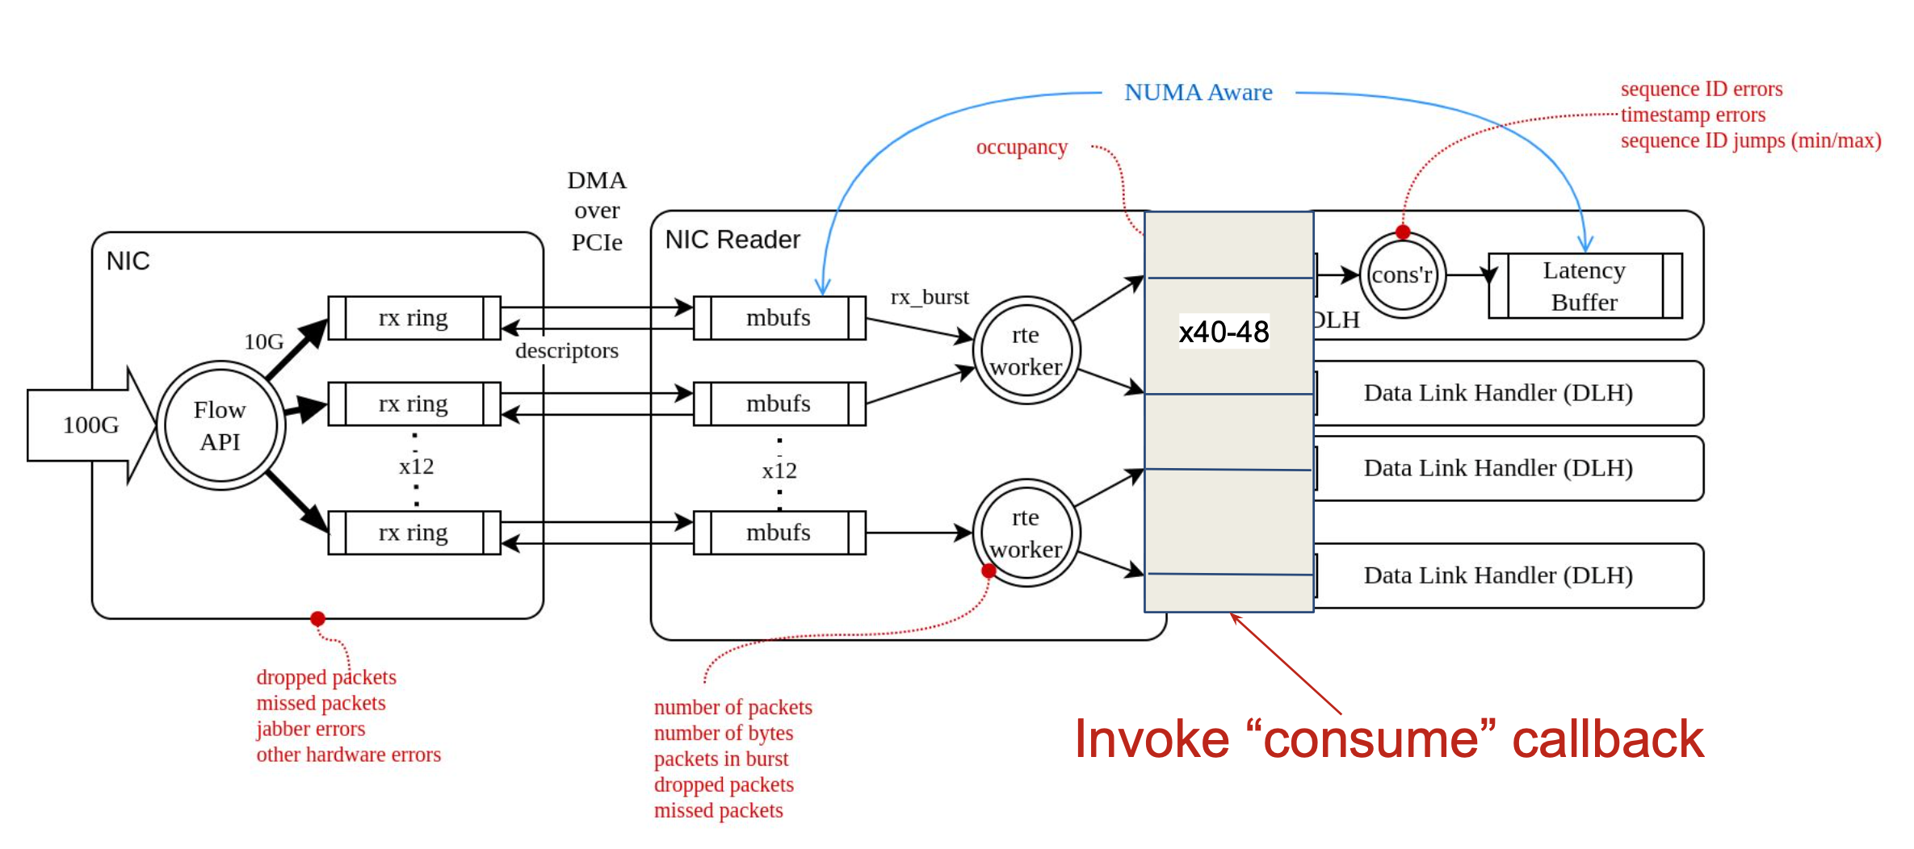
Callbacks

