Slide 1
9 AM Meeting
Keymonty Bullock
MCR Crew Chief
Wednesday, June 5, 2024

Slide 2
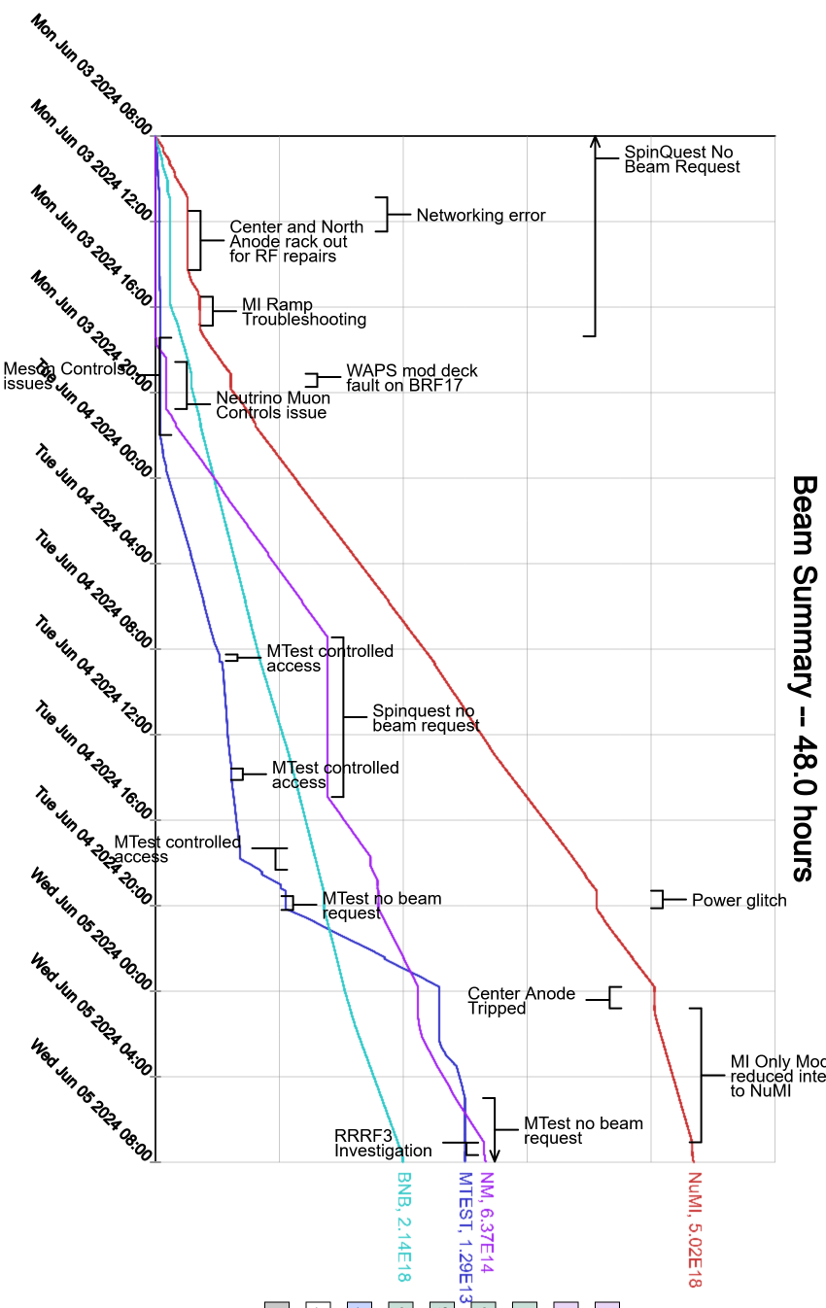
Since Monday…
Controls glitch from main router being overloaded
D:IB trip on Voltage Reg Rectify
Experts have been investigating
Power Glitch from storm overnight
Booster Quads were recovered by experts
ISD/HV had a relay trip for Transformer 88
They are taking oil samples and we are fine to run at the moment
Neutrino Muon studies underway
Beam to NuMI, BNB

