Slide 1
A17 shim analysis
Paolo Ferracin
on behalf of the MQXF collaboration
AUP Meeting
LBNL, USA
June 7th, 2024

Slide 2
Outline
A14b and A05 and A13 quench performance
Computation radial build-up in A14b and A05
Target loading shim size in A17

Slide 3
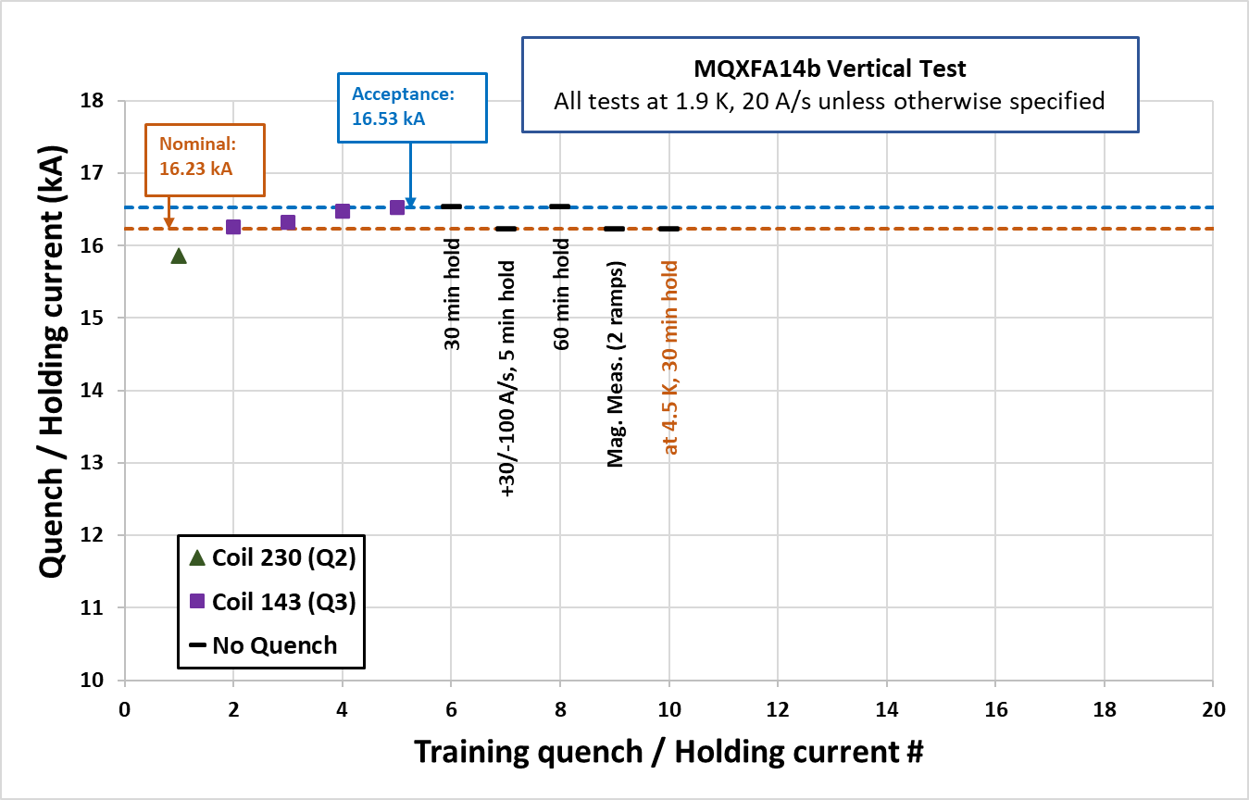
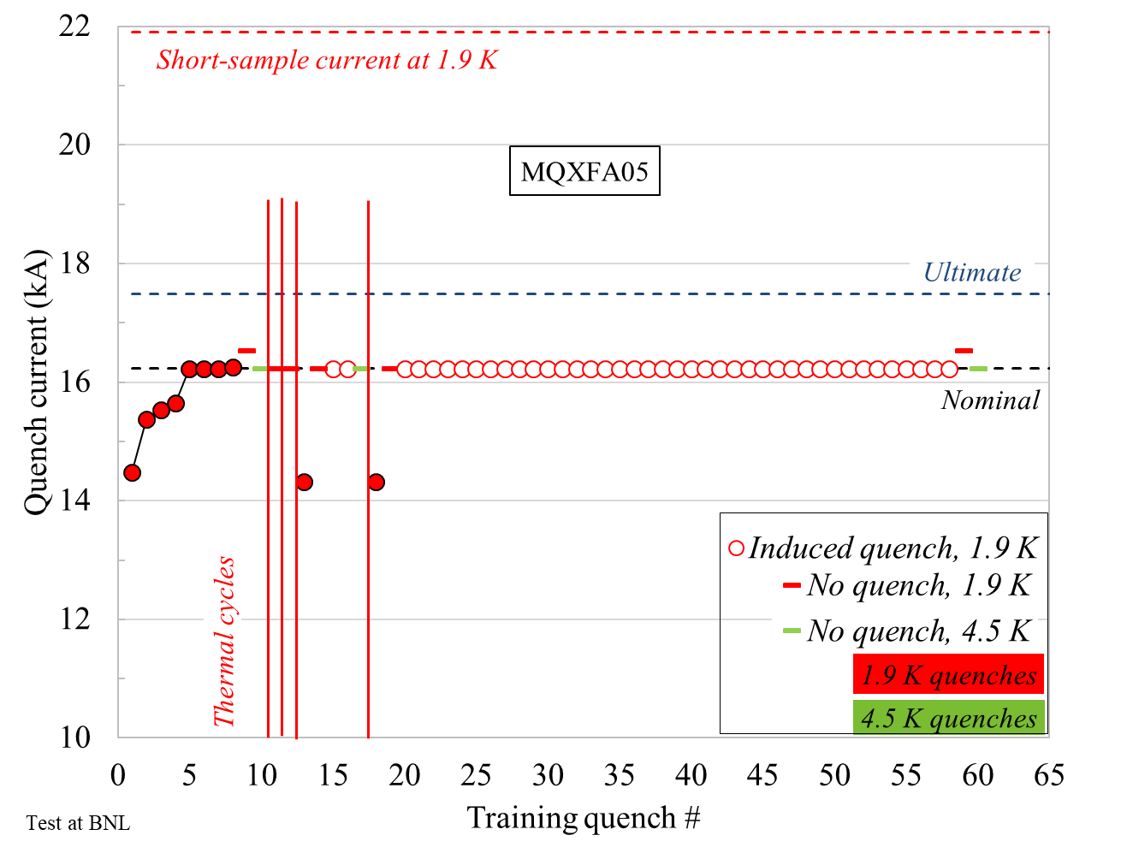
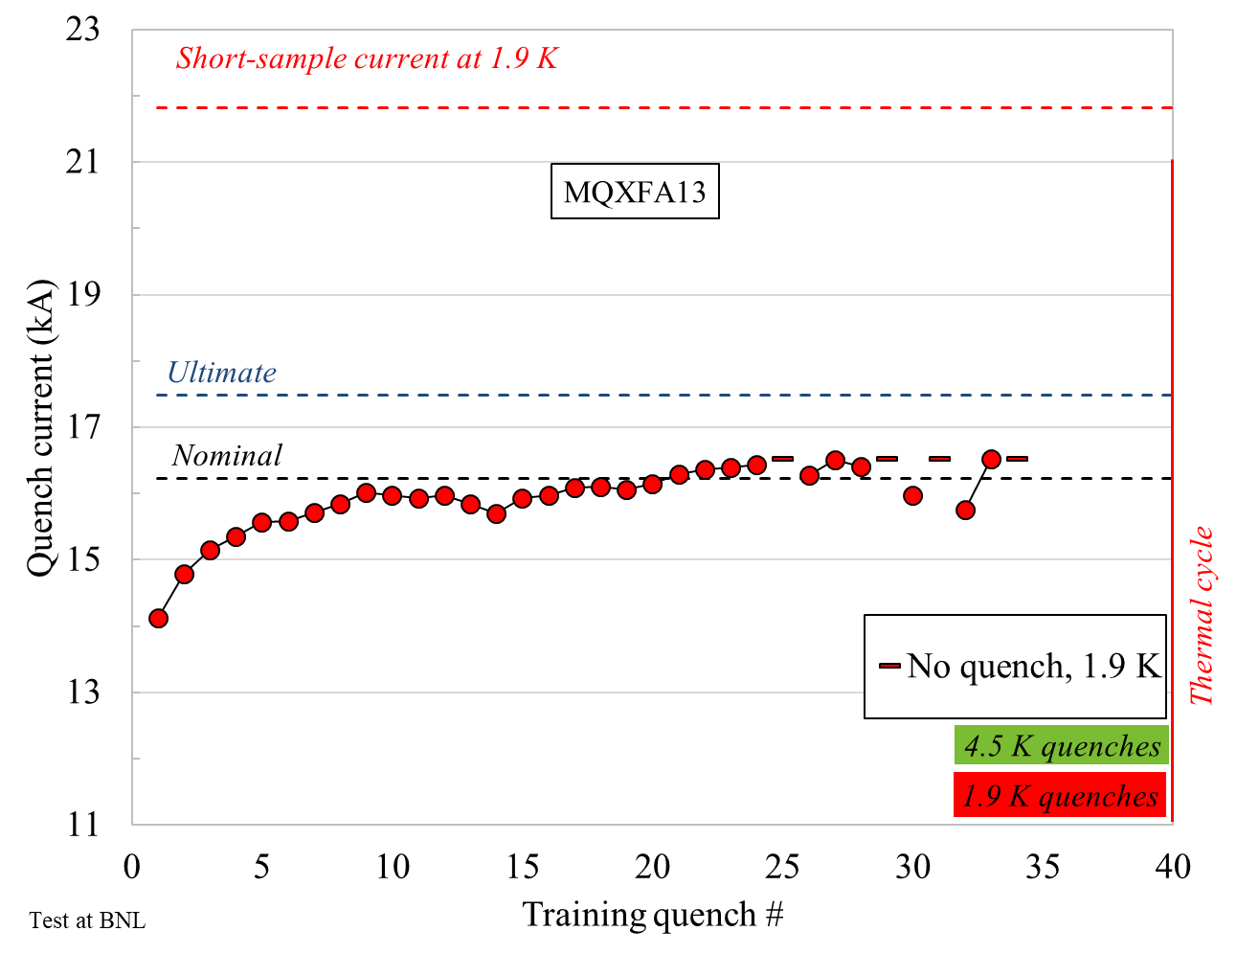
Quench performance
After the test of A13, we focused on the analysis of the pre-load in A14b and A05
  At that time, they had the fewest training quenches up to the acceptance current, and both of them met requirements
A14b
A05
A13

Slide 4
Outline
A14b and A05 and A13 quench performance
Computation radial build-up in A14b and A05
Target loading shim size in A17

Slide 5
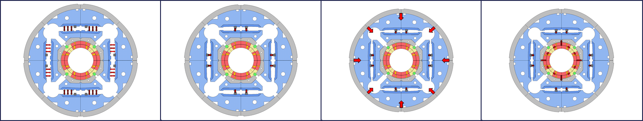
Room temperature pre-stress
The final coil and shell pre-load achieved at the end of the bladder and key operation is determined by the combination of
  the size of the load key shim
  the radial dimensions of the shimmed coil pack
    (under the assumption that collars, pads, masters, yoke, and shell have nominal dimensions).

Slide 6
Size of the load key shim
Loading shim size: 43 mils, 1.092 mm
Total key size: 13.84 mm
A14b
Loading shim size: 41 mils, 1.041 mm
Total key size: 13.79 mm
A05

Slide 7
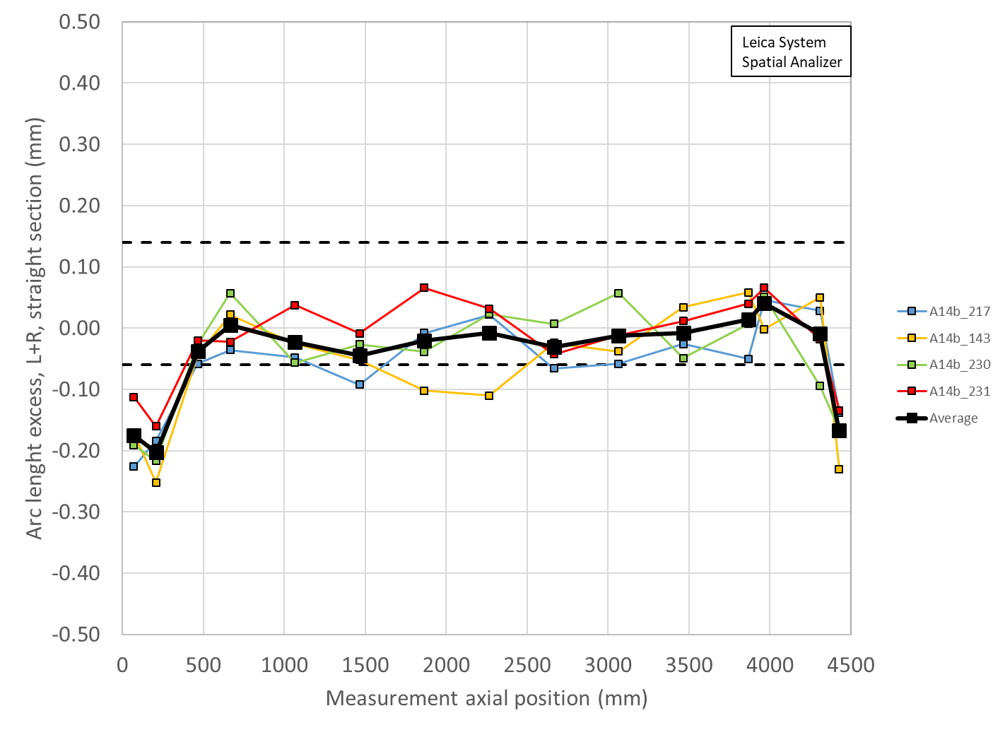
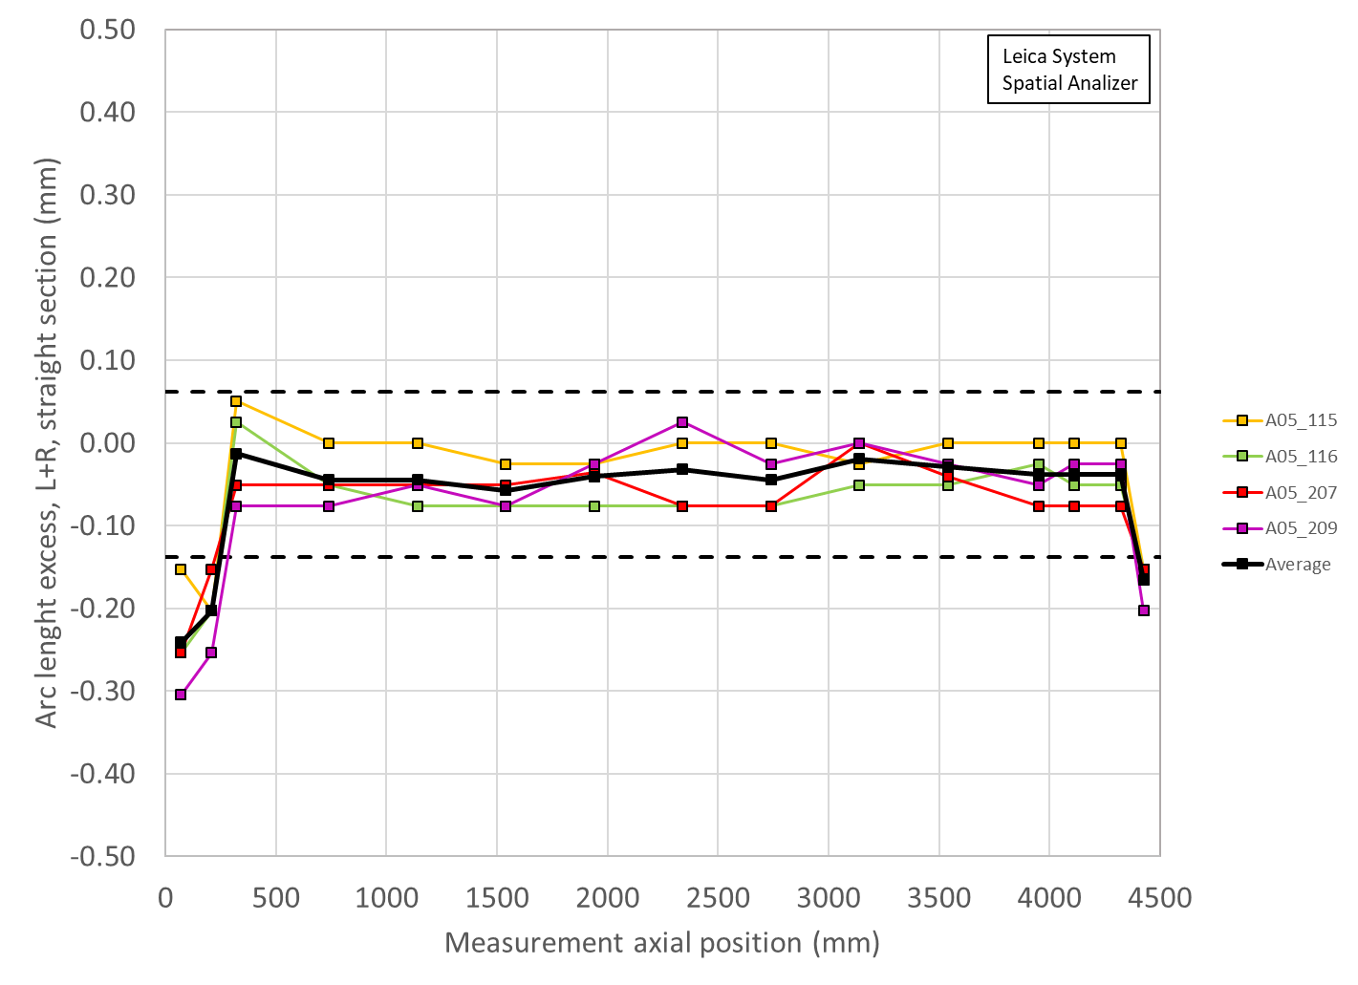
Radial dimensions of the shimmed coil pack
The coil arc-length is usually undersized
With the mid-plane shim we bring the coil “almost” to the nominal dimensions
  In reality 1) shim has finite given thickness and 2) coil has size variations along the length (and shim is full length with constant thickness)
So, we can produce a radial deviation resulting from the final shimmed azimuthal deviation (average of the coils)
  Δr_{_ave} = Δ_arc-length_{_ave} * 2/ π
A14b
A05
 | Ave ss | LE min | RE min
 | mm | mm | mm
A14b | -0.007 | -0.129 | -0.107
A5 | -0.025 | -0.129 | -0.105

Slide 8
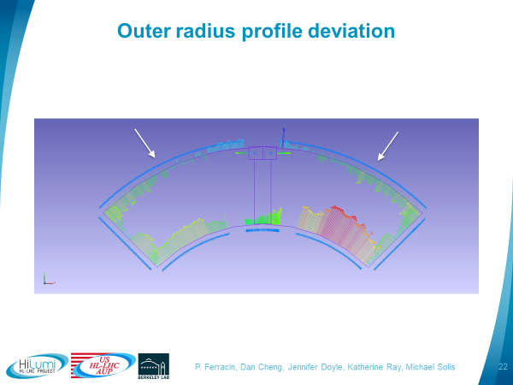
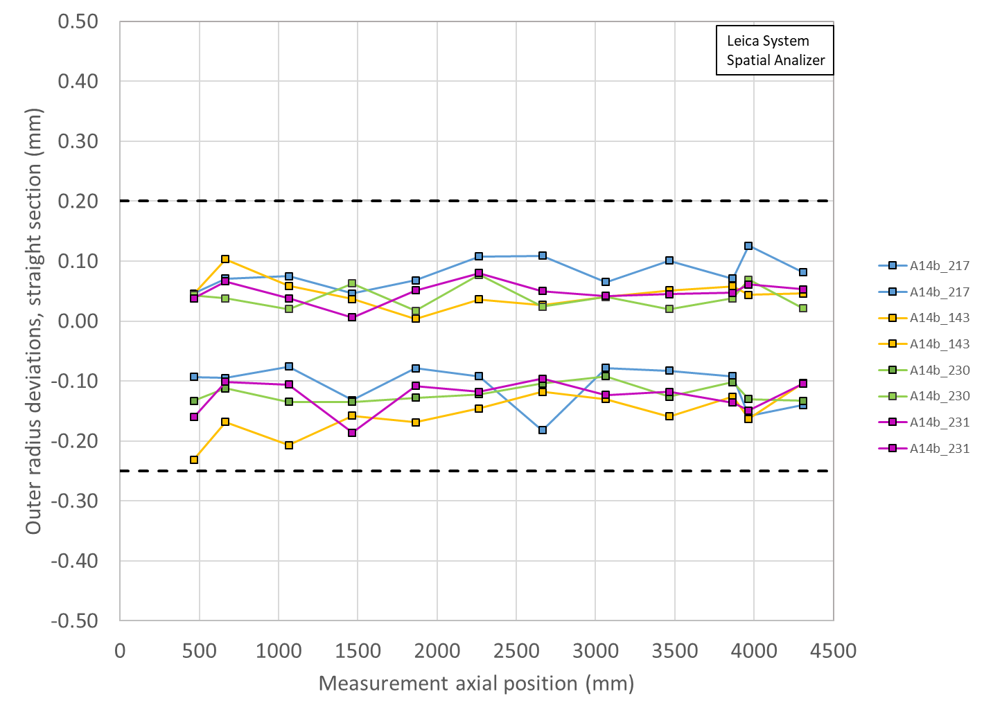
Radial dimensions of the shimmed coil pack
There is also a radial deviation due to OR+mid-plane fit of the coil dimensional measurement data
 | OR Ave ss | OR LE min | OR RE min
 | mm | mm | mm
A14b | -0.029 | -0.056 | -0.050
A5 | -0.025 | -0.050 | -0.050

Slide 9
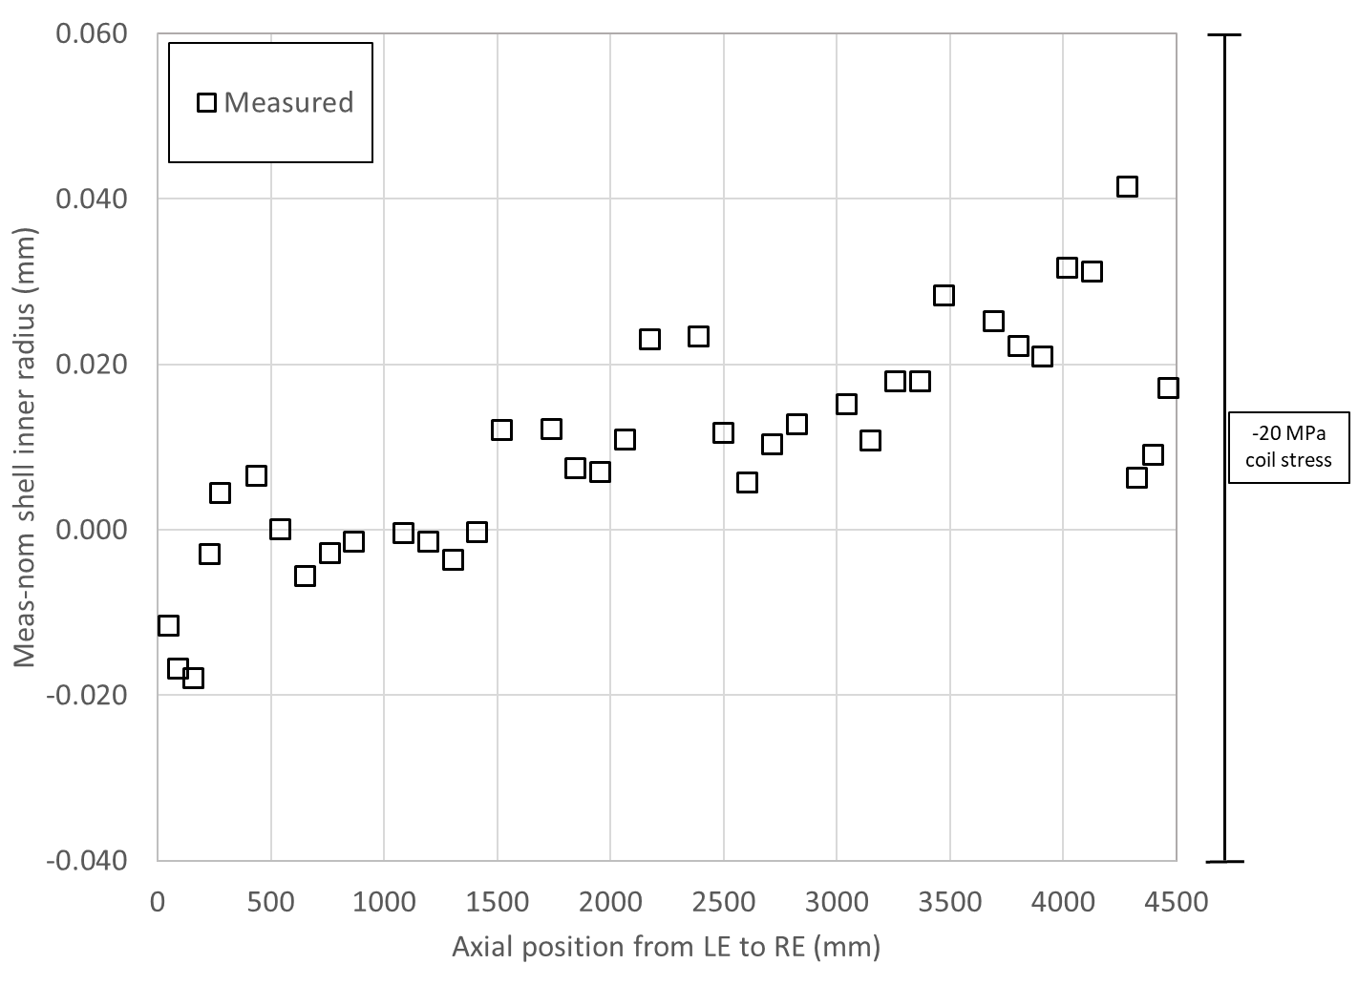
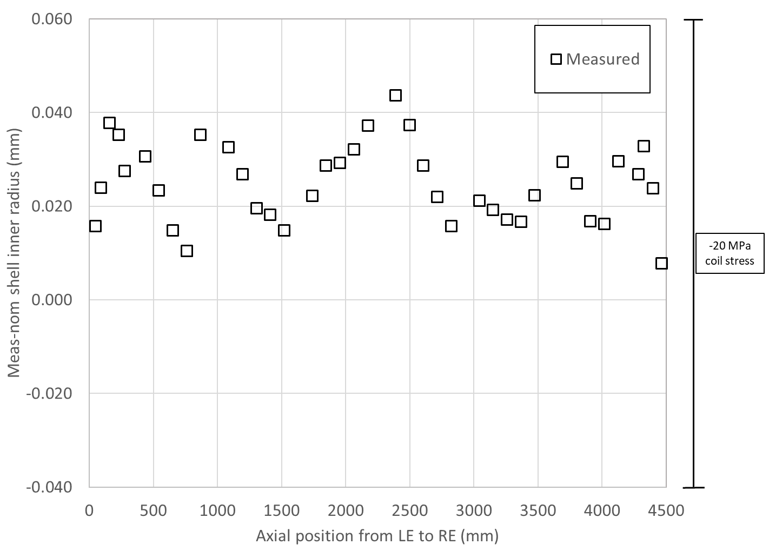
Radial build-up of the structure
“under the assumption that collars, pads, masters, yoke, and shell have nominal dimensions”
A14b
A05

Slide 10
Summary
By adding up….
  We get an upper bound (A14b) and a lower bound (A05)
 | Ave ss | OR_Ave ss | Sum_ss | LE min | OR_LE_min | Sum_LE | RE min | OR_RE_min | Sum_RE | Key | Shim | Shim | Ave ss + shim | LE + shim | RE + shim
 | mm | mm | mm | mm | mm | mm | mm | mm |  | mm | mils | mm | mm | mm | mm
A14b | -0.007 | -0.029 | -0.037 | -0.129 | -0.056 | -0.185 | -0.107 | -0.050 | -0.157 | 13.84 | 43 | 1.092 | 1.055 | 0.907 | 0.935
A5 | -0.025 | -0.025 | -0.050 | -0.129 | -0.050 | -0.179 | -0.105 | -0.050 | -0.155 | 13.79 | 41 | 1.041 | 0.991 | 0.862 | 0.886

Slide 11
Outline
A14b and A05 and A13 quench performance
Computation radial build-up in A14b and A05
Target loading shim size in A17

Slide 12
Summary and proposal
 | Ave ss | Key | Shim | Shim | Ave ss + shim
 | mm | mm | mils | mm | mm
A17 up | -0.004 | 13.84 | 43 | 1.092 | 1.088
A17 low | -0.004 | 13.77 | 40 | 1.016 | 1.012
 | LE | Key | Shim | Shim | LE + shim
 | mm | mm | mils | mm | mm
A17 up | -0.134 | 13.84 | 43 | 1.092 | 0.959
A17 low | -0.134 | 13.77 | 40 | 1.016 | 0.882
 | RE | Key | Shim | Shim | RE + shim
 | mm | mm | mils | mm | mm
A17 up | -0.125 | 13.87 | 44 | 1.118 | 0.992
A17 low | -0.125 | 13.82 | 42 | 1.067 | 0.941
Proposed target
  Aiming at a shim of 43 mils, with the possibility of going to 42-44 mils depending on SG data

Slide 13
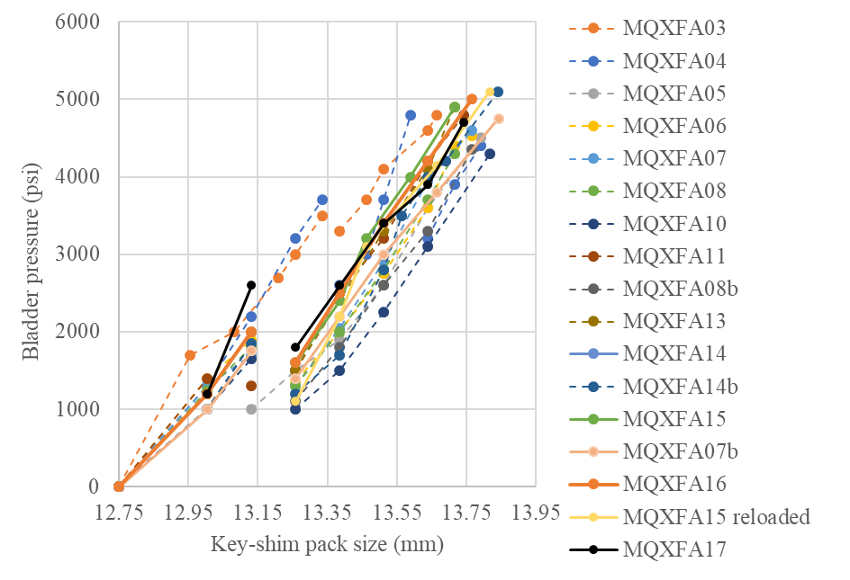
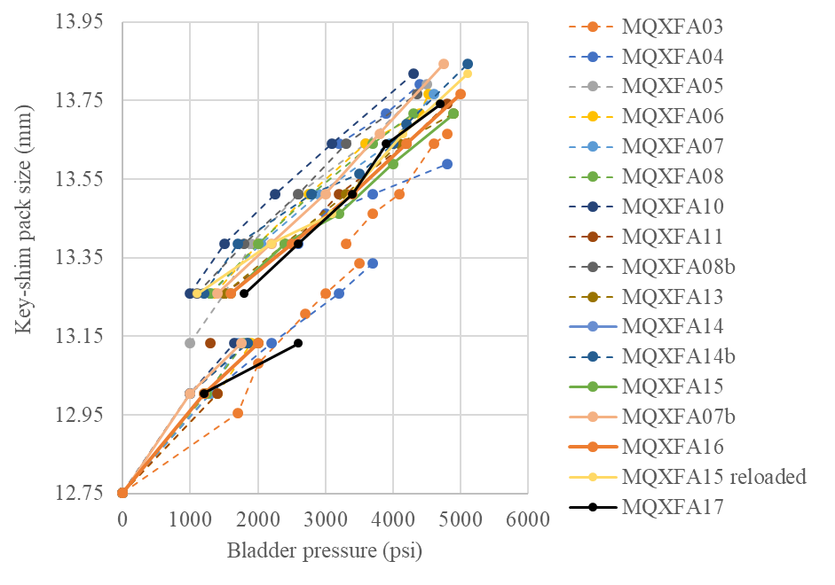
Key-shim size vs. bladder pressure

Slide 14
Magnet assembly and loading
Specifications (shells)
For the pre-load targets at the end of the pre-load:
  The target average measured stress on coils, shells and rods at the end of the loading (after at least 24 h) shall be
    Shell average azimuthal stress: +58 ±6 MPa
Channel | SC02TT | SC02RT | SC02BT | SC02LT | Average
Preload (end) | 64 | 65 | 47 | 66 | 61
Overnight (end) | 63 | 65 | 45 | 66 | 60
Channel | SC04TT | SC04RT | SC04BT | SC04LT | Average
Preload (end) | 65 | 50 | 69 | 66 | 63
Overnight (end) | 65 | 50 | 68 | 65 | 62
Channel | SC07TT | SC07RT | SC07BT | SC02LT | Average
Preload (end) | 61 | 67 | 71 | 66 | 66
Overnight (end) | 60 | 67 | 71 | 65 | 66

Slide 15
Magnet assembly and loading
Specifications (coils)
For the pre-load targets at the end of the pre-load:
  The target average measured stress on coils, shells and rods at the end of the loading (after at least 24 h) shall be
    Coil (winding pole) average azimuthal stress: -80 ±8 MPa
Channel | CQ1T | CQ2T | CQ3T | CQ4T | Average
Preload (end) | -92 | -73 | -98 | -79 | -86
Overnight (end) | -93 | -72 | -98 | -80 | -86

Slide 16
Magnet assembly and loading
Specifications (coils)
For the maximum stress reached during the pre-load operations:
  During the entire pre-load operation, the maximum compression measured on each coil shall never exceed -120 MPa
Peak stress on coils (MPa)
Electrical SGs
CQ1 | CQ2 | CQ3 | CQ4
-110 | -91 | -120 | -100
FBGs
CQ1-700 | CQ2-700 | CQ3-700 | CQ4-700 | CQ1-1900 | CQ2-1900 | CQ3-1900 | CQ4-1900 | CQ1-3800 | CQ2-3800 | CQ3-3800 | CQ4-3800
-86 | -89 | -98 | -83 | -88 | -129 | -121 | -103 | -83 | -93 | -94 | -70

Slide 17
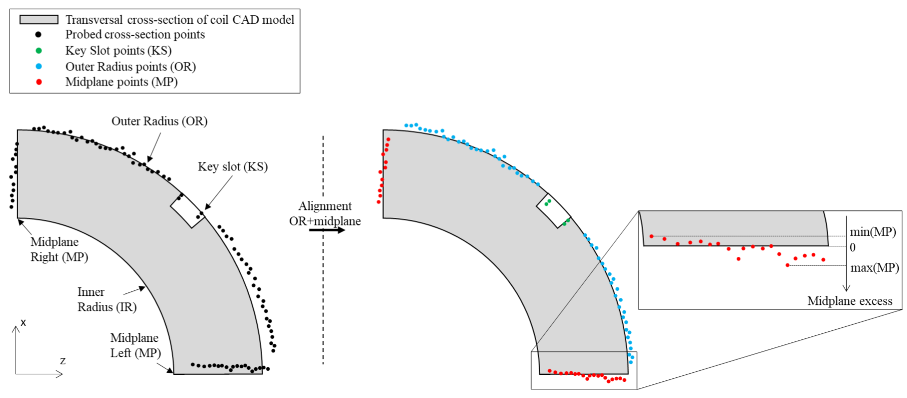
Impregnated coil dimensional tolerances
Arc length excess (ends)
At 260 and 300 mm (for the lead end) and at 4340 and 4380 mm (for the return end) the absolute value of the coil delta arc-length must not exceed 210 mm.
  The coil delta arc-length is the difference between the coil arc length at each location in the ends and the average coil arc-length in the straight section.

Slide 18
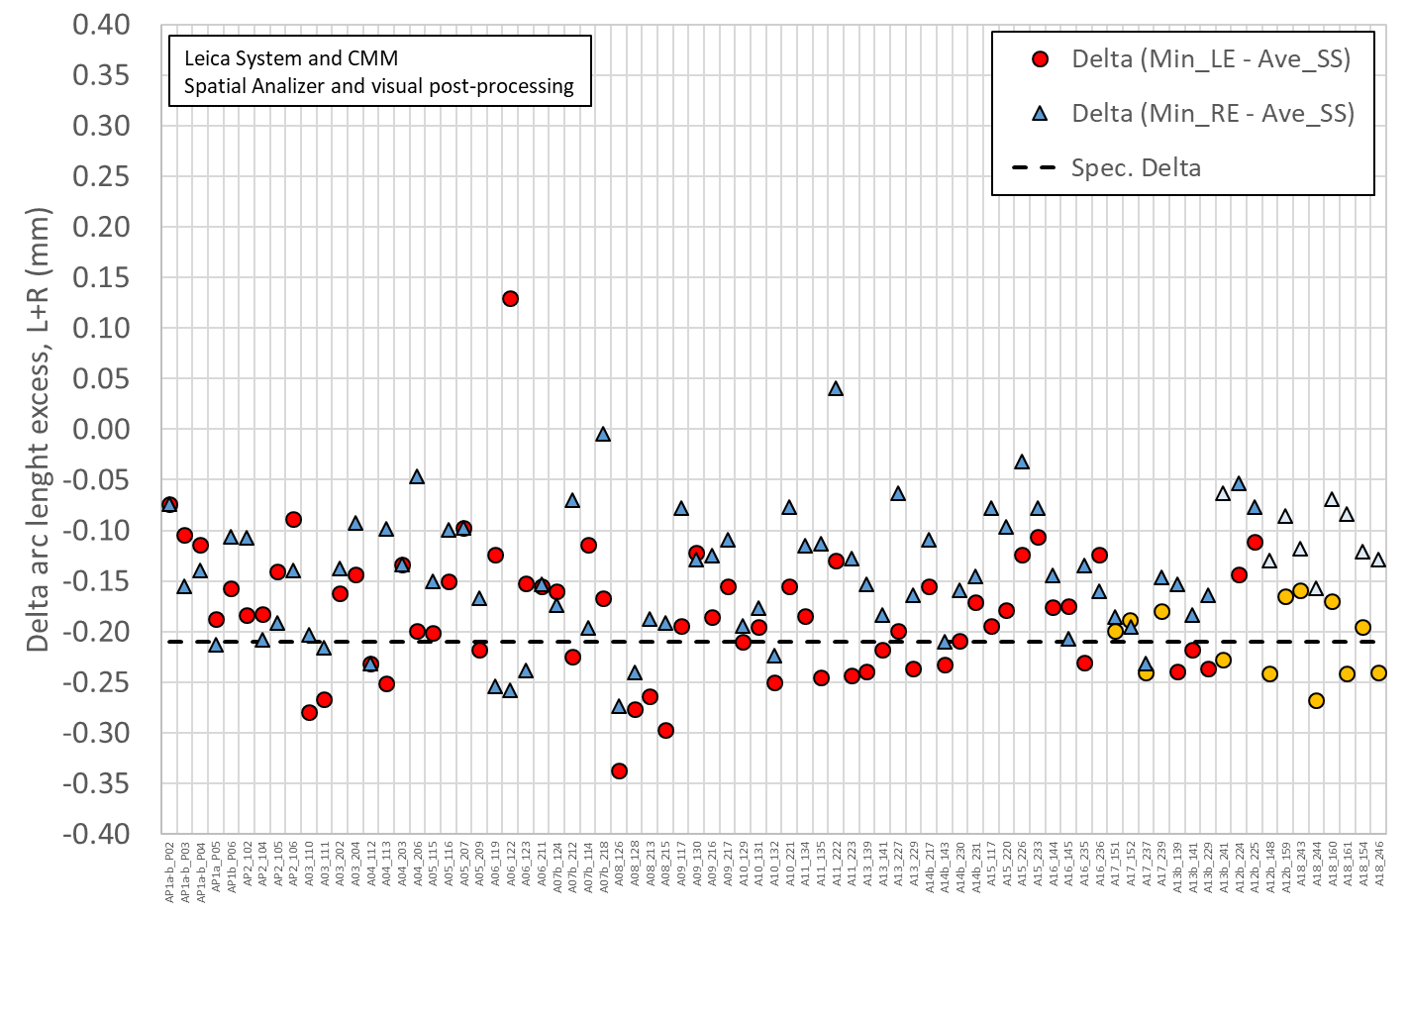
Only few coils have the measurements in the 260-300 mm positions, but all in the 207 mm position

Slide 19
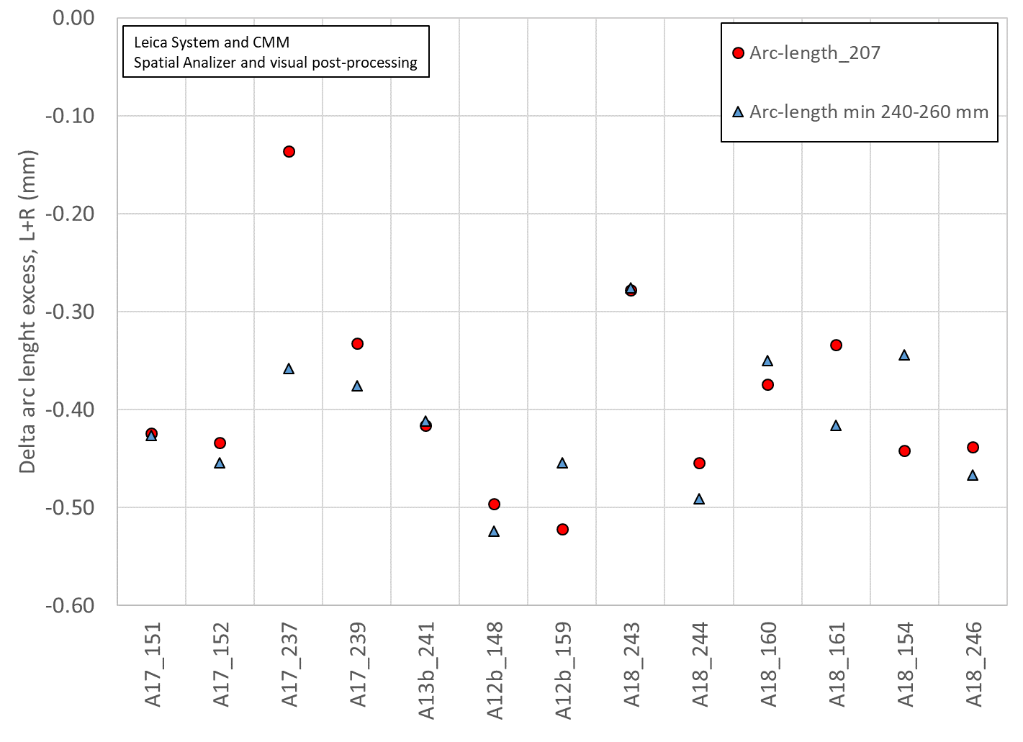
Only few coils have the measurements in the right position
Except for 1 coil (A17_237), the 207 mm position is a relatively good representation of the minimum of 260-300 mm positions
All included, the average difference is -0.021 mm (260-300 mm slightly smaller than 207 mm

Slide 21
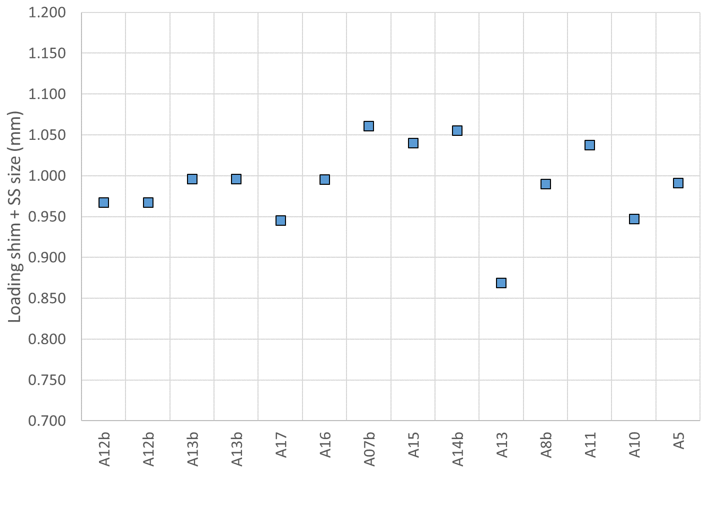
Loading shim + SS radial size

Slide 22
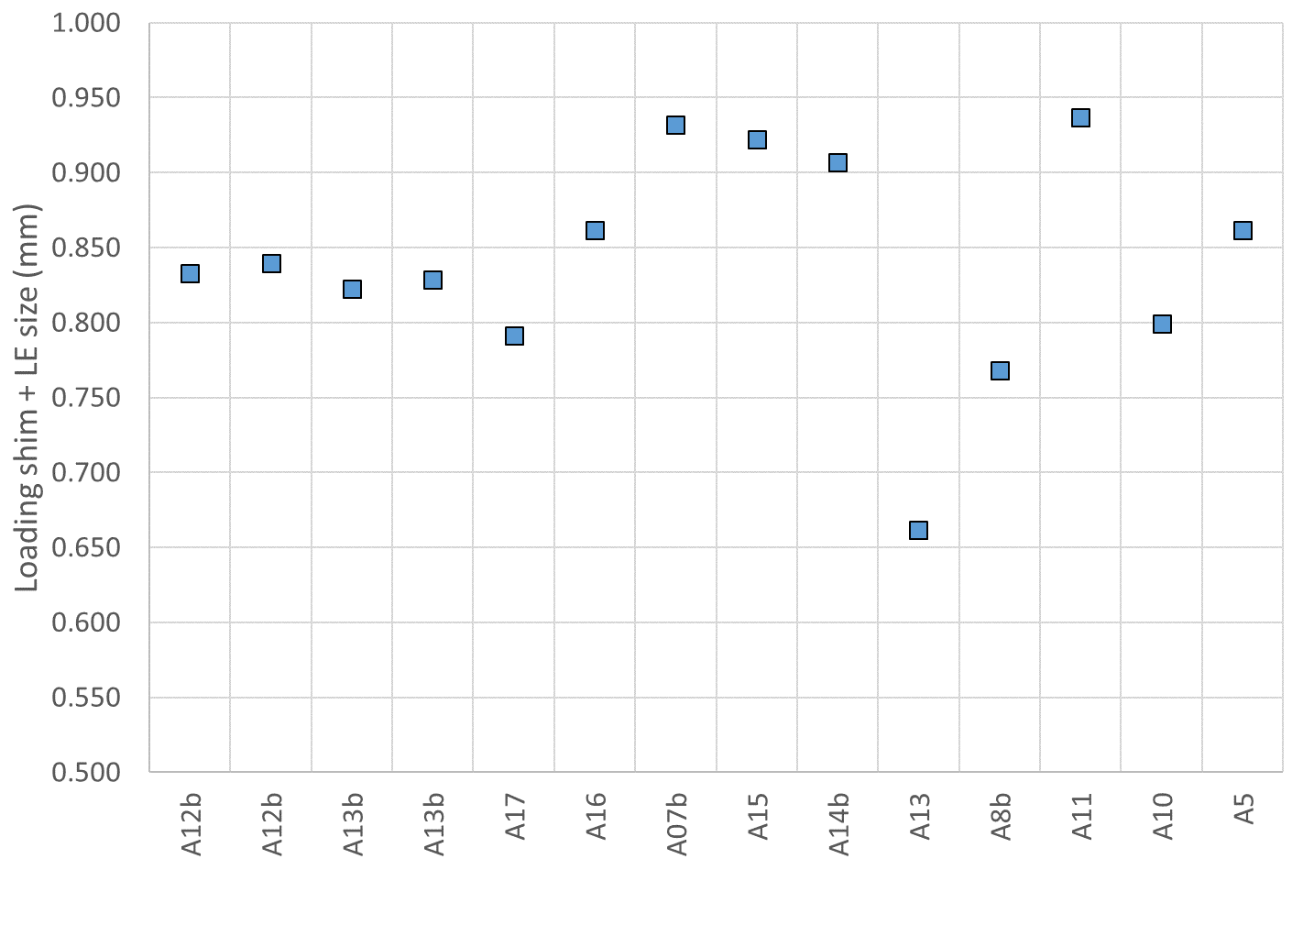
Loading shim + LE radial size

Slide 23
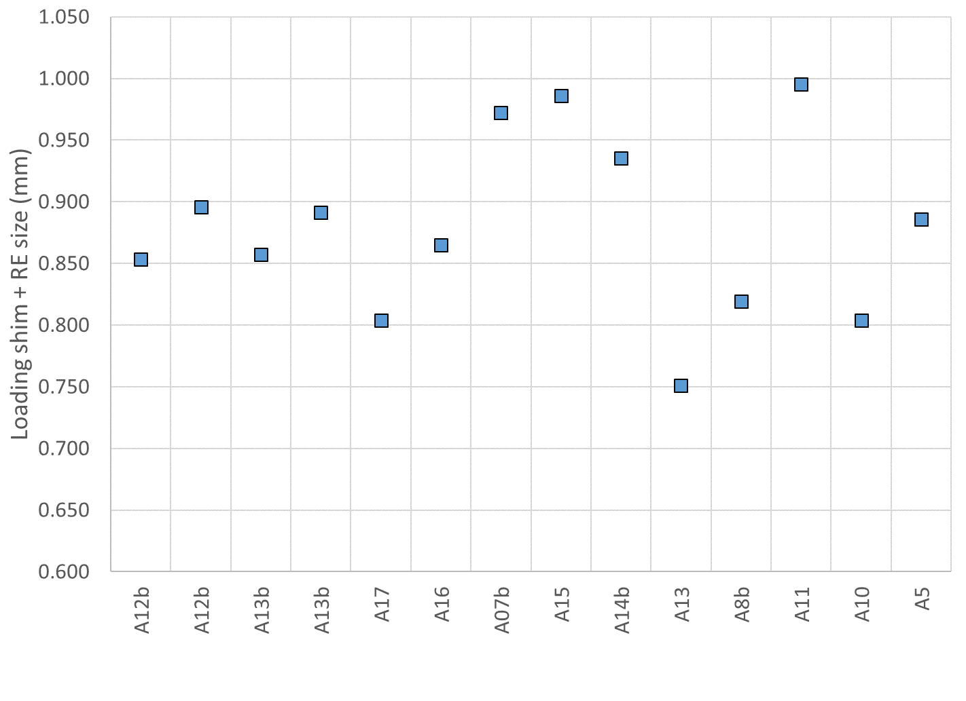
Loading shim + RE radial size

