Slide 1
CMS and CCE2
Chris Jones
CCE AHM
July 2024

Slide 2
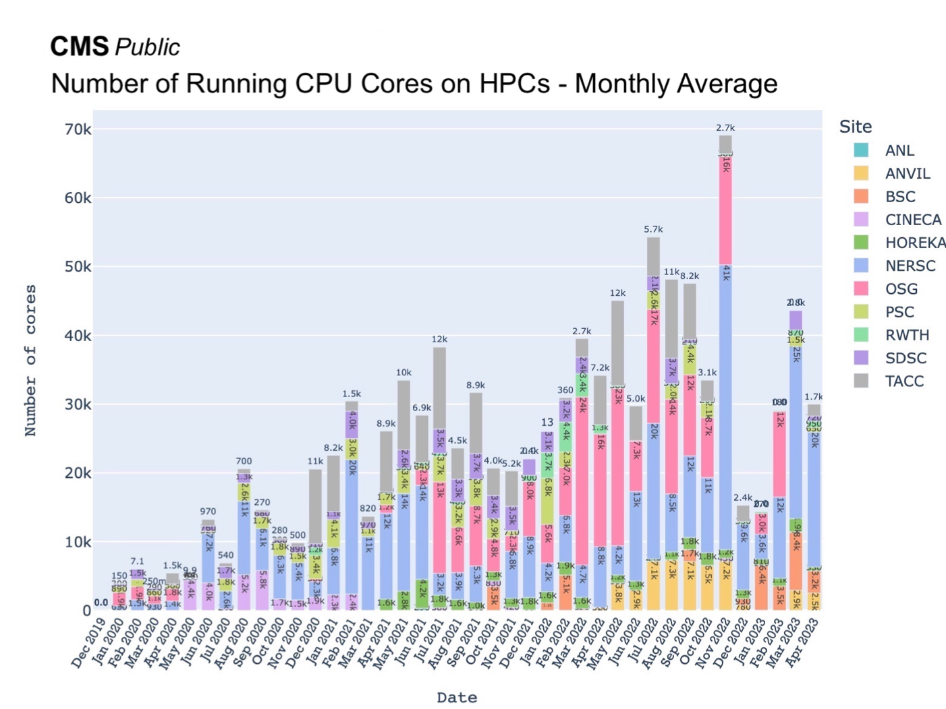
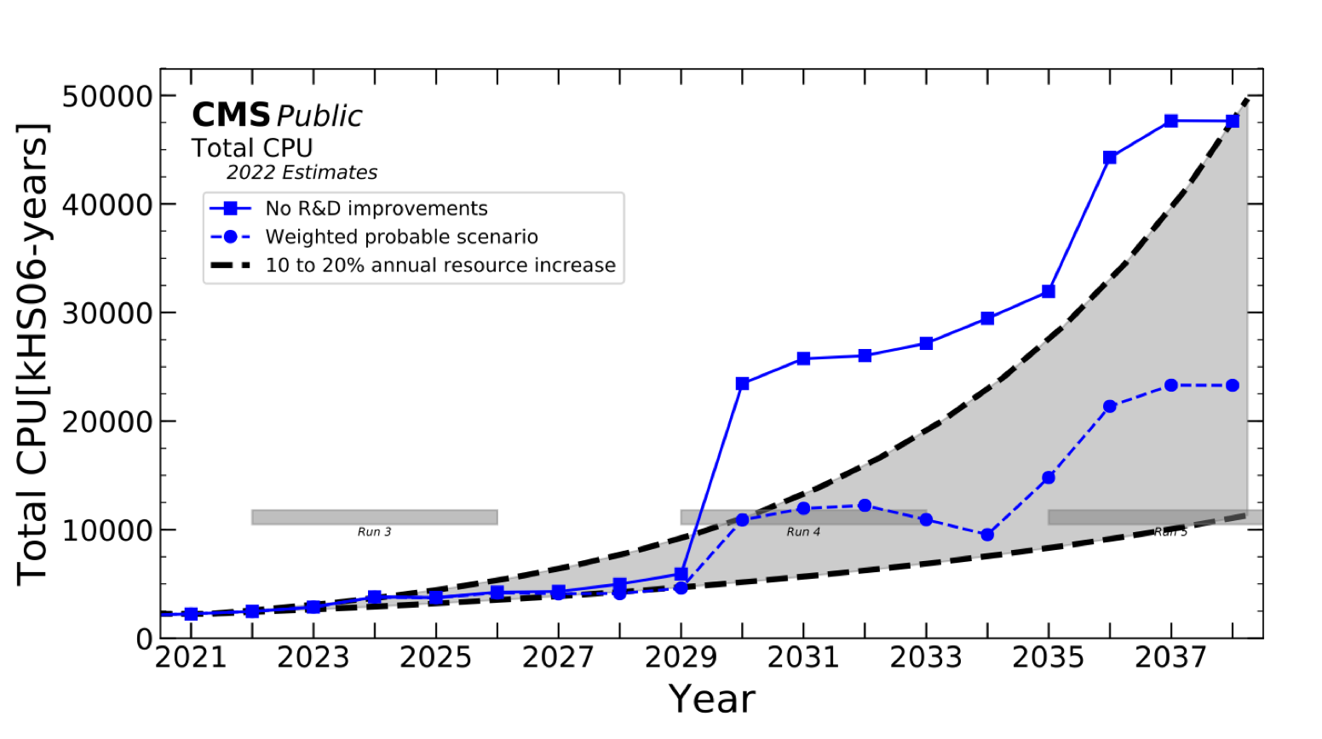
Strategy
USCMS investing in heterogeneous architectures to meet challenges of HL-LHC
HPC resources are key aspect of this strategy
Three areas
Easing and further ramp up of HPC resources for all use cases
Integrating heterogeneous resources and workflows into our software
Developing distributed, scalable, and efficient storage systems (we’ve focused on this thus far)

Slide 3
Effectively using HPCs
Take advantage of heterogeneous resources from production to large scale ML training
Areas
Patatrack to demonstrate on-host acceleration of reconstruction algorithms
Offload to inference servers (like SONIC) on HPC
Following HEPCloud, integrate HPCs through common API
Develop fast and scalable ML training interface to users
Optimize data and network from HPCs to experiment
Develop event generator workflows that scale to HPC

Slide 4
Object Stores – RNTuple Integration
Evaluation and eventual migration to RNTuple is a critical activity
Different data-sharing model – Object Stores
Perhaps replace concept of data tiers with queries and tiered caching
Had performed studies that show excellent scaling of s3 protocol backed by Ceph object store
Investigate RNTuple integration with object stores
Nick Smith (new junior physicist) will lead
Connection to DUNE and other experiments

Slide 5
CMS related work so far in CCE2
Focused on RNTuple evaluation and integration (highest priority for CMS)
See Chris Jones Talk
Starting to investigate DAOS and s3 for object stores (Nick Smith)
Simplifying deployment of p2r (multiple GPU workflows) with Spack for Cookbook (Martin Kwok)
Replace command line tools and scripts with Spack recipe
Ramping up work in other areas
Effectively using HPC (patatrack, SONIC, data and network optimization, etc)
Heterogeneous Workflow Integration – MLPF for reconstruction with ML techniques
Significant GPU training needs

