Slide 1
CERN openlab and HPC activities
Maria Girone, CERN
Head of CERN openlab
Notes:
Good morning, I am Maria Girone, the Head of CERN openlab. I will discuss some of the activities focused at CERN for HPC integration, in particular within the European ecosystem

Slide 2
Outline
01
02
03
Introduction: CERN and HPC activities
R&D collaborations with science and industry
CoE RAISE
interTwin
04
05
Relationship with EuroHPC and access to resources
Spectrum
Notes:
This is the outline of my talk. I will start with our R&D Collaborations between science and industry, then I will cover two of the technical developments, and then finish with our planning and strategy activities

Slide 3
Introduction: CERN and HPC activities
R&D collaborations with science and industry
01
Notes:
I will start with HPC Activities at CERN with Science and Industry

Slide 4
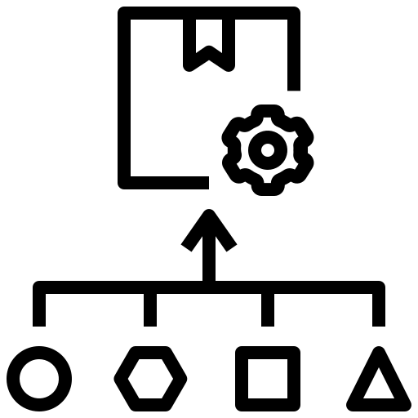
Motivation
New Techniques and Technologies
New Challenges and Opportunities
Enables Machine Learning and AI algorithms and processing techniques
New resources for processing
Opens the possibility for real-time interactive simulations (Digital Twins)
Encourages stronger engagement with industry, other science communities and the computing community
A path to optimize energy usage
Requires technology migration and redesigning of applications
Requires strategic planning and communication with the existing distributed computing community
Notes:
The motivation for engaging with HPC is driven by the new challenges and opportunities that arise today from the rapidly evolving technological landscape.
Access to resources essential to tackle complex problems, such as AI and ML, DT, however
Necessitates technology migration and the redesigning of applications to fully leverage these advanced capabilities, offering a path to energy optimizations
HPC encourages stronger collaboration with industry, other scientific communities
Requires strategic planning and effective communication

Slide 5
Collaborations and R&D on HPC
New Techniques and Technologies
New Challenges and Opportunities
Enables Machine Learning and AI algorithms and processing techniques
New resources for processing
Requires technology migration and redesigning of applications
Opens the possibility for real-time interactive simulations (Digital Twins)
Encourages stronger engagement with industry, other science communities and the computing community
A path to optimize energy usage
ODISSEE
Online Data Intensive Solutions for Science in the Exabyte Era
Requires strategic planning and communication with the existing distributed computing community
Notes:
Many Collaborations, supported by European Commission and Horizon Europe, with projects like CoE RAISE, interTwin and SPECTRUM, while on the technological side CERN openlab

Slide 6
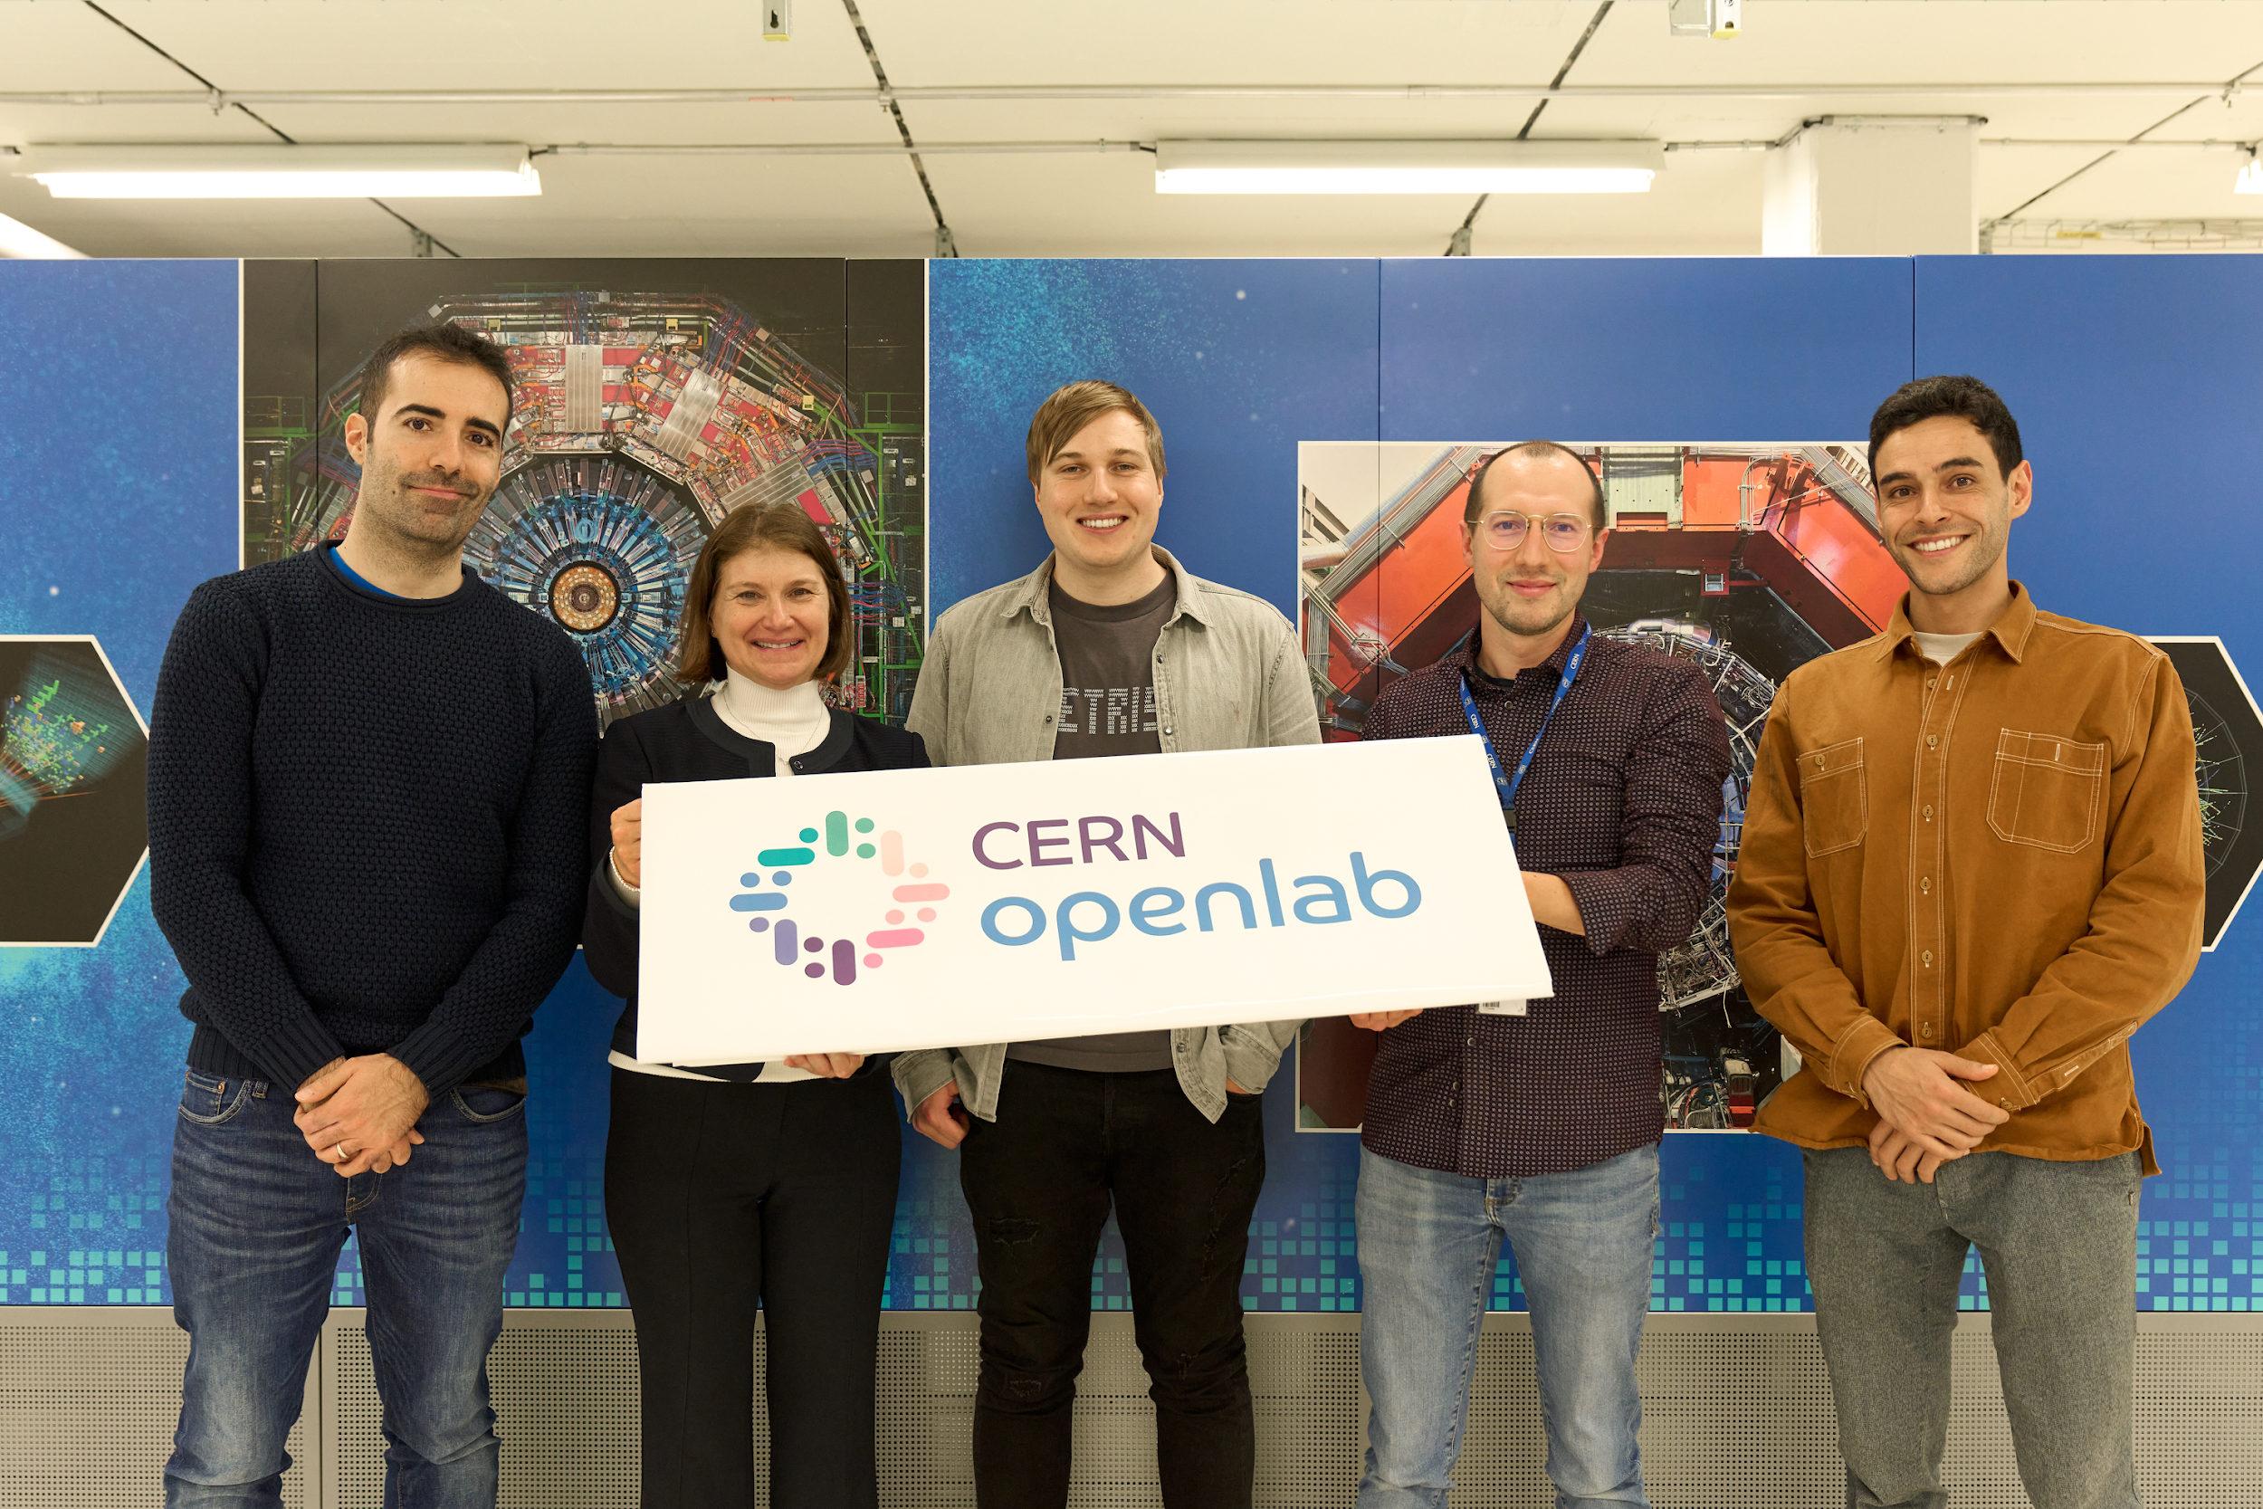
CERN
openlab
1
Establishing strategic industry collaborations
2
Fuelling technological innovation
Since its inception, CERN openlab has fostered the development of big data scientific research through four primary missions.
3
Exposing technology to scientists
4
Nurturing knowledge and growth in young STEM researchers
Notes:
CERN openlab has been running for more than 20 years as a unique public-private partnership. We focus on establishing industry collaborations, fuelling technological innovation, exposing technology to scientists and nurturing knowledge and growth in your STEM researchers

Slide 7
Stakeholders
CERN openlab’s primary role is to act as conduit and facilitator for collaboration in computing science and technology between two categories of stakeholders:
The science communities
(CERN departments and groups; R&D teams at CERN; Research centres)
Technology providers
(Industry)
Notes:
CERN openlab’s primary role, which makes it a unique resource for science, is to act as a conduit and facilitator for collaboration connecting the science computing and industry

Slide 8
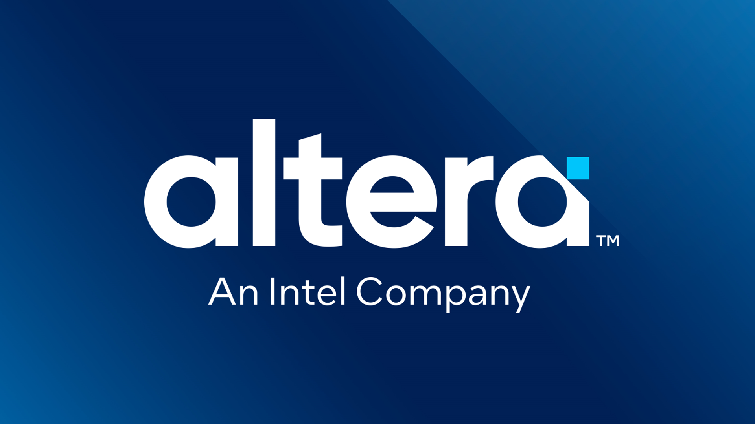
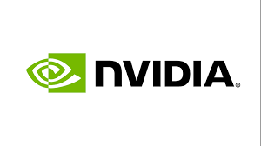
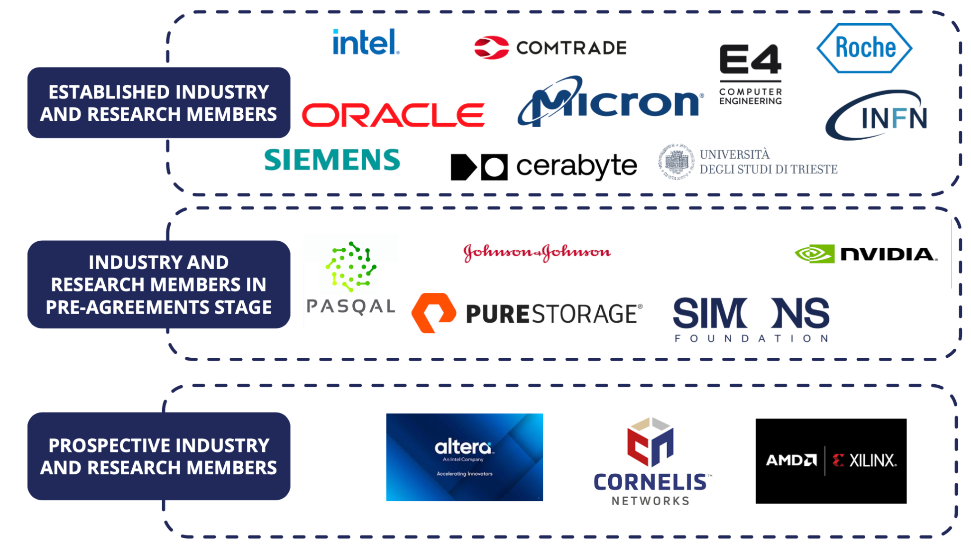
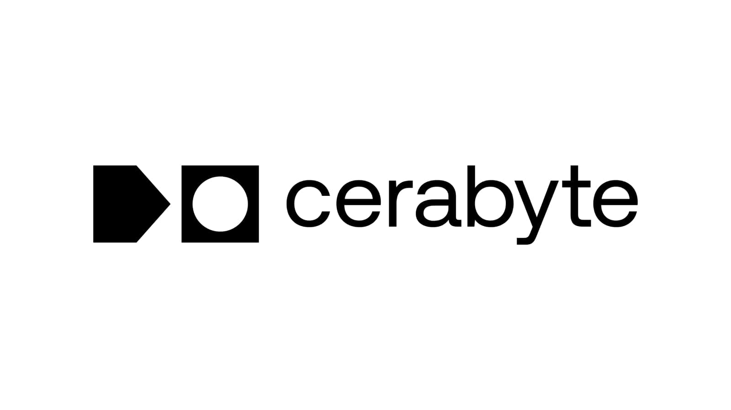
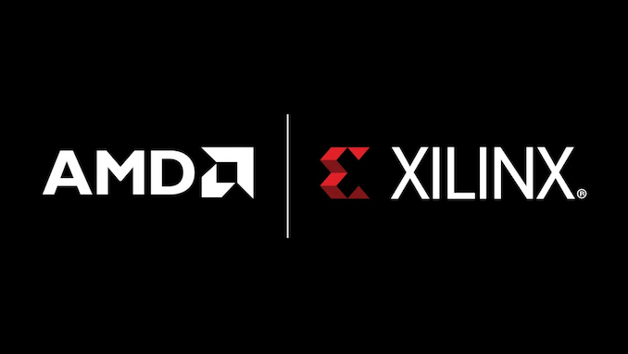
Unified programming models and portability
Examples of Projects in HPC Areas
FPGA Acceleration
Expandable Memory and AI on edge devices
Accelerators and RISC-V
Accelerators, digital twins and AI
AI/HPC Convergence, AI tuning
Advanced Archival Storage & Digital Preservation
High Performance Scalable Storage
Low latency networking
FPGA Acceleration
Notes:
On the left you see a list of current, developing and prospective openlab partners. On the right I have called out an incomplete list of example projects with connections to our HPC R&D projects.

Slide 9
CoE RAISE
02
Notes:
In CERN openlab teams also work on with the support of European commission. The first project is Center of Excellence RAISE

Slide 10
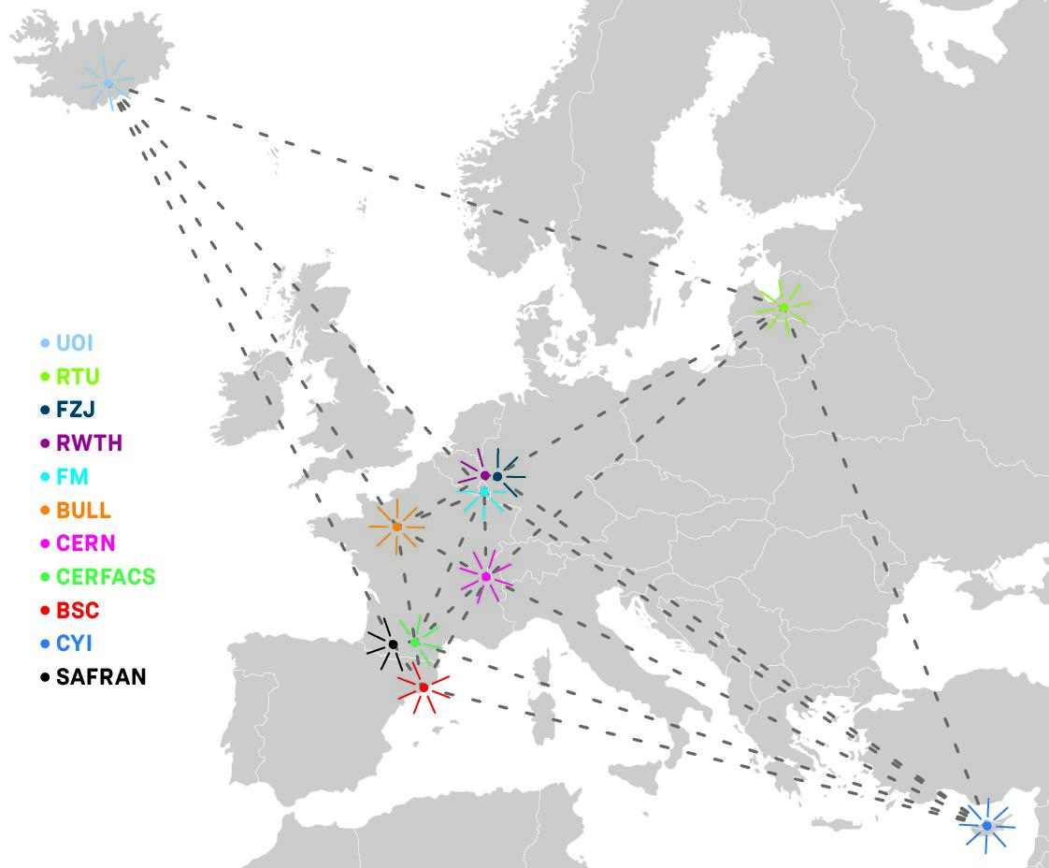
CoE RAISE
Develop novel, scalable Artificial Intelligence technologies
Center of Excellence for Research on
AI- and Simulation-based Engineering at Exascale
Hardware infrastructure
Software infrastructure
Computer-driven use-cases
Data-driven use-cases
Connect
WP4: Data-Driven Use-Cases towards Exascale
Leader: Dr. Maria Girone
Task 4.1.: Event reconstruction and classification at the CERN HL-LHC → more details later
Leader: Eric Wulff
WP2: AI- and HPC-Cross Methods at Exascale
Leader: Prof. Morris Riedel
Provides expert support on HPC and AI methods to use-cases in WP4
CoE RAISE Partners
https://www.coe-raise.eu/
Notes:
The Center of Excellence for Research on AI- and Simulation-based Engineering at Exascale, or CoE RAISE.
Our primary objective is to develop novel and scalable Artificial Intelligence technologies. The project CONNECS hardware and software infrastructures and HPC centers to SCIENCE, with use-cases that are computer- and data-driven categories, leveraging cutting-edge computational resources and data processing techniques. CERN leads the Data-Driven Use-Cases towards Exascale, with event reconstruction and classification at the CERN HL-LHC.

Slide 11
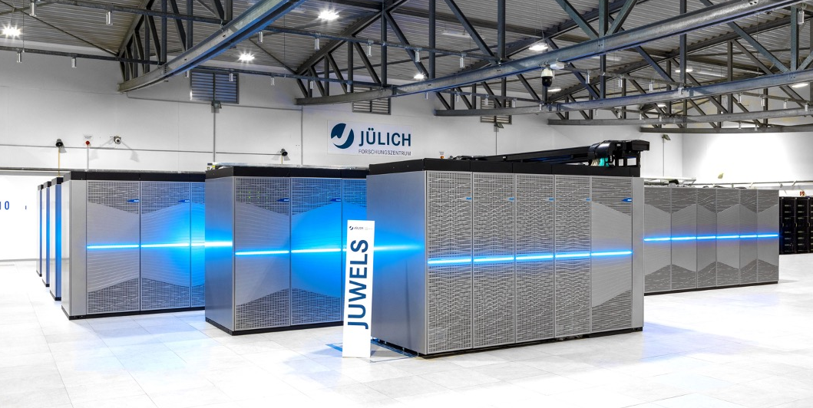
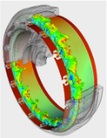
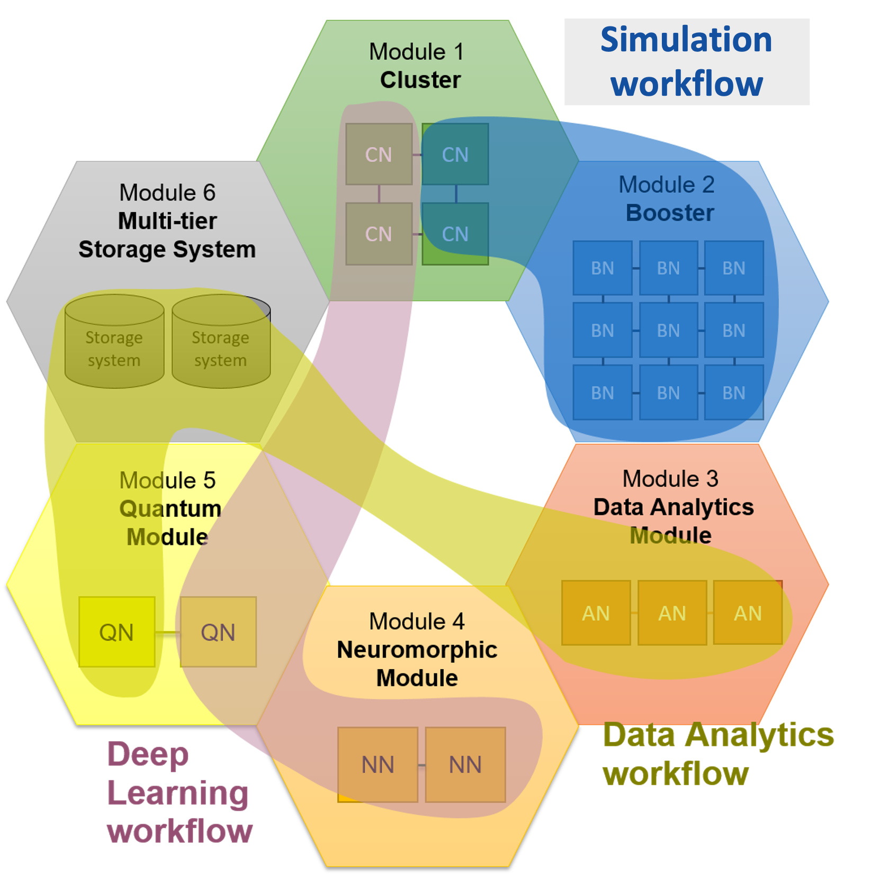
CoE RAISE
Modularity of next generation HPC systems
Complex Hardware
Complex Task
Find the most suitable hardware for a specific task
Enable intertwined AI- and HPC workflows
EuroHPC’s roadmap includes integrating Quantum Computers and Quantum simulators in already existing supercomputer centers [1]
[1] https://eurohpc-ju.europa.eu/selection-six-sites-host-first-european-quantum-computers-2022-10-04_en
Notes:
CoE RAISE is built on the innovative modular supercomputer architecture, pioneered at the JSC, which allows us to tackle complex tasks by seamlessly integrating them with sophisticated hardware.
This architecture is designed to identify and utilize the most suitable hardware for each specific task, ensuring optimal performance and efficiency. One of the key strengths of CoE RAISE is its ability to intertwine AI and High-Performance Computing workflows, creating a powerful synergy that enhances both fields. This includes also the QC resources for specific tasks.

Slide 12
AI-based particle flow reconstruction workflow
Physics Simulation
Dataset Creation
ML Training
Trained Model
Data Selection
Data Pre-processing
Model Export
Event Reconstruction
J. Pata et al.
Tracks and Calorimeter Clusters
Reconstructed Particles
Notes:
The CERN use-case is the AI-based particle flow, in collaboration with colleagues at CMS.
Starting from a physics simulation, we create a labelled dataset suitable for supervised learning.
Once trained, the model is exported to a portable format (usually ONNX, Open Neural Network Exchange). We are then able to use our model in inference mode to efficiently reconstruct individual stable particles and their four momentum from tracks and calorimeter clusters.

Slide 13
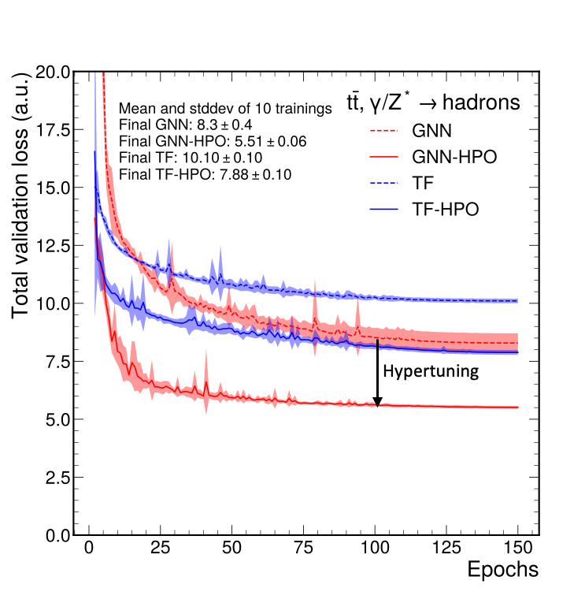
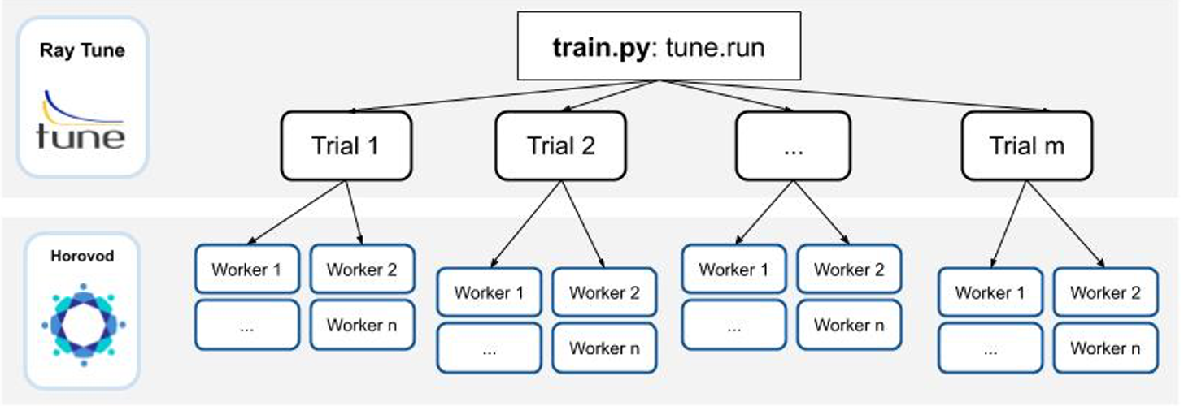
Large-scale distributed hyperparameter optimization
Distributed HPO
Hyperparameter tuning results
Using ASHA + Bayesian Optimisation
Scalable up to hundreds of GPUs
Final validation loss decreased by giving a significant performance improvement from HPO
Pata, J., Wulff, E., Mokhtar, F. et al. Improved particle-flow event reconstruction with scalable neural networks for current and future particle detectors. Commun Phys 7, 124 (2024). https://doi.org/10.1038/s42005-024-01599-5
Notes:
A use case where HPC can be especially helpful, due the impressive computing power of modern supercomputing systems, is hyperparameter optimization (HPO).
HPO is very compute resource intensive. We perform HPO in two levels of parallelization.
One where trials are run in parallel, with one trial per compute node we have available.
The second level is the distribution of each trial in each node to all available GPUs in that node, usually 4 or 8 GPUs.
Using the ASHA algorithm to schedule and terminate trials and Bayesian Optimization to select which trials to evaluate next, we improved the final validation loss by more than a third, giving a significant physics performance improvement. We have seen that this kind of workflow is scalable up to hundreds of GPUs.

Slide 14
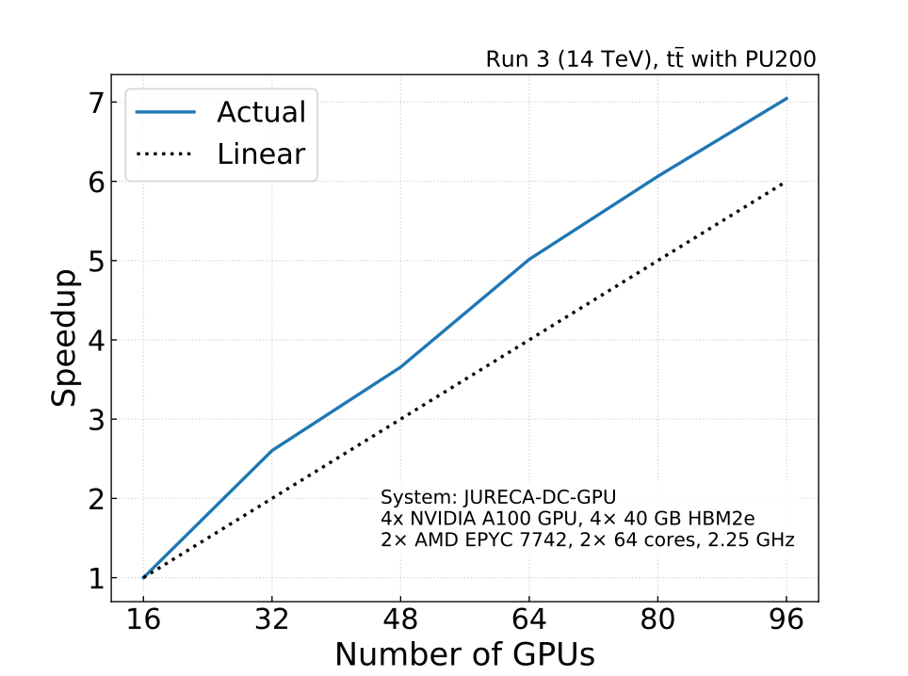
Scaling of an HPO workflow on HPC
Scaling of a HPO run of MLPF on the JURECA-DC-GPU system at the the Jülich Supercomputer Centre (JSC), 4 NVIDIA A100 and 2× 64 cores AMD EPYC 7742 per node.
Superlinear scaling due to re-loading of models when using fewer nodes
Using the ASHA algorithm to schedule and terminate trials, in combination with Bayesian optimization
In collaboration with WP2 in CoE RAISE we have also shown scaling of multi-node distributed training of deep learning models on up to 256 compute nodes (1024 GPUs).
Data used: Simulated particle-level events of ttbar and QCD with PU200 using Pythia8+Delphes3 for machine learned particle flow (MLPF), https://doi.org/10.5281/zenodo.4559324
Notes:
This plot shows the scaling of an HPO workflow where the MLPF model is optimized. It was run on the JURECA-DC system at JSC. We observe a superlinear scaling in the speedup with the number of GPUs used, likely due to the more frequent re-loading of models that is necessary when running ASHA with fewer nodes. This superlinear scaling shows that HPO can benefit immensely from large-scale computing resources such as those available at HPC sites.
In addition, in collaboration with WP2 in CoE RAISE, we have shown multi-node distributed training of deep learning model to scale very well up to 256 compute nodes (1024 GPUs).

Slide 15
interTwin
03
Notes:
The next project is also an example of executing complex science workflows using HPC infrastructures. In this case it is digital twins.

Slide 16
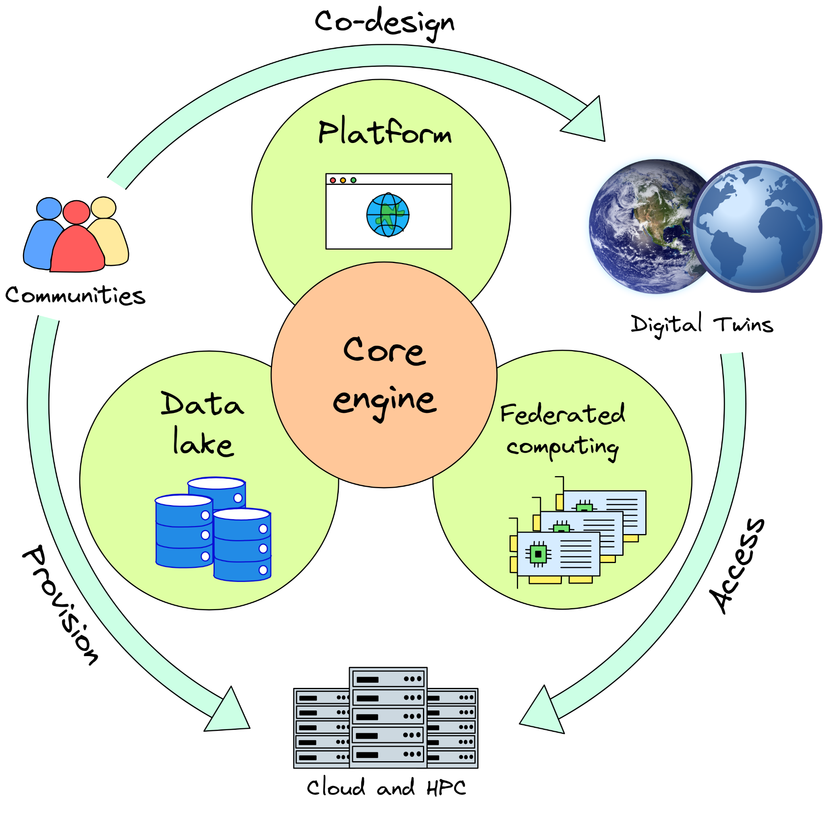
interTwin
A Digital Twin Engine for Science
Co-design and implement the prototype of an interdisciplinary Digital Twin Engine​
Open-source platform based on open standards​
Large spectrum of diverse use cases from physics and earth observation sciences​
https://www.intertwin.eu/
Notes:
interTwin, a project funded by the EC, in which we are developing a digital twin engine for science.
The goals of interTwin are: <read the 3 boxes>
Differently from traditional DT applications, scientific DTs are compute intensive. One of the goals of interTwin is to provide researchers with simplified access to a federated pan-European computing infrastructure, sized to support large-scale DT applications.

Slide 17
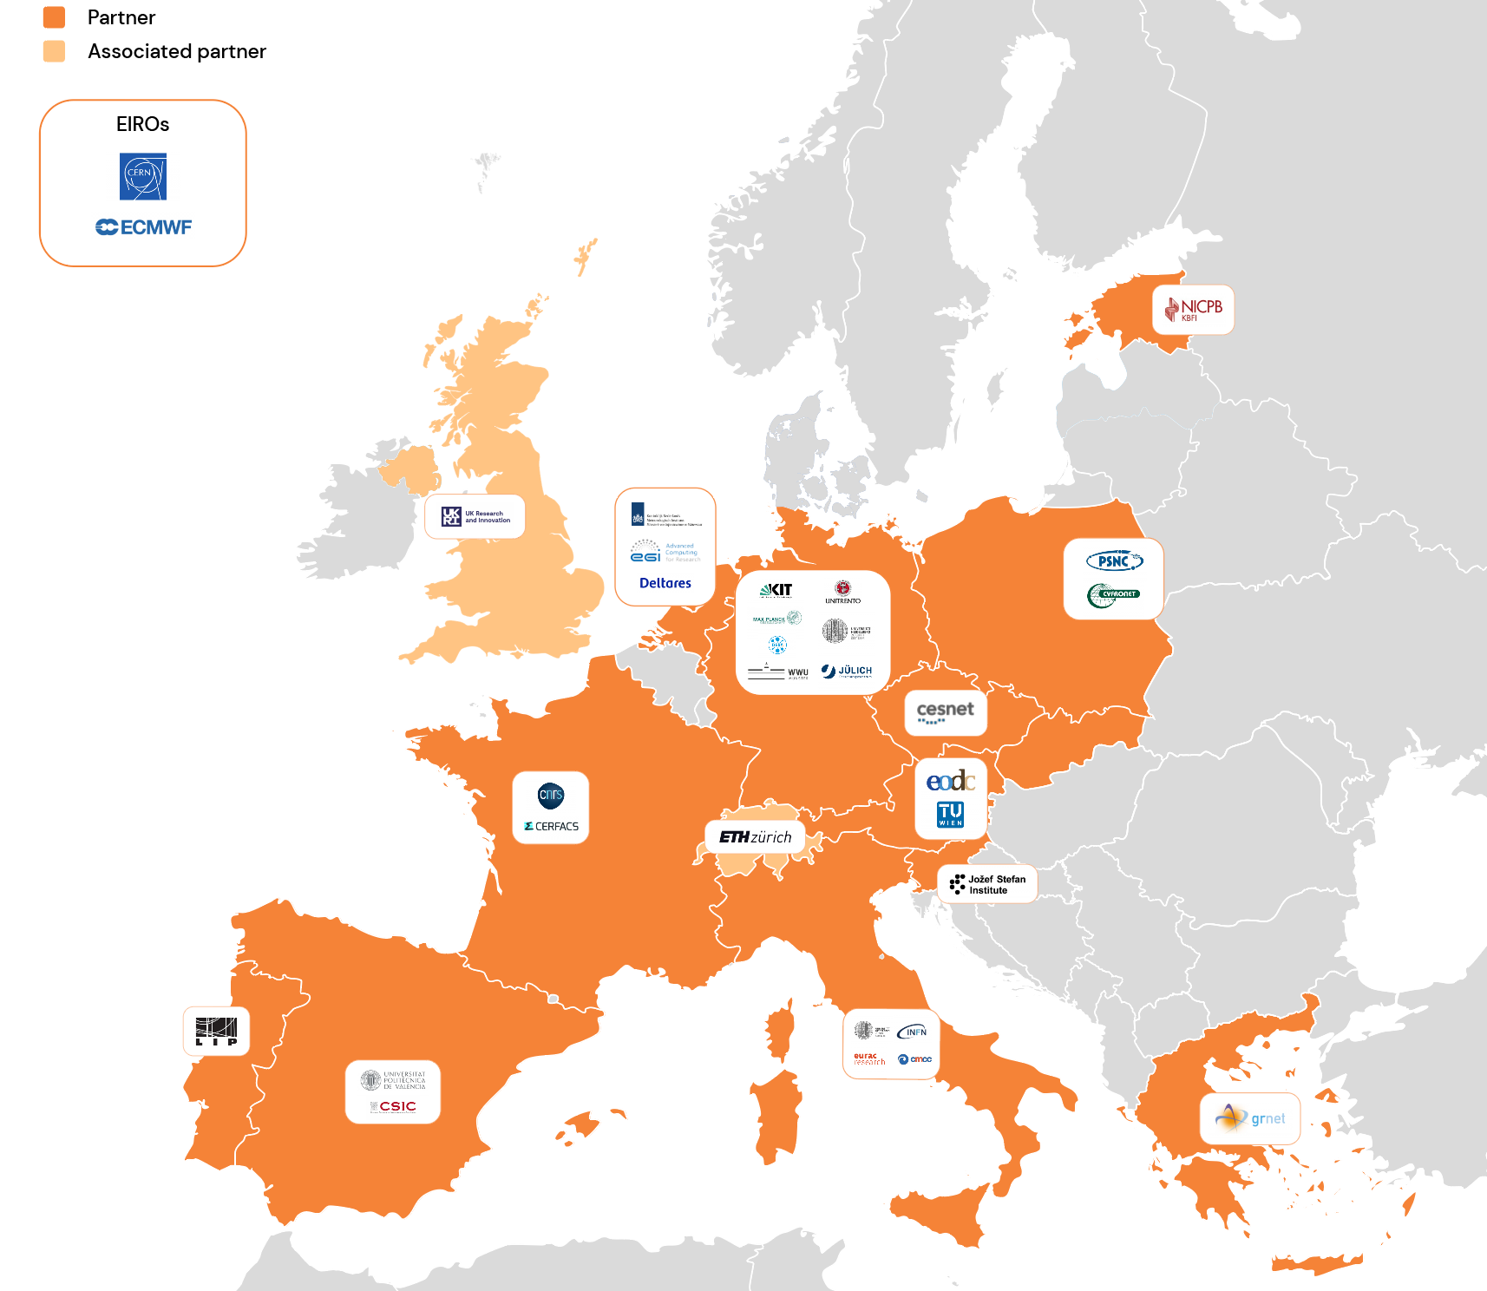
interTwin
Early flood warnings
Fire hazard
prediction
A Digital Twin Engine for Science
Drought
prediction
Ciclone detection
Radio
astronomy
High-energy
physics
Lattice
QCD
Gravitational
waves
29 participants, including sciences, technology and resource providers.​
Notes:
We are developing a generic engine to support a large set of communities, from physics to earth and climate sciences. CERN is a part of a consortium of around 30 institutes, including infrastructure providers (cloud HPC HTC), technology providers (developers if the core engine and other modules), and use cases from climate and earth sciences.

Slide 18
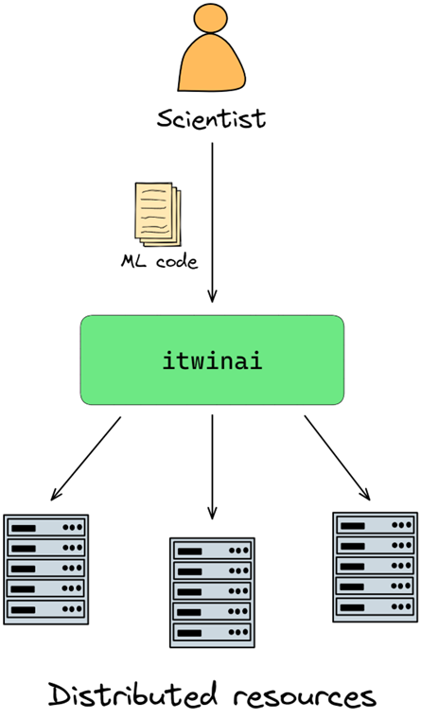
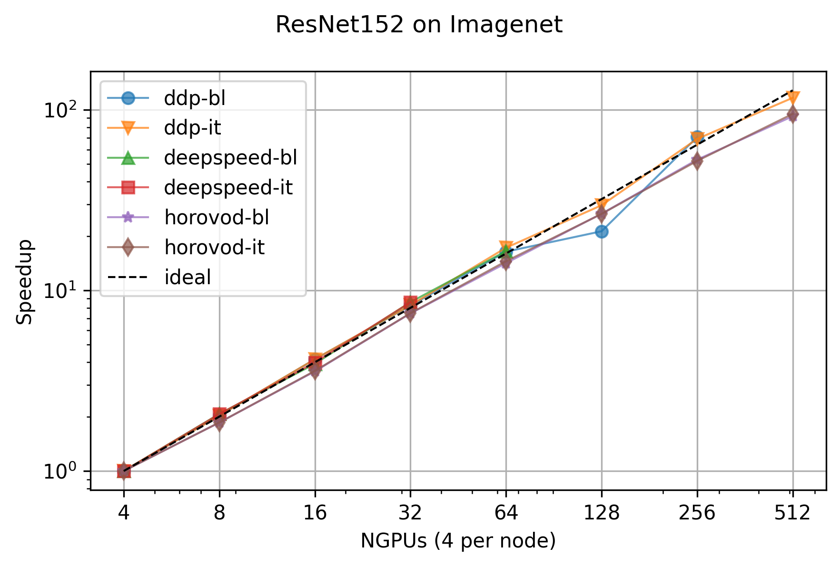
Distributed Machine Learning training
Built on top of the expertise acquired in RAISE, developing a unified abstraction layer for distributed training with PyTorch, seamlessly integrating Torch Distributed (DDP), Microsoft Deepspeed, and Horovod.
Scaling test demonstrated on up to 512 GPUs JSC.
Notes:
One of the core components of the DT core is to develop a unified abstraction layer for distributed training, integrating a number of distributed ML algorithms and demonstrate that the abstraction layer developed by us does not introduce significant overheads and scales well. Preliminary results on 512 GPUs.
Hyper-parameter optimization is currently under development

Slide 19
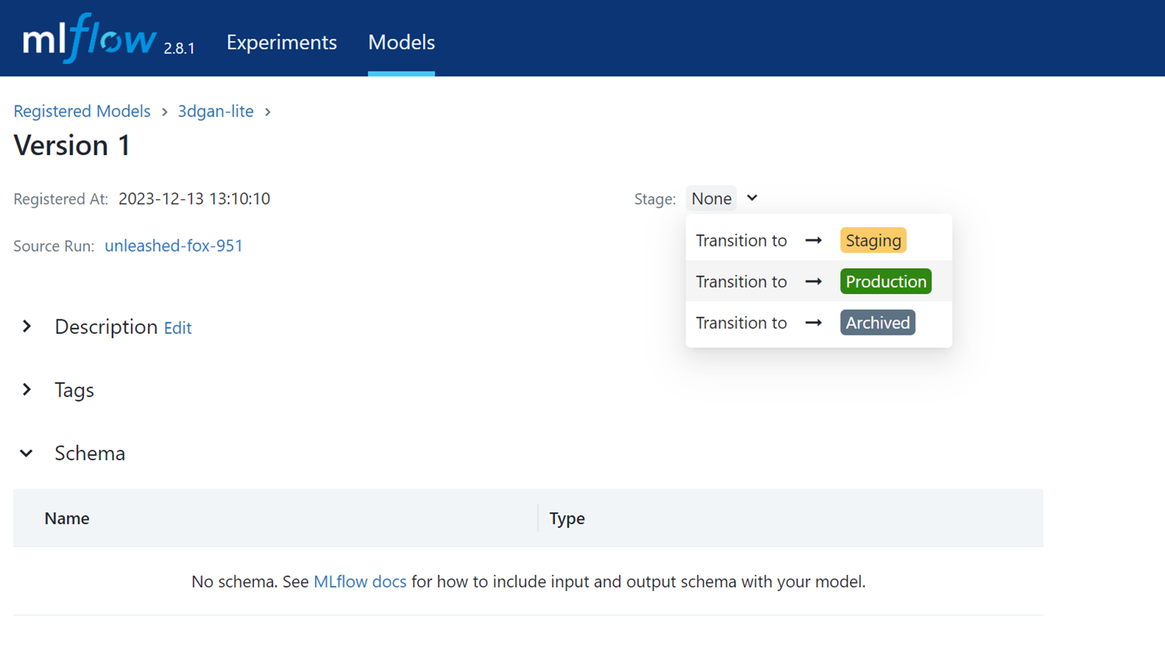
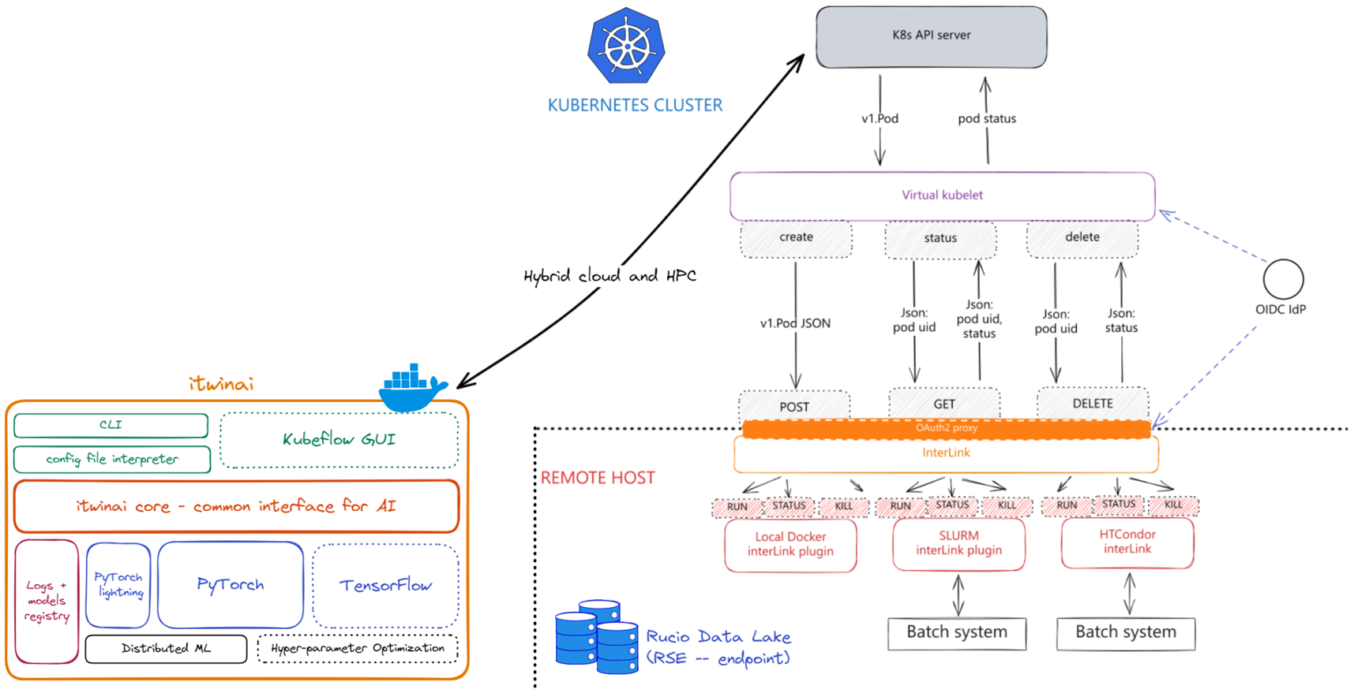
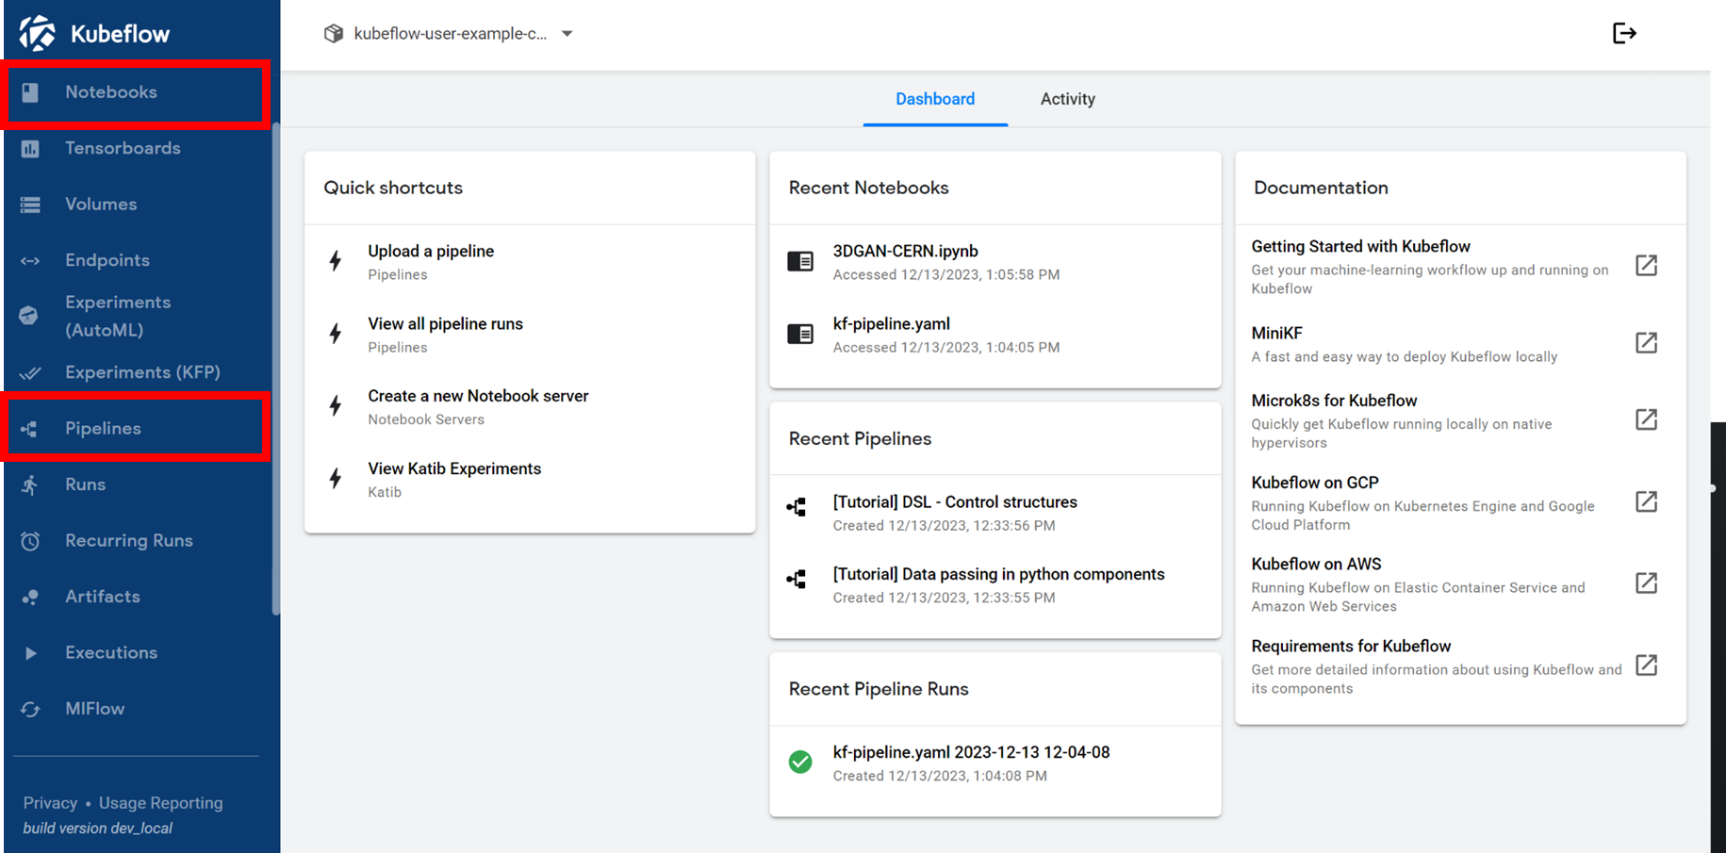
Machine learning on cloud and HPC
InterLink: leverages k8s’ Virtual Kubelet and microservice architecture of the DTE
Notes:
interTwin provides a unified access model to cloud and HPC resources to enable advanced machine learning workflows, based on
Kubernetes. We have developed also a tool (interlink) to seamless offload jobs from cloud to a remote HPC. This allows us to have the cloud as the users frontend.

Slide 20
Relationship with EuroHPC and access to resources
04
Notes:
These EC-funded projects have allowed us to work closely with some HPC centers in Europe to co-design solutions for HPC adoption in HEP and sciences with similar challenges. BUT we’re also negotiating with EuroHPC to be closer and eventually be a “flagship” science, like destination Earth.

Slide 21
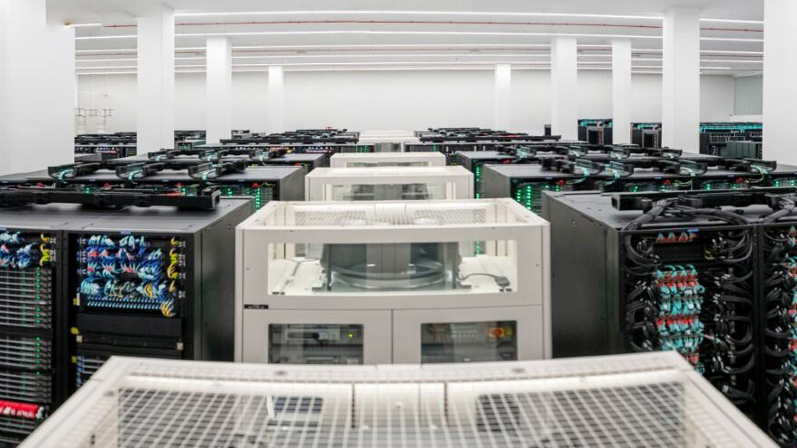
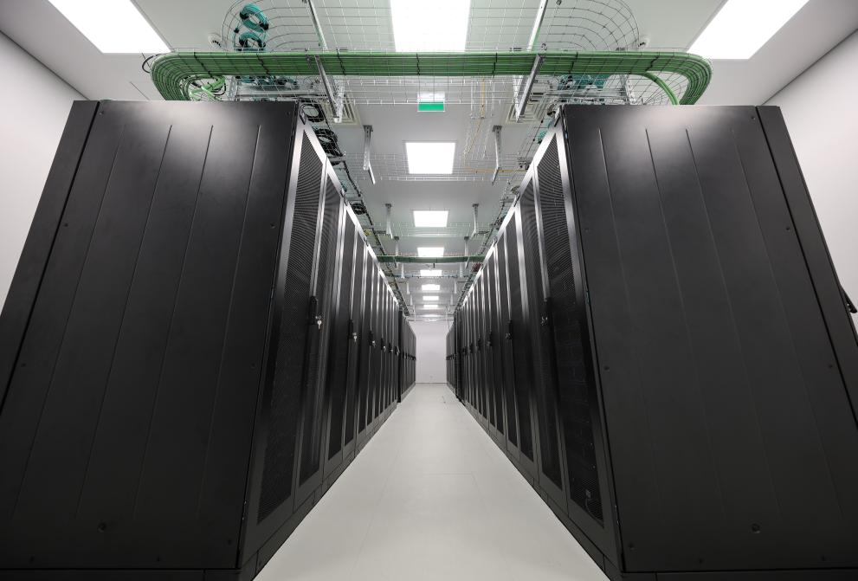
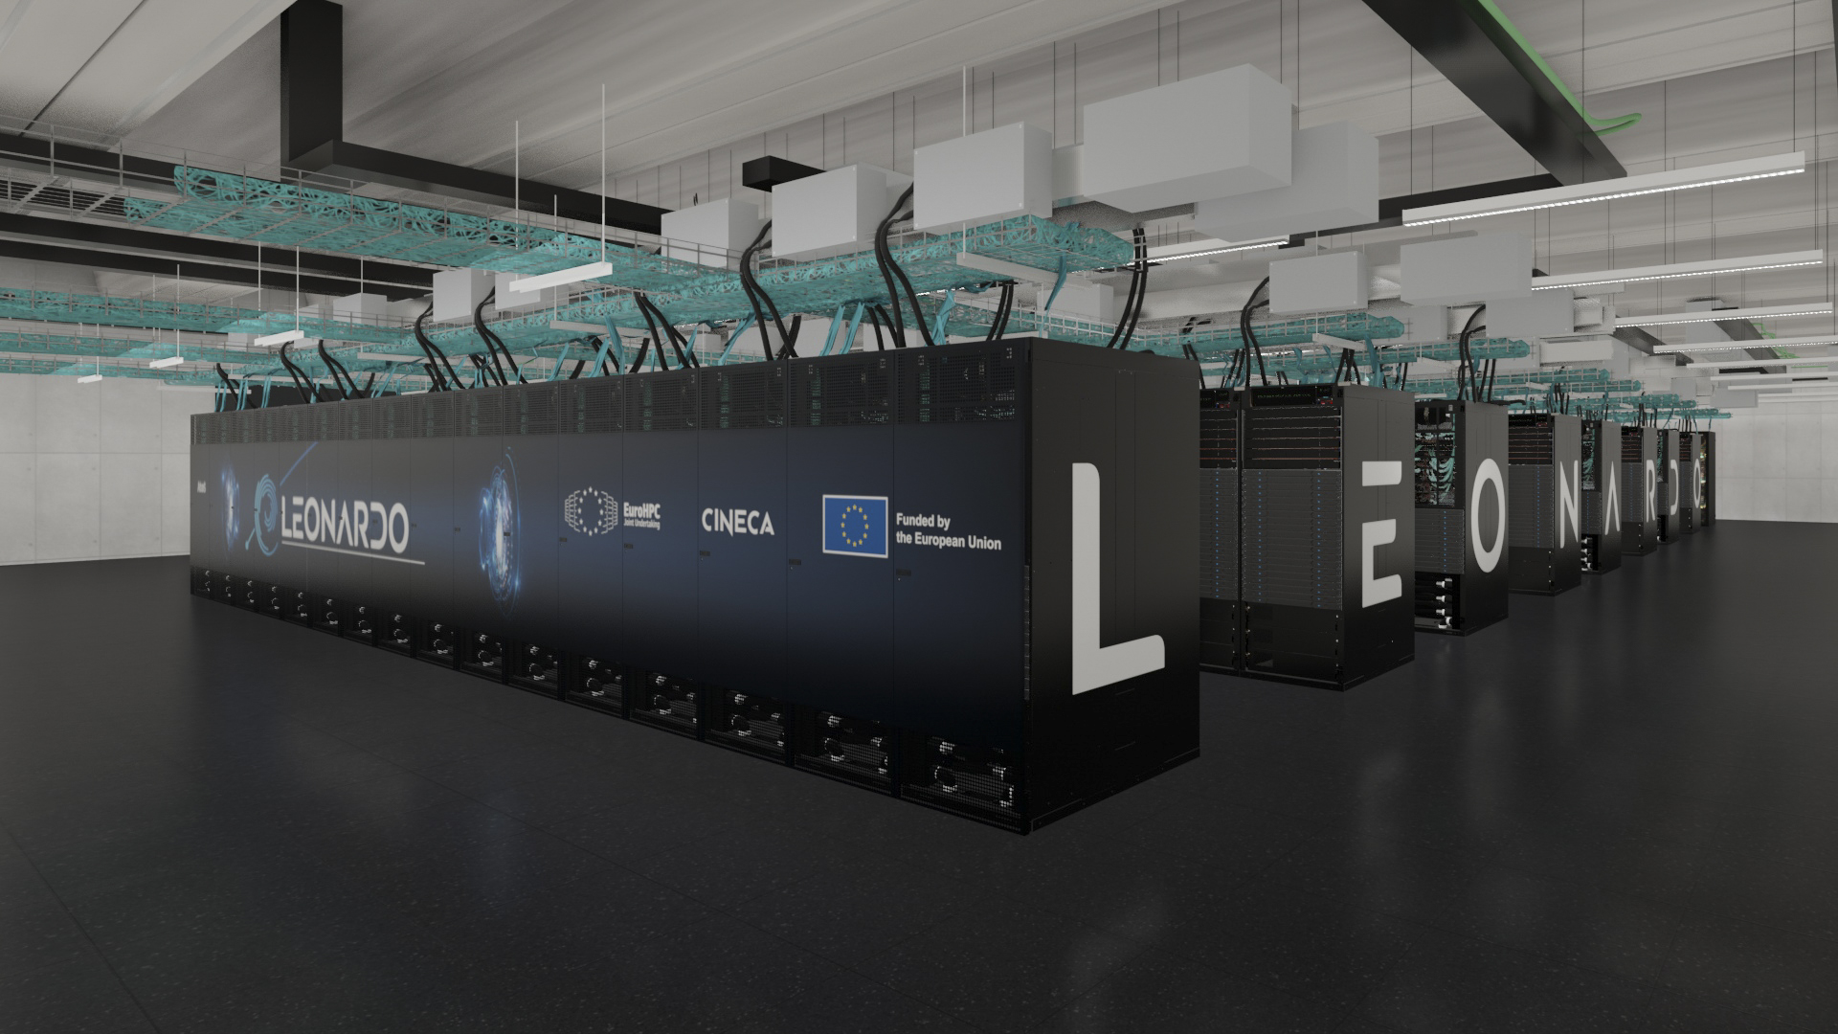
EuroHPC
EuroHPC JU is the main organization enabling HPC access and development in EU
Budget EUR 7 billion for the period 2021-2027
Made up of EU, Member states, and several private partners (consortiums)
The Joint Undertaking manages the Union’s access time for HPC (from 35% up to 50% of their total capacity)
Daedalus
EHPCPL
JUPITER
Exascale 2
Post-Exascale
Leonardo
MN5
Deucalion
Mid-range 2
Lumi
2023
2024
2025
2026-2027
Upgrades
Upgrades
Federation/Hyperconnectivity
Industrial Systems
Quantum Systems
Quantum Systems
https://eurohpc-ju.europa.eu/index_en
Notes:
The EuroHPC Joint Undertaking (EuroHPC JU) is the primary organization responsible for enabling high-performance computing (HPC) access and development within the European Union.
It has got a budget of EUR 7 billion allocated for the period 2021-2027
Made up of EU, Member states, and several private partners (consortiums), EuroHPC JU manages the Union’s access time to HPC resources, ensuring that 35% to 50% of the total computing capacity is available for EU use.
The timeline at the button shows the turn-on dates of the current HPC resources and plans for the near future

Slide 22
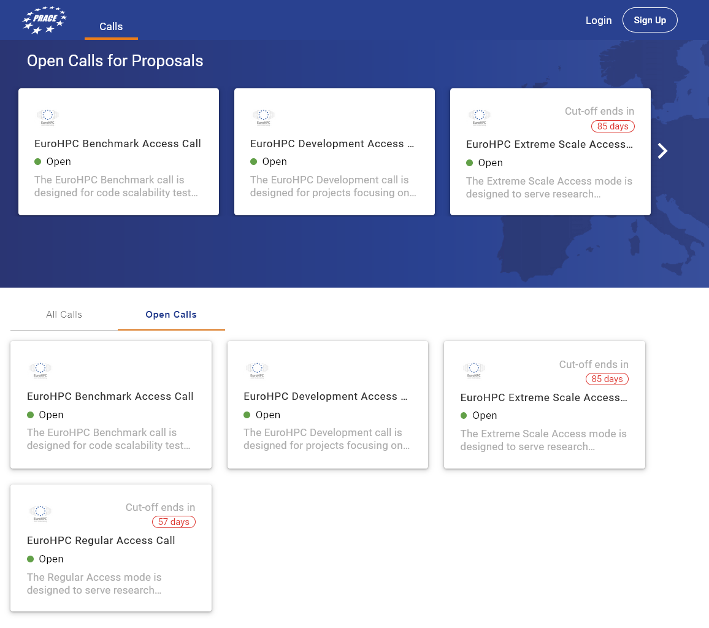
EuroHPC
CERN participates in EuroHPC user related working groups, including requirements and is developing close relationships and a roadmap for seamless integration
EuroHPC is the primary portal for research access, via regular Open Calls:
Benchmarking (3 months)
Development (1 year, low capacity)
(extensively used at CERN by developers)
Regular (extended use)
Extreme (high impact/use)
https://pracecalls.eu
Notes:
CERN participates in EuroHPC user related working groups designed to strengthen our relationship, ensure the infrastructure meets our requirements in order to seamlessly integrate resources.
EuroHPC has a portal for research access through regular open calls. Researches can ask for benchmarking which is up to 3 months and easy to get, development at a low capacity for a year, which is being extensively used at CERN by developes, regular extended use, and finally Extreme use, which is high impact and high use.

Slide 23
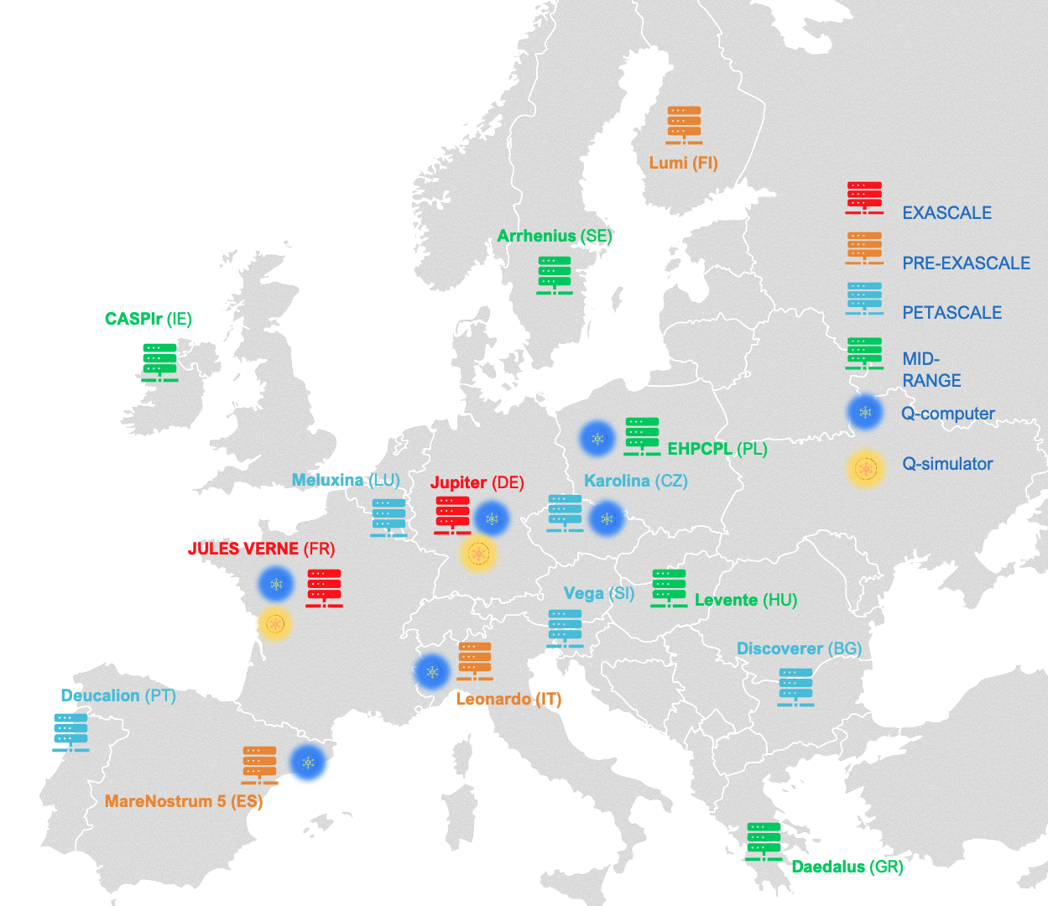
EuroHPC
Quantum Computing Infrastructure (2024+)
EuroHPC currently exposes 9 HPC sites for use
6 quantum computers will be hosted by EuroHPC facilities
Free access for Research, Development and Innovation
Integration of QC with HPC and development of hybrid HPC-QC applications and workflows
European Quantum Excellence Centres in quantum applications, for science and industry
Image by Gustav Kalbe, Opening Plenary Session at EuroHPC Summit 2024.
Notes:
An exciting new element of EuroHPC Is Quantum Computing. EuroHPC currently hosts 9 systems and 6 of those will also host Quantum computers. This involves free access for R&D and Innovation. It also involves the development of hybrid HPC-QC applications.

Slide 24
Spectrum
05
Notes:
To further strengthen relationships with HPC, together with Radio-Astronomy, HEP has been funded by EC for a Coordination and Support Action to work together with HPC experts to prepare a strategy for HPC integration.

Slide 25
What is SPECTRUM?
A project granted under the call HORIZON-INFRA-2023-DEV-01-05, which aims to the preparation of a Computing Strategy for Data-intensive Science Infrastructures in Europe for the High Energy Physics (HEP) and Radio Astronomy (RA) domains.
SPECTRUM gathers selected stakeholders in the HEP and RA research domains, and at the same time experts from the e-Infrastructures (HPCs, Clouds, Quantum Computing). The former group brings directions and future needs, the latter expectations for new e-Infrastructures about technical and policy aspects.
Who is SPECTRUM?
Communities of Practice
(CoP)
Coordinator
EGI Foundation
Research Infrastructure representatives
LHC: CERN, INFN
SKA: CNRS/OCA
LOFAR: NWO-I through ASTRON
e-Infrastructure representatives
FZJ (HPC Exascale and quantum computing)
CINECA (HPC & Quantum)
SURF (HTC, HPC, Cloud)
(also EGI Foundation, INFN)
Radio Astronomy
High
Energy
Physics
https://www.spectrumproject.eu/
SPECTRUM
Computing Continuum
Cloud
Quantum
HTC
HPC
Notes:
SPECTRUM gathers selected stakeholders in the HEP and RA research domains to bring directions and future computing needs, together with experts from e-infrastructures to co-develop technical and policy aspects for the future machines

Slide 26
What are the
expected outcomes of SPECTRUM?
The realization of a Community of Practice to gather and inform about future directions and needs in data-intensive research on the one side, about future e-Infrastructures on the other.
A Strategic Research, Innovation and Deployment Agenda (SRIDA) and a Technical Blueprint about agreed processing models and solutions, to provide feedback on investment to funding agencies and policy makers.
Previous interactions between the research and the e-Infrastructures communities have been a-posteriori, attempting to adapt scientific workflows to already operational facilities. This has been only partially successful due technical (non-compliant system architectures, …) and policy (user access, …) incompatibilities.
SPECTRUM wants to move the handshaking process a-priori, before e-Infrastructures are designed and deployed.
Why is SPECTRUM different from previous attempts?
Notes:
The SPECTRUM project aims to create a Community of Practice for sharing knowledge on data-intensive research and e-Infrastructures. By developing a Strategic Research, Innovation and Deployment Agenda (SRIDA) and a Technical Blueprint, it seeks to establish agreed processing models and solutions. This will enhance collaboration, guide innovation, and inform investment and policy decisions.
SPECTRUM differs from past efforts by promoting proactive collaboration between research and e-Infrastructure communities to participate in co-design of the next generation of infrastructure, ensuring compatibility and effectiveness before deployment, unlike previous reactive methods.

Slide 27
SPECTRUM: Plan of Work
Project length: 30 months (Jan24 - Jun26)
First period: January 2024 - March 2025
Second period: April 2025 - June 2026
6 Work Packages Identified
WP1: Project Management and
Communications (first period)
Draft documents, questions
Draft documents, questions
WP2: Project Management and
Communications (second period)
WP3: Community of Practice Creation
and First Consultation
Domain knowledge and feedback
Domain knowledge and feedback
WP4: Community of Practice Second
Consultation and Long-term Sustainability
Domain knowledge and feedback
Draft documents, questions
KER is input to
WP activities
KER is input to
WP activities
WP5: Landscape, use-cases, challenges and gaps
WP6: Strategy Research, Innovation
and Deployment Agenda
Relationship between WPs and and their related KERS
Notes:
The Spectrum project will run for 2 and a half years in two periods. The project is divided into 6 interconnected work packages. CERN’s contribution is in WP6, the Strategy researcher, innovation and deployment agenda.

Slide 28
SPECTRUM CoP
Working Groups
WG1: Data Management and Access
Data Management - including data location,
movement and registration
Data Access protocols
Data Archiving
Security
WG3: Compute Environment
Expected Tools and Services - Describes the tools and services expected at centers, including virtualization and CVMFS (CernVM File System).
Facility Expectations - Outlines expectations for facilities, including workflow execution times (“be able to execute workflows xx hours long), memory requirements (“nodes with at least YY GB RAM”), networking capabilities (“networking in/out at least at YY Mbps per core”) and virtualization.
Edge Services - Discusses edge services needed to establish environment(s).
Library Provisioning - Discuss the minimal set of libraries and how to provide them, including virtualization, Spack, and module.
WG2: Workflow Management and organisation
Resource Discovery and Workflows Submission
Resource Allocation
Complex Workflows

Slide 29
SPECTRUM CoP
Working Groups
WG4: SW tools
Machine Learning Frameworks
Multithreading Frameworks
Multi-Node Tools - Including MPI (Message Passing Interface) and similar tools
Compilers, toolchains, …
Quantum Computing Tools and Frameworks
Code Management Practices
WG6: Facilities
HPC Centers - Discusses drivers and future directions of HPC centers
Access to Quantum Computing Hardware
Access to Commercial and Public Clouds
Sustainability - Examines economic and carbon footprint aspects
Security - Including access and translation from global SSO to local credentials
WG5: Scientific Use-Cases
Typical Use-Cases - Describes typical use-cases with quantitative descriptions
Requirements and Needs
Best Practices Collection - Gathers best practices and existing documents
Data Fluxes and Paths
The SPECTRUM project and the JENA Computing Initiative are conducting a survey to gather insights on current best practice and expected future evolutions in the domain of large scale / data intensive scientific computing

Slide 30
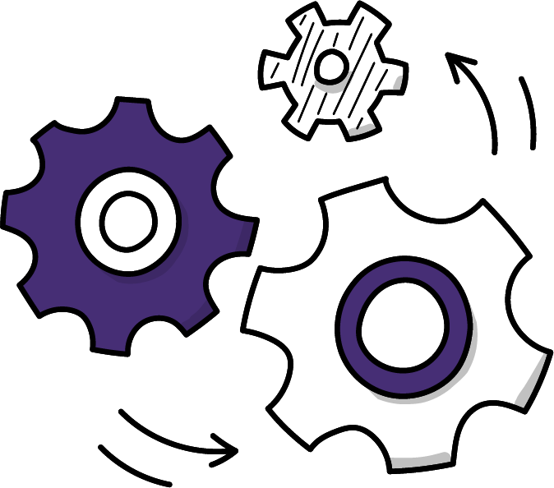
Outlook
We have already begun to see the benefits from engaging with the HPC community
Opportunistic access to resources, technical progress in AI/ML applications, and real-time interactive simulation
We are continuing with community engagement and strategic planning
Activities in SPECTRUM, and soon ODISSEE, will bring the communities closer together and more seamlessly integrate the computing environments
Computing is experiencing a rapid evolution of technology and techniques with large improvements in accelerators and the applications
We are trying to stay on the forefront while stably supporting programmes that run for decades

Slide 31
Get in touch!
Send us a message
Thank you
Email | openlab-communications@cern.ch
Website | openlab.cern
Follow us!
Maria Girone (CERN)
Head of CERN openlab
Phase VIII Brochure
CERN openlab LinkedIn

Slide 32
Thank you!
Maria Girone
Head of CERN openlab

Slide 33
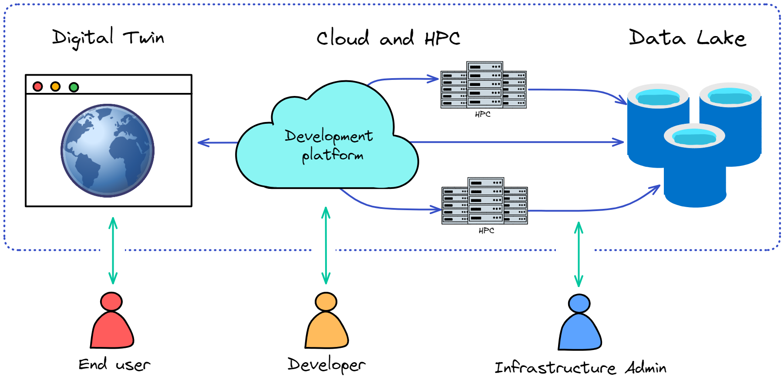
interTwin
A Digital Twin Engine for Science
Notes:
A DT application is distributed over different resources: parts of it run on cloud, other parts are offloaded to HPC, when needed because of resource-intensive operations.
We have 3 sets of users:
End users (e.g., scientists, policy makers), who use the DT engine to make scientific discoveries and make decisions. For instance, image an environment modelling DT cyclone prediction, which can be used by weather scientists to monitor the atmosphere and by policy makers to raise alarms and organize responses to extreme events like cyclones.
Developers develop both the services provided by the core engine (e.g., advanced AI workflows on HPC), and DT applications using the services provided by the core engine.
Infrastructure providers have a different set of skills related to the provision and maintenance of European resources granted to the project.

Slide 34
SPECTRUM:
Goals (up to now)
Specific scientific (sub)domains working as silos:
Very intense R&D, well performing computing models, but very few cross domain communications
Have HEP and RA share experience, tools, solutions, visions
Roadmap for next 5-10 years often available, but not compared with other subdomains needs
Conflicting models?
Many attempts to extend the computing to large infrastructures (HPC, Clouds, ..)
But mostly a-posteriori: try to use an already deployed system, facing with limitations (technical and political)
No participation to the planning and deployment phases; no participation to the definition of target use cases
Notes:
Spectrum aims to break the silos between scientific subdomains. Creating a common roadmap for the next 5-10 years. It also intends to break the cycle of trying to extend into existing large infrastructures, and instead work together to codesign computing resources for the most benefit to the most science domains

