Slide 1
Loading shim proposal for A18
Paolo Ferracin, Dan Cheng, Laura Garcia Fajardo, Giorgio Vallone
on behalf of the MQXF collaboration
MQXFA18 Structure & Shims Review
LBNL, USA
May 14th, 2024

Slide 2
Outline
A14b and A05 and A13 quench performance
Computation radial build-up in A14b and A05
Target loading shim size in A18

Slide 3
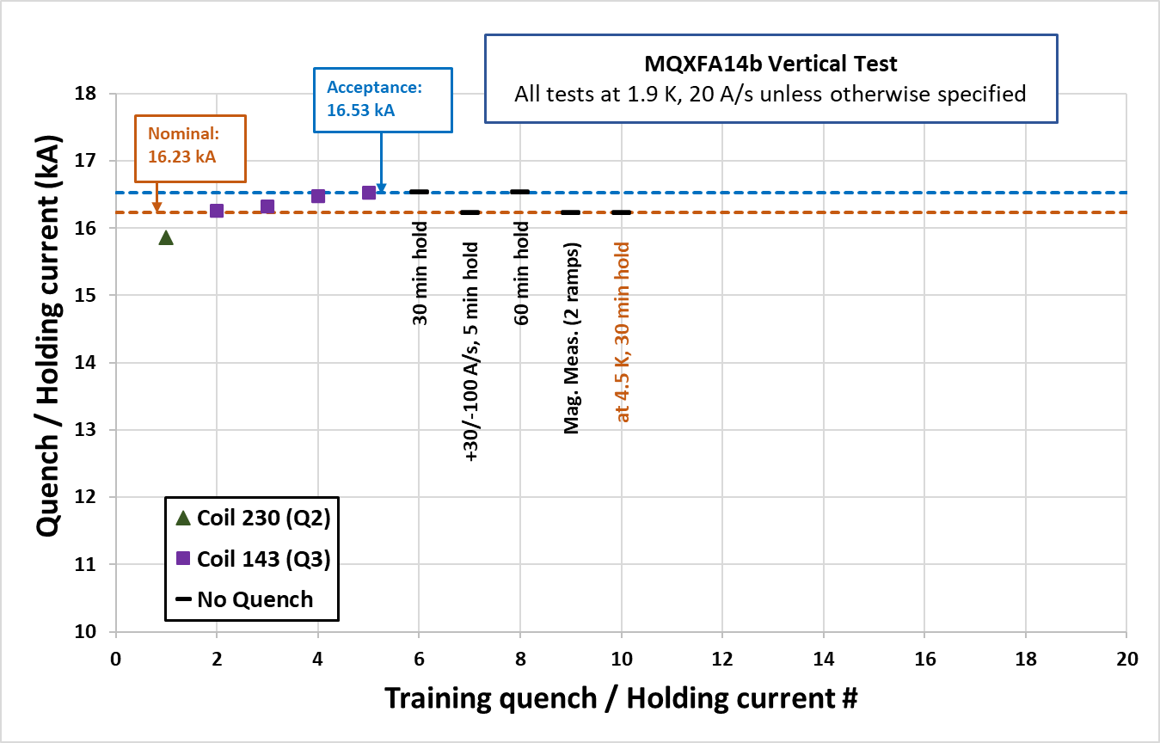
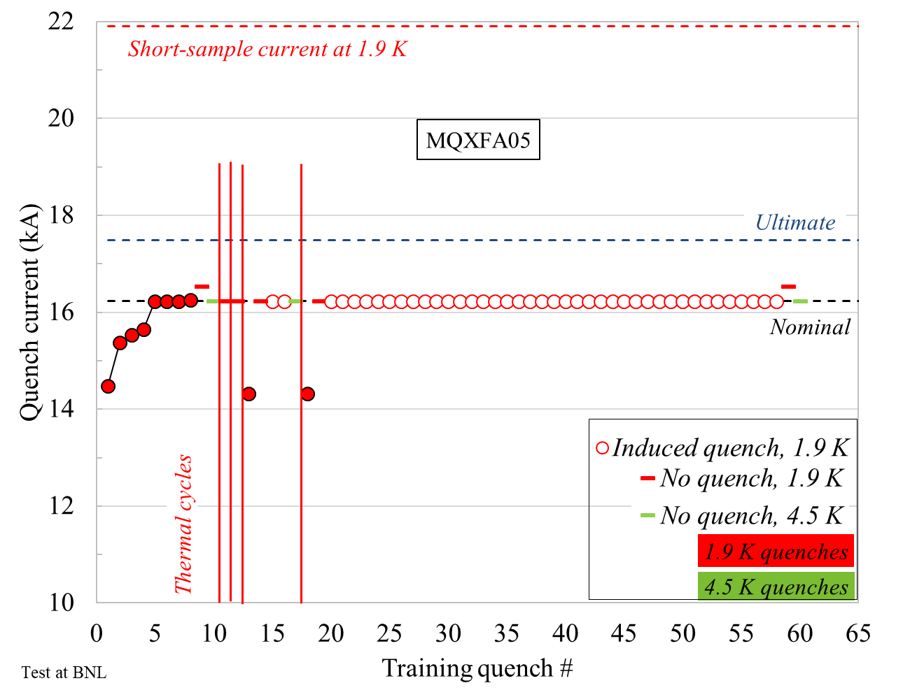
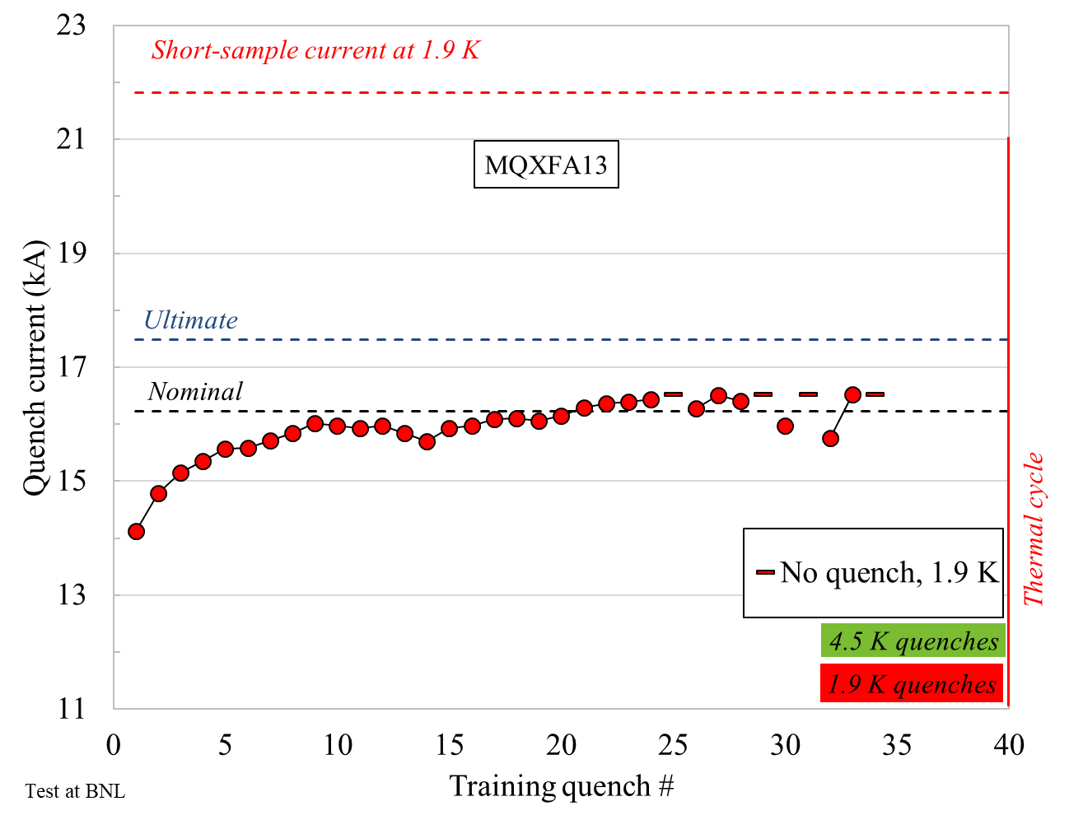
Quench performance
After the test of A13, we focused on the analysis of the pre-load in A14b and A05
  At that time, they had the fewest training quenches up to the acceptance current, and both of them met requirements
A14b
A05
A13

Slide 4
Outline
A14b and A05 and A13 quench performance
Computation radial build-up in A14b and A05
Target loading shim size in A12b

Slide 5
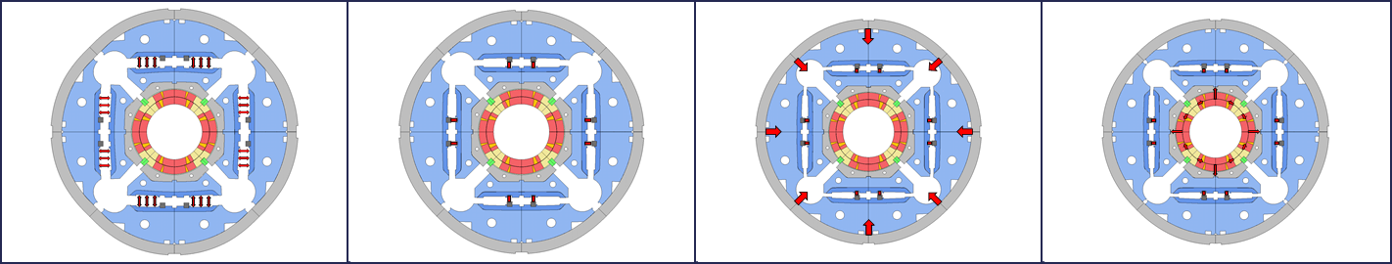
Room temperature pre-stress
The final coil and shell pre-load achieved at the end of the bladder and key operation is determined by the combination of
  the size of the load key shim
  the radial dimensions of the shimmed coil pack
    (under the assumption that collars, pads, masters, yoke, and shell have nominal dimensions).

Slide 6
Size of the load key shim
Loading shim size: 43 mils, 1.092 mm
Total key size: 13.84 mm
A14b
Loading shim size: 41 mils, 1.041 mm
Total key size: 13.79 mm
A05

Slide 7
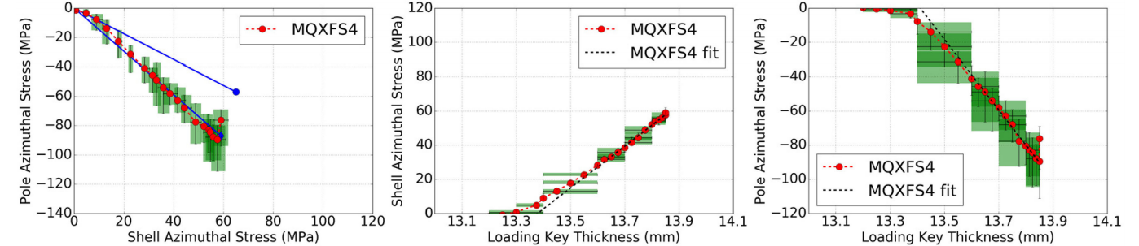
Size of the load key shim
A14b
Loading shim size: 43 mils, 1.092 mm
Total key size: 13.84 mm
Loading shim size: 41 mils, 1.041 mm
Total key size: 13.79 mm
A05
A portion of the total key/shim is to create contact (contact key/shim), and a portion to produce the pre-load (interf. Key/shim)
contact shim : 22 mils, 0.483 mm
contact key size: 13.31 mm

Slide 8
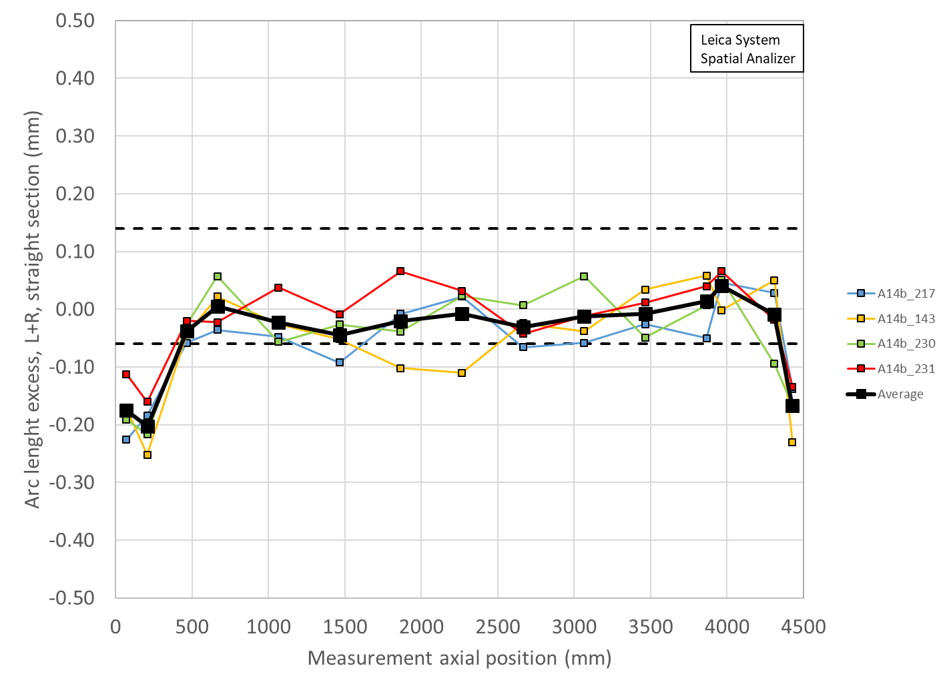
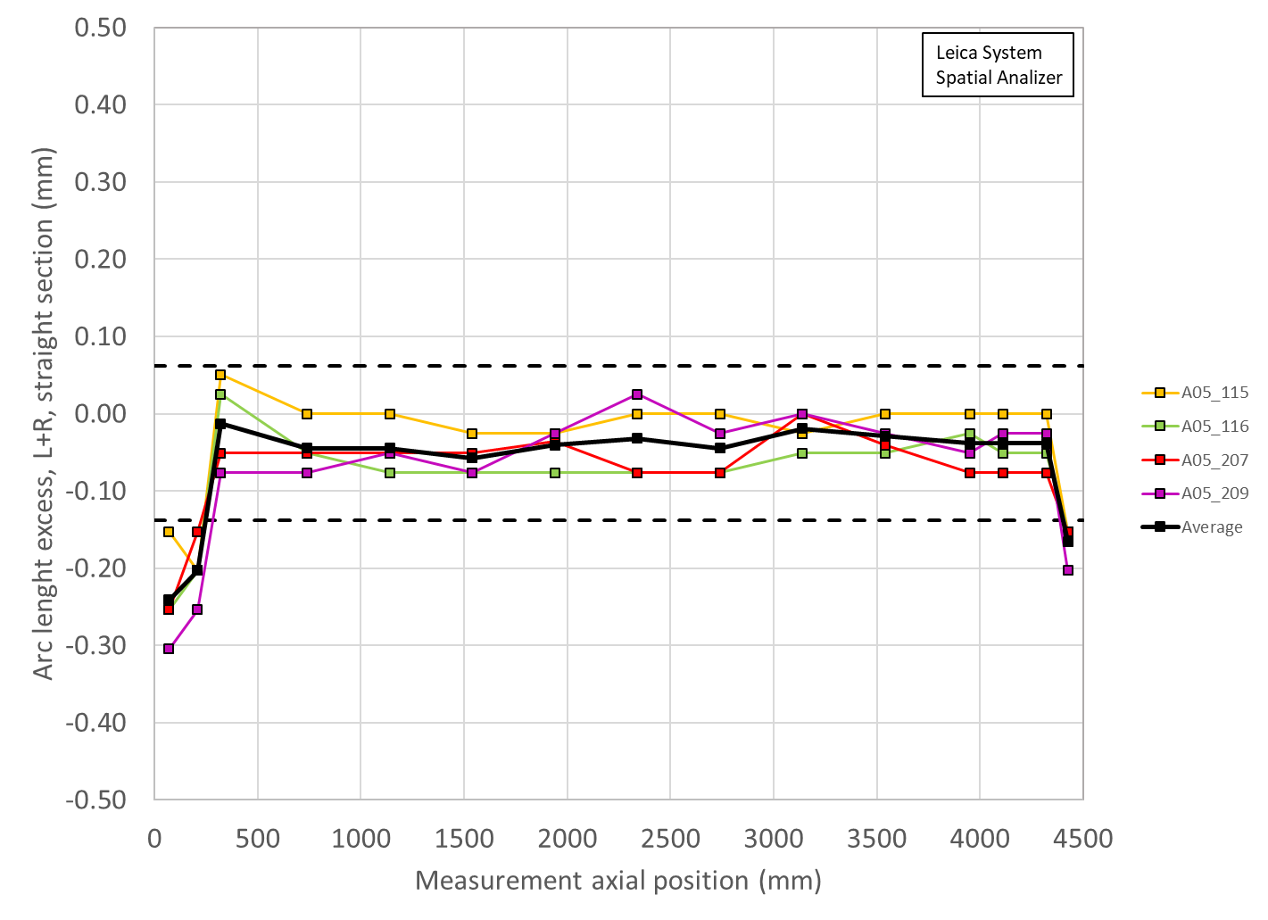
Radial dimensions of the shimmed coil pack
The coil arc-length is usually undersized
With the mid-plane shim we bring the coil “almost” to the nominal dimensions
  In reality 1) shim has finite given thickness and 2) coil has size variations along the length (and shim is full length with constant thickness)
So, we can produce a radial deviation resulting from the final shimmed azimuthal deviation (average of the coils)
  Δr_{_ave} = Δ_arc-length_{_ave} * 2/ π
A14b
A05
 | Ave ss | LE min | RE min
 | mm | mm | mm
A14b | -0.007 | -0.129 | -0.107
A5 | -0.025 | -0.154 | -0.105

Slide 9
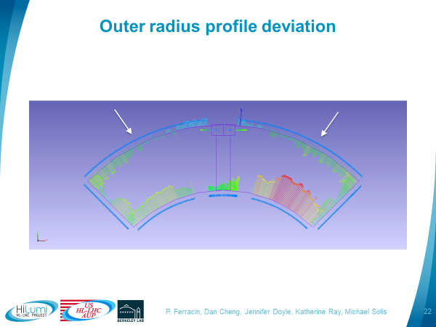
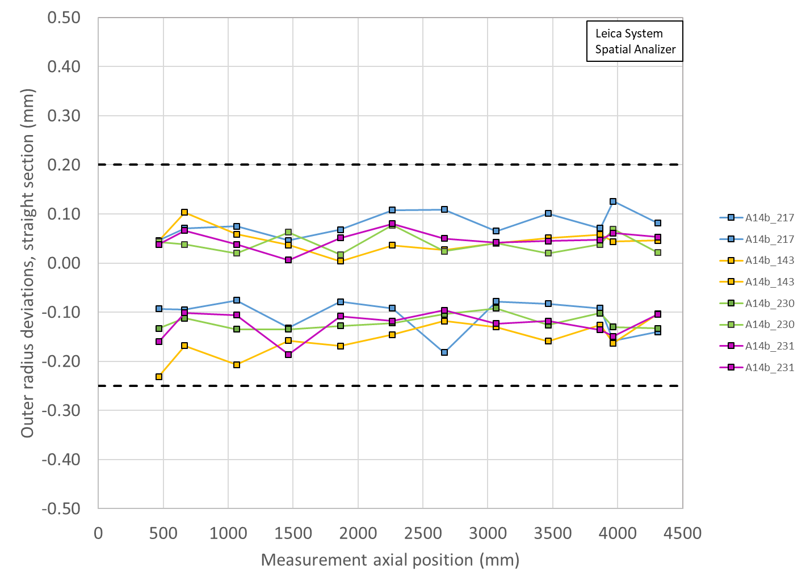
Radial dimensions of the shimmed coil pack
There is also a radial deviation due to OR+mid-plane fit of the coil dimensional measurement data
 | OR Ave ss | OR LE min | OR RE min
 | mm | mm | mm
A14b | -0.029 | -0.056 | -0.050
A5 | -0.025 | -0.050 | -0.050

Slide 10
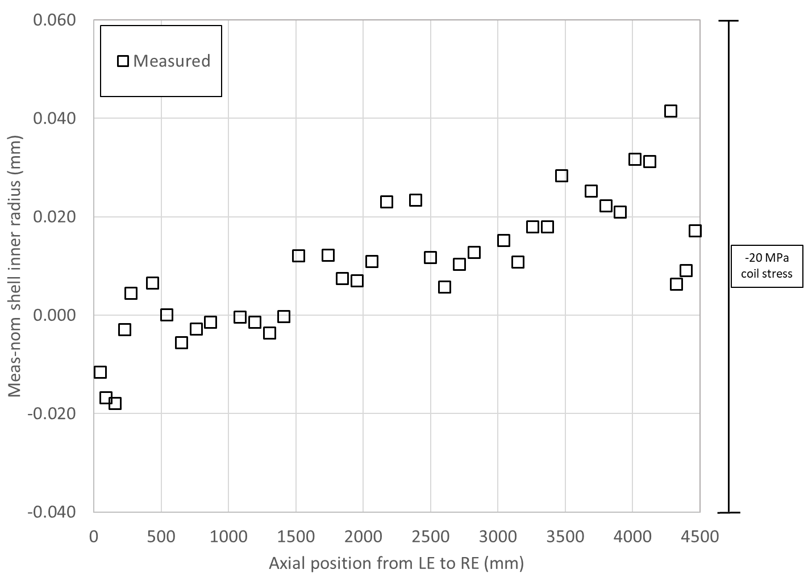
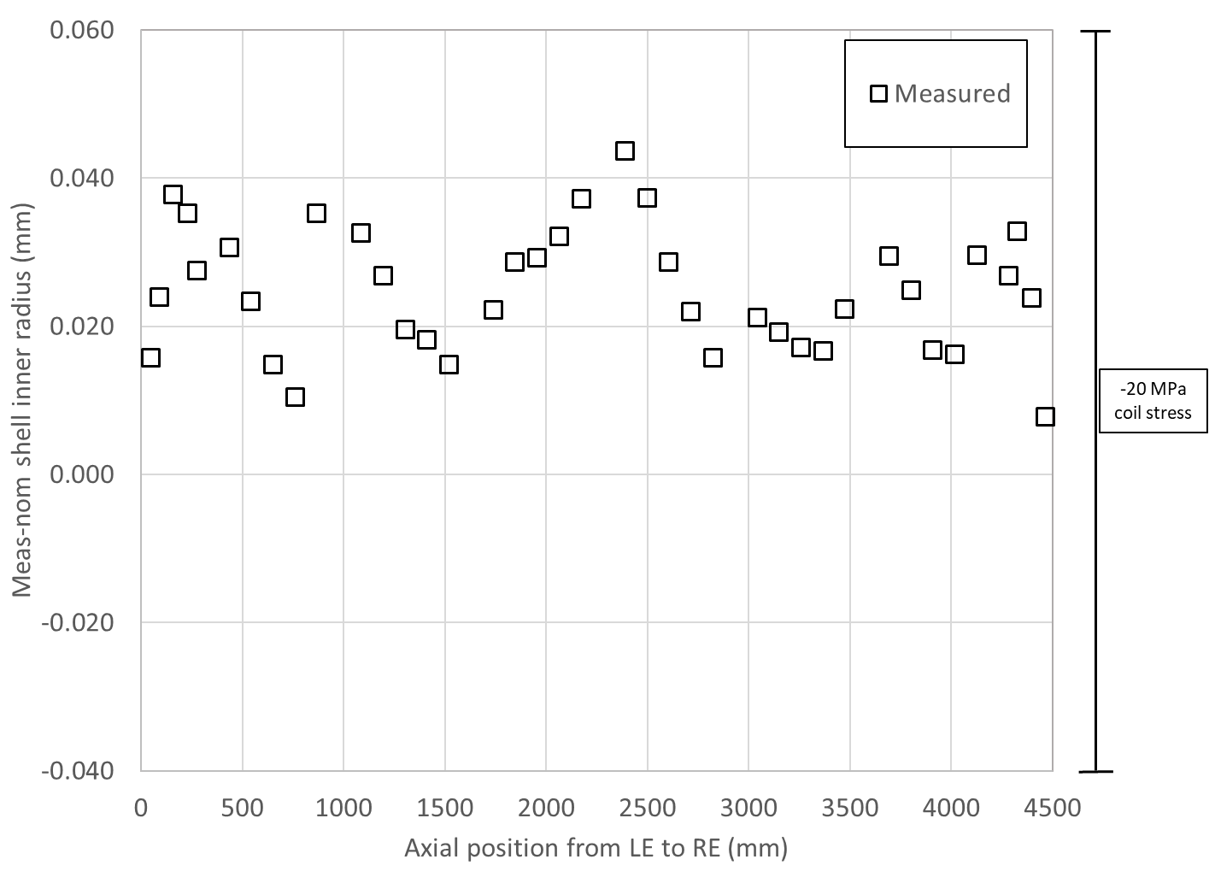
Radial build-up of the structure
“under the assumption that collars, pads, masters, yoke, and shell have nominal dimensions”
A14b
A05

Slide 11
Summary
By adding up the interf. Shim and the coil radial size……
  We get an upper bound (A14b) and a lower bound (A05)
 | Ave ss | OR_Ave ss | Sum_ss | LE min | OR_LE_min | Sum_LE | RE min | OR_RE_min | Sum_RE | Key | Shim | Shim | Ave ss + ishim | LE + ishim | RE + ishim
 | mm | mm | mm | mm | mm | mm | mm | mm |  | mm | mils | mm | mm | mm | mm
A14b | -0.007 | -0.029 | -0.037 | -0.129 | -0.056 | -0.185 | -0.107 | -0.050 | -0.157 | 13.84 | 43 | 1.092 | 0.497 | 0.348 | 0.377
A5 | -0.025 | -0.025 | -0.050 | -0.129 | -0.050 | -0.179 | -0.105 | -0.050 | -0.155 | 13.79 | 41 | 1.041 | 0.433 | 0.303 | 0.327

Slide 12
Outline
A14b and A05 and A13 quench performance
Computation radial build-up in A14b and A05
Target loading shim size in A18

Slide 13
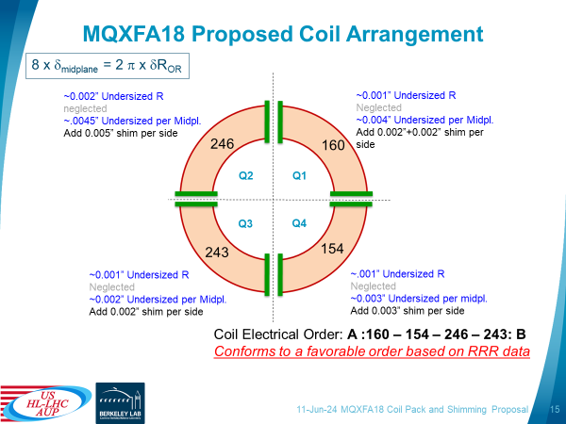
Proposed mid-plane shim for A18

Slide 14
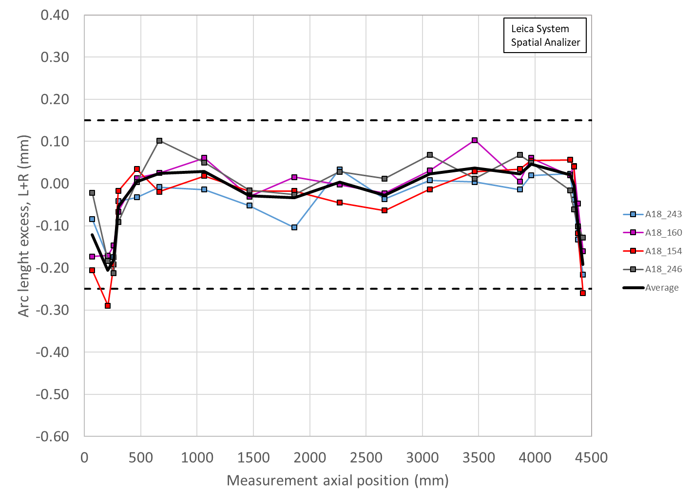
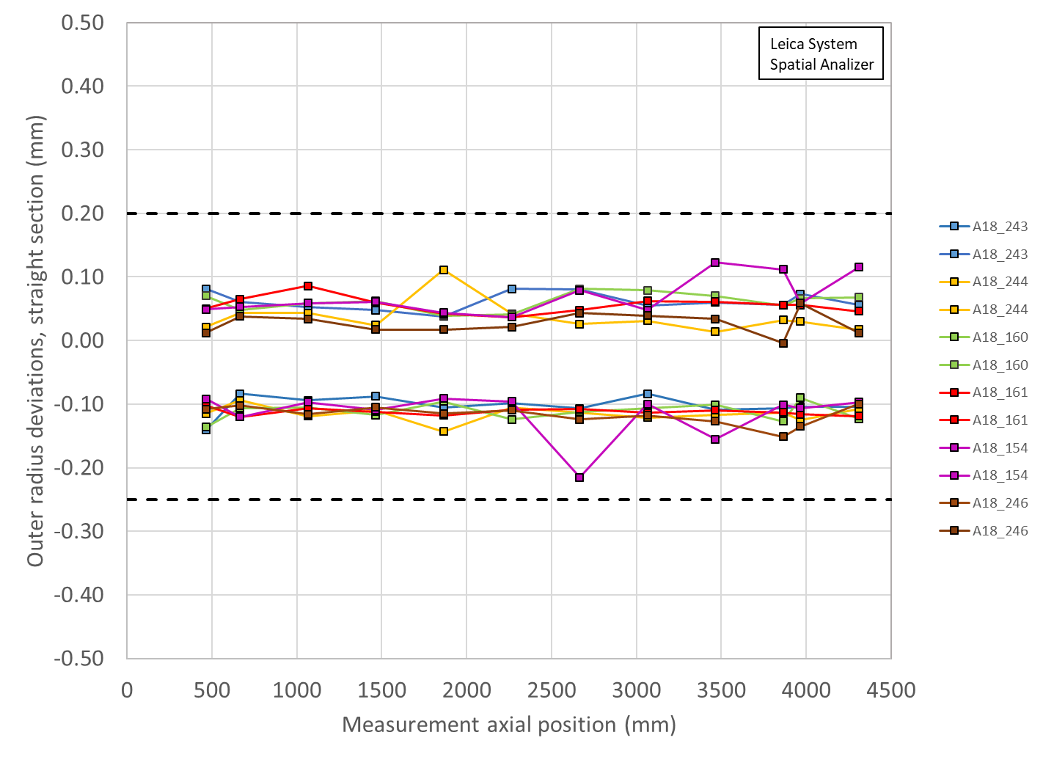
Radial deviations of 18
 | Ave ss | OR_Ave ss | Sum_ss | LE min | OR_LE_min | Sum_LE | RE min | OR_RE_min | Sum_RE
 | mm | mm | mm | mm | mm | mm | mm | mm | mm
A18 | 0.006 | -0.032 | -0.025 | -0.115 | -0.052 | -0.167 | -0.063 | -0.043 | -0.106

Slide 15
Target loading key shim
For final loading key shim size reached during the pre-load operations, the following target is set:
At the end of the pre-loading operation, the sum of the loading shim size and the coil-pack radial dimension deviations in straight section, LE and RE shall be within the range achieved in magnets MQXFA14b and MQXFA05
  If, with such load key shim, the coil stress measured in 2+ strain gauges at the end of the loading or during bladder inflation is above the coil stress spec., priority should be given to keeping the coil stress within the specs.

Slide 16
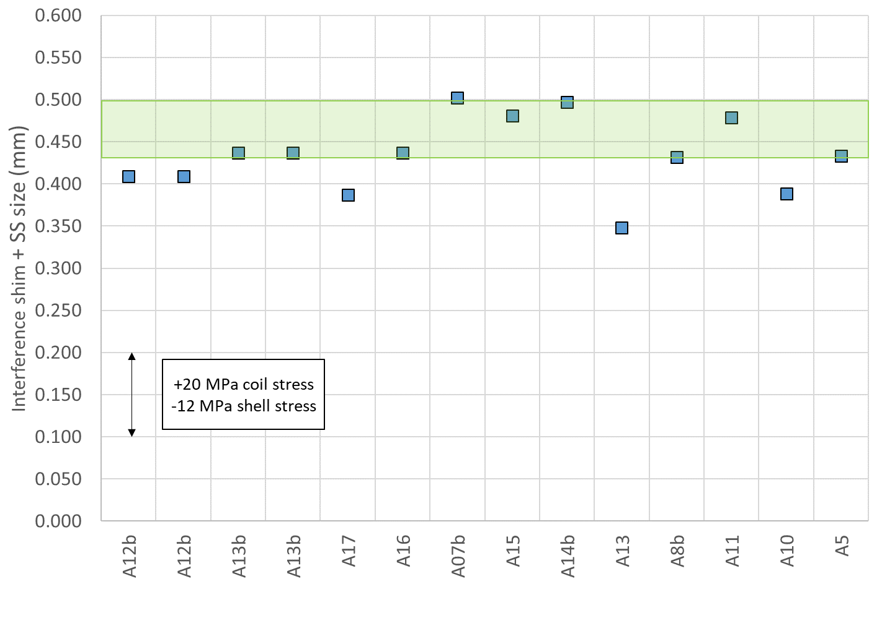
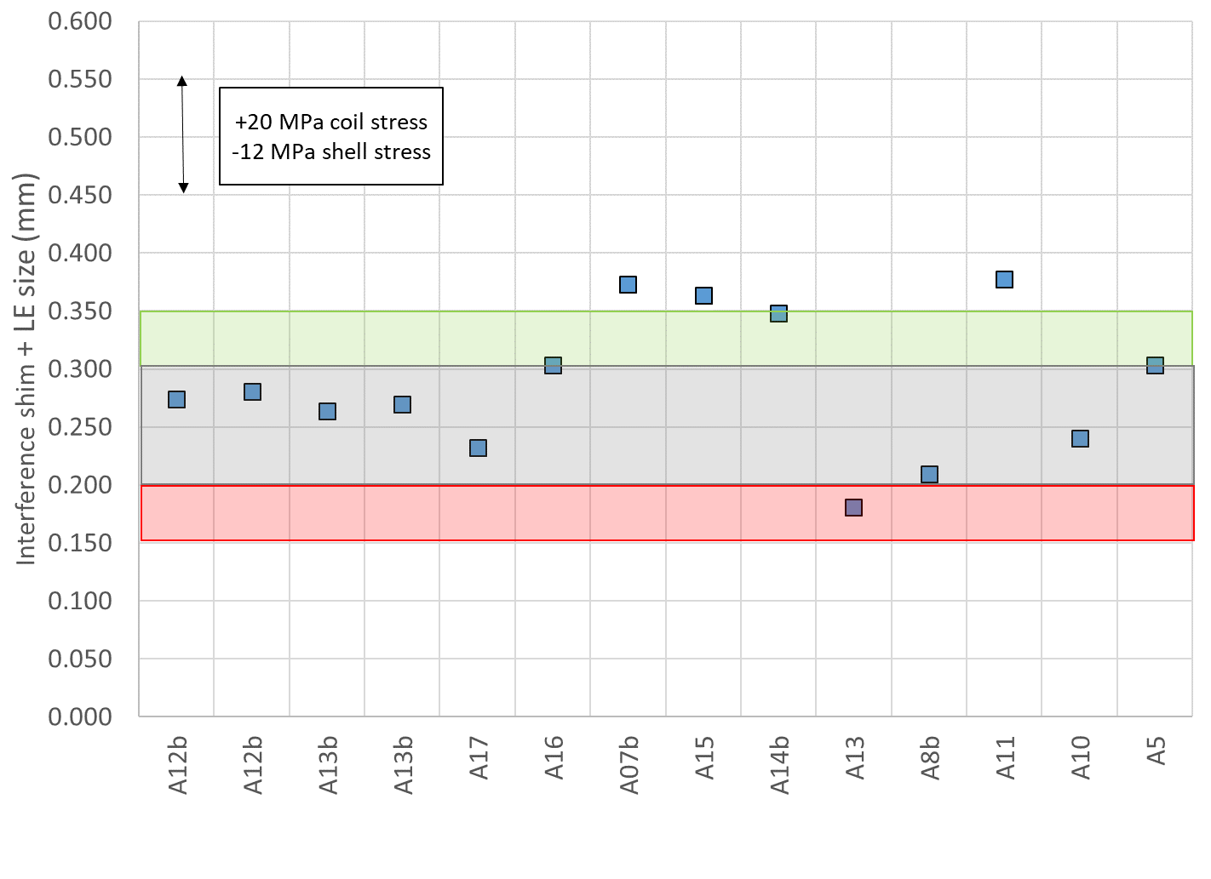
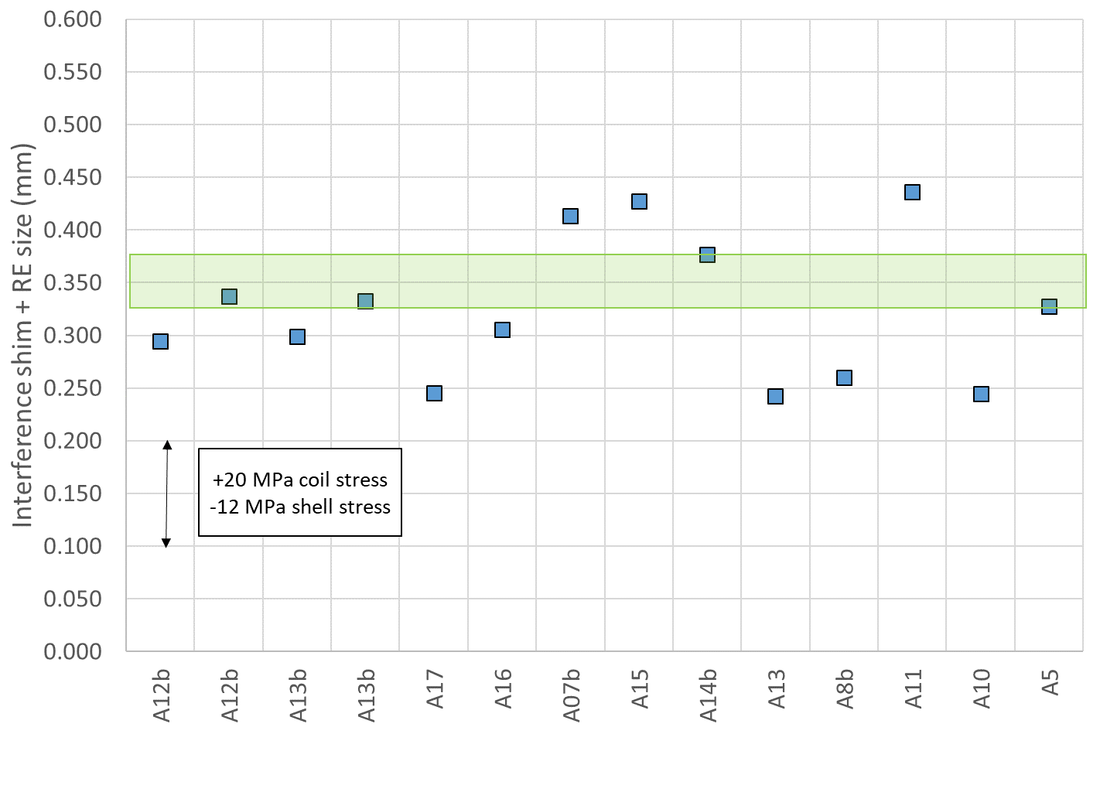
Review of all magnets
Straight section
LE
RE

Slide 17
Summary straight section
Coil radial (shimmed) deviation + key/shim size
 | Ave ss | Key | Shim | Ishim | Ave ss + ishim
 | mm | mm | mils | mm | mm
A18 up | -0.025 | 13.84 | 43 | 0.533 | 0.508
A18 low | -0.025 | 13.79 | 41 | 0.483 | 0.457
A14b | -0.037 | 13.84 | 43 | 0.533 | 0.497
A5 | -0.050 | 13.79 | 41 | 0.483 | 0.433

Slide 18
Summary LE
Coil radial (shimmed) deviation + key/shim size
 | LE | Key | Shim | Ishim | LE + Ishim
 | mm | mm | mils | mm | mm
A18 up | -0.167 | 13.82 | 42 | 0.508 | 0.341
A18 low | -0.167 | 13.79 | 41 | 0.483 | 0.315
A14b | -0.185 | 13.840 | 43 | 0.533 | 0.348
A5 | -0.179 | 13.790 | 41 | 0.483 | 0.303

Slide 19
Summary RE
Coil radial (shimmed) deviation + key/shim size
 | RE | Key | Shim | Ishim | RE + Ishim
 | mm | mm | mils | mm | mm
A18 up | -0.106 | 13.79 | 41 | 0.483 | 0.376
A18 low | -0.106 | 13.74 | 39 | 0.432 | 0.326
A14b | -0.157 | 13.84 | 43 | 0.533 | 0.377
A5 | -0.155 | 13.79 | 41 | 0.483 | 0.327

Slide 20
Summary and proposal
 | Ave ss | Key | Shim | Ishim | Ave ss + ishim
 | mm | mm | mils | mm | mm
A18 up | -0.025 | 13.84 | 43 | 0.533 | 0.508
A18 low | -0.025 | 13.79 | 41 | 0.483 | 0.457
 | LE | Key | Shim | Ishim | LE + Ishim
 | mm | mm | mils | mm | mm
A18 up | -0.167 | 13.82 | 42 | 0.508 | 0.341
A18 low | -0.167 | 13.79 | 41 | 0.483 | 0.315
 | RE | Key | Shim | Ishim | RE + Ishim
 | mm | mm | mils | mm | mm
A18 up | -0.106 | 13.79 | 41 | 0.483 | 0.376
A18 low | -0.106 | 13.74 | 39 | 0.432 | 0.326
Proposed target: 41-43 mils

Slide 21
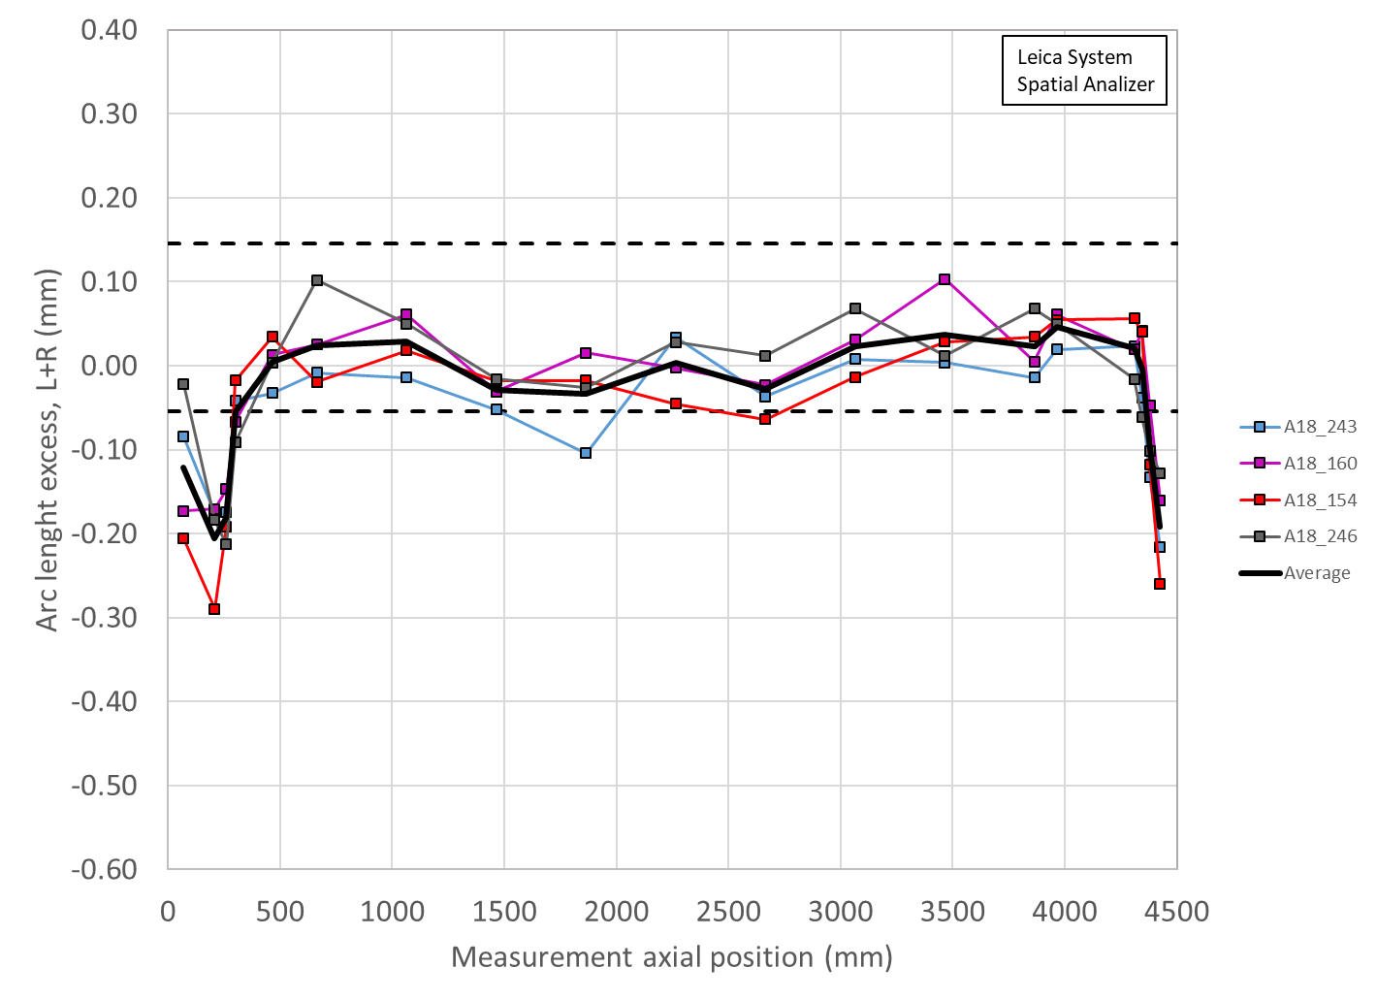
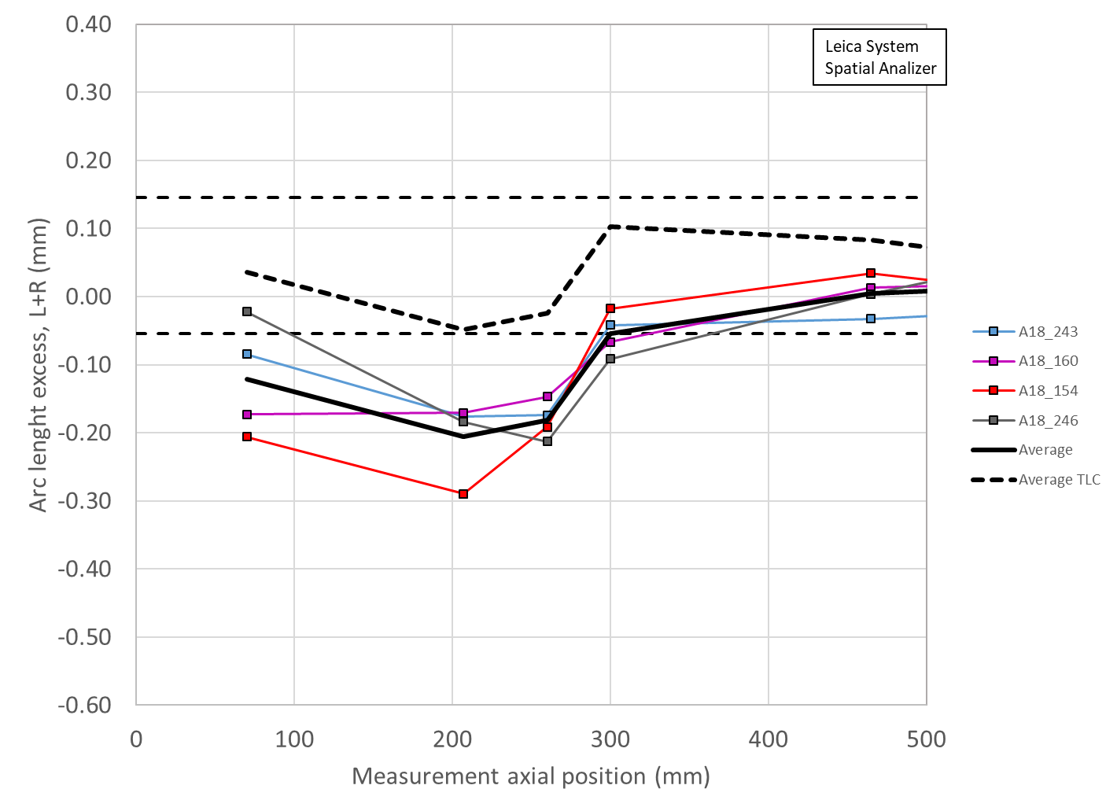
Tapered load shim (TLS)
Distance from coil end to 0.050 mm TLS end: 439 mm
Distance from coil end to 0.100 mm TLS end: 363 mm
Δr_{_ave} = Δ_arc-length_{_ave} * 2/ π
Δ_arc-length_{_ave} = Δr_{_ave} * π/2 → 0.100 mm rad = 0.157 mm arc_length
The max arc-length excess will be +0.100 mm at 300 mm

Slide 22
Appendix

Slide 23
From arc length deviation to radial deviation
Δ_arc-length_{_ave} * 4 = 2π Δr_{_ave}
Δr_{_ave} = Δ_arc-length_{_ave} * 2/ π

Slide 24
Magnet assembly and loading
Sensitivity analysis
+0.100 mm of coil outer radius increase
  -20 MPa of coil stress variation
  +12 MPa of shell stress variation
+0.100 mm of total coil arc-length increase (0.050 per mid-plane)
  -13 MPa of coil stress variation
  +8 MPa of shell stress variation
FE values confirmed in short models, like MQXFS4
By E. Takala

Slide 25
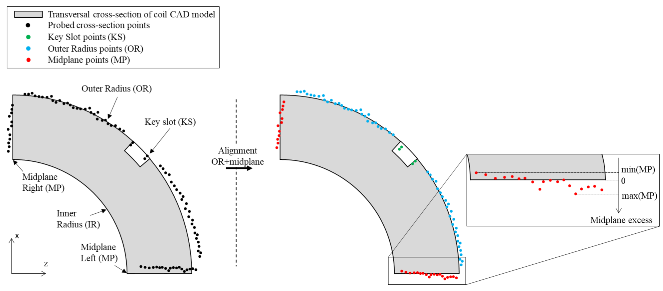
Impregnated coil dimensional tolerances
Arc length excess (ends)
At 260 and 300 mm (for the lead end) and at 4340 and 4380 mm (for the return end) the absolute value of the coil delta arc-length must not exceed 210 mm.
  The coil delta arc-length is the difference between the coil arc length at each location in the ends and the average coil arc-length in the straight section.

Slide 26
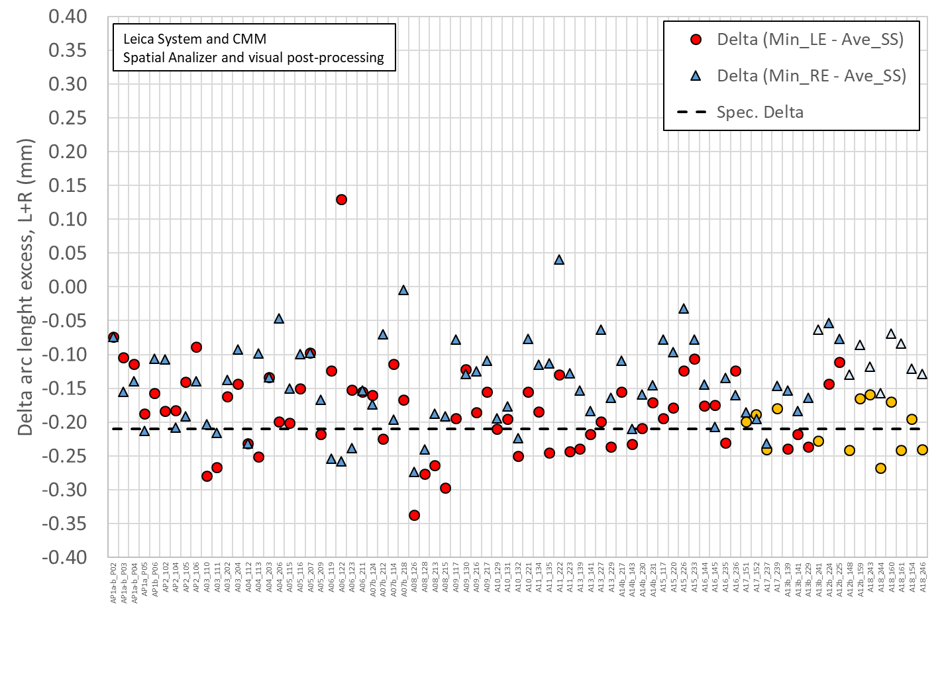
Only few coils have the measurements in the 260-300 mm positions, but all in the 207 mm position

Slide 27
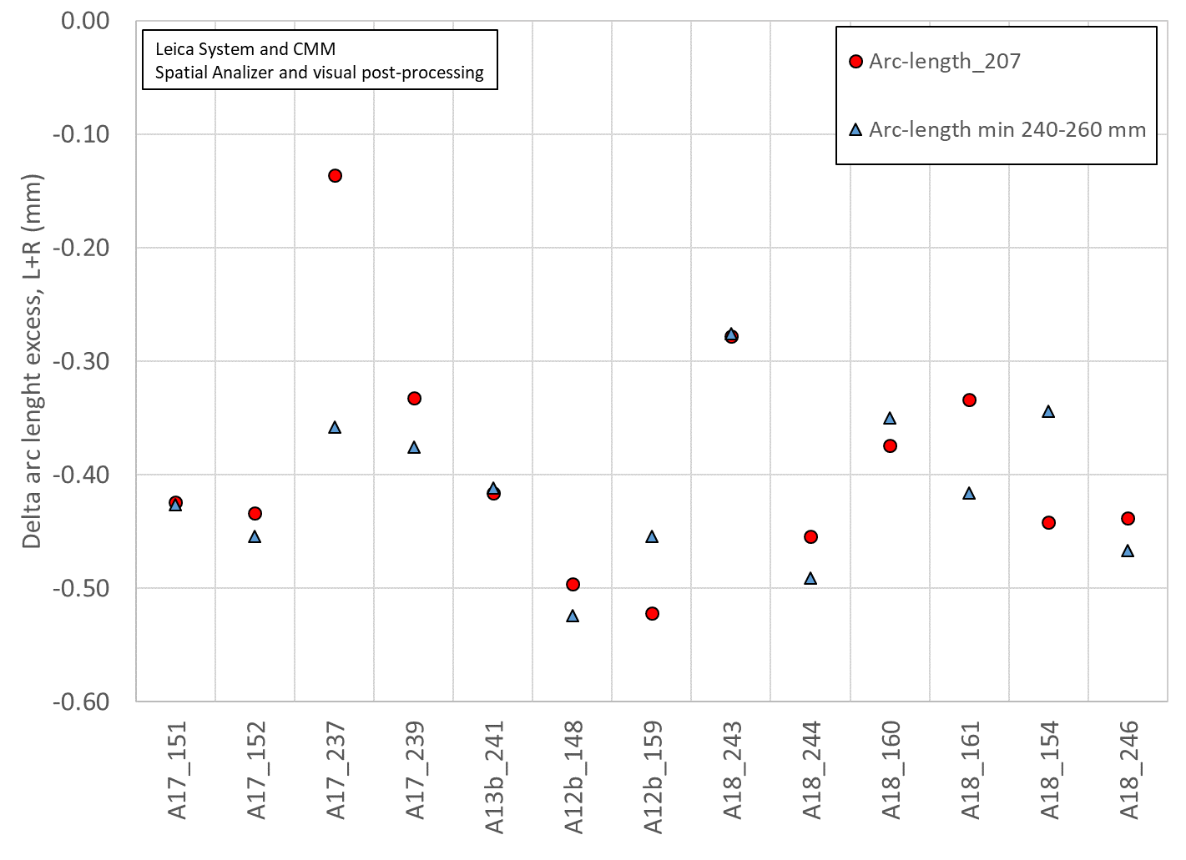
Only few coils have the measurements in the right position
Except for 1 coil (A17_237), the 207 mm position is a relatively good representation of the minimum of 260-300 mm positions
All included, the average difference is -0.021 mm (260-300 mm slightly smaller than 207 mm

