Slide 1
IOTA Proton Injector Update
Dean (Chip) Edstrom
06/07/2024

Slide 2
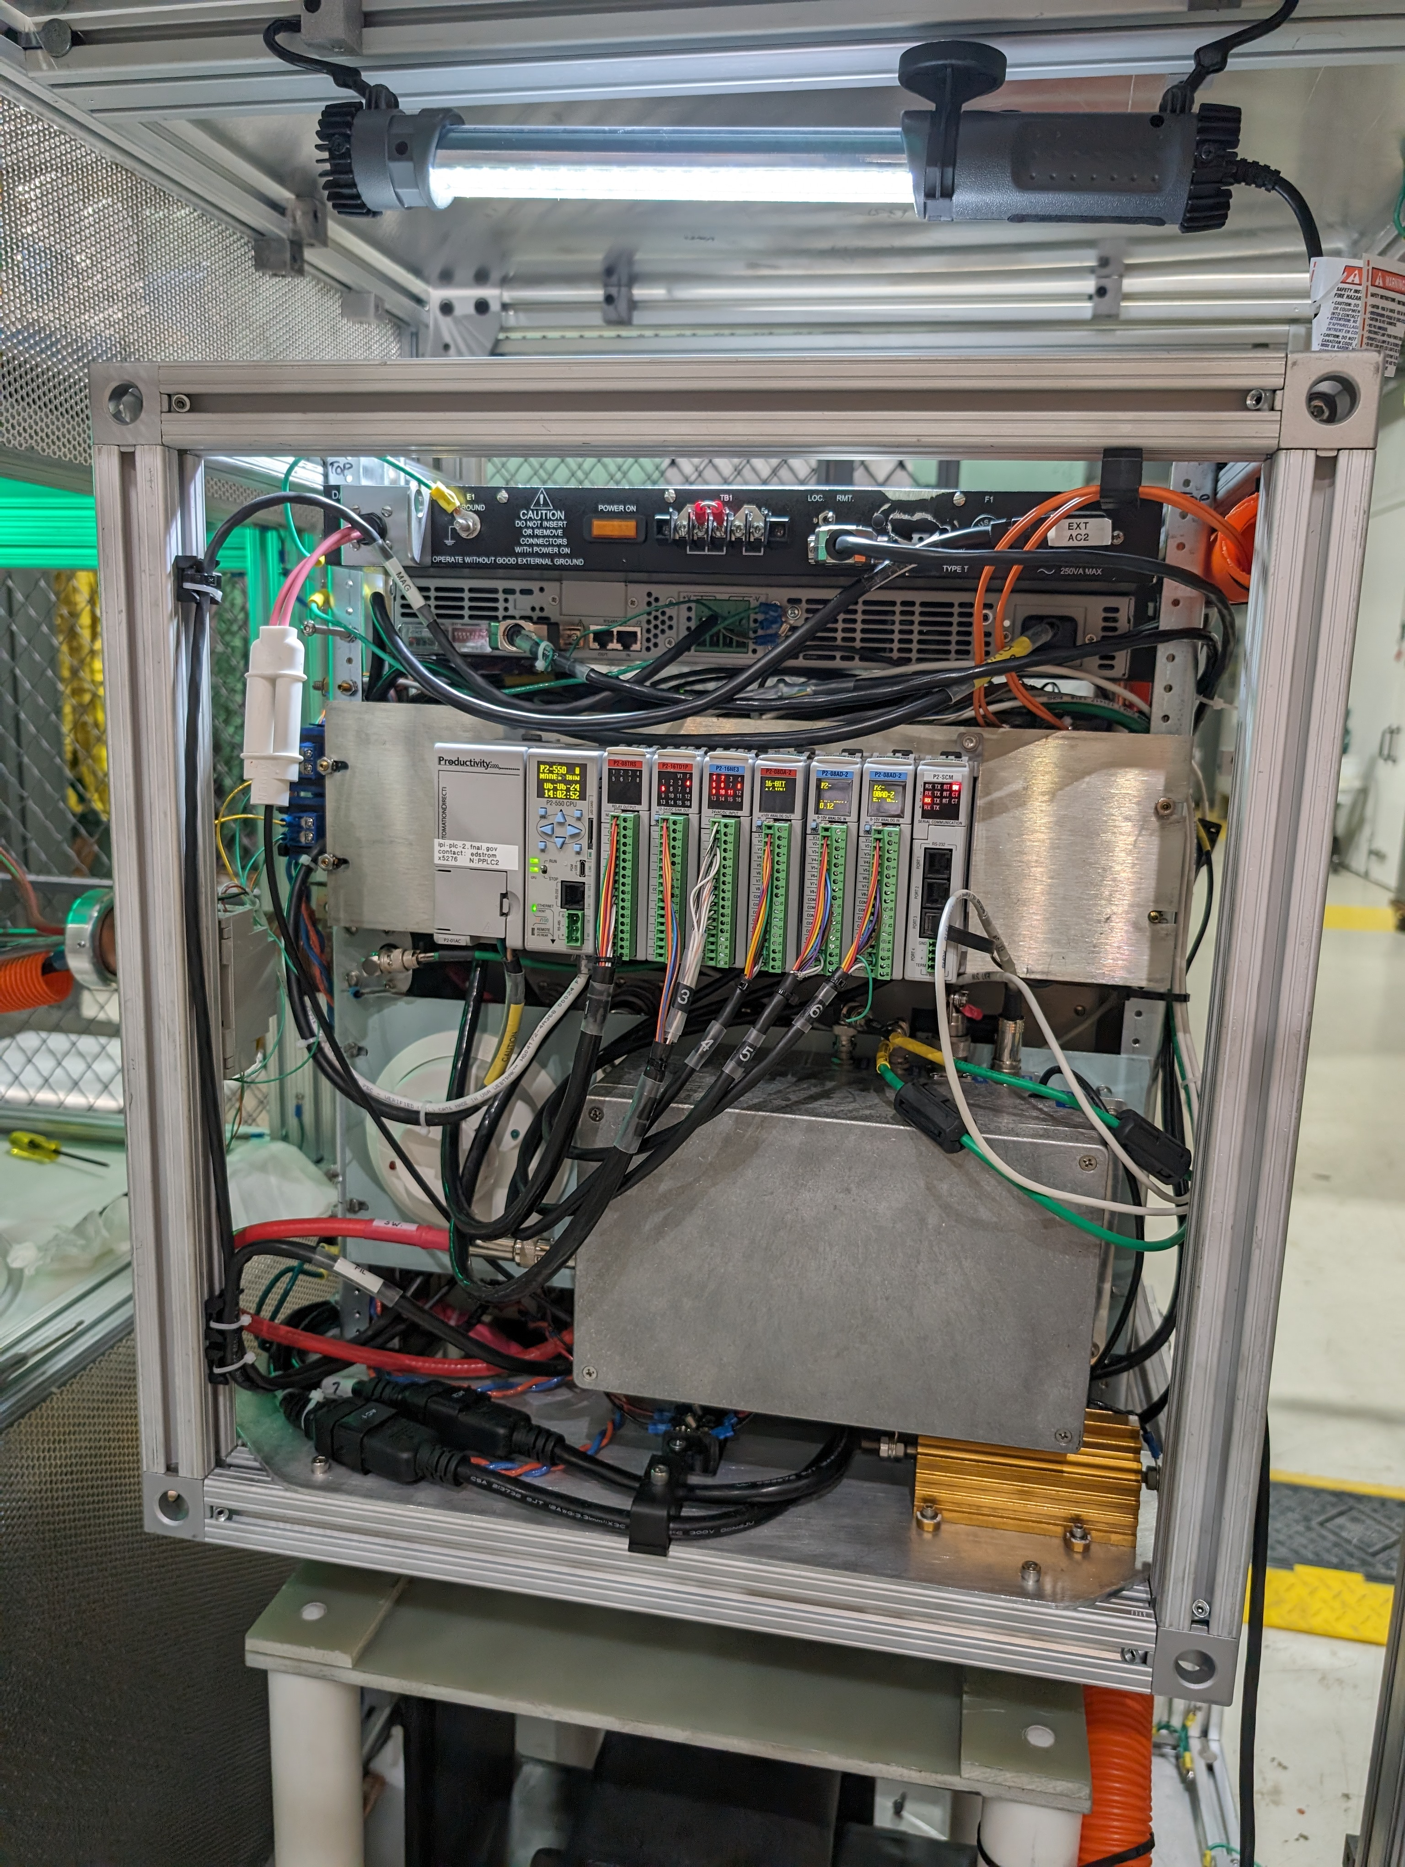
Source Status:
60μA @ 10keV, 450μA @ 50keV
First Signal on Faraday Cup!
  “Some are almost certainly protons.”
  Arc modulator issues tamed…
    Added a 10Ω series resistor to arc circuit
      Control ringing that was damaging MOSFETs
      Could step this down later
Studies to do…

Slide 3
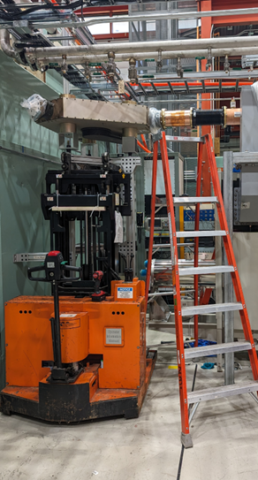
Gallery
HLRF (Daniel & Trey)
  CS/Mod/Xformer/Kly Connections wrapping up
  Component Testing / Evaluation
    ✔ 180 Deg Hybrid
    ✔ Circulator → Klystron checkout/condition/test?
    … Variable Coupler
  LCW Progressing…
    Time to run cable to the PLC
    Run switch readbacks to Modulator VME
  180 Deg Hybrid Installation
Still coming up…
  Electrical Contract for Misc Items (600A Disconnect Test Points)

Slide 4
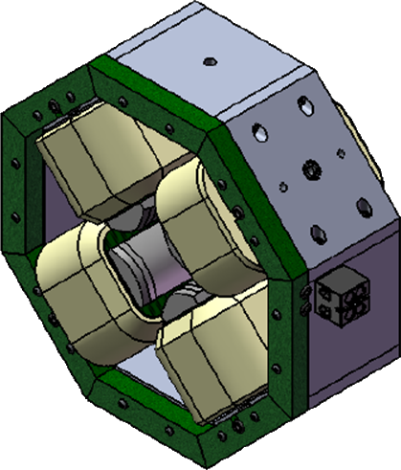
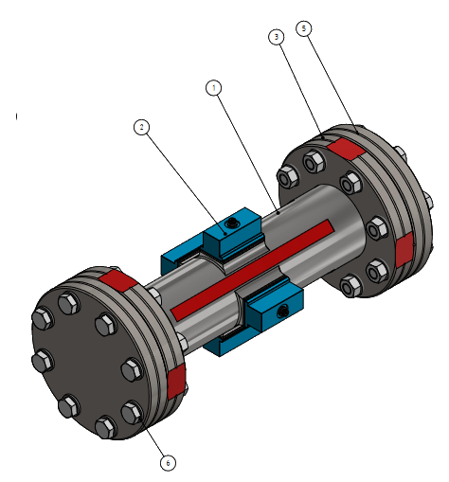
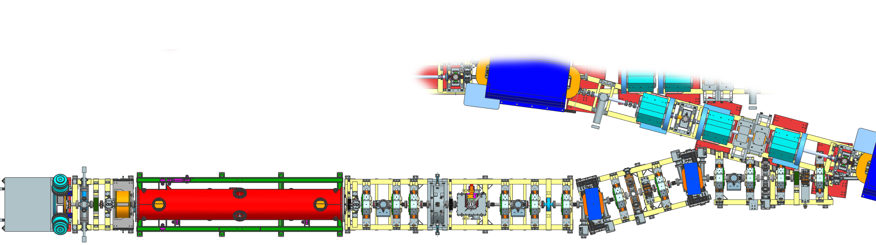
Beamline Installation…
Alignment
  RFQ / Quads / Bend Dipoles
  Vacuum Crosses / Ion Pumps
  !!! Do Not Move These !!!
BPMs
  Connectors ‘fit’ but maybe too snug
    G10 Shaved… Ready to connect?
Full-Aperture Crosses (x315 / x332 / x343)
Turbo Pump Fore Vacuum Carts

