Slide 1
9 O’Clock Meeting
Keymonty Bullock
MCR Crew Chief
Friday, June 7, 2024

Slide 2
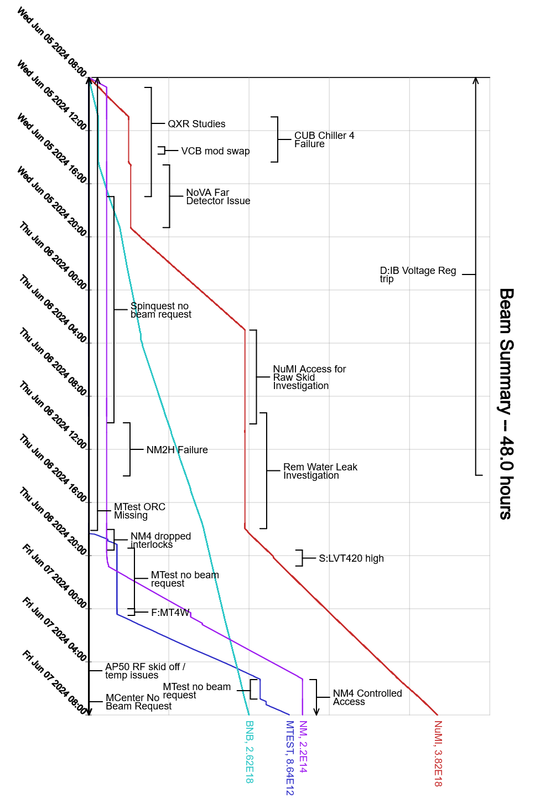
Since Wednesday…
L:LCWT reached its upper limit due to Chiller 4 issues
MI-65 Access to address NuMI baffle temperature issues
F-Sector leak discovered on magnet F38
Patch finished near the end of day shift
Beam to NuMI, MTest and BNB

