Slide 1
Cryostat Update
R. Rabehl
June 10, 2024

Slide 2
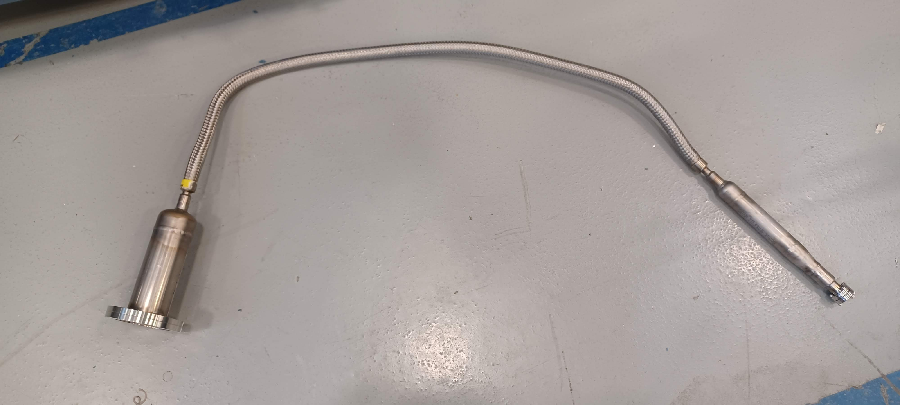
Cryostating – CA-02
CA-02 cryostat activities from last week.
Insulating vacuum space pumped out.
Unable to reach helium background levels below 10⁻⁶ atm-cc/s. Pressurizing the Cold Mass resulted in a response on the leak detector, indicating a leak.
Were suspicious of the flex hose assembly (used for pressurizing the Cold Mass) connecting the Cold Mass to the Lead End Vacuum Can.
Flex hose assembly was removed from the system, and all helium ports were blanked off.
Pumped out the insulating vacuum over the weekend.
With residual helium in the Cold Mass and Heat Exchangers (~ 1 atm differential relative to insulating vacuum), the measured helium background is in the high 10⁻⁹ atm-cc/s range so the flex hose assembly appears to be the problem.
Setting up for a pressure test this morning prior to final preparations for sending the Cryo-Assembly to the test facility.

Slide 3
Cryostating – CA-02
CA-02 DRs
13503: Unidentified surfaced blemishes on LD pipe. Awaiting disposition.
13526: Contact between IFS capillaries and thermal shield extrusions. Awaiting disposition verification.
13527: FSI target installation screws not torqued to specified value to due lack of an appropriately-rated torque wrench. Awaiting disposition verification.
13545: Unable to install three studs attached the fixed point support post to the Cold Mass saddle. Awaiting disposition verification.
13552: Thermal shield is ~5 mm too far towards the Non-IP end such that the thermal shield support pieces cannot be installed at the fixed support post. Awaiting disposition.
13575: IFS-A wired in the wrong orientation. Awaiting disposition.
13583: IFS-A RTD miswiring. Awaiting disposition.
13584: Misalignment between new IFS-A cover and interface ring after welding. Awaiting disposition.
13586: Unstable Pt100 temperature sensor on inboard side of magnet MQXFA05. Used only for controlled warm-up/cool-down monitoring at FNAL. Redundant sensor present. Closed.
CA-02 NCRs
Cold Mass saddle threads/support post installation.
Thermal shield misalignment.
Central support post bearing bolts.

Slide 4
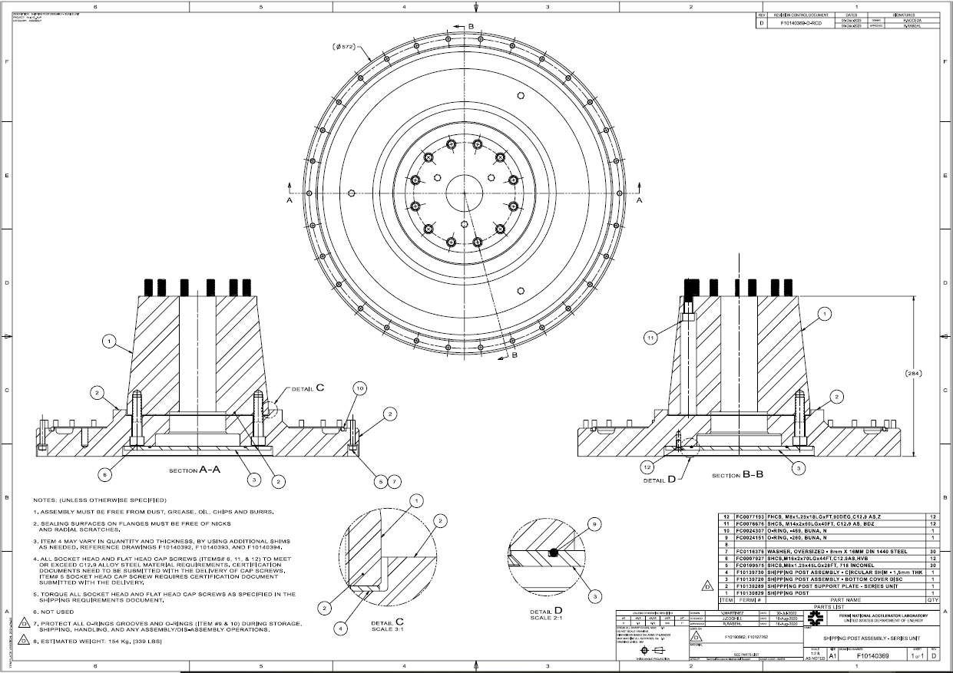
Cryostat – Shipping Posts
Teamcenter Engineering Order Form ED0033225 submitted
Remaining 2 sets of shipping posts/support plates/cover discs. (Req. 354738 / P.O. 712185)
May 10, 2024 promised date
All items received, in QC
All bolting hardware for the remainder of the project. (Req. 357424)
Placed on SAM.gov due to vendor error in indicating foreign-sourced material.
A set of bolting hardware for CA-02 has been ordered (P.O. 714732). June 17 promised date.

