Slide 1
9 O’Clock Meeting
Nathan Ruffatti
MCR Crew Chief
Monday, June 10th, 2024

Slide 2
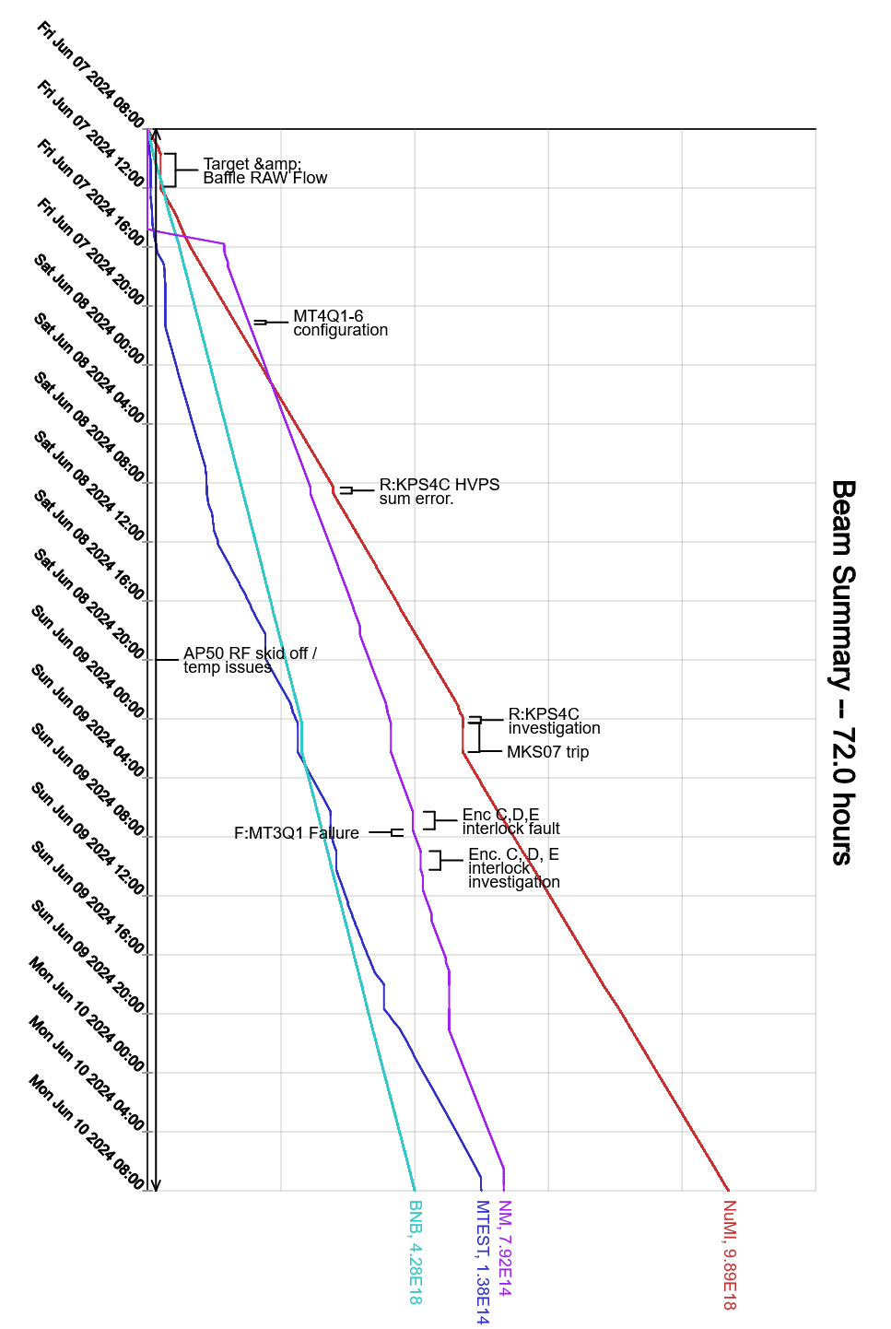
Since Friday…
Friday:
NuMI Target RAW flow issues, MI65 access to vent air from the system. Also swapped to the other pump.
Saturday:
R:KPS4C tripped off a couple times in the morning,
Low magnet current, found bad capacitor in resonant charging chassis
MKS07 trip on fan flow, fan flow switch vane repaired
Enc. CDE interlocks dropped. Interlocks found a bad relay and cleaned the sensors/reflector for the light link
S:H203 regulation issue, causing occasional low intensity pulses. This may account for a 10-20 bad pulses an hour
Sunday:
F:MT3Q1 at MS3 tripped breaker, reset ok
Baffle temp high when running without $20
Monday:
M4 prepared for controlled access
NM3 controlled access this morning

