Slide 1
PPD Department Heads Meeting DSO Slides
ES&H
12 June 2024

Slide 2
Summary
Training/ITNA Status
Injuries in May
ORPS/NTS in May
FESHM and QAM Updates
July 1-5, 2024, Low Tempo Period Work Guidance

Slide 3
ES&H Training and ITNA Status for employees – as of 06/10/2024
 | Training Courses |  |  |  | Individual Training Needs Assessments
Div/Sec | Completed | Required | Percent | Employees | < 1 Year Old | Percent | Missing | Missing for New Hires
 | 583 | 683 | 85.36% | 93 | 68 | 73.12% | 1 | 21
AD/ACTD | 5,682 | 6,024 | 94.32% | 229 | 226 | 98.69% | 0 | 0
AD/ARD | 340 | 356 | 95.51% | 17 | 17 | 100.00% | 0 | 0
AD/BD | 4,097 | 4,304 | 95.19% | 154 | 149 | 96.75% | 0 | 0
APS-TD/CS | 1,279 | 1,544 | 82.84% | 41 | 40 | 97.56% | 0 | 0
APS-TD/DFS | 923 | 970 | 95.15% | 52 | 49 | 94.23% | 0 | 0
APS-TD/MAG | 2,172 | 2,354 | 92.27% | 97 | 95 | 97.94% | 0 | 0
APS-TD/SRF | 1,453 | 1,542 | 94.23% | 69 | 69 | 100.00% | 0 | 0
COM | 544 | 581 | 93.63% | 52 | 50 | 96.15% | 0 | 0
COO/COAS/QU | 141 | 143 | 98.60% | 8 | 8 | 100.00% | 0 | 0
CSAID/DSSL | 539 | 551 | 97.82% | 44 | 41 | 93.18% | 0 | 0
CSAID/RTPS | 388 | 422 | 91.94% | 32 | 20 | 62.50% | 0 | 0
CSAID/SCSS | 648 | 663 | 97.74% | 59 | 58 | 98.31% | 0 | 0
DCO | 12 | 13 | 92.31% | 2 | 2 | 100.00% | 0 | 0
DI | 2,206 | 2,363 | 93.36% | 264 | 250 | 94.70% | 0 | 1
DI/IA | 44 | 44 | 100.00% | 4 | 4 | 100.00% | 0 | 0
ES | 2,960 | 3,248 | 91.13% | 104 | 99 | 95.19% | 0 | 0
ETD/IARCD | 188 | 214 | 87.85% | 9 | 9 | 100.00% | 0 | 0
ETD/MD | 296 | 321 | 92.21% | 24 | 20 | 83.33% | 0 | 0
ETD/QID | 195 | 221 | 88.24% | 15 | 12 | 80.00% | 1 | 0
FI | 1,090 | 1,148 | 94.95% | 106 | 84 | 79.25% | 0 | 0
FRA | 12 | 12 | 100.00% | 1 | 1 | 100.00% | 0 | 0
HR | 622 | 643 | 96.73% | 57 | 50 | 87.72% | 0 | 0
ISD | 5,791 | 6,192 | 93.52% | 220 | 213 | 96.82% | 0 | 0
ITD | 1,103 | 1,118 | 98.66% | 124 | 123 | 99.19% | 0 | 0
LBNFDUNE | 770 | 824 | 93.45% | 53 | 44 | 83.02% | 0 | 0
NQC/NQCDIV | 705 | 767 | 91.92% | 47 | 39 | 82.98% | 0 | 0
PIPII/PIPII | 264 | 282 | 93.62% | 20 | 15 | 75.00% | 0 | 0
SEC | 2,472 | 2,637 | 93.74% | 104 | 98 | 94.23% | 0 | 0
ND | 1,528 | 1,634 | 93.51% | 91 | 79 | 86.81% | 0 | 0
PPD | 275 | 302 | 91.06% | 40 | 40 | 100.00% | 0 | 0
PPD/ABS/CMSD | 441 | 482 | 91.49% | 42 | 41 | 97.62% | 0 | 0
PPD/ABS/MD | 299 | 333 | 89.79% | 19 | 19 | 100.00% | 0 | 0
PPD/APD | 300 | 333 | 90.09% | 22 | 15 | 68.18% | 0 | 0
PPD/ES | 2,913 | 3,150 | 92.48% | 114 | 110 | 96.49% | 0 | 0
THD | 375 | 417 | 89.93% | 52 | 37 | 71.15% | 0 | 0
Fermilab Total | 43,650 | 46,835 | 93.20% | 2,481 | 2,294 | 92.46% | 2 | 22
This month:
Last month:
ND | 1,589 | 1,685 | 94.30% | 93 | 88 | 94.62% | 0 | 0
PPD | 4,409 | 4,808 | 91.70% | 249 | 243 | 97.59% | 0 | 0
THD | 372 | 417 | 89.21% | 53 | 38 | 71.70% | 0 | 0
Notes:
Direct Link to Dashboard: https://cdv-fdashp.fnal.gov/Reports/report/Management%20Systems%20-%20MS/ESH/Reports/ESH%20Training%20and%20ITNA%20Completion

Slide 4
Injuries/Illnesses in May
05/07/2024 - First Aid Only, APS-TD
An employee experienced a standard threshold shift of their hearing in both ears over time.
05/08/2024 - First Aid Only/Not Reportable, SEC
An employee was walking and reading an ID badge when they struck an open cabinet drawer that was obstructing the walkway. The employee received a small scratch to their head.
05/20/2024 - Medical Treatment Beyond First Aid, SEC
An employee had just finished providing site access to an employee when they set down the corded badge scanner and walked back towards the guard shack. The employee’s foot was then caught up in the cord of the badge reader causing them to trip and fall. The employee caught themselves with their arms resulting in a tear in their shoulder.

Slide 5
Injuries/Illnesses in May
05/21/2024 - First Aid/Limited Duty, ISD
An employee was lifting a mop bucket to empty it into a sink when the bucket slipped from their grip. The employee attempted to stop the bucket from falling, but experienced pain in their left shoulder. The employee experienced a strain and was given lifting restrictions.
05/22/2024 - First Aid Only/Not Reportable, ND
An employee was leaving the men's room while carrying a laptop in their left hand and opening the door with their right hand. When they opened the door, it slammed on their right hand and caused pain. The employee iced for 15 minutes and then reported to FOMO. No abnormal facility conditions were identified upon closer inspection of the bathroom doors.
05/23/2024 - First Aid Only/Not Reportable, CSAID
An employee was reaching for a cord that had fallen behind their desk when they struck their head on a shelf bracket. This shelf bracket was situated above their desk with no shelf attached. It was removed after the incident. The employee received a small abrasion/laceration to their head.

Slide 6
ORPS/NTS in May
Stop Work order for Off-Site Waste Shipments, certain class of vehicles, 05/04/2024 (ORPS Event, Level 3)
During the week of April 29th, the lab was undergoing a Packaging and Transportation Program assessment with reviewers external to the lab. The assessment team identified several concerns that were raised to senior lab management on Thursday, May 2nd. The assessment team expressed several concerns, including the laboratory's interpretation of Department of Transportation (DOT) Hazardous Materials Regulations pertaining to transporting hazardous materials, as well as the interpretation of requirements for operations of commercial motor vehicles in the 10,000-to-26,000-pound weight class.
Upon review of the concerns and actions recommended by the team, Senior Lab Management issued a Stop Work Order on Saturday, May 4th for all hazardous and radioactive materials and waste shipments, and all operations of laboratory vehicles in the 10,000-to-26,000-pound weight class.
The laboratory immediately began developing interim compensatory measures that would compliantly and safely allow resumption of most operations involving the movement of hazardous and radioactive materials and waste shipments. The laboratory reviewed these compensatory measures with the Fermilab Site Office (FSO), and with FSO concurrence, resumed most suspended operations on the afternoon of May 7, 2024.

Slide 7
ORPS/NTS in May
Linac LRF3 Crowbar Box Shock Event, 05/06/2024 (ORPS Event, Level 3)
An employee working in the Linac the afternoon of May 6th experienced an electrical shock (tingle felt in the finger) while removing a failed a Crowbar Trigger Assembly chassis. The employee had removed the top plate to unbolt the assembly from the relay rack, but inadvertently placed a finger across the 385-volt DC supply to ground, experiencing a small tingle in the tip of their finger. The DC source is able to deliver up to 65 milliamperes and has a filter capacitor that can store up to 1.5 Joules of energy. The employee reported the event to their supervisor, who in turn notified their Directorate Safety Officer. The employee was directed to report to the Fermilab Occupational Medical Office for evaluation.
While the investigation is ongoing, the Associate Lab Director for Accelerators issued a stop work order for the 4616 Anode Crowbar PS Trigger Assembly (0230-ED-60085 Rev A) replacements and repairs until a LOTO procedure for this module is developed, reviewed and approved.

Slide 8
FESHM and QAM Updates in May
The following chapters have been updated in the last month. A brief summary is provided below.
05/10/2024 - FESHM 6011: Periodic Testing Of Emergency & Exit Lights
Changes:
Changed §4.3 Documentation Requirements to include electronic records.
05/28/2024 - QAM 12060: Quality Assurance Guidelines for Scientific Research
Changes:
Updated position titles and changes as a result of recent reorganizations

Slide 9
FESHM and QAM Updates in May
The following chapters have been updated in the last month. A brief summary is provided below.
05/30/2024 - FESHM 10160: Traffic Safety, is out for Lab-wide review until June 13th, 2024.
Changes:
Added Definition of Utility Task Vehicle
Added Definition UTV Attachment
Updated Appendix 7.0
Operating Differences
Qualification Training
Remedial Training
Evaluation Requirement
Evaluator Program
06/05/2024 - FESHM 7005: Facility Construction, Modification & Inspection, is out for Lab-wide review until June 19th, 2024.
Changes
Acronym changes: ESH&Q to ESH and FESS to ISD, FESHM Chapter updates, Definition changes.

Slide 10
FESHM and QAM Updates in May
The following chapters have been updated in the last month. A brief summary is provided below.
06/11/2024 - FESHM 5035 - Mechanical Refrigeration Systems, is out for Lab-wide review until June 25th, 2024.
Changes:
Update to exclusions for small, commercially produced, factory charged units by charge limits which are installed in spaces with adequate Effective Dispersal Volumes per ASHRAE Standards 15 and 34. Added related definitions.

Slide 11
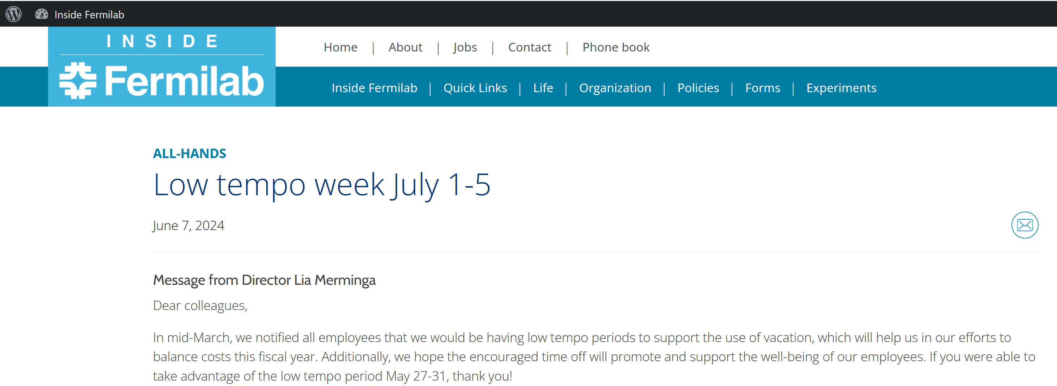
July 1-5, 2024, Low Tempo Period Work Guidance
Work conducted during the July low tempo period will be considered off hours work.
Work packages will need to be approved for high hazard work to be conducted during this off-hours work period.
Requests must be sent to the ALD by the week of Monday, June 17th to be reviewed by Senior Lab Management on Monday, June 24th
Off hours high hazard high risk work

