Slide 1
FY24 rate changes
Rate changes for June, retroactive to the start of the fiscal year. More details to come, but expect a net increase to rates:
SLRs – Decrease
LDRD OH – Decrease, due to pool underspending
Program Support OH – Increase, due to pool overspending
OPTO Rates – Increase, due to SSVSP payouts.
Machine Shop & Construction Engineering – Increase
Rate sheets will be updated by the end of June.

Slide 2
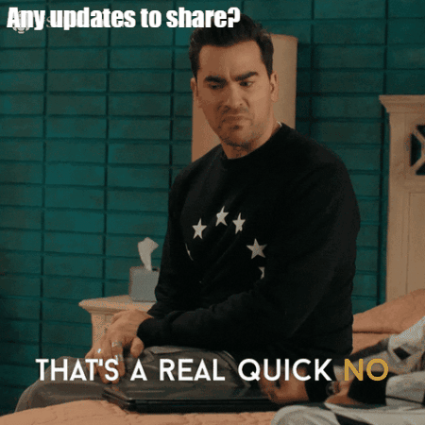
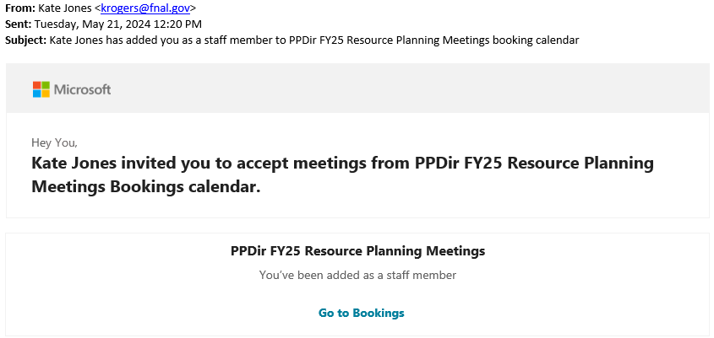
Summer Planning Exercise (for FY25)
Labor resource requests (non-base/non-P6 projects)
Info to come…
Did you receive the below email from Kate? Please ignore. 😊

Slide 3
FY25 Indirect requests
Indirect request exercise due to the Budget Office by June 24.
Plan for a flat-flat Program Support budget.
What big PS changes from FY24 are you expecting? What is the impact if the increases aren’t funded? Are there any planned decreases? Finance will gather this information from department heads in the next week.
Still working on a strategy for planning CSS, which will be down significantly for PPD.

Slide 4
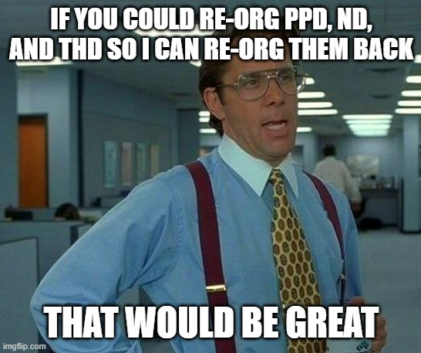
Other News
More re-org info coming… sometime?
Existing signature authority is still valid
No new proj/task structure yet
Take a vacation while you wait!

