Slide 1
302.4.01 Magnets Vertical Test at BNL Test Summary- MQXFA17
Febin Kurian
12-June-2024

Slide 2
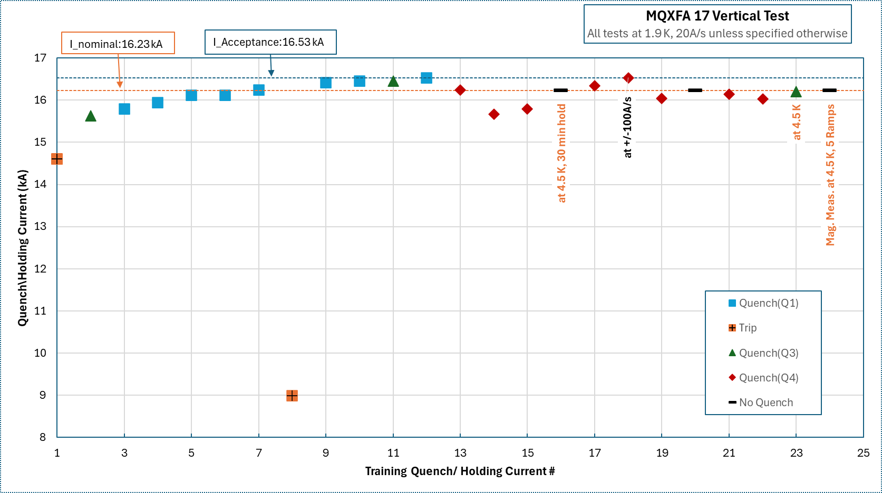
MQXFA17
Training summary

Slide 3
MQXFA17
Training sequence
Quench 1-10: Quench current increases; 8 quenches on Q1 and 2 quenches on Q3 (Quench-10, 16528 A)
Quench 11-13: Quenches at significantly lower currents, all quenches on Q4 (16245A, 15664A & 15787A)
New Ramps:
Ramp to 16230 A at 4.5 K at 20 A/s, hold for 30 mins→ No quench
Ramp to 16530 A at 1.9 K at 20 A/s, hold for 30 mins→ (Quench-14, 16337 A on Q4)
Ramp to 16530 A at 1.9 K at 100A/s→ (Quench-15, 16531 A on Q4)
New Training Ramps:
Ramp to 16530 A at 20A/s at 1.9 K, if quench, go to next step (Quench-16, 16037 A on Q4)
Ramp to 16230 A at 20A/s at 1.9 K, hold for 30 min. If no quench, go to next step (Quench-17, 16142 A on Q4)
Increase to I_nom+100A, hold for 15 min. If no quench, go to next step
Increase to I_nom+200A, hold for 15 min. If no quench, go to next step
Increase to I_nom+300A, hold for 30 min.
Repeat step 2-5: Quenches at step2 again (Quench-18, 16030 A on Q4)
Ramp to 16230 A at 20A/s at 4.5 K, hold for 30 min. If no quench, go to next step (Quench-19, 16199 A on Q3)
Increase to I_nom+100A, hold for 15 min. If no quench, go to next step
Increase to I_nom+200A, hold for 15 min. If no quench, go to next step
Increase to I_nom+300A, hold for 30 min.
Magnetic field measurements at 4.5 K, total 5 ramps to 16230 A – No quenches (un-finished…)

Slide 4
MQXFA17
Training summary

Slide 5
Quench Start Location

Slide 6
Quench Current vs Quench Start Time
activation of quench

Slide 7
Quench Antenna Signals- Q4 Quenches
Q-11

Slide 8
Similarities-Quench Antenna Signals-1
Q-11

Slide 9
Similarities-Quench Antenna Signals-2
Q-12
Q-13

Slide 10
Similarities-Quench Antenna Signals-3
Q-14
Q-15

Slide 11
Similarities-Quench Antenna Signals-4
Q-16
Q-17
Q-18

Slide 12
QA signals-Z4250 Channels
Q-12
Q-13
Q-14
Q-15
Q-16
Q-17

Slide 13
Splice Measurements

