Slide 1
DRs and NCRs for MQXFA17 NCR analysis
Summary of contributions from all MQXF team members
MQXFA Mtg
June 12, 2024

Slide 2
Outline
Conductor and Coil 239 DRs/NCRs
MQXFA17 Assembly data and NCRs

Slide 3
Coil 239: Conductor & Coil Fabrication DRs
Coil 239 Travelers and DRs are in FNAL Vector and BNL system:
  Vector link to Coil 239 Interface Travelers and DRs:
  https://vector-onsite.fnal.gov/GenerateTravelerRequest.asp?qsDocID=34203
Presented at MQXFA17 and MQXFA13b Coils Acceptance Review:
  MQXFA17 and MQXFA13b Coils Acceptance Review (October 6, 2023) · INDICO-FNAL (Indico)

Slide 4
MQXFA17 Cable QC Summary
All cables passed the required quality control testing per US-HiLumi-Doc 74
There were No Critical DRs
No impact on coil 239

Slide 5
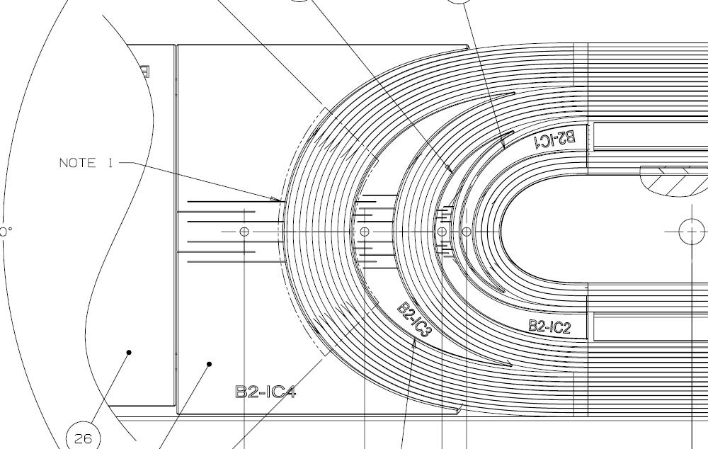
QXFA239 - DR
DRs posted to interface traveler.
Critical = Affecting Form, Fit or Function
(as found)

Slide 6
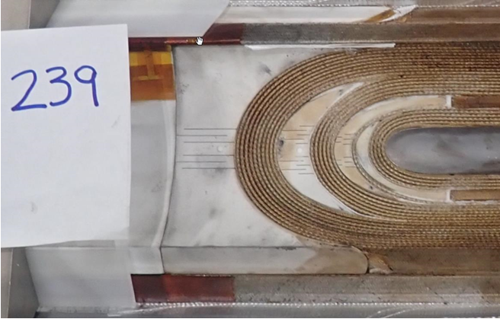

Slide 7
MQXFA17 Assembly Data and NCRs
MQXFA17 Structure and Shims Review:
  MQXFA17 Structure & Shims Review (October 18, 2023) · INDICO-FNAL (Indico)
  MQXFA17 NCRs:
    #593 – Coil 239 accelerometer issues upon arrival
    #601 – Proud pin on Coil 239 at 1365 mm from LE (modified alignment key)
MQXFA17 Specs Mtg:
  MQXFA17 Spec Meeting (March 15, 2024) · INDICO-FNAL (Indico)
  “MQXFA17 load keys are smaller than target because a coil reached 120 MPa” (Paolo)
MQXFA17 Fabrication Report:
  US-HiLumi-doc-5151
  Critical NCR for Overheated splice
  Critical NCR caused axial-preload unloading twice

Slide 8
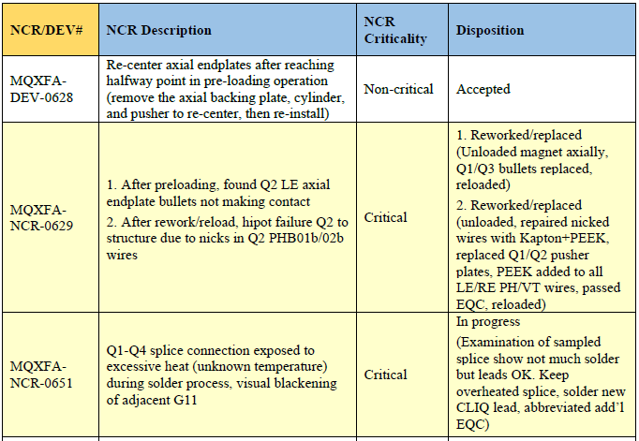
MQXFA17 Critical NCRs

Slide 9
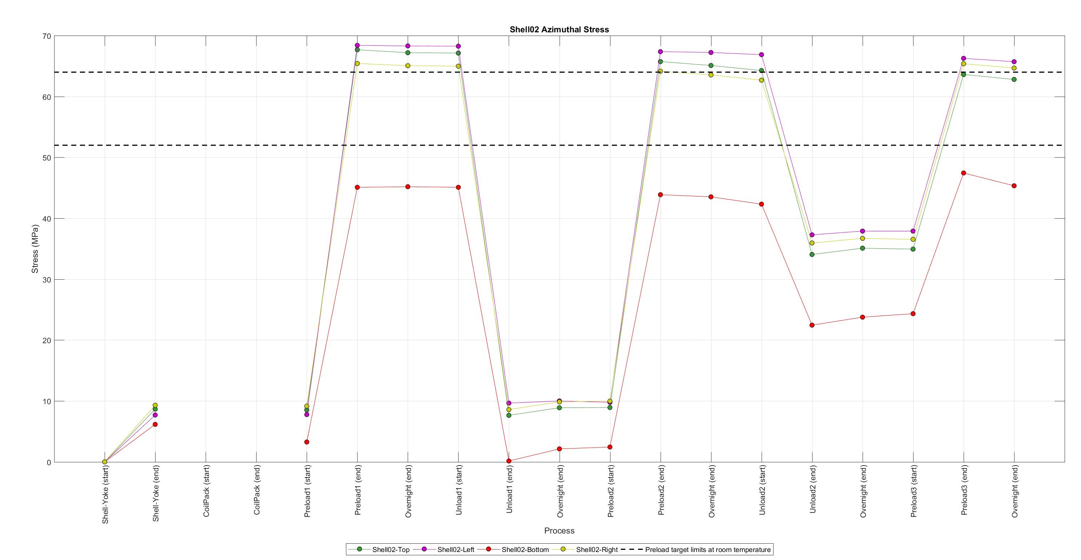
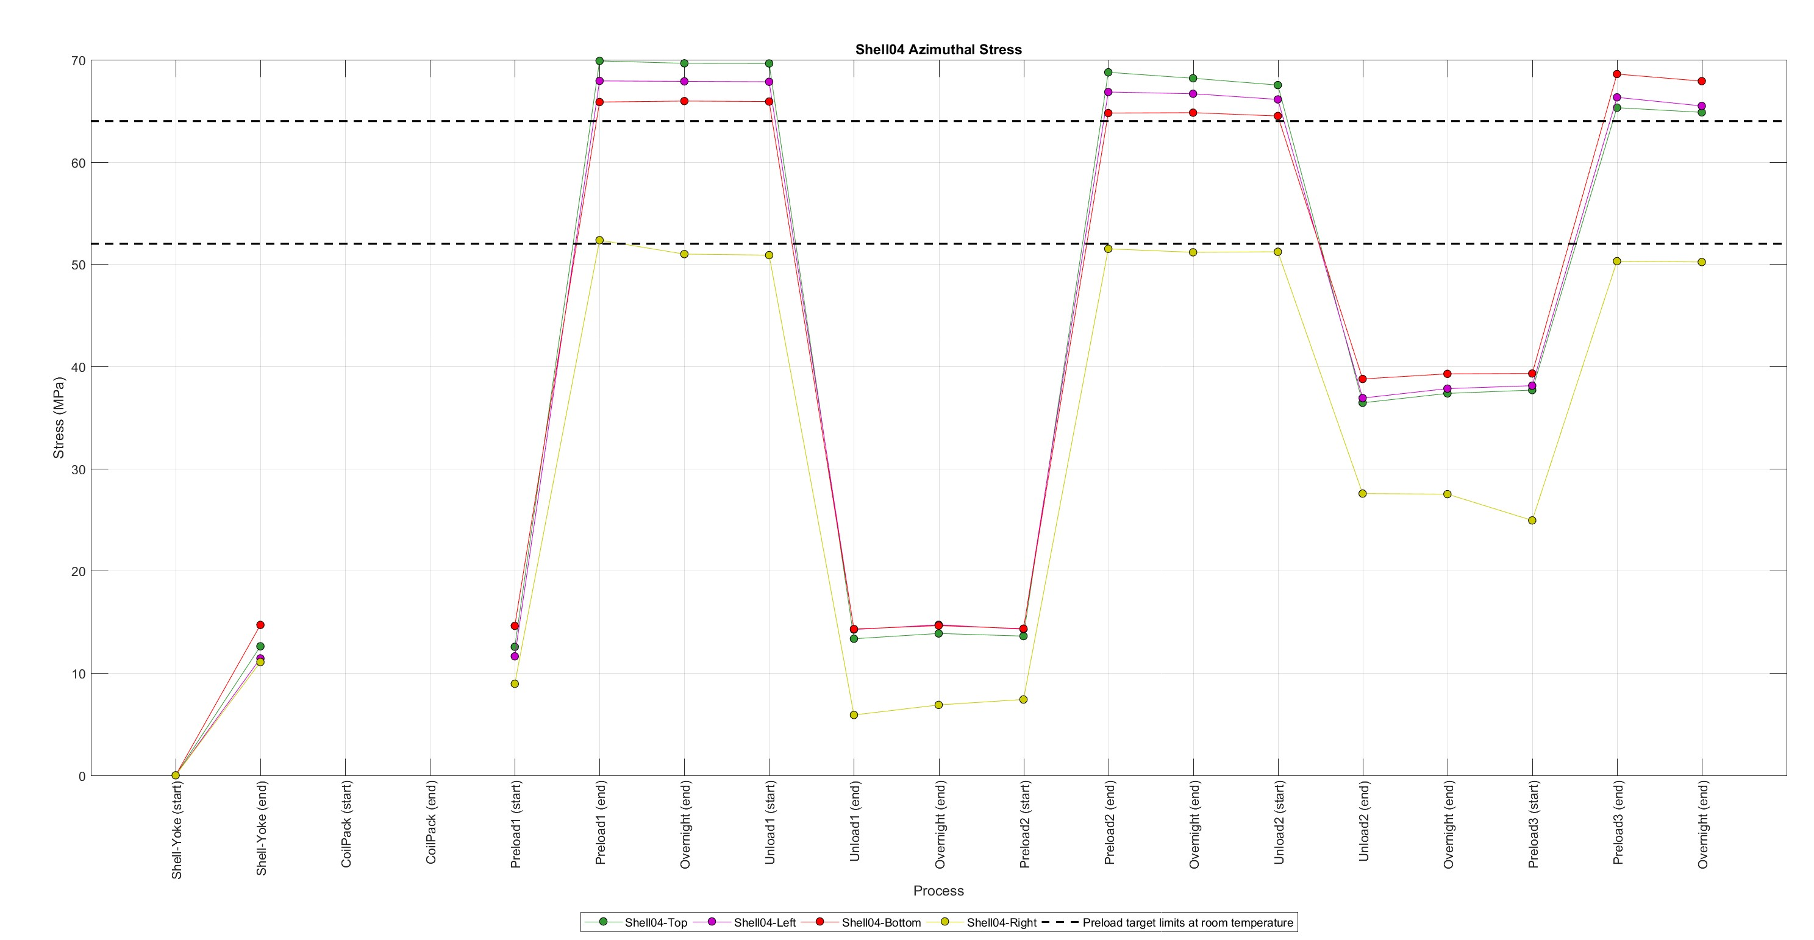
Magnet assembly and loading
Specifications (shells)

Slide 10
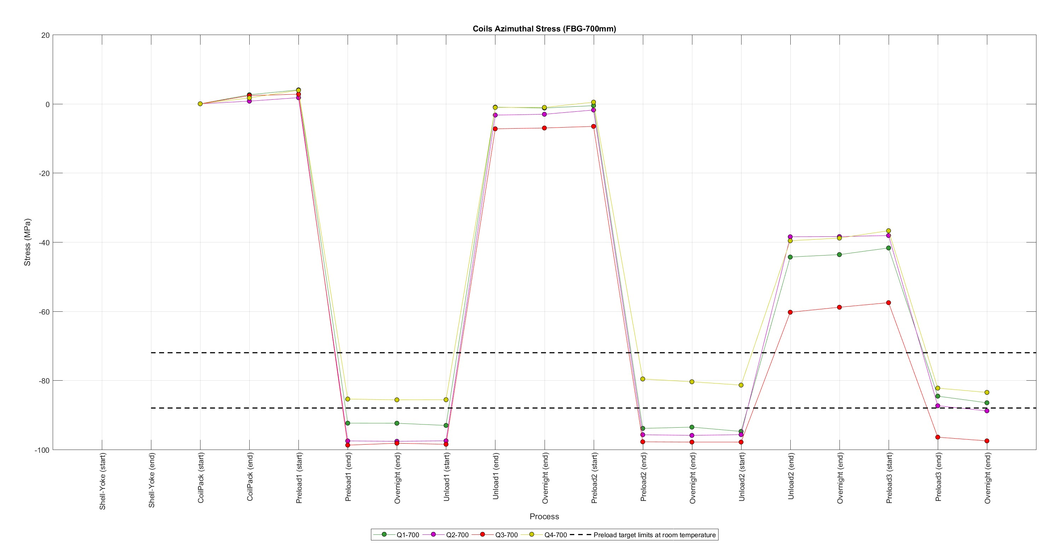
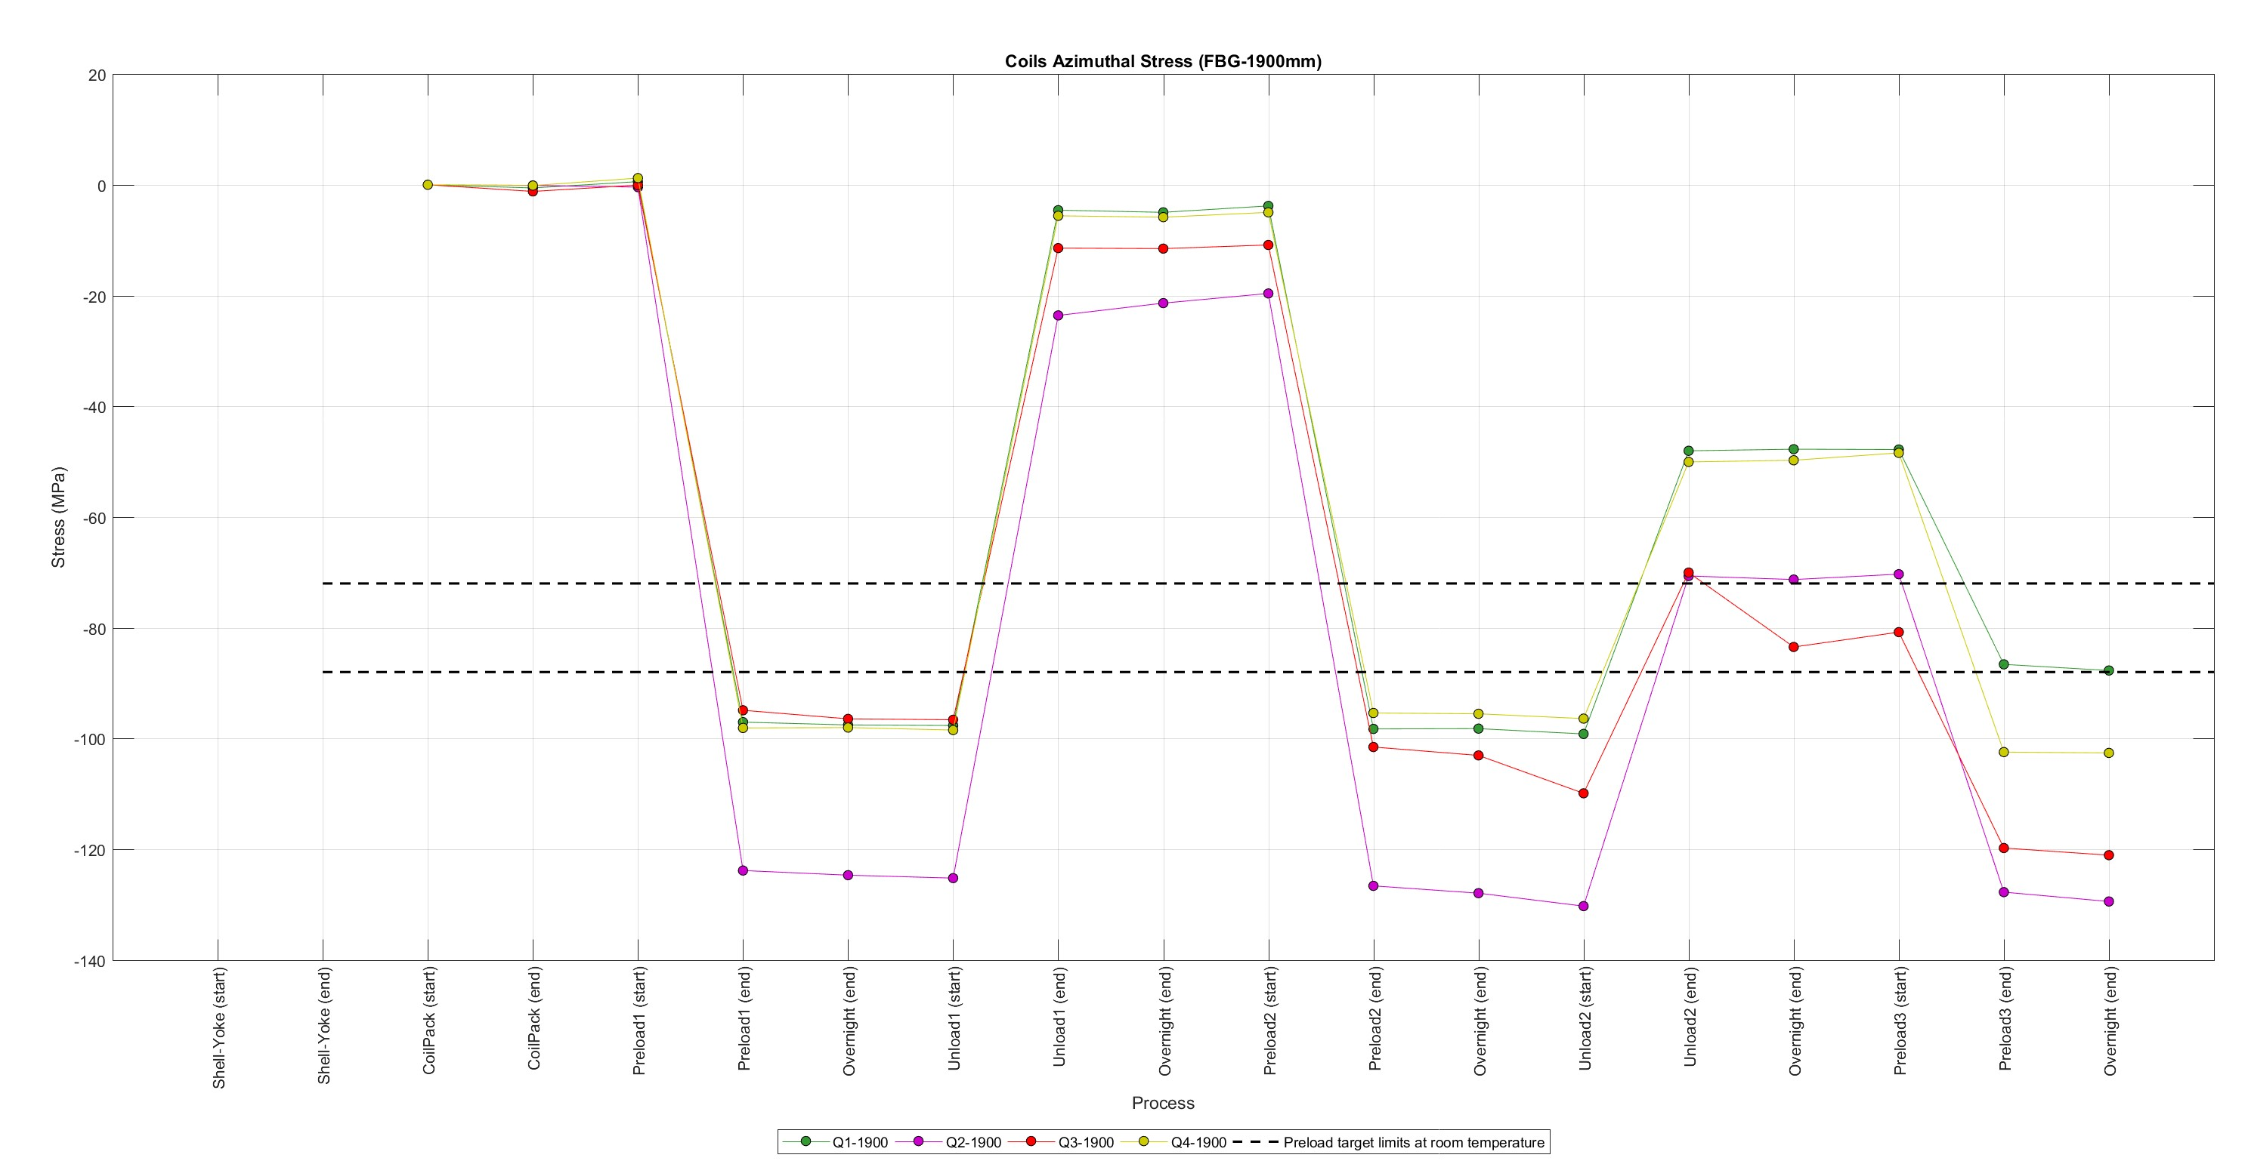
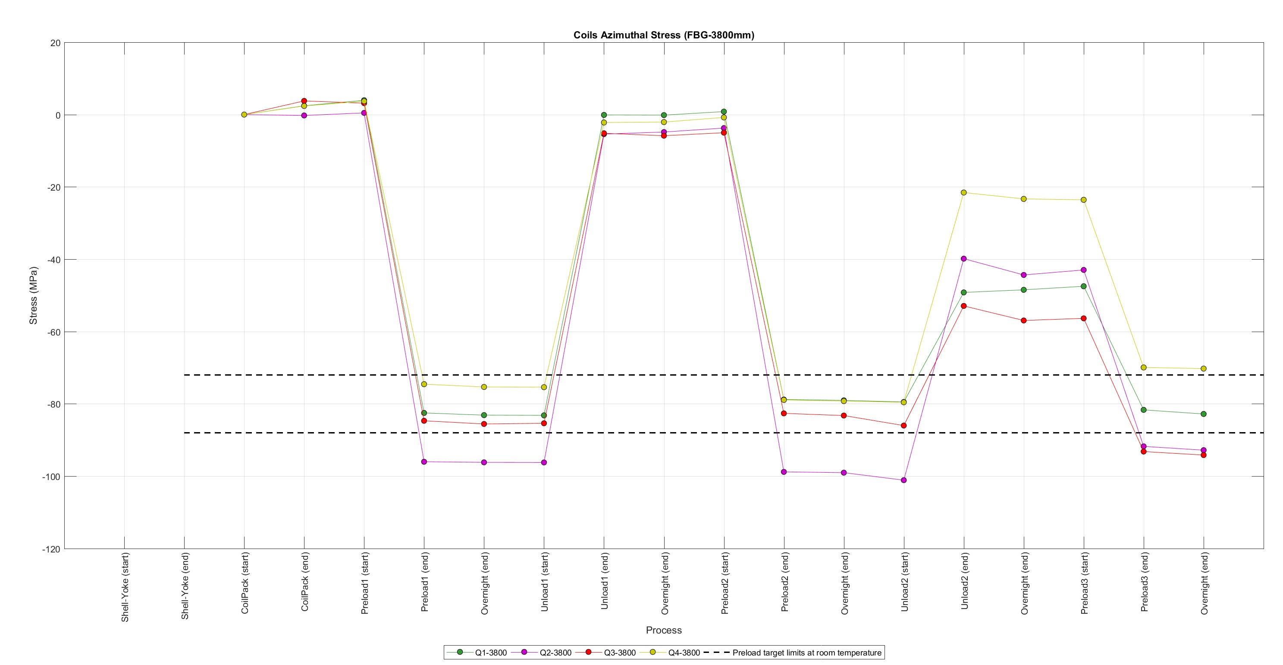
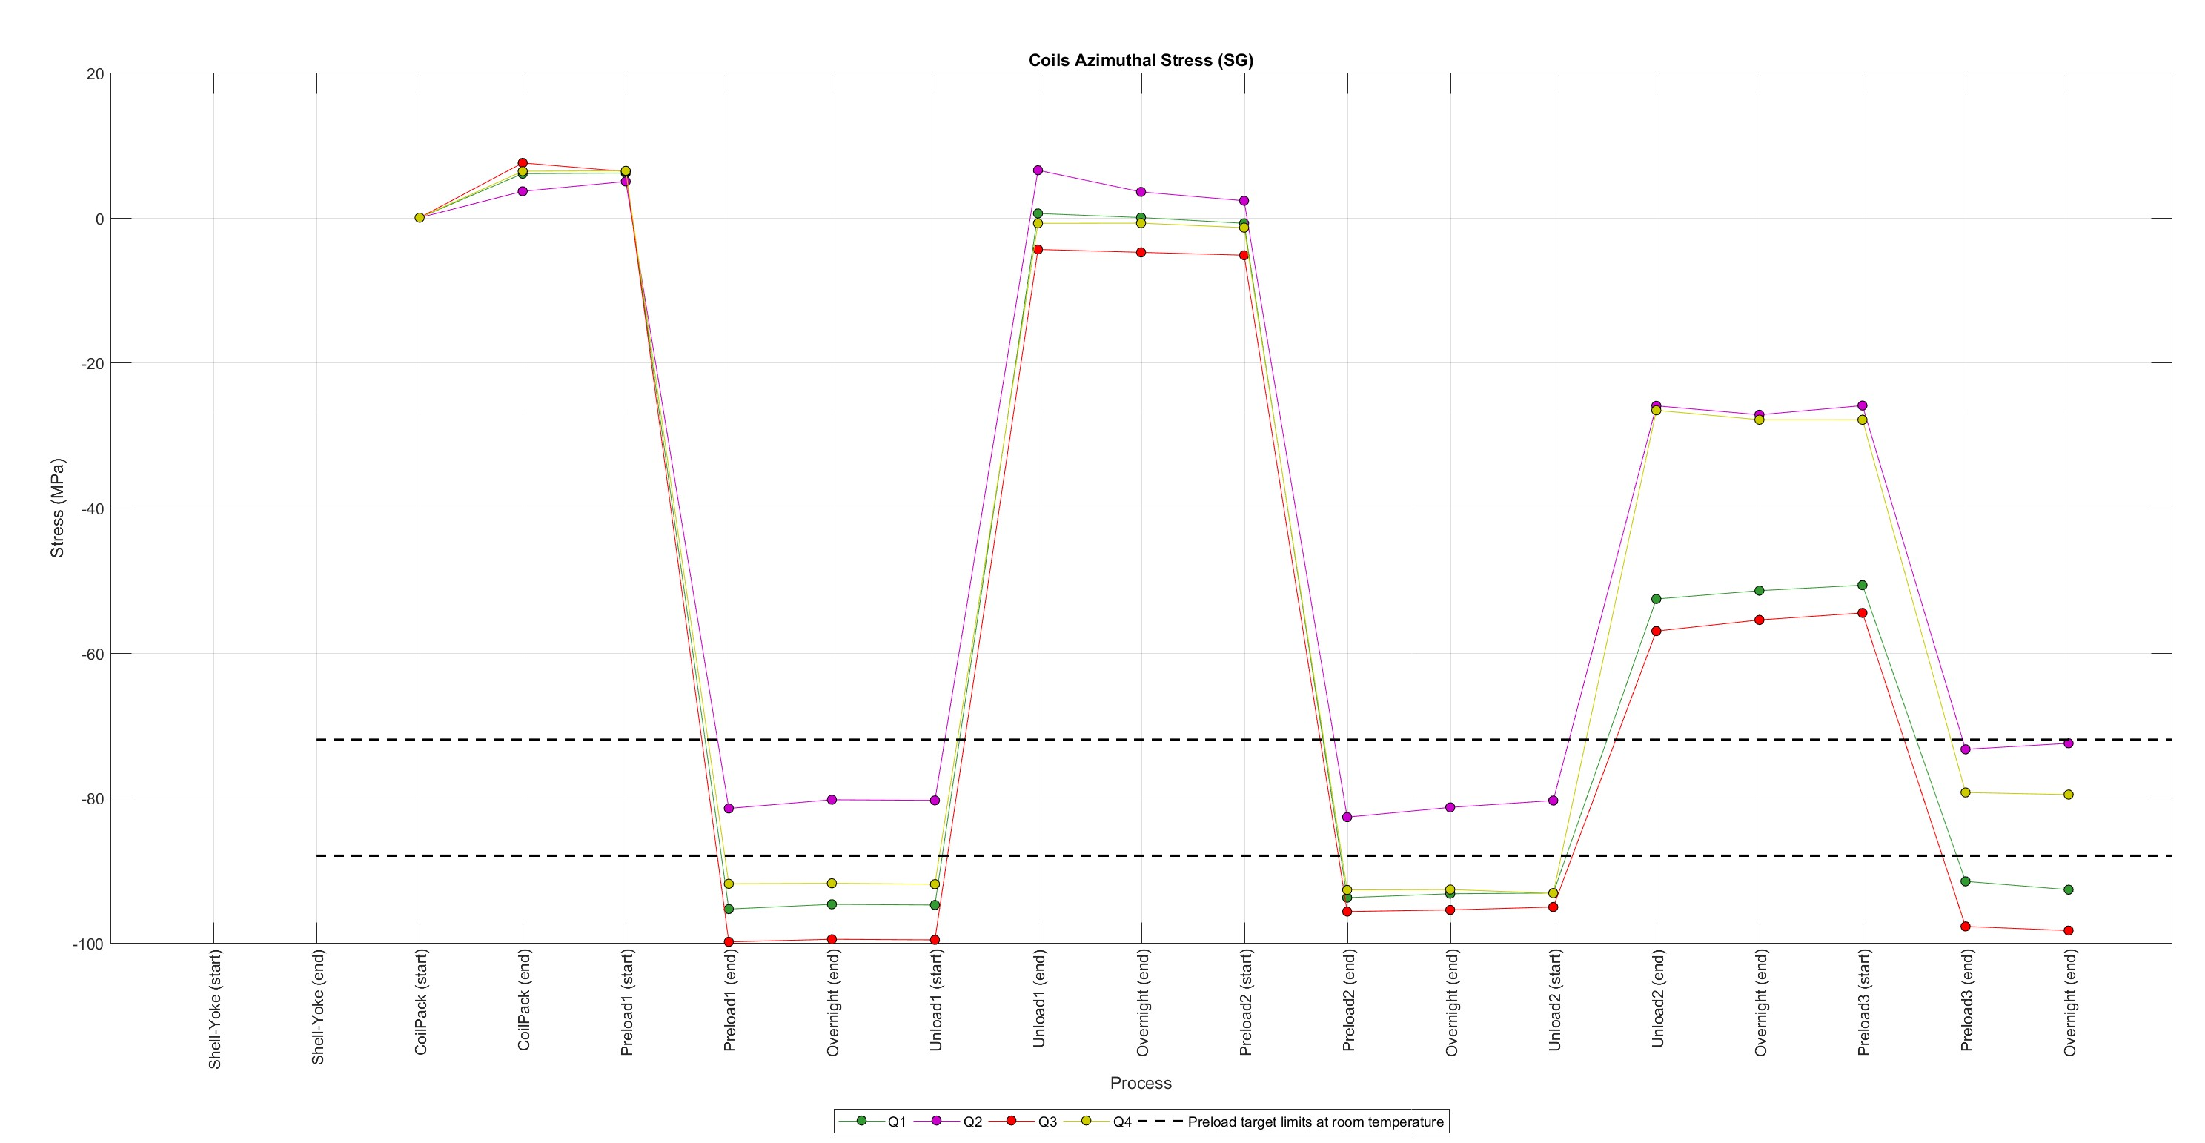
Magnet assembly and loading
Specifications (coils)
FBG @ 700 mm
FBG @ 1900 mm
FBG @ 3800 mm
SG

Slide 11
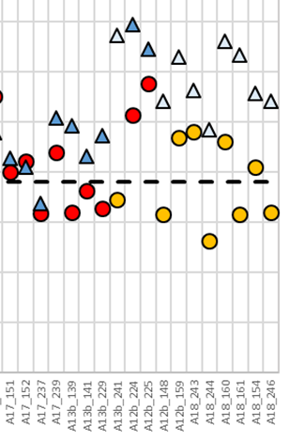
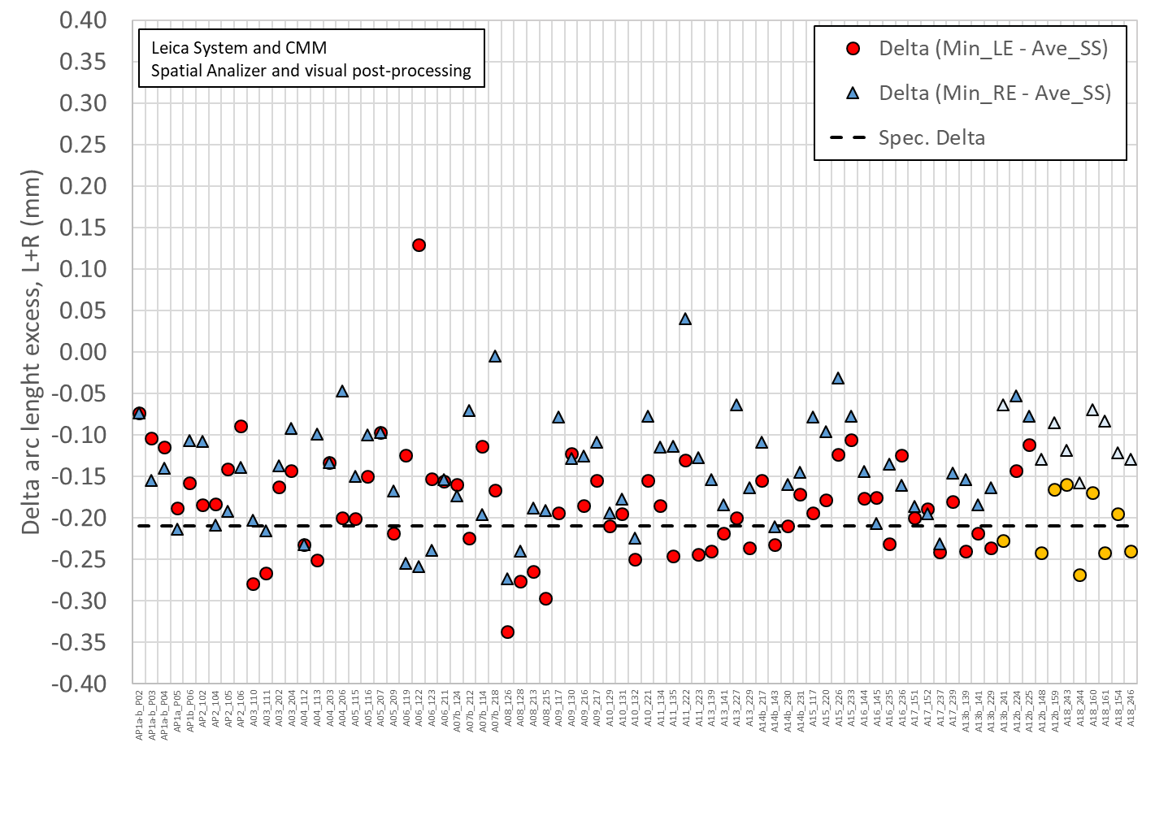
Delta between arc length excess straight section and spacer-wedge transition
Red & dark blue markers: measured at 207 mm and 4426 mm
Orange & light blue markers: measured at 260-300 mm and 4340-4380 mm

Slide 12
Target loading key shim
For final loading key shim size reached during the pre-load operations, the following target is set:
At the end of the pre-loading operation, the sum of the loading shim size and the coil-pack radial dimension deviations in straight section, LE and RE shall be within the range achieved in magnets MQXFA14b and MQXFA05
  If, with such load key shim, the coil stress measured in 2+ strain gauges at the end of the loading or during bladder inflation is above the coil stress spec., priority should be given to keeping the coil stress within the specs.

Slide 13
Summary and proposal
 | Ave ss | Key | Shim | Shim | Ave ss + shim
 | mm | mm | mils | mm | mm
A17 up | -0.004 | 13.84 | 43 | 1.092 | 1.088
A17 low | -0.004 | 13.77 | 40 | 1.016 | 1.012
 | LE | Key | Shim | Shim | LE + shim
 | mm | mm | mils | mm | mm
A17 up | -0.134 | 13.84 | 43 | 1.092 | 0.959
A17 low | -0.134 | 13.77 | 40 | 1.016 | 0.882
 | RE | Key | Shim | Shim | RE + shim
 | mm | mm | mils | mm | mm
A17 up | -0.125 | 13.87 | 44 | 1.118 | 0.992
A17 low | -0.125 | 13.82 | 42 | 1.067 | 0.941
Proposed target
  Aiming at a shim of 42 mils, with the possibility of going to 42-44 mils depending on SG data

Slide 14
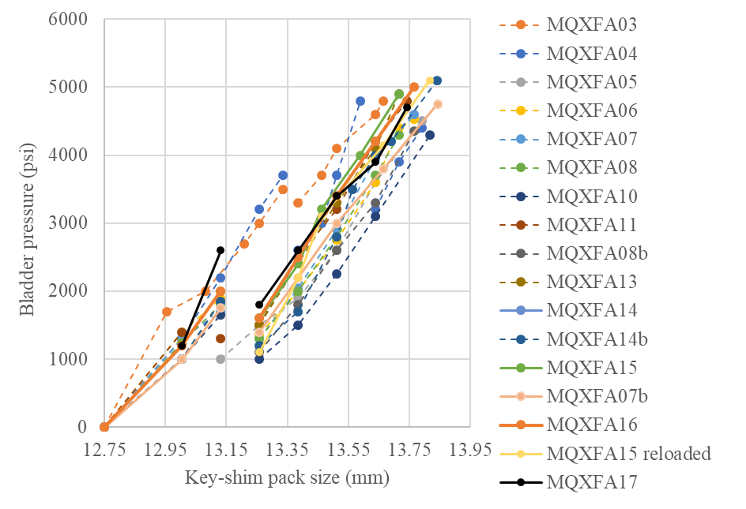
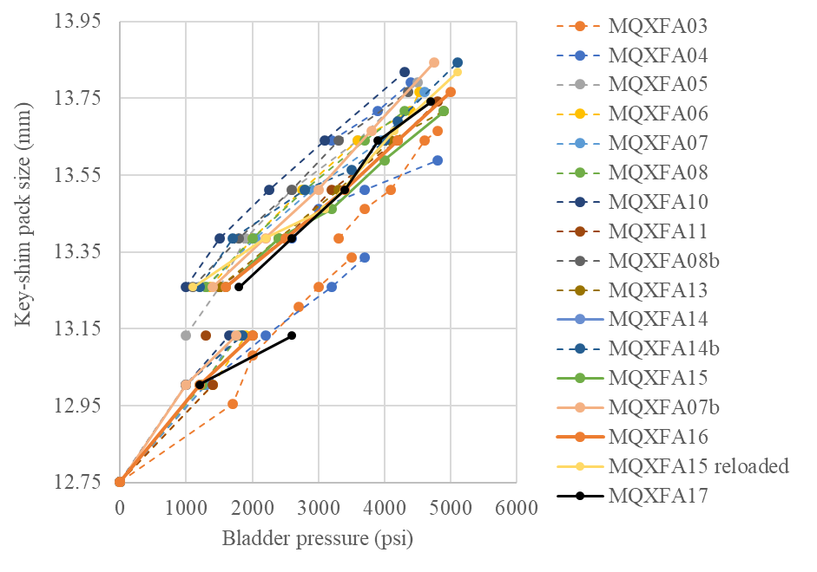
Key-shim size vs. bladder pressure

Slide 15
Magnet assembly and loading
Specifications (coils)
For the maximum stress reached during the pre-load operations:
  During the entire pre-load operation, the maximum compression measured on each coil shall never exceed -120 MPa
Peak stress on coils (MPa)
Electrical SGs
CQ1 | CQ2 | CQ3 | CQ4
-110 | -91 | -120 | -100
FBGs
CQ1-700 | CQ2-700 | CQ3-700 | CQ4-700 | CQ1-1900 | CQ2-1900 | CQ3-1900 | CQ4-1900 | CQ1-3800 | CQ2-3800 | CQ3-3800 | CQ4-3800
-86 | -89 | -98 | -83 | -88 | -129 | -121 | -103 | -83 | -93 | -94 | -70

Slide 16
Magnet assembly and loading
Specifications (shells)
For the pre-load targets at the end of the pre-load:
  The target average measured stress on coils, shells and rods at the end of the loading (after at least 24 h) shall be
    Shell average azimuthal stress: +58 ±6 MPa
Channel | SC02TT | SC02RT | SC02BT | SC02LT | Average
Preload (end) | 64 | 65 | 47 | 66 | 61
Overnight (end) | 63 | 65 | 45 | 66 | 60
Channel | SC04TT | SC04RT | SC04BT | SC04LT | Average
Preload (end) | 65 | 50 | 69 | 66 | 63
Overnight (end) | 65 | 50 | 68 | 65 | 62
Channel | SC07TT | SC07RT | SC07BT | SC02LT | Average
Preload (end) | 61 | 67 | 71 | 66 | 66
Overnight (end) | 60 | 67 | 71 | 65 | 66

Slide 17
Back up Slides

Slide 18
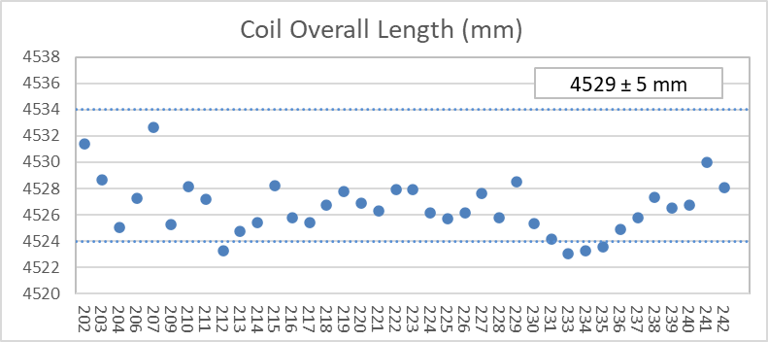
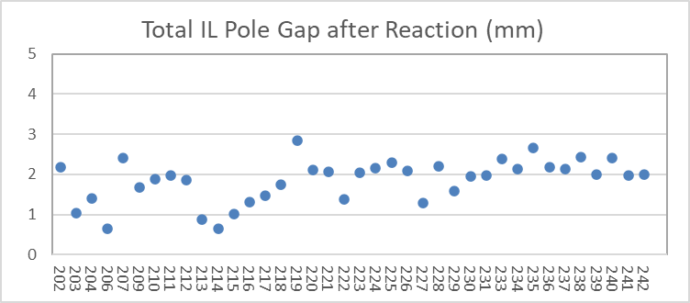
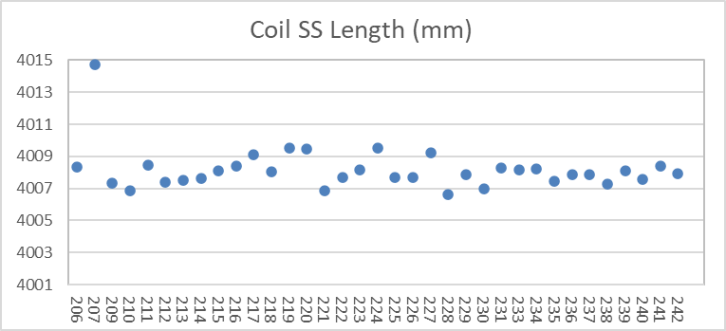
QXFA239 – Length, Gaps
Coil length within spec.
(207 error in initial pole gap setting)

Slide 19
QXFA239 - Reaction
Temperatures and dwell times all within spec.

Slide 20
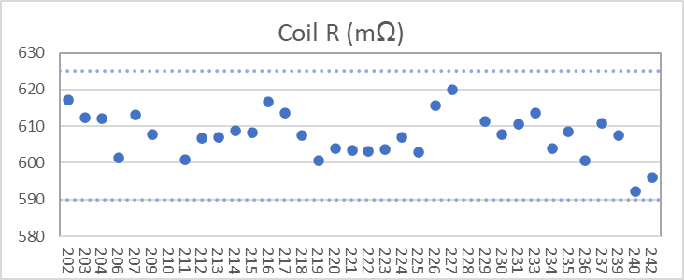
QXFA239 - Electrical
Final electrical checks – all passed

Slide 21
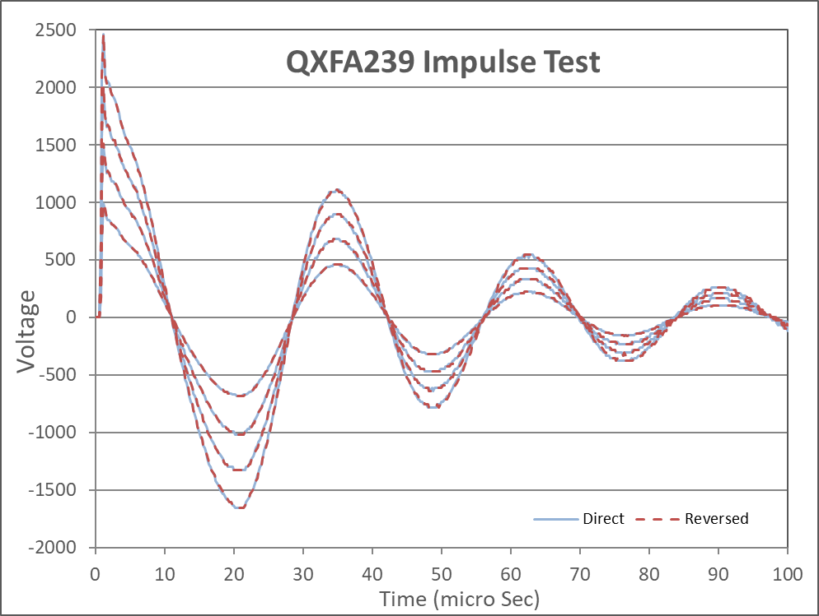
QXFA239 - Electrical

