Slide 1
pTP coated plate mounting
D. Warner
June 11, 2024

Slide 2
P6 plan for final module assembly at SURF
Plan in P6
Module preliminary assembly at assembly sites (complete but without glass plates):
Cathode modules assembled at 2 sites- NIU and one to be determined.
Membrane modules assembled at CIEMAT (Other site? I don’t know of any plans for a second site).
Cold testing –
Cathode modules at CSU, FNAL.
Membrane modules cold tested at CIEMAT.
Glass plates coated at 2 sites: Naples and ???
Plates and modules shipped to SURF for final assembly and installation.
Plates installed into filter frames in surface clean room (already available).
Shipped underground to clean assembly area outside cryostat.
Final warm test and installation into cathodes underground.

Slide 3
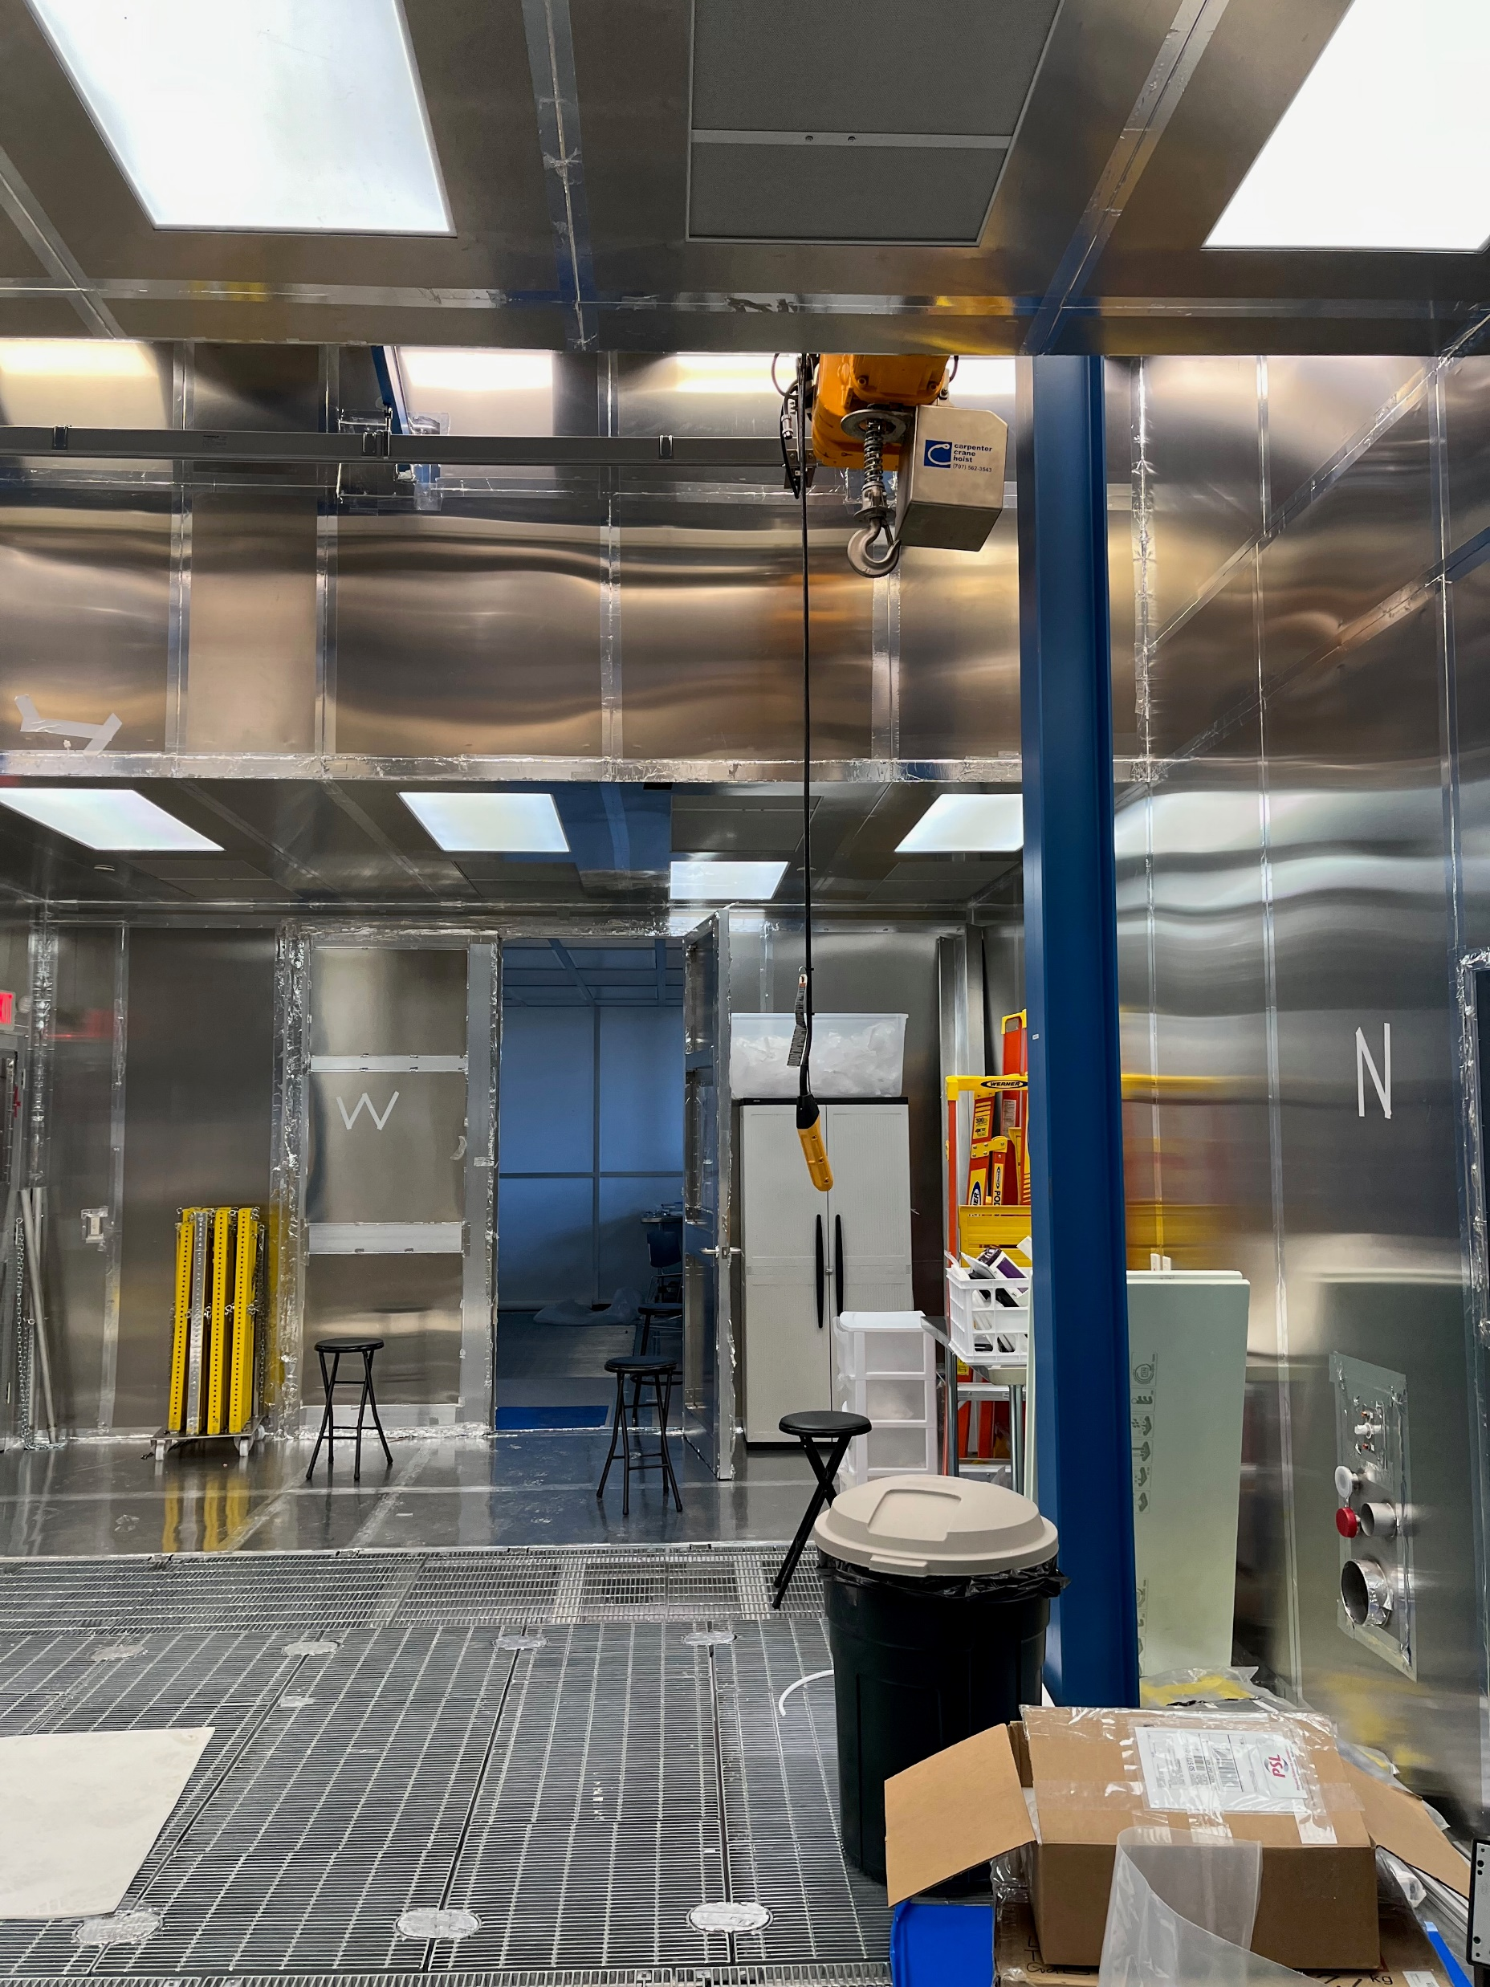
Clean room at SURF
Existing clean room for installation of both HD and VD modules at SURF.
Lighting can be retrofit for pTP requirements.
On the surface, but a short walk to the mine shaft.
Allows efficient installation of filters on the surface but without extensive transportation.

Slide 4
Pros and cons of P6 plan
Pros:
Keeps filters safely in sealed box for maximum duration, safe from exposure.
Shipping plan validated during ProtoDUNE installation/assembly.
Filter plates not required until immediately before module installation
Separates supply chain for filters from module assembly.
Does not require removing filter plates from assembled modules for cold test.
Cons:
Requires building more filter storage boxes.
Filter boxes not available for re-use until installation (possibly use VD boxes for FD1?).
Requires shipping modules from Europe to SURF.
n.b.: duty-free shipping to the US has been identified
Requires additional labor at SURF (but not underground, so less difficult.

Slide 5
BACKUP

Slide 6
Updated Vertical Drift Detector Installation Schedule
April 2027
March 2028

Slide 7
Updated Vertical Drift Detector Dichroic Filter Coating
June 2025
March 2027

