Slide 1
Wilson Cluster Decommissioning and You! - Fermigrid
Shreyas Bhat
June 11, 2024

Slide 2
Where to login
For IF experiments (nova, dune, mu2e, etc.):
Use experiment interactive nodes. Usually <experiment>gpvm01-xx. e.g. novagpvm01
For AD people, accelaigpvm01, marsaccelgpvm01 are two possibilities (if you’re not sure which, contact Jason St. John or Tia Miceli). Else, EAF.
For EAF users:
Select appropriate notebook (FIFE, DUNE, and Generic work), open Terminal
See EAF slides for more details

Slide 3
Jobsub_lite
Software for batch/grid job submission and monitoring
Client-only, installed on experiment interactive nodes and EAF
jobsub_lite takes user command, converts it to HTCondor (batch system) submission file (Job Definition File), and submits job to grid
More info on jobsub_lite:
https://fifewiki.fnal.gov/wiki/Getting_started_with_jobsub_lite

Slide 4
jobsub_submit
$ jobsub_submit -G fermilab file:///usr/bin/printenv
Attempting to get token from https://fermicloud543.fnal.gov:8200 ... failed
Attempting kerberos auth with https://fermicloud543.fnal.gov:8200 ... succeeded
Attempting to get token from https://fermicloud543.fnal.gov:8200 ... failed
Attempting OIDC authentication with https://fermicloud543.fnal.gov:8200
Complete the authentication at:
https://cilogon.org/device/?user_code=<code>
No web open command defined, please copy/paste the above to any web browser
Waiting for response in web browser
Storing vault token in /tmp/vt_u10610
Storing bearer token in /tmp/bt_token_fermilab_Analysis_10610
Submitting job(s).
1 job(s) submitted to cluster 57106734.
Use job id 57106734.0@jobsub01.fnal.gov to retrieve output

Slide 5
jobsub_submit, explained
$ jobsub_submit –G nova –N 100 --tar-file-name dropbox:///local/path/to/my/tarball.tar file:///path/to/myscript script_arg1 script_arg2
-G required to designate “group” (usually the experiment you’re on, or accel for AD folks)
-N 100: Submit cluster of 100 jobs with these parameters
--tar-file-name designates a tarball to send to the grid job. See https://fifewiki.fnal.gov/wiki/File_Transfers_in_jobsub_lite for more details on uploading files to grid jobs
The file:// URI is used to designate the executable the job should run. It supports both absolute and relative paths
For full list of jobsub_submit options, see https://github.com/fermitools/jobsub_lite/wiki#jobsub_submit

Slide 6
First-time authentication
First job submission: jobsub will prompt user to authenticate with CILogon to obtain proper token
Attempting OIDC authentication with https://htvaultprod.fnal.gov:8200
Complete the authentication at:
https://cilogon.org/device/?user_code=_redacted_user_code
No web open command defined, please copy/paste the above to any web browser
Waiting for response in web browser
Will need to copy/paste that link into browser
Authenticate with SERVICES username/password

Slide 7
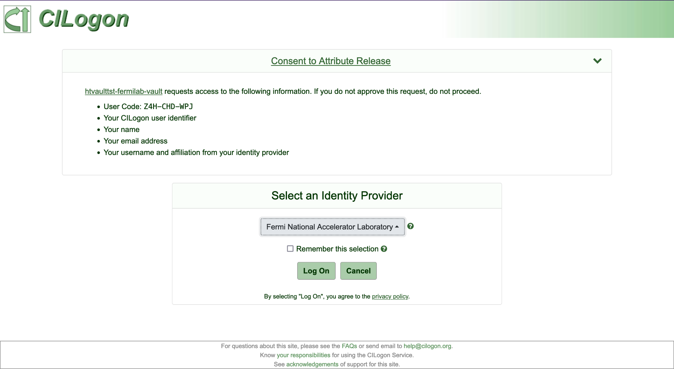
First-time authentication, continued
Select “Fermi National Accelerator Laboratory”
Then click “Log On”
Log in with Services Credentials

Slide 8
Manage jobs
jobsub_q: see your jobs (e.g. jobsub_q –G nova --user=me)
Also, jobsub_hold, jobsub_release, jobsub_rm, etc. See https://fifewiki.fnal.gov/wiki/Getting_started_with_jobsub_lite#Managing_Jobs

Slide 9
jobsub_q
$ jobsub_q -G fermilab
JOBSUBJOBID OWNER SUBMITTED RUNTIME ST PRIO SIZE COMMAND
57106962.0@jobsub01.fnal.gov sbhat 11/30 14:59 0+06:00:10 C 0 1953.1 simple.sh
57106973.0@jobsub01.fnal.gov sbhat 12/01 13:48 0+06:00:27 R 0 0.0 simple.sh
$ jobsub_q -G fermilab 57106973.0@jobsub01.fnal.gov
JOBSUBJOBID OWNER SUBMITTED RUNTIME ST PRIO SIZE COMMAND
57106973.0@jobsub01.fnal.gov sbhat 12/01 13:48 0+06:00:27 R 0 0.0 simple.sh

Slide 10
Viewing logs/monitoring jobs - Landscape
https://fifemon.fnal.gov
From here, can click “Help” to get good overview of our monitoring
Best dashboards:
User Batch Details (look at my running jobs)
User Batch History (look at my completed jobs)
Job Cluster Summary (look at a specific job)
Has link to your cluster’s sandbox, where job script, stdout, and stderr are available

Slide 11
File Transfer Inside Grid Jobs
ifdh commands to transfer files into/out of jobs
e.g.: ifdh cp /grid/job/path/to/file /pnfs/nova/scratch/users/me/file
ifdh cp –D /pnfs/dune/persistent/users/me/directory /local/parent_dir
Can read/write from/to several /pnfs locations
Most experiments/roles do not have storage.modify scope
cannot overwrite or remove files from jobs
Many /cvmfs mountpoints available inside jobs
In job script, do​
. /cvmfs/fermilab.opensciencegrid.org/products/common/etc/setups.sh​
setup ifdhc​
Then use ifdh commands
For more details, see https://cdcvs.fnal.gov/redmine/projects/ifdhc/wiki/Ifdh_commands

Slide 12
How to get your current data to interactive nodes
Wilson Cluster IO node: wcio.fnal.gov
Use to transfer data/files from Lustre to /nashome (home dir)
Currently /exp areas not mounted on wcio.fnal.gov - under discussion

Slide 13
Resources
Github repo for jobsub_lite: https://github.com/fermitools/jobsub_lite
Getting Started with jobsub_lite: https://fifewiki.fnal.gov/wiki/Getting_started_with_jobsub_lite
IFDH Commands: https://cdcvs.fnal.gov/redmine/projects/ifdhc/wiki/Ifdh_commands

