Slide 1
PIP-II Report
PIP-II Team
Project Management Group
June 2024

Slide 2
Project Management
Project org-chart updates after voluntary separation include:
  ESH liaison E. McHugh -> A. Pavnica (interim)
  AccU L2 I. Kourbanis -> J. Dey
  AccS Vacuum L3 R. Campos -> L. Nobrega
  OPSS Consultant D. Hoffer -> none
  Deputy PD R. Stanek -> none
New L3s and L4s in AccU better integrate the APS-TD effort on PIP-II magnets.
Contingency draws continue to be significant, and more is expected from now to the end of the FY.
Schedule delays at the Linac Complex Construction and delivery delays of components impact the SPI.
Several procurement readiness reviews are planned in the next two months, which will initiate many procurements.
INFN placed the contract for 38 LB650 production cavities with Zanon.
Progress in the RF testing of the pHB650 cryomodule continues.
The delivery of the cryoplant compressors is delayed to September/October.
420.2D ARR3, the PIP-II team was strongly involved, the outcome was successful
2

Slide 3
Financials
SPI
0.97
-0.01
CPI
0.96
-0.01
BSI
0.92
-0.01
BEI
0.91
-0.01
ETi
0.92
-0.01
SPI and CPI trends need correction; the team is working on it.
Current Period Negative Red Variances:
PM -> Overlap of PDs and 420.2D effort
SRFCryo -> CDS equipment delivery delays
LIC -> Racks delivery delays
CF -> Progress slower than planned on Linac Construction

Slide 4
RLS Development Status
Contingency on WTG reduced to 21.7% (-0.7%)
Critical path through CF
BCRs for $1.5M including few procurement maturation that totaled ~$-2.5M and increased He cost for FY24 and FY25 $660k
Early CD-4 stable(schedule contingency 39 months)
Partner schedules up to date in P6
4

Slide 5
QA
QC Planning / Execution
  Received and approved the QC plan from the Steel Fabricator/Erector subcontractor for the Linac Complex.
  Received QC plan from Rachke piping for the PCW Piping Installation Project. Minimal feedback provided after comparing it against project specifications.
  Issued incoming inspection travelers for the latest batch of Y567B Amplifier Tubes received.
  Supported a PRR for the 20kW amplifiers.
  CDS QC Plan from WUST was reviewed and feedback provided.
  SSR1 and 2 QC Plans revision being drafted.
Performed a formal causal analysis (Cause Mapping) exercise for a gate valve issue on the pHB650CM.
Developed an SAR Checklist template and shared with the IKC Coordinator and QCCG colleagues for review/feedback.
Chaired the review committee for the Vacuum Systems Integration FDR and delivered the final report.
SRF/Cryo L2 QA Plan underwent a revision, and a new version has been released.
Transferred open iTrack CAPs from Rich to Pantaleo, Eric to Amy, and Ioanis to Joe.
5

Slide 6
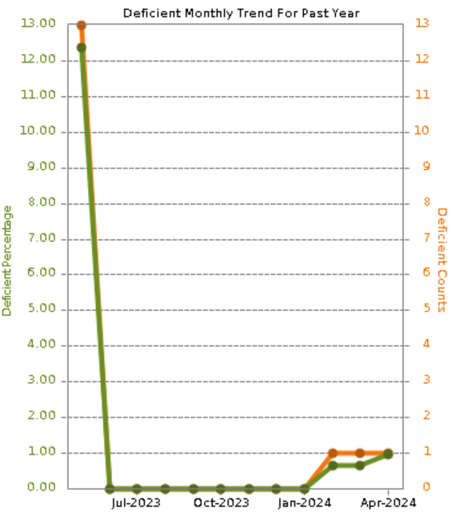
ESH
Subcontractor pre-construction meetings for Cryo building piping work. Working with sub to create site-specific safety plan.
Concrete pours of Linac going well.
Positive observation examples - personnel placement, barriers, tag lines, communication during concrete form work. Pre-job tool box meetings documented, HA's on site and signed, site-specific orientation for sub-tiers, regular inspections documented for equipment and PPE.
Deficiency noted, equipment stored in front of fire hydrant. Subcontractor removed immediately. This deficiency was mentioned to the CF team and subcontractor reps on our weekly coordination meeting.
Linac Construction
6

Slide 7
International
CEA:
  LB650 CM component contracts continue being awarded. Kick off meetings have been held for several contracts.
CNRS/IN2P3/IJCLab: Will begin upgrading their facilities soon, in preparation for the production SSR2 cavity testing.
DAE:
  70 kW SSA internal review is ongoing. FDR is anticipated in August.
  Several procurements are being initiated, with PRRs being completed.
INFN: 38 LB650 cavity contract awarded.
UKRI:
  HB650 Cavities: 2nd pre-series cavity being processed at vendor and is anticipated to be tested at FNAL in July.
  CM components: procurements are progressing.
WUST, WUT, TUL: Work progressing through FNAL POs; IKC funding from Poland still uncertain.
TUL:
  Prototype 6-cavity RFPI system tested at Fermilab, and FDR conducted on 14-June.
7

Slide 8
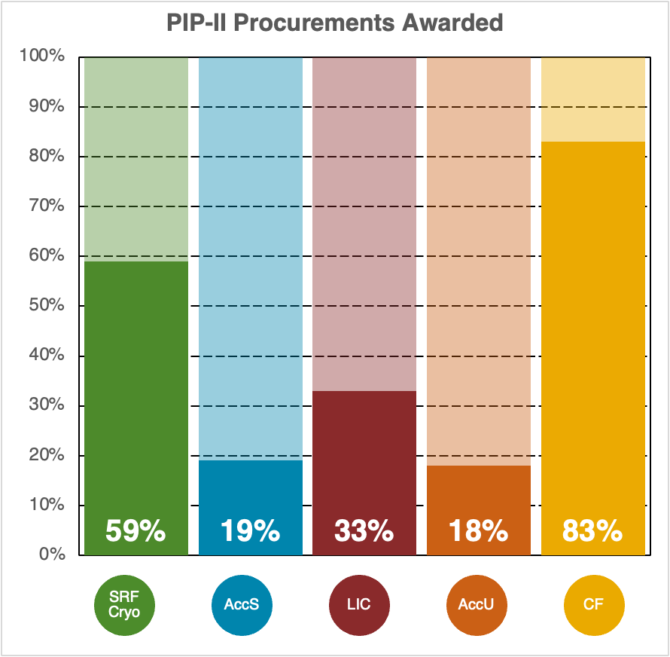
Procurement
Purchasing Training
SSR2 Cavities responses received
Working with Teams to pull forward purchases
PIP Reqs. w/Procurement | 38
Previous month | 36
Value | $16M

Slide 9
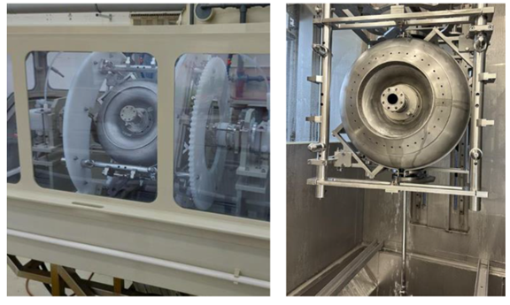
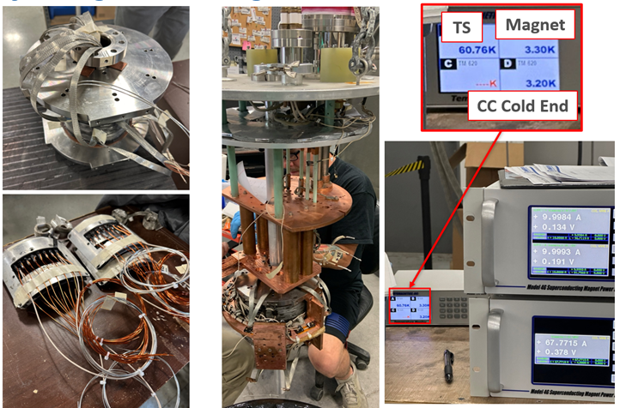
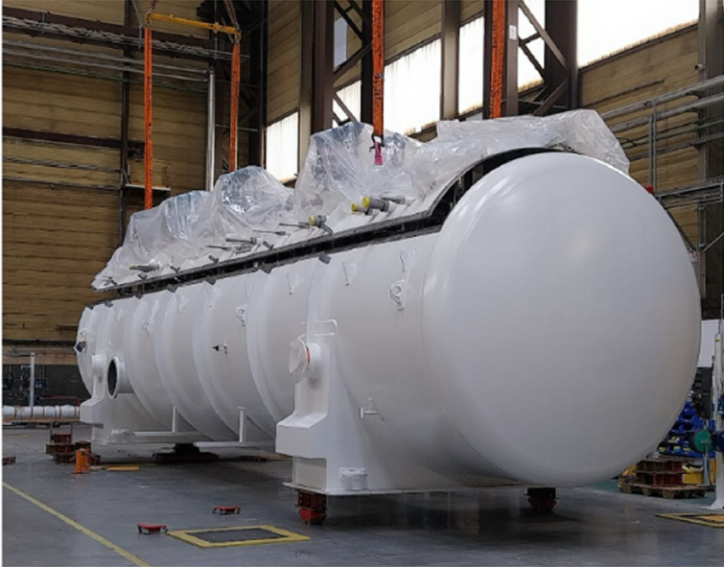
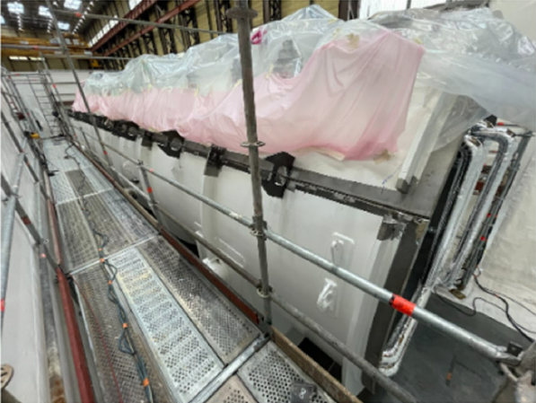
SRF Cryo
First pre-production SSR2 cavity at RI
SSR cavities and cryomodules
  First SSR2 magnet built in industry was successfully tested and qualified.
  Current leads test conducted in CoCoLoCo. Reached 70 A and temperatures above 80K. The high temperature did not affect the current leads operation.
  Three out of 5 cavities needed for the ppSSR2 CM are now successfully tested and qualified.
  RI is about to complete the first jacketed SSR2 cavity. Delivery to Fermilab for cold test expected in July.
  Preparation for string assembly in the cleanroom 2 at MP9 is ongoing.
650 cavities and cryomodules
  pCM HB650 is ready at PIP2IT for Phase 3 cold testing. CM RF test completed. Static heat loads measurements will be conducted next.
Cavity HB302 (2nd pre-series production cavity from Zanon, UKRI cavity vendor) is being processed at Zanon in preparation for the cold test at Fermilab in July.
Cryoplant
  Cryoplant warm compressors now arriving in late September. Some delays due to leaks during final inspections.
  Coldbox shell in process of being closed. On schedule for end of year arrival.
  Recovery System piping installation completed (radiography of closure welds was performed with one weld failing. This has been repaired and now awaiting additional radiography to confirm compliance).
Cryogenics Distribution System:
  DVB/TTL: In-house TTL design optimization effort ongoing (a) NX conversion of HWR Bayonet Can is close to completion (b) external TTL support to tunnel floor complete.
  ITL: Near to closing FDR (held at vendor on May 6-7) by resolving open action items.
  Control System: Preparing procurement items for (a) CM Heater Power Supplies (b) Rack/Panel fabrication and assembly contract.
  Warm Piping system: Fabrication/assembly drawings are being prepared; final bill of materials being completed with component purchases to follow.
First SSR2 magnet built at Cryomagnetics
Coldbox closure at ALaT
9

Slide 10
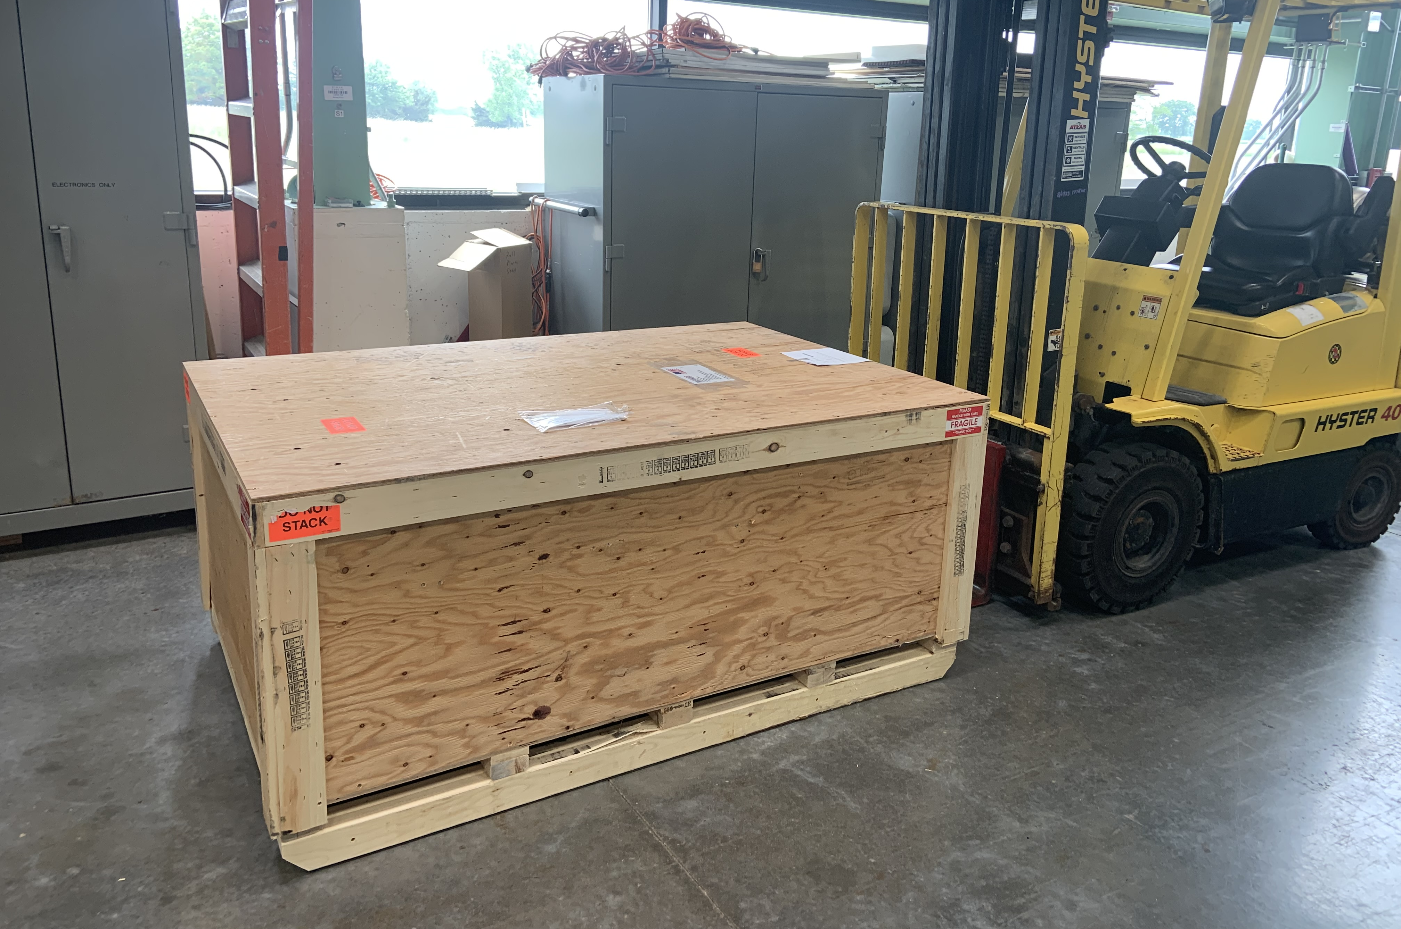
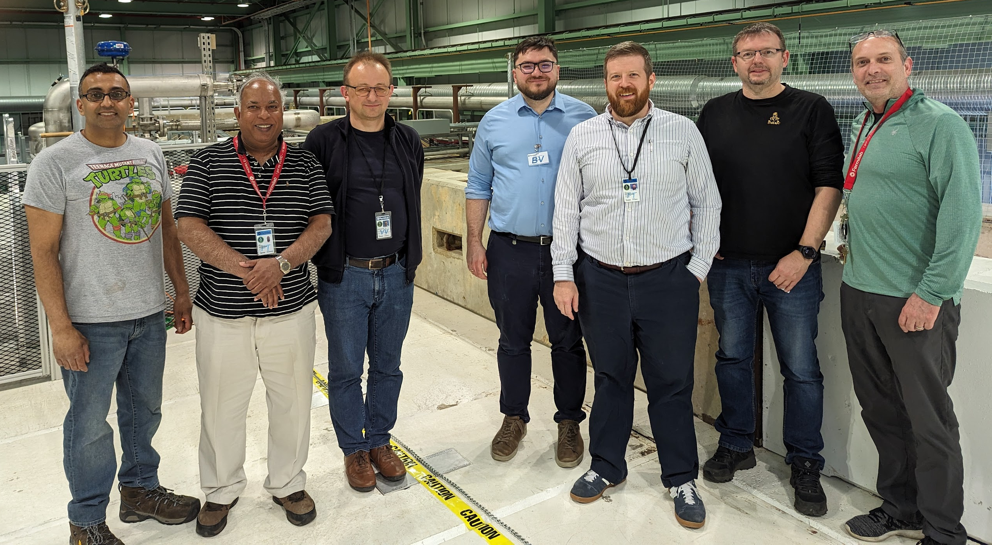
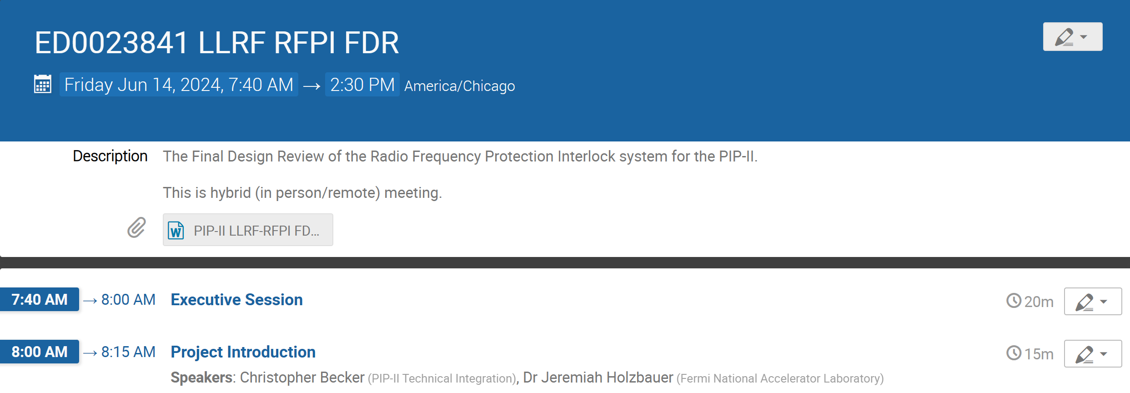
Accelerator Systems
Overall
  Detailed CPI/SPI Plan for Accel Sys shared with Project Management; starting to perform to it. Performance has started to stabilize, with more changes/improvements coming in next quarter.
MPS
  MPS is ramping into full system procurements and starting systematic refresh of their signal inputs from all systems (signals, permit logic, etc.) including documentation updates.
HPRF
  40 kW 650 MHz SSA FDR closeout held, responding to recommendations.
  RF Distribution procurements ramping up, with first components arriving already.
LLRF
  TUL partner visit including testing of RFPI system at PIP2IT and their successful FDR.
  Preparing for full LLRF system FDR in mid-July after pHB650 testing.
Magnets/Power supplies
  TUL SOW for RF Coupler HV bias supply drafted, in Procurement soon.
  Vendor prototype magnets due soon, first in shipment.
  Production of power supplies and Quench Protection Systems in full swing, ensuring NTRL compliance
Vacuum
  Finalizing implications of Vacuum Integration FDR and working hard to start procurements for WFE
Controls
  Kickoff meeting held with ANL on EPICS resources contract, positive indications. Will need to complete alignment of available effort
  Working hard on preparation for remaining major design reviews (DAQ/Motion Control FDRs)
Instrumentation
  Finalizing Laser Wire design after FDR and working to update production estimates
  Continuing focus on mid-2024 electronics FDR, final remaining FDR for BI scope
RF Dist for PIP2IT 6 Cavity Testing
10

Slide 11
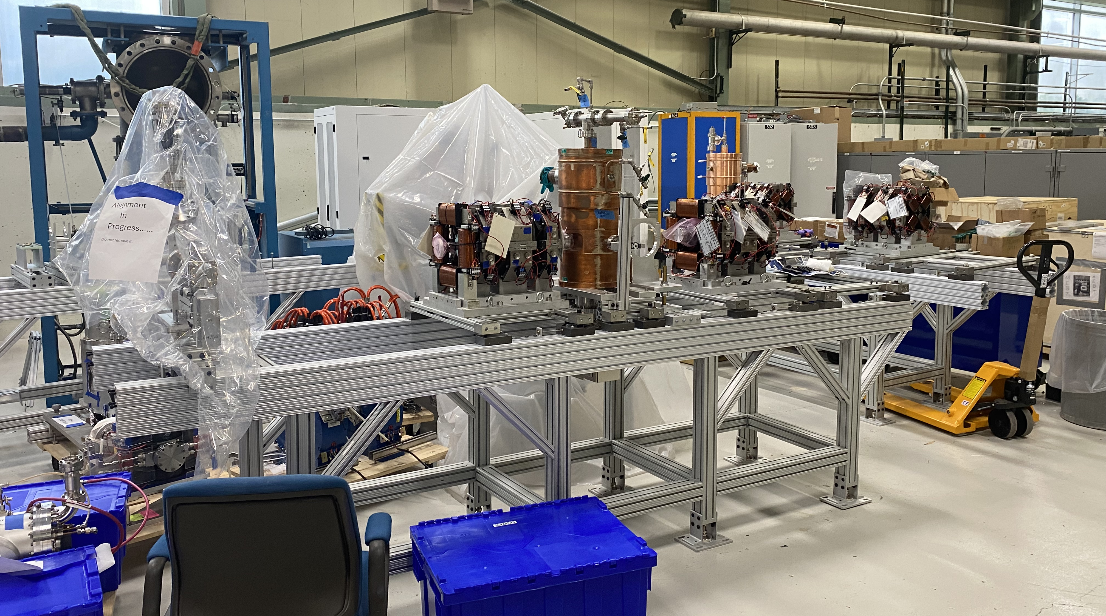
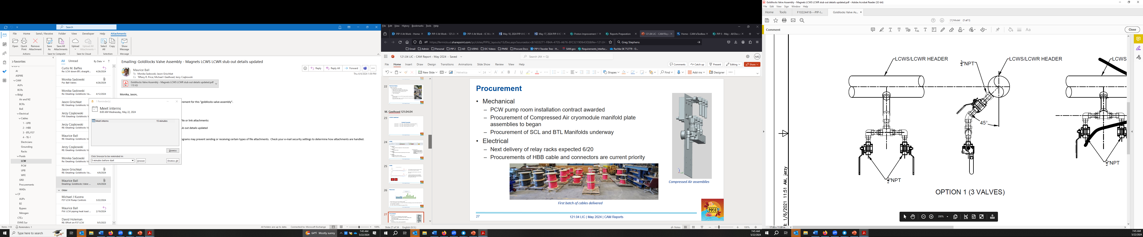
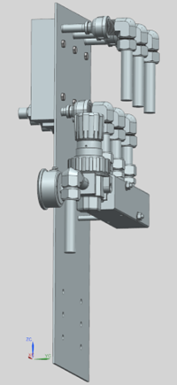
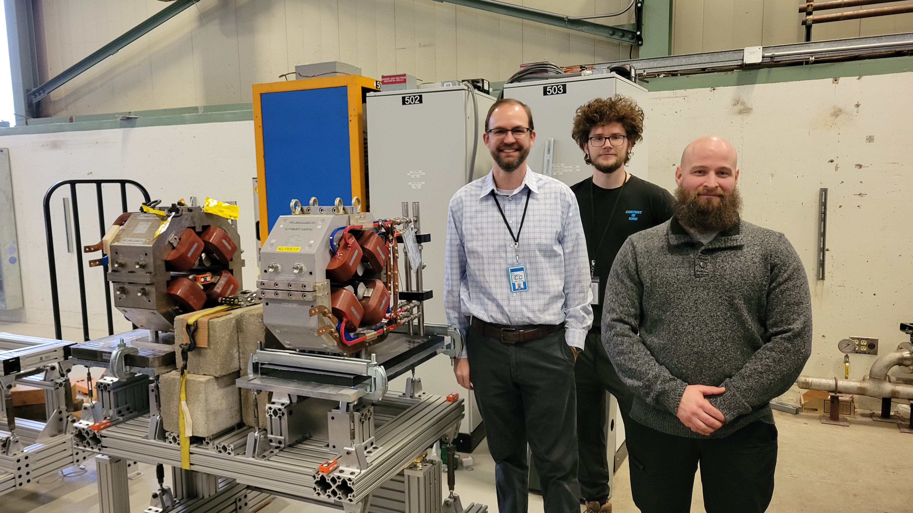
Installation and Commissioning
Warm Front End
  Installation of components (beam scrapers, bunching cavities, magnets, etc.) on PIP-II MEBT girders continued at A0 staging facility
  Procurement Readiness Review (PRR) for 2nd Ion Source in progress
Test Infrastructure
  Prototype HB650 cryomodule re-testing (post transport test) underway at PIP2IT
  420.2D Accelerator Readiness Review (ARR) for PIP2IT and other test stands (VTS, STC, and CMTS1) took place June 11-13
Building Infrastructure
  Continuing procurements (cables, air and water manifolds, etc.)
  Processing subcontractor material submittals for Process Clean Water (PCW) system installation in Utility Plant Building
Linac Installation
  Completed multi-year collaboration with NIU Engineering Dept. to design and qualify Warm Unit Structures (i.e. support frames that go between cryomodules)
  Alignment group performing QC of conventional facility tunnel penetrations
Commissioning & Accelerator Physics
  External Review of PIP-II Beam Commissioning Plan held on June 13th
  High-level application (HLA) and Shielding Assessment development continued
MEBT girder assembly at A0
LCW manifolds and compressed air assemblies
Warm Unit Structure design team

Slide 12
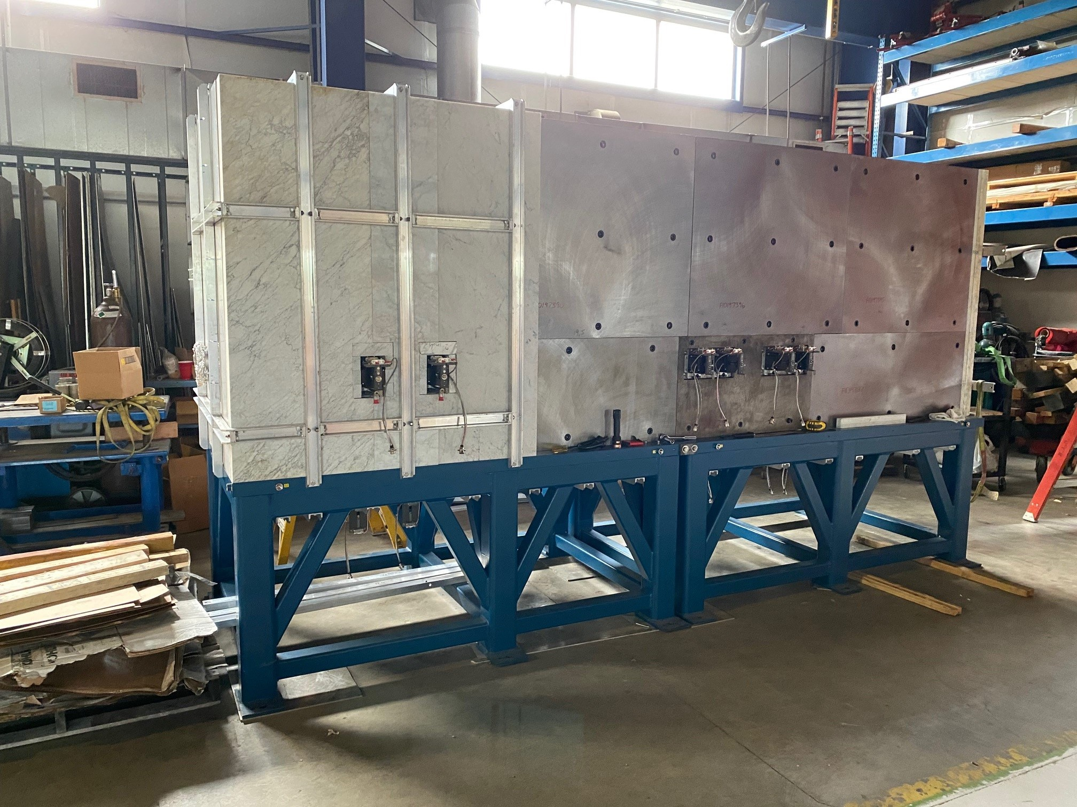
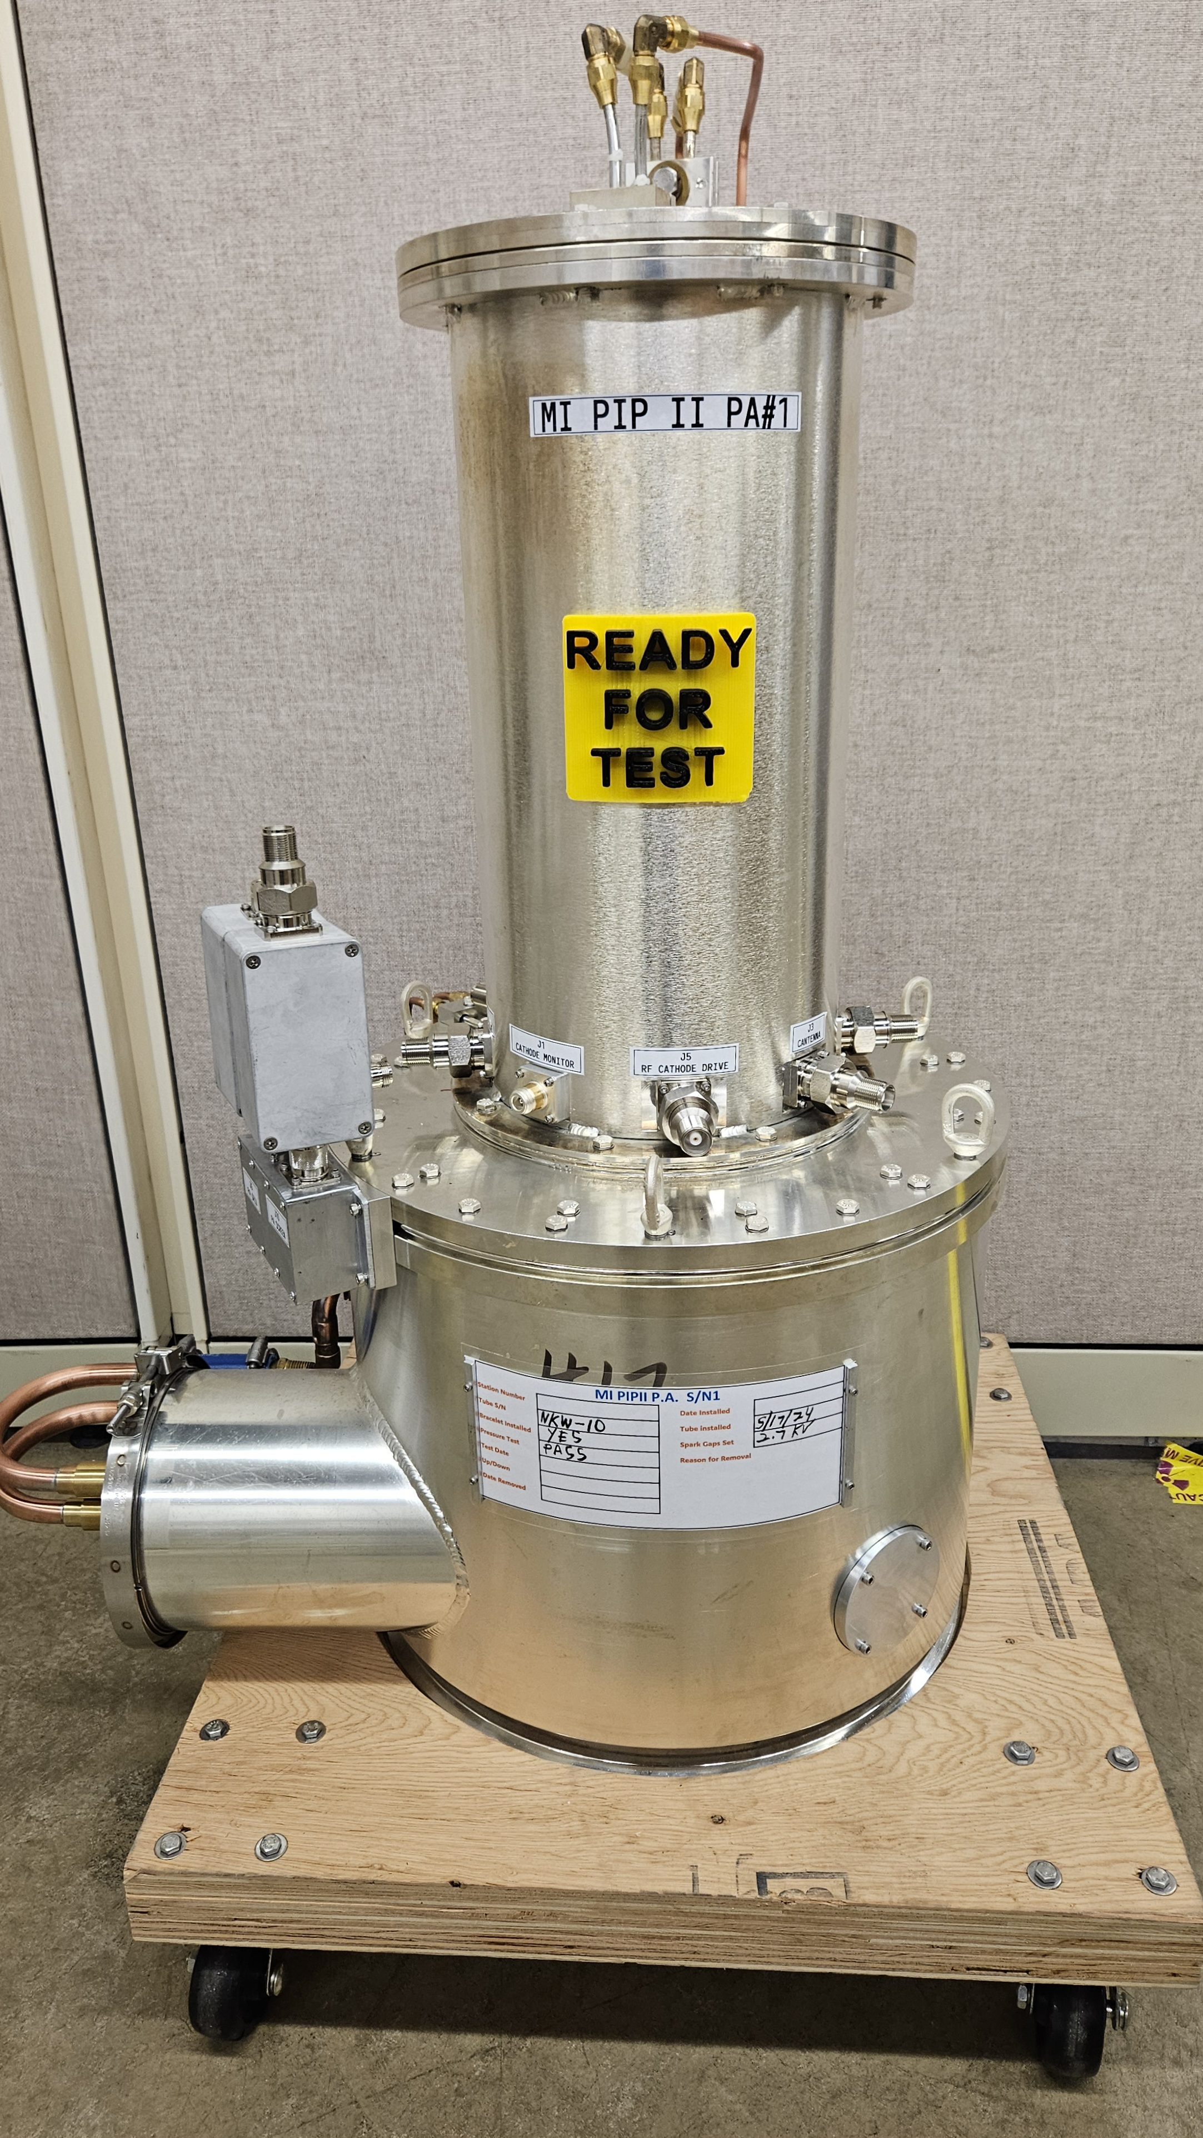
Accelerator Complex
BTL Installation
  Preparing to remove Tevatron components from the Main Ring remnant where the BTL line crosses
  BTL stand designs for magnets, instrumentation and vacuum components is underway for an FDR in Q2 of 2025
Beam Transfer/Absorber Line
  Preparing for the BTL Collimators PRR review (Late June 2024 – Early July 2024)
  Still finalizing the design of the air-cooling system for the 25KW absorber, and of the vacuum windows
  Finalizing the design of the Power Supply for the gamma-T quad magnets
Booster
  Ordering parts for the ORBUMP power supply prototype is going well
  Preparing for the ORBUMP magnet PRR review this fall
  Preparing for installation in the Booster during the summer shutdown
  At E4R, the power supply has been checked out using a dummy load and is now connected to the girder with magnets
  Booster Combined Function magnets PDR scheduled for this month
MI/RR/Booster RF
  Initial testing of two upgraded dual PA modulators has been completed
  First Main Injector Power Amplifier assembled
  CPI is ahead of schedule for delivering power tubes (34/40)
  Copper clad stainless has come in for the manufacturing of the MI dual PA coupling loop
  Received $822k worth of cavity parts out of $1,400k ordered. We have begun initial welds on the copper Booster cavity
Booster Collimator assembly
First Main Injector Power Amplifier assembled
12

Slide 13
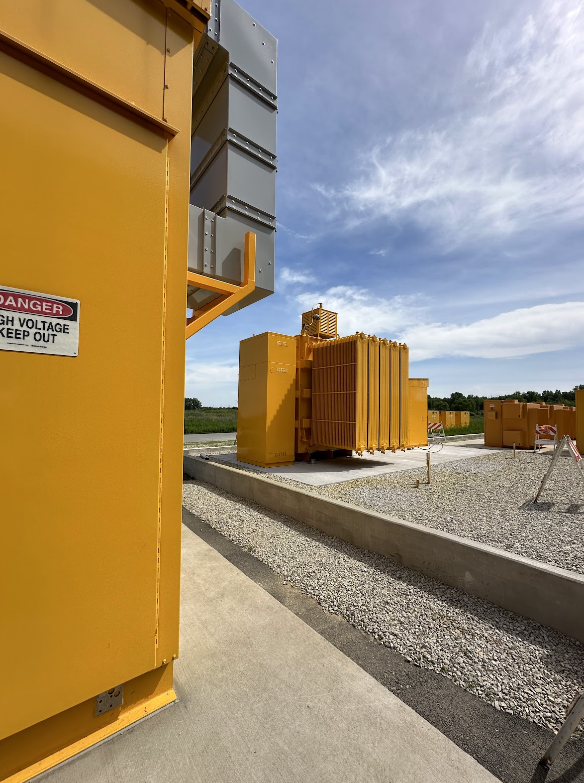
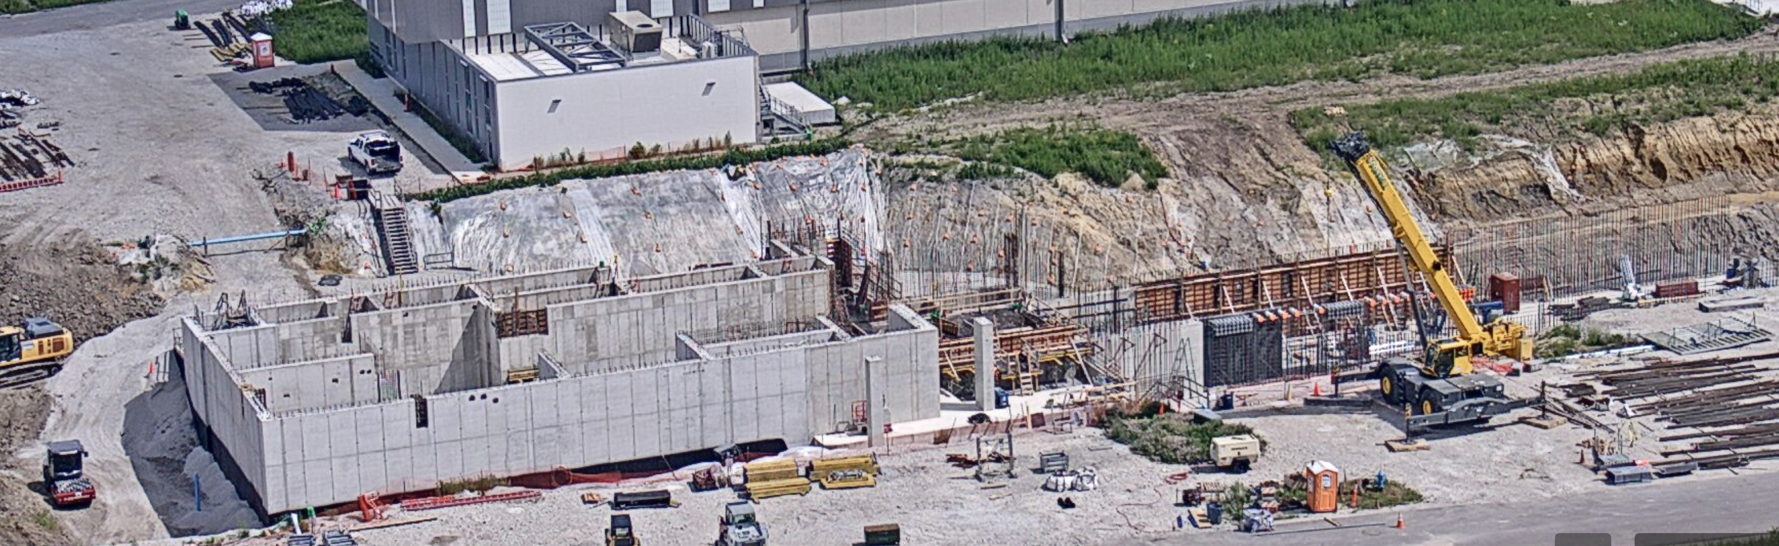
Conventional Facilities
WBS 121.06.07.02 - Cryogenic Plant Building ​(99% complete)
Final punchlist item is commissioning of air handling unit. Scheduled for late June 2024
Final Acceptance anticipated for June/July 2024
WBS 121.06.07 – CPB Outfitting Packages
Isolated Cooling Loop construction underway. (99% complete)
  Substantial Completion (water flowing) completed in January 2024
  Remaining work (insulation, controls, etc.) underway in June 2024
  Final Acceptance scheduled for late July 2024
Process Power Transformer Pad and CHL Transformer Relocation (90% complete)
  Electrical buss duct delayed until early August 2024
  Working with supplier and subcontractor to mitigate delay
  Completion date anticipated for October 2024
5 KVA Process Power Transformer: PO issued 12SEP23. Delivery scheduled for February 2027.
WBS 121.06.05 – Linac Complex ​(15% complete)
High Bay Building interior and exterior concrete wall construction continues
First 120 feet of linac tunnel started in May 2024
Backfilling HBB foundation walls and alcoves continues
13

Slide 14
Technical Integration
Design Maturity
Cost-weighted Design Maturity through May reporting date = 96.2%
  Completed technical reviews
    Laser wire/Beam Instrumentation FDR
    Vacuum integrated system FDR
  34 Technical Reviews remain in the project plan (>150 completed to date)
  26 remaining Technical Reviews are planned for CY2024
Design Change Requests (DCRs):
Completed DCRs
  SSR cryomodule RF coupler to current lead airflow addition
  Controls consolidated infrastructure modifications
Upcoming DCRs or in Review
  CF-focused DCRs under evaluation:
    Bulletin 2 (13 individual changes within the Linac complex – still working through details)
    Tunnel Shielding Design
  QPM chassis reduction
  RF circulator load pressure reduction
  LLRF WFE controller upgrade
Technical Integration is supporting the evaluation of changing the designs of SSR cryomodule tunnel slots and the prototype SSR1 cryomodule to enable use in the LINAC tunnel.
Non-NRTL electrical equipment inspection requirements were finalized.
14

Slide 15
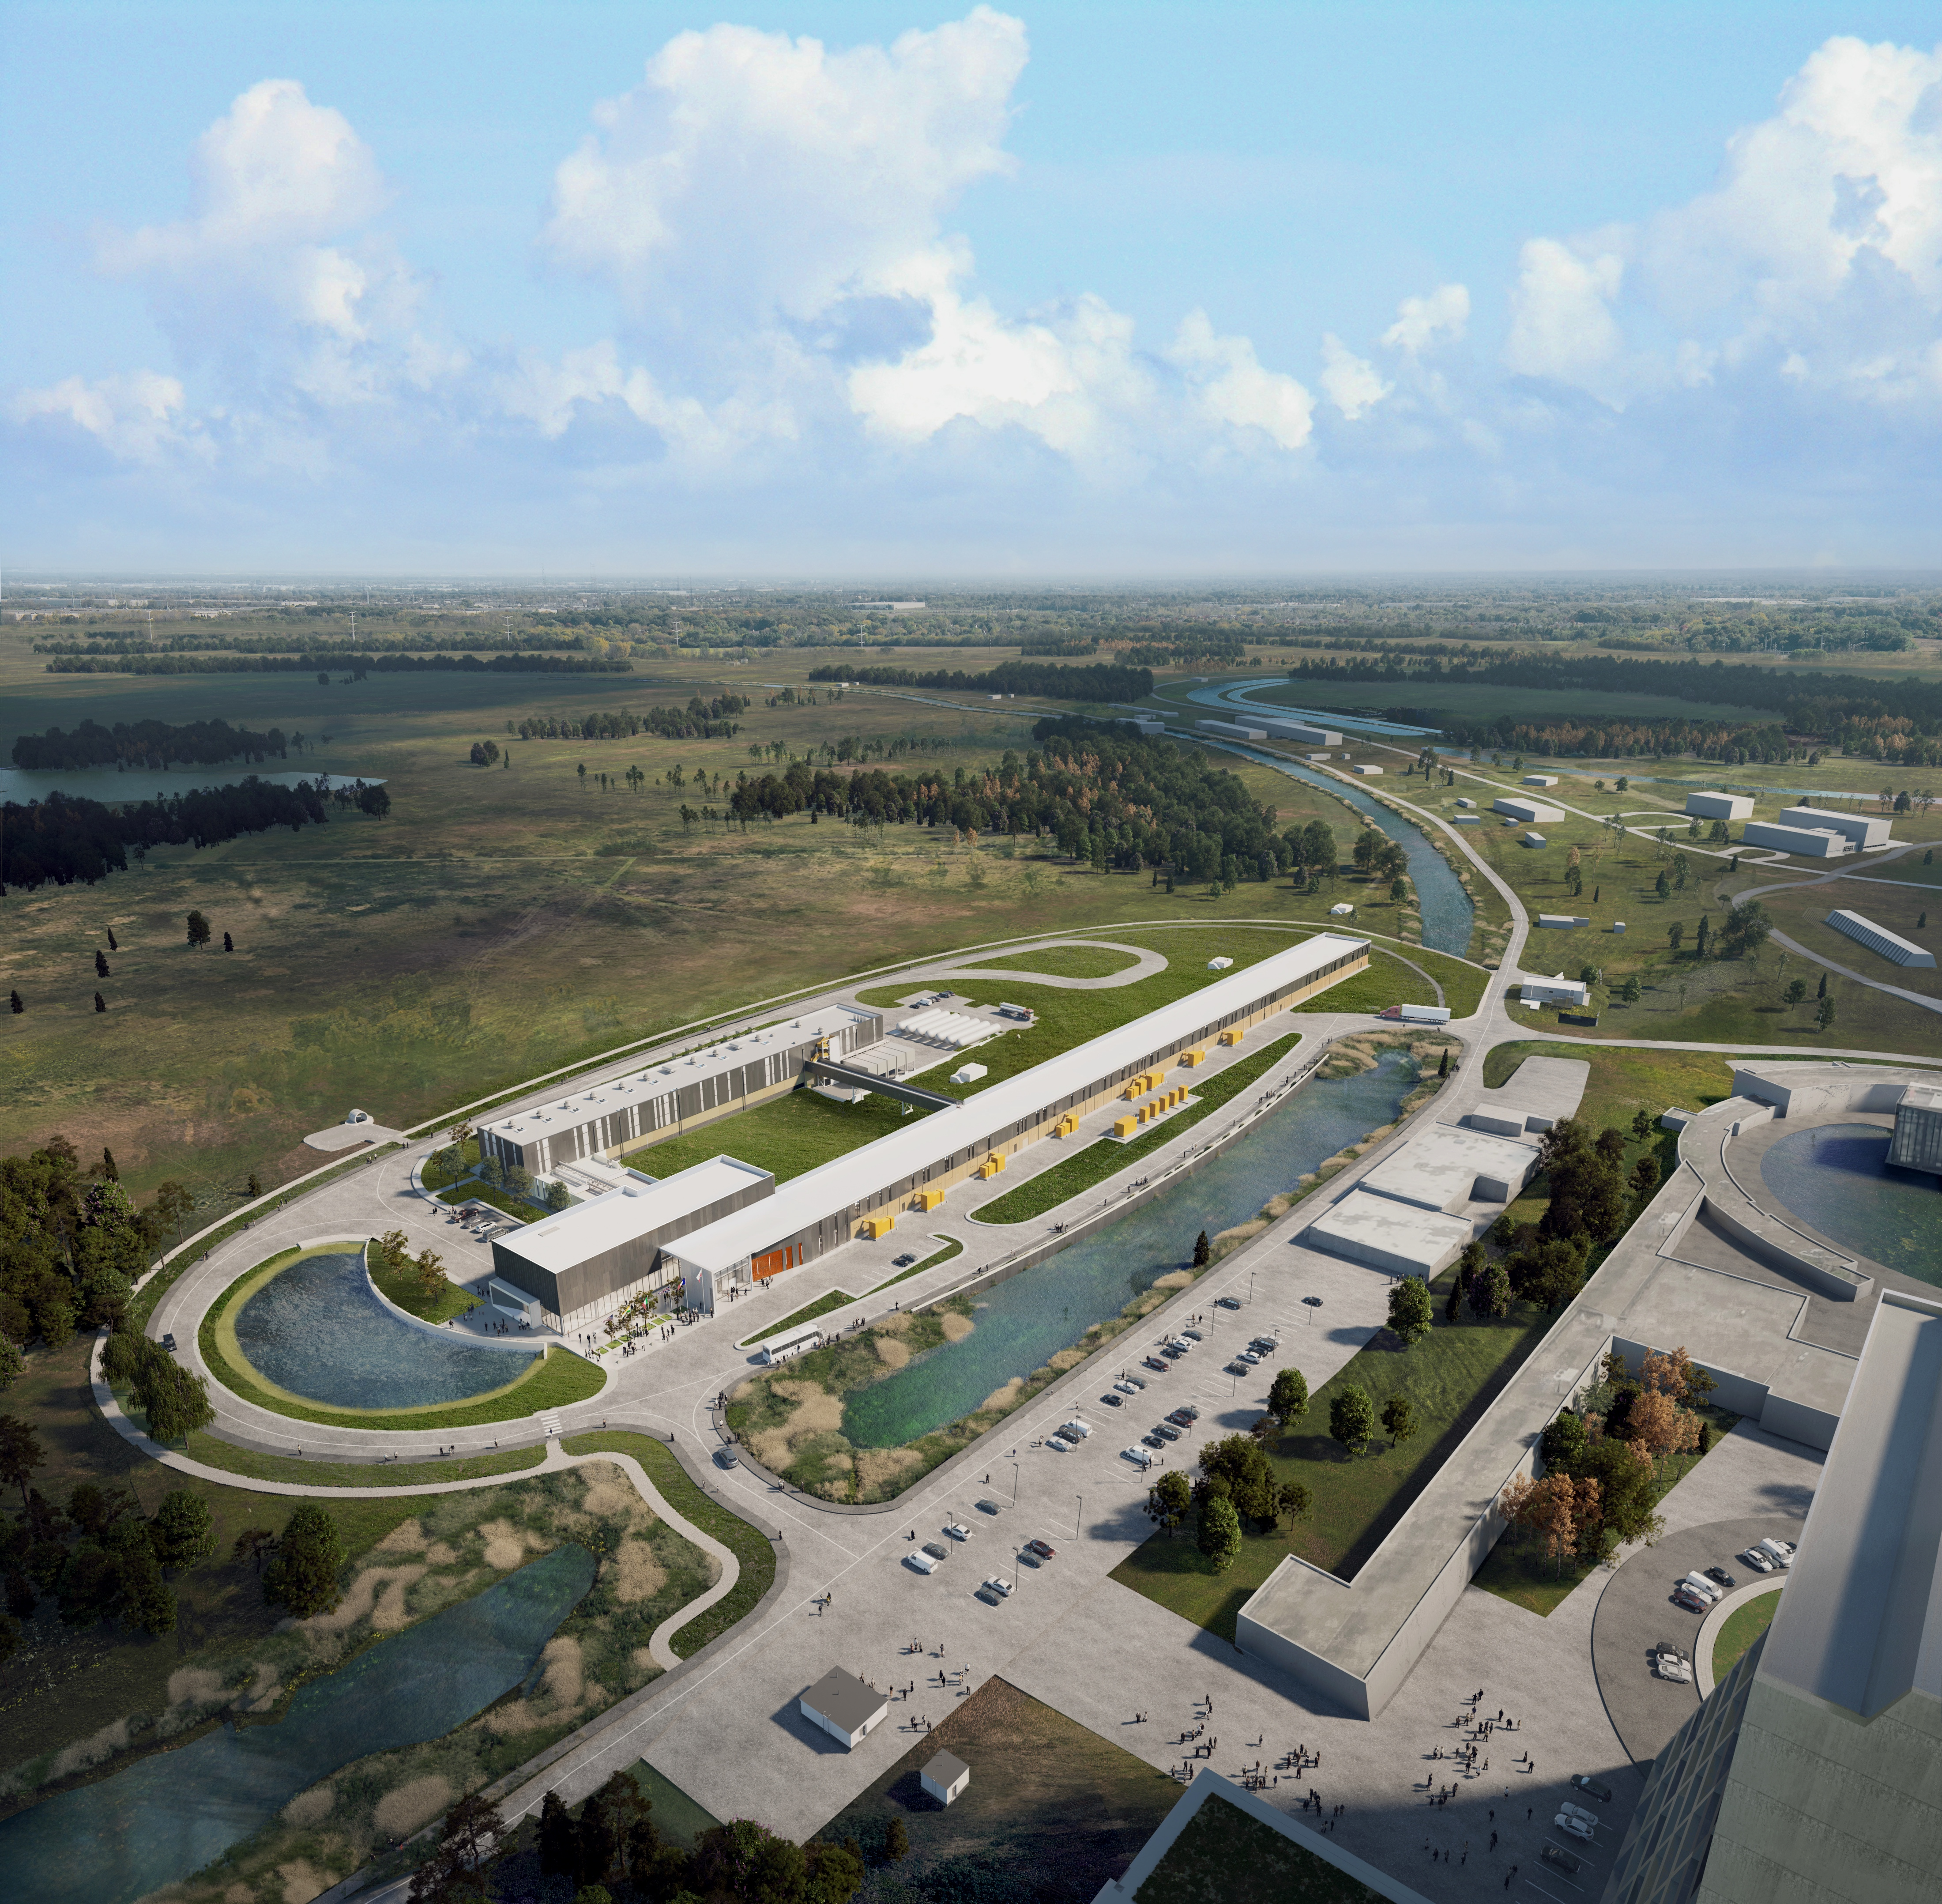



THE FUTURE OF FERMILAB
Follow us:
http://pip2.fnal.gov/
@PIP2accelerator
/showcase/pip-ii/

