Slide 21
0.1 mm
10 mm
10 mm

Slide 23
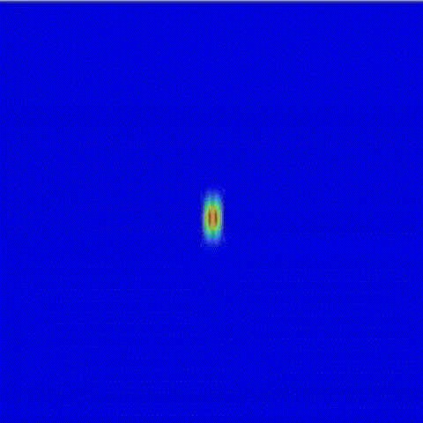
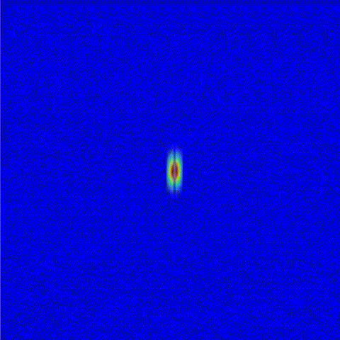
Thin line: nanofiber mat viewed from side!
f=0.05
f=0.20
(Beam moves left to right)

