Slide 1
48 Hour Summary
Patrick Dowdle
MCR Crew Chief
June 12th, 2024

Slide 2
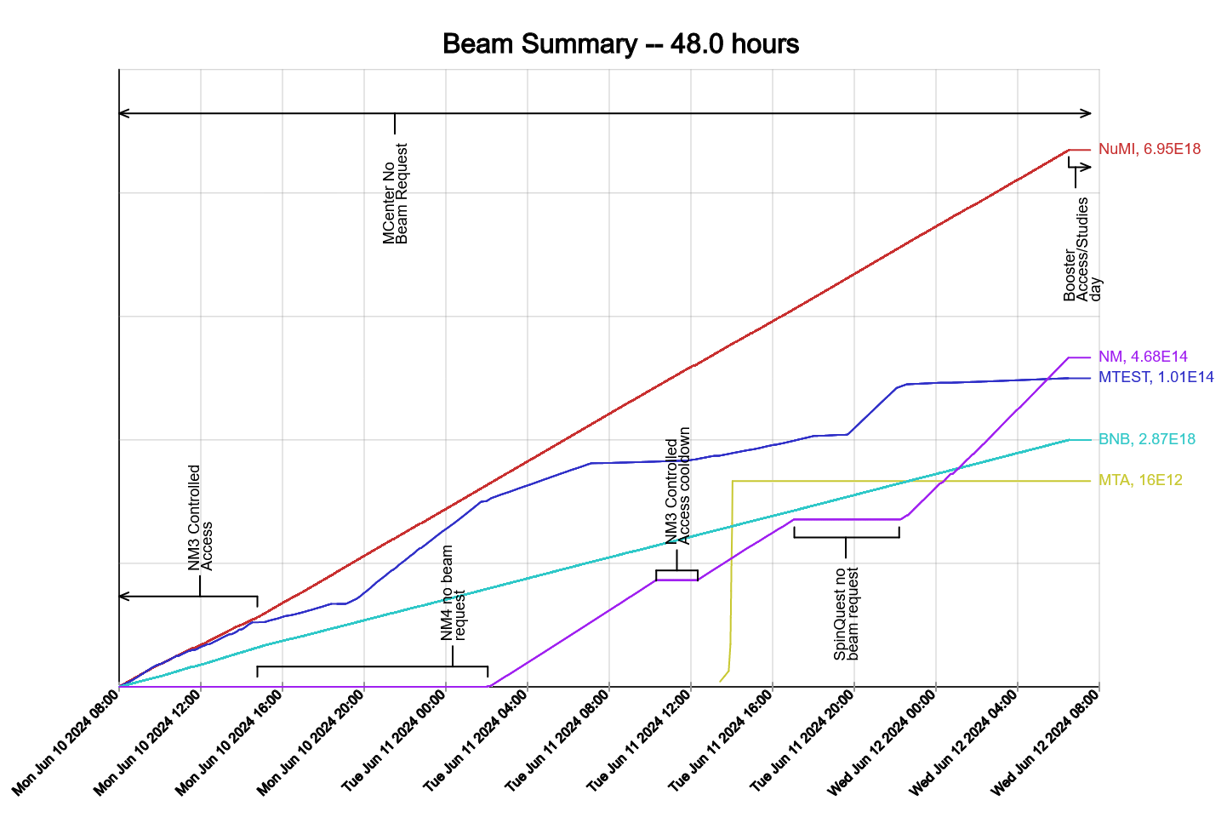
Summary
In General:
Supporting machine studies
Tuning up the machines
Adjusting NuMI intensity to keep baffle temp down
Monday:
Linac LIP nodes 615 and 737 went down
Tuesday:
Secured MTA, ran beam
Today:
MI-40-2 vacuum cascade
Racked out Booster for inspection
Booster is back on and ready for studies
Ran F-Sector off for MI-52 pond strainer
Turned off Meson
MTA is transitioning to supervised access
Power outage at EAD Training Center, NW8, NS3, Feeder 32 has started
Current Conditions
Setting up for Booster dedicated studies

