Slide 1
Mu2e report
Tom Diehl (FNAL), Greg Rakness (FNAL)
Friday 9am AD meeting
14-Jun-2024
https://indico.fnal.gov/event/65188/

Slide 2
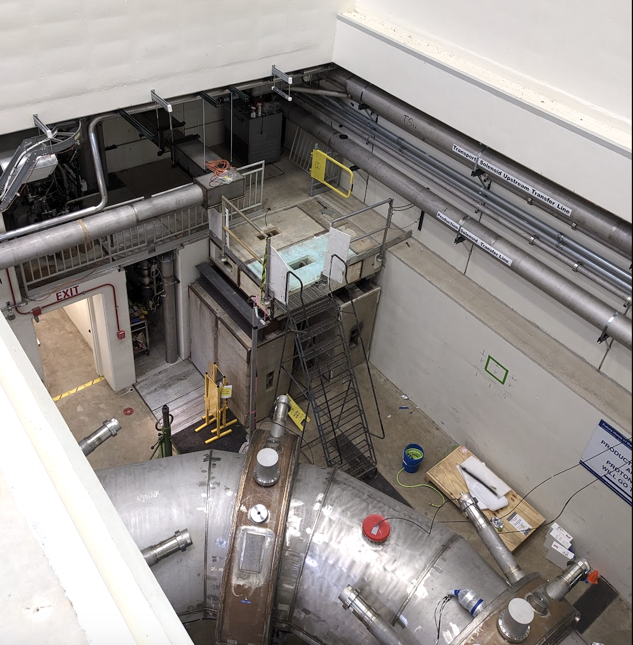
Some of the ongoing work at Mu2e (1/3)
Quench Protection Racks in process of being moved into the room
One installed, three to go
Dump Resistor banks in process of being modified
Replace split washers with Belleville washers
One in process, three to go
Electrician work in pipe chase alcove complete
Time to remove platform

Slide 3
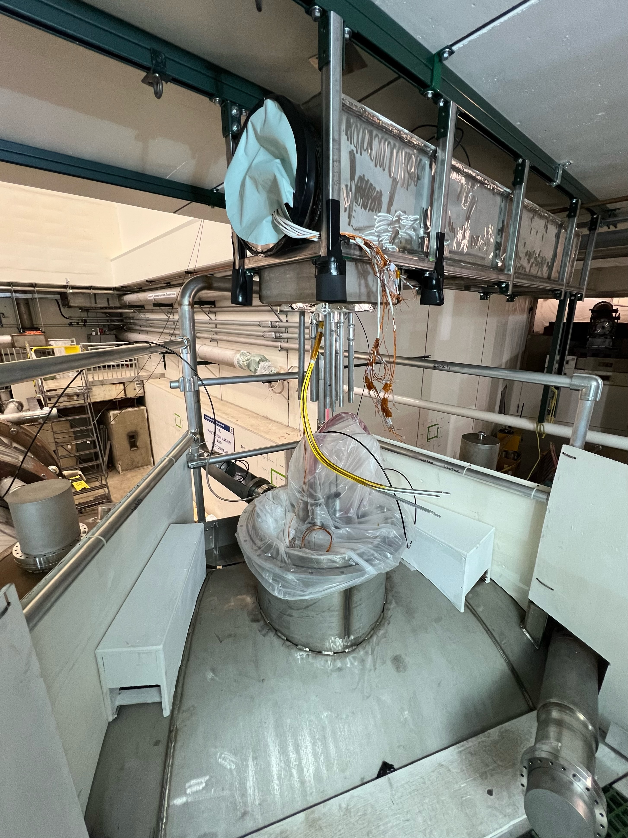
Some of the ongoing work at Mu2e (2/3)
TSu access platform ready
ES&H sign-off complete
Presently evaluating the first jobs to do
Need to confirm that the magnets are in their real final location before connecting the transfer line

Slide 4
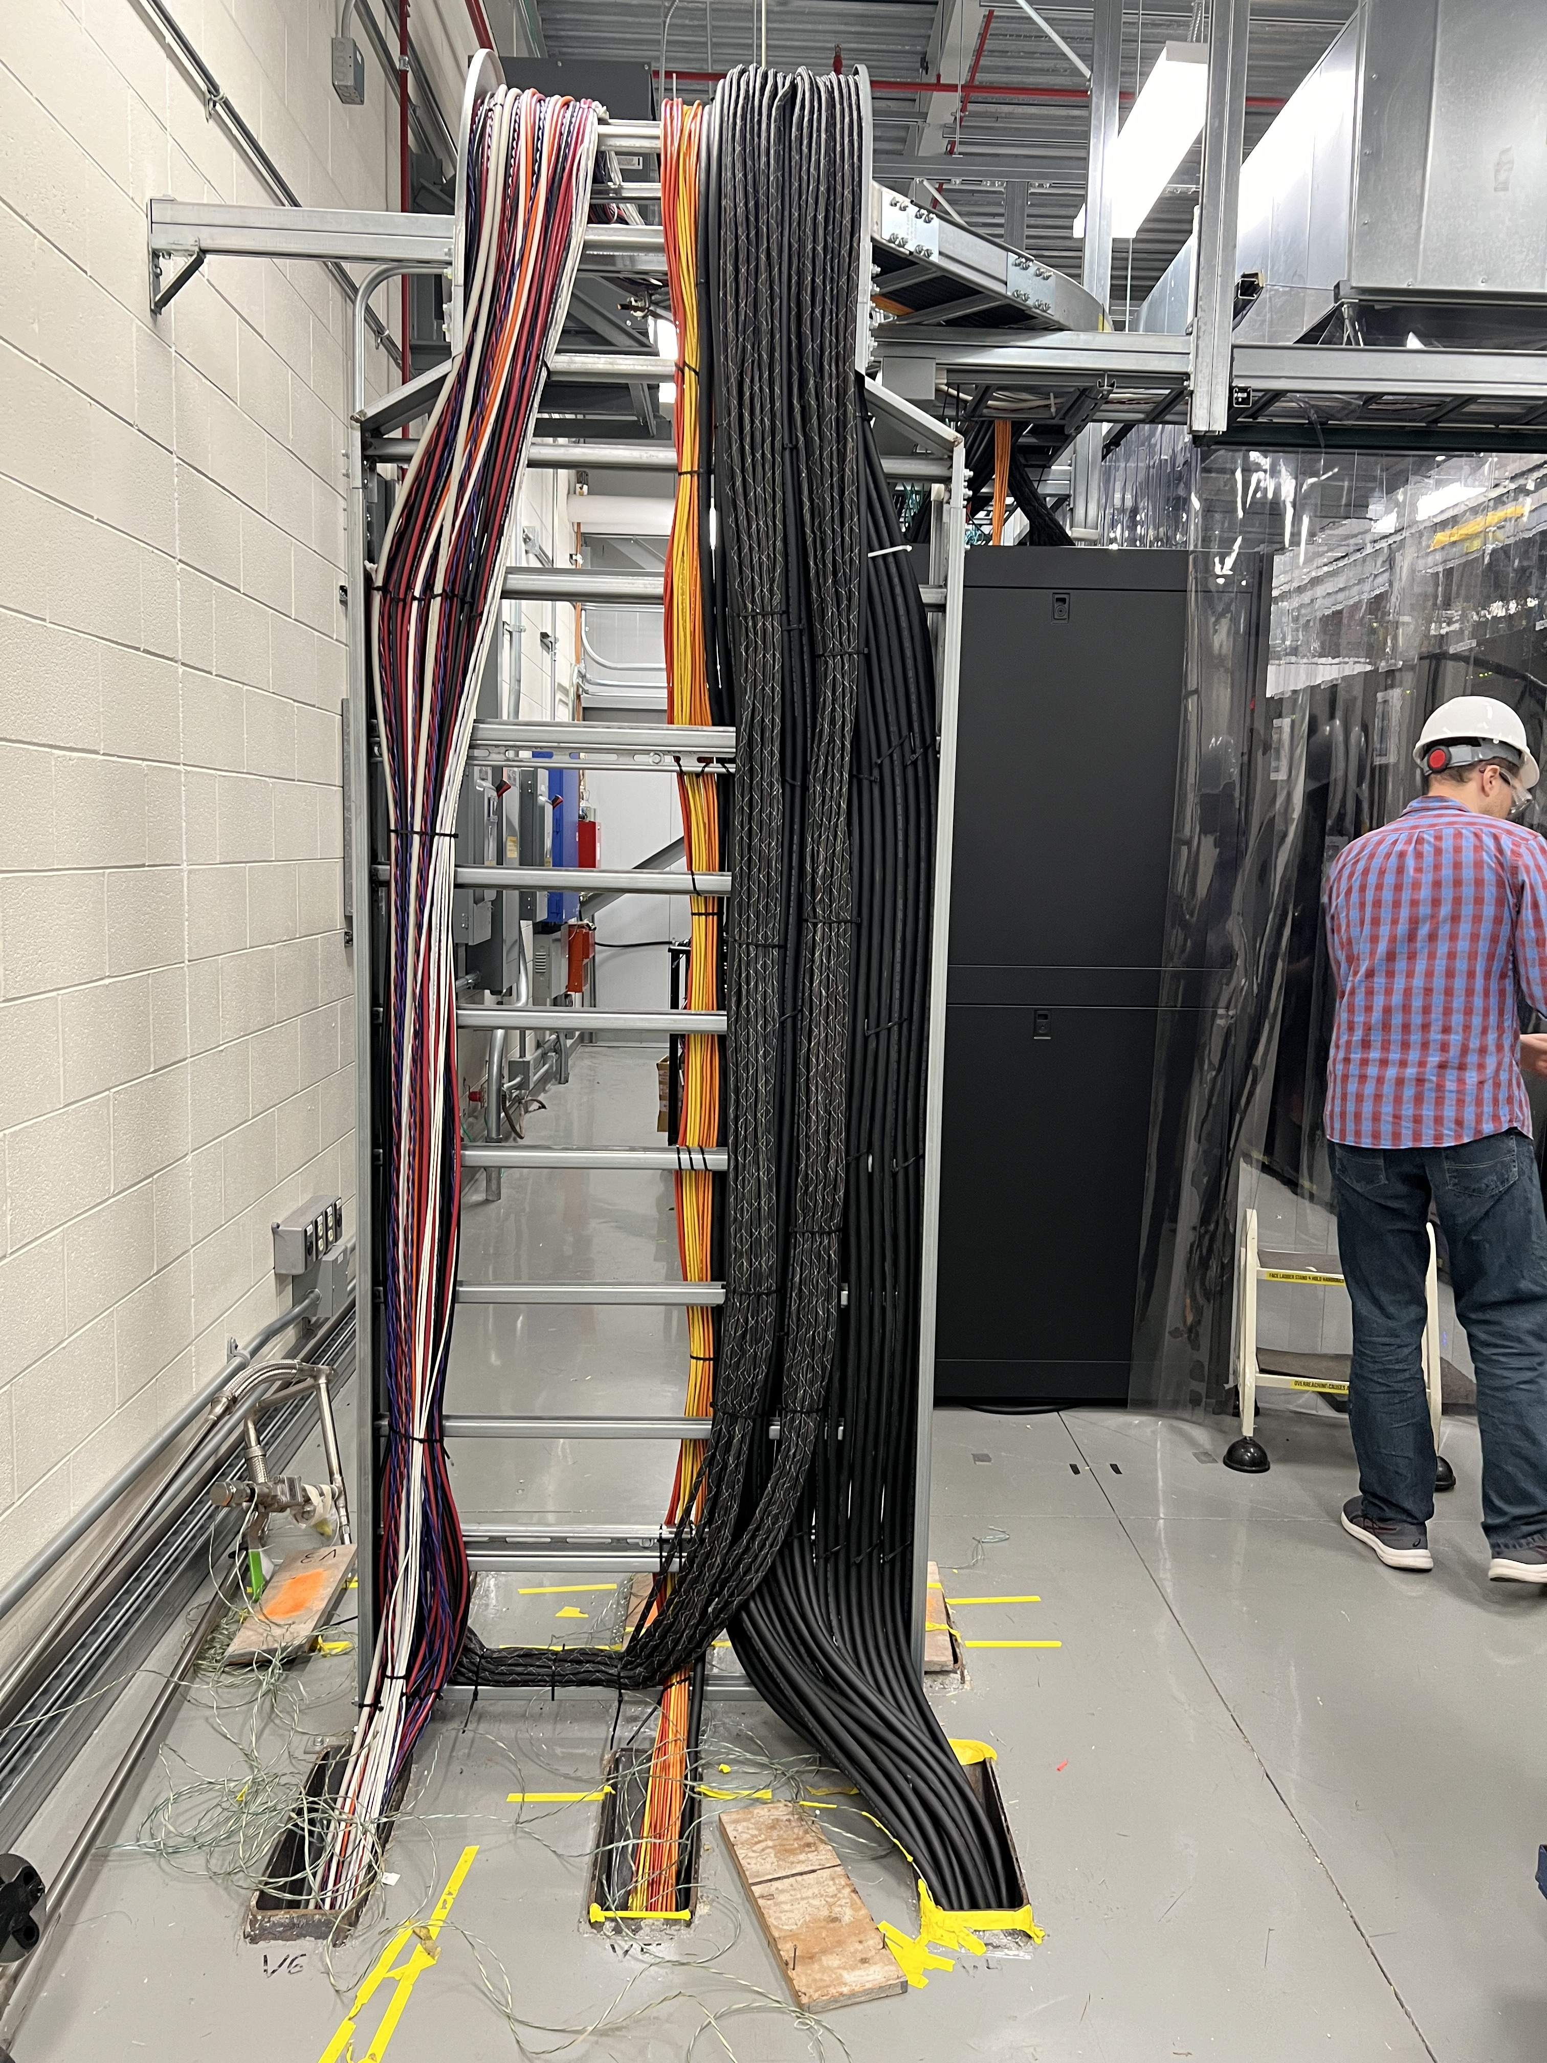
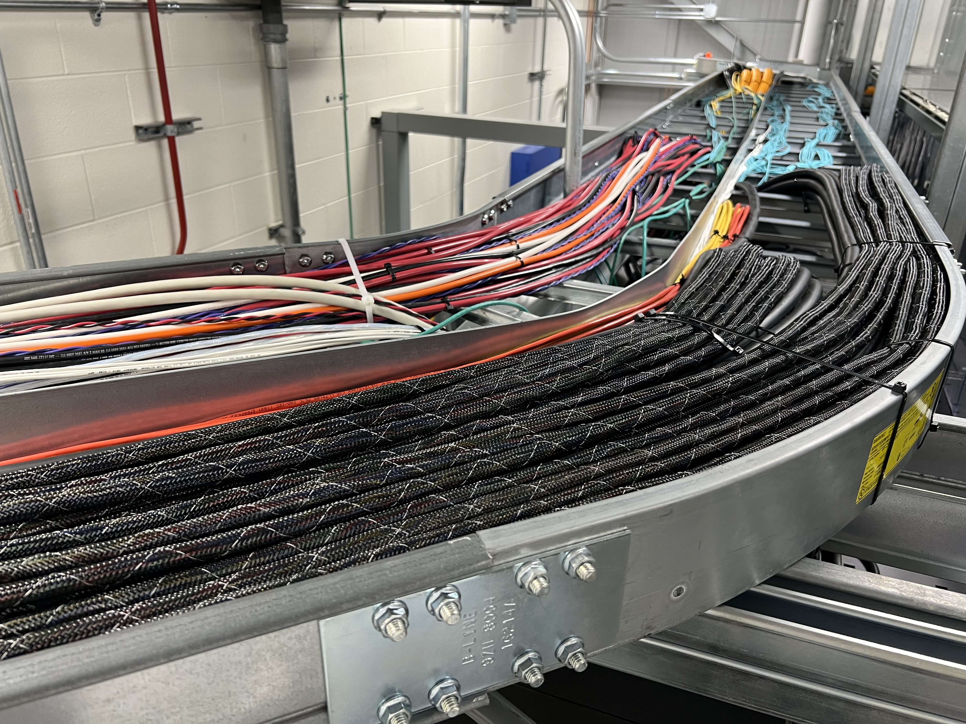
Some of the ongoing work at Mu2e (3/3)
Tracker cabling has been dressed
Next: 2nd half of calorimeter cables

