Slide 1
Main Injector / Recycler at The Nine
A.P. Schreckenberger 2024-06-14

Slide 2
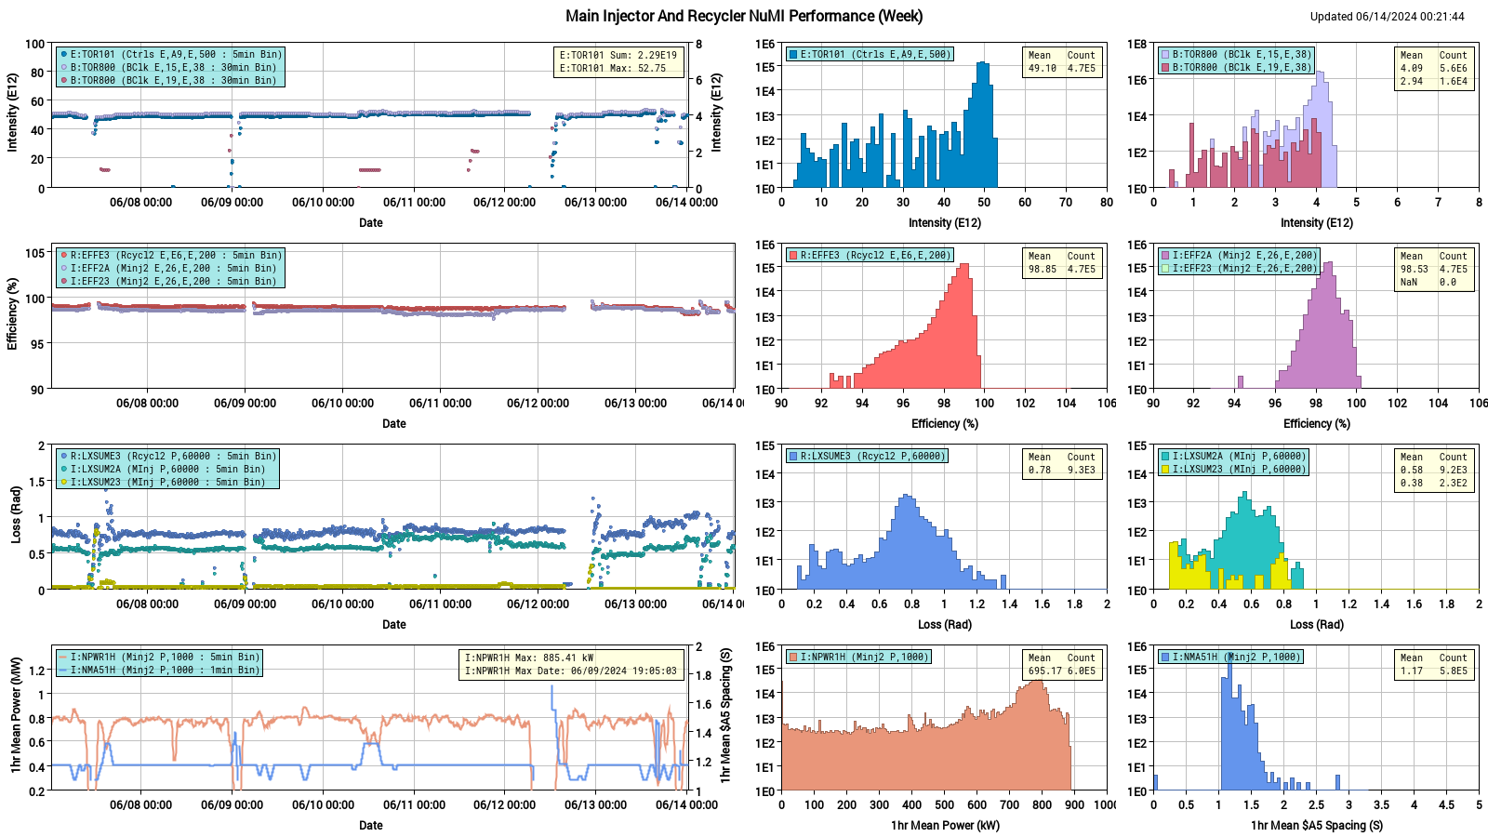
Beam to NuMI – The Weekly Summary

Slide 3
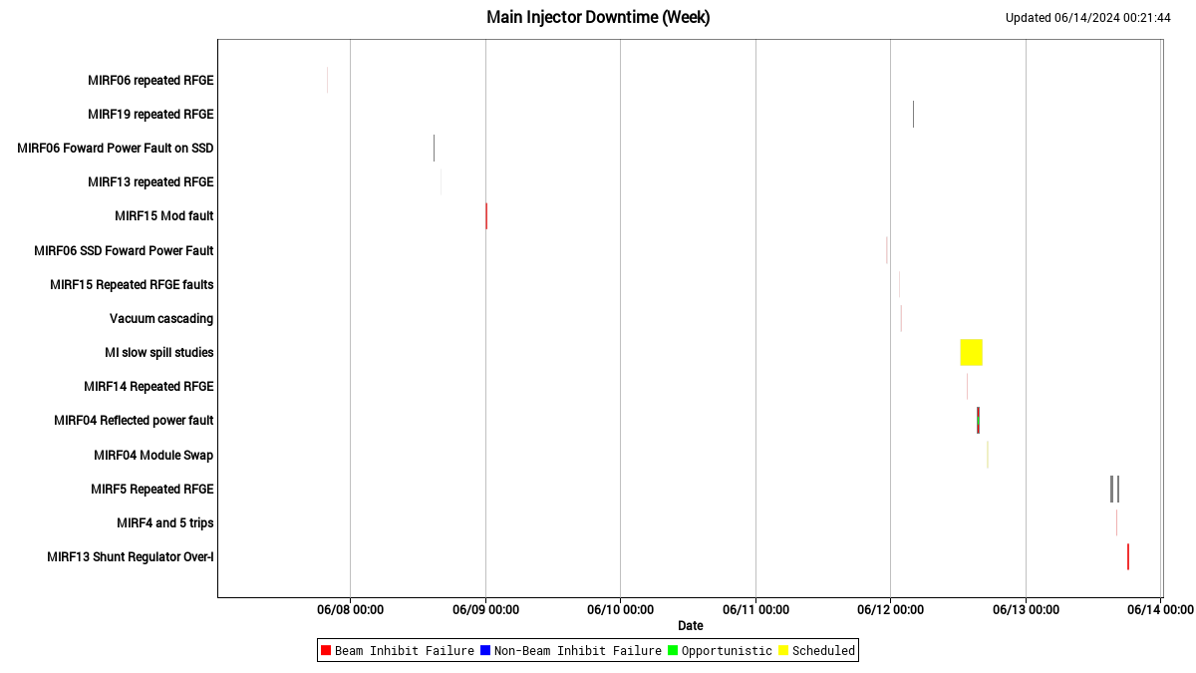
MI Downtime – The Weekly Summary

Slide 4
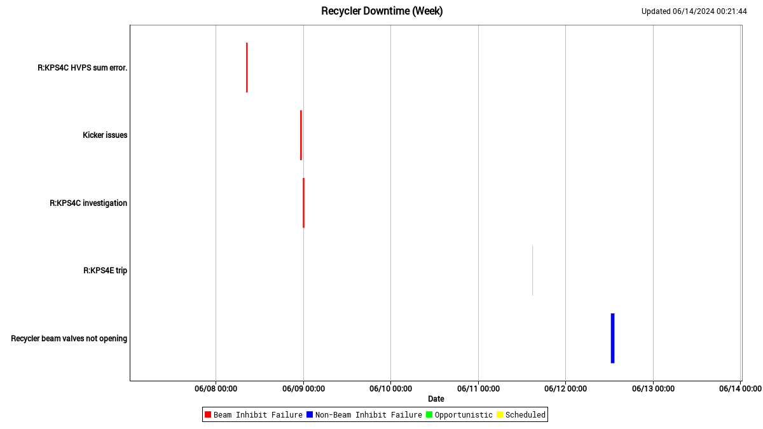
RR Downtime – The Weekly Summary

Slide 5
Can I Get A Mid-Week Montage!? – Recap
Look at MI8 collimator losses on Monday morning
Wren continued his abort line tuning studies
Established decent tunes for 8 and 10 GeV
Still working on 9 GeV
Phil looked at impact of 8 GeV vertical tune on beam at the NuMI baffle
Long tails must come from different mechanism
Cris has returned to us! And is already doing RR studies parasitically under the $E0

Slide 6
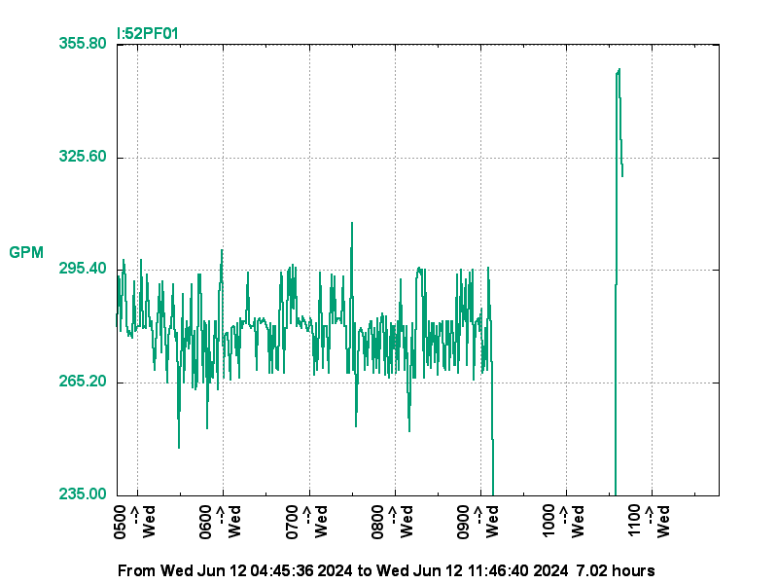
Can I Get A Mid-Week Montage!? – Recap
Modulator swap in RF Station 14
MI-52 Pond Pump flow [I:52PF01] dropped under lower limit
Strainers were cleaned on May 7th and the pond was treated
ISD cleaned strainer again on June 12
Took pump out of alarm state
Heat exchanger cleaning??
I:S118AR Sump A went to zero
Ops bypassed A and enabled alarms on Sump B [I:S118BR]

Slide 7
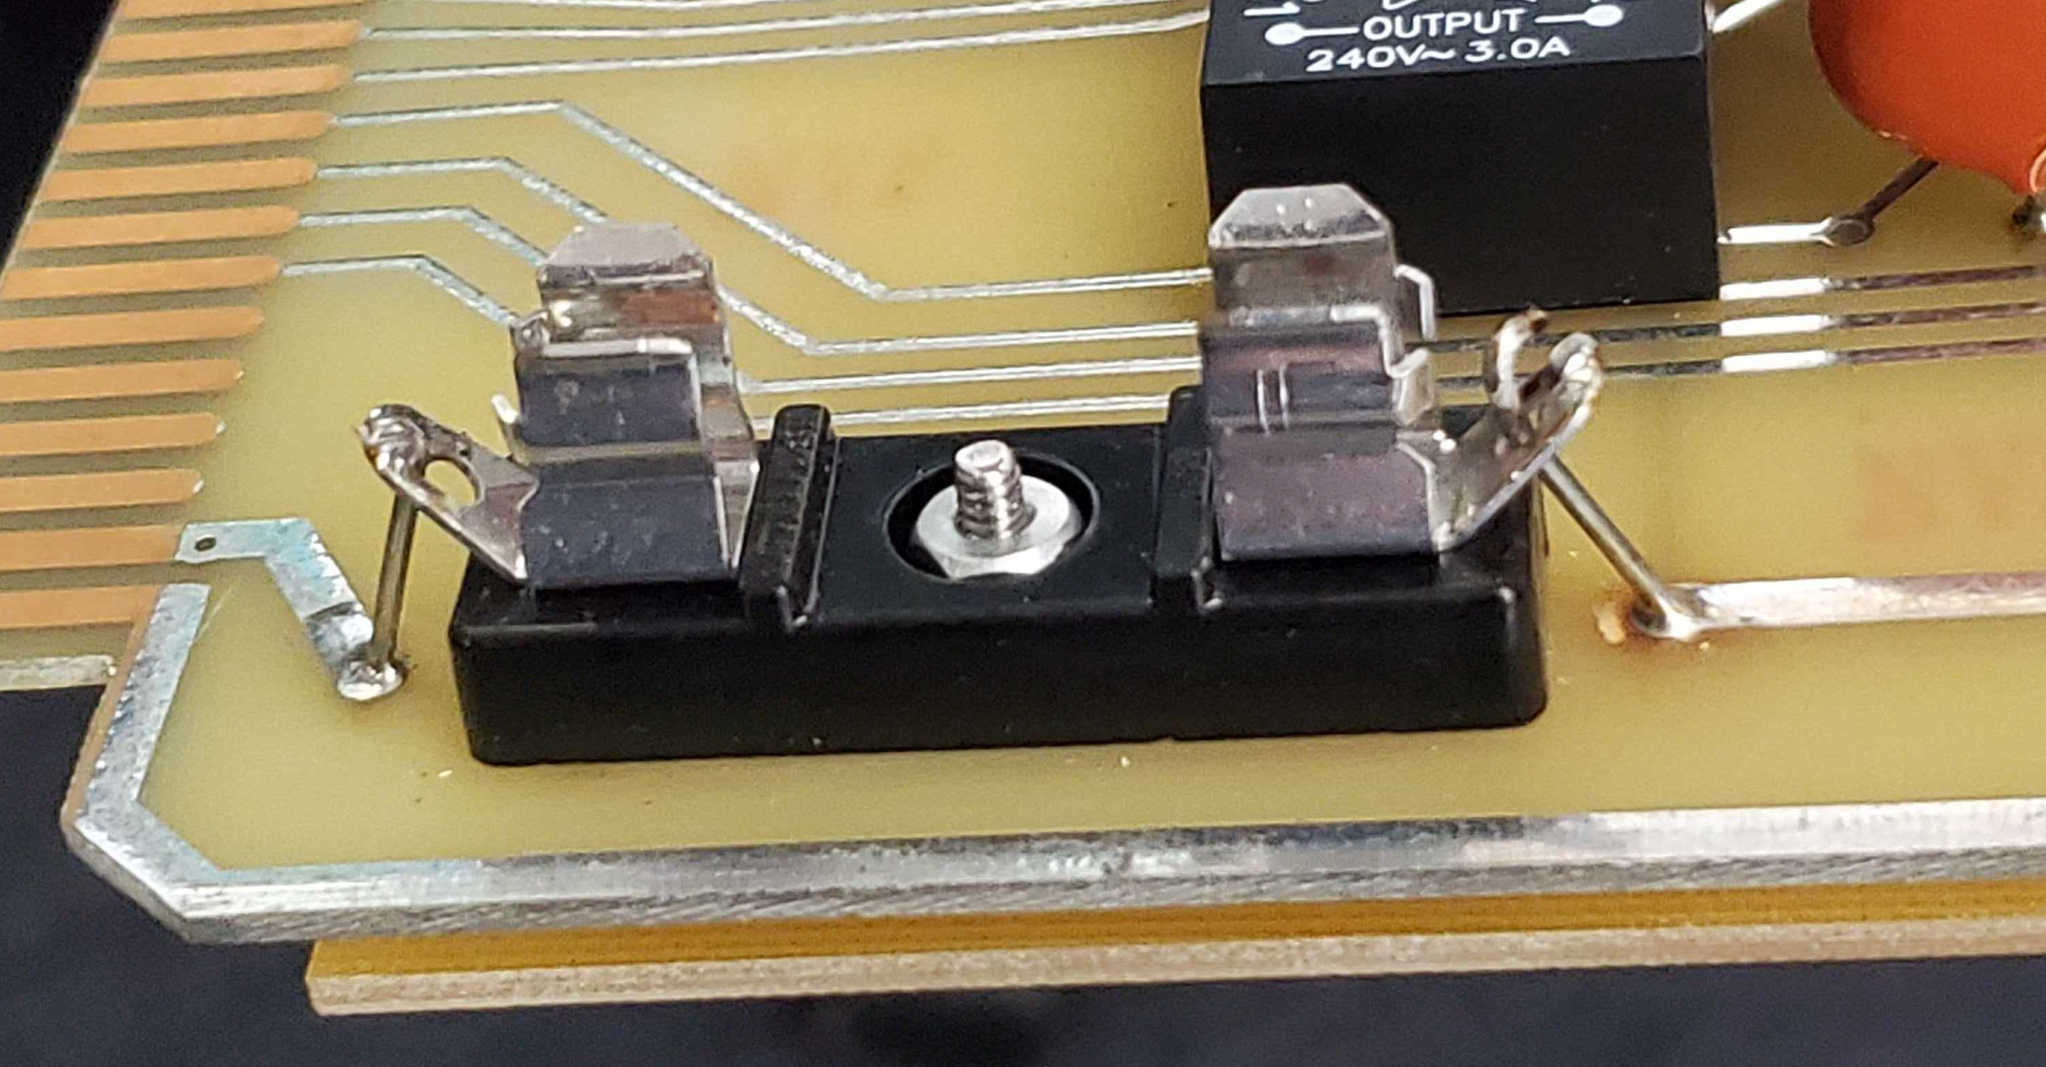
T.G.I.F.
Strange readouts observed coming from RF Station 19
Was operating, but Mid-level RF signals drove feedback mechanisms in unexpected ways
Group B RF sum (I:VSMAGB) was reading artificially low
RF experts swapped a cable, which yielded resolution
Vacuum issues developed when R:BV341 and R:BV401 closed unexpectedly
Cold, frigid solder... ...broken links and shuttered valves... ...healed by an iron
AKA, the joint was resoldered
R:IP6101 toggling alarm

Slide 8
T.G.I.F.
I:LD6FP (longitudinal damper forward power) alarm
Phil and Mitch guided ops through condition
MI-30 LCW Pump #3 had low suction pressure trip WedN
Reset attempts by ops did not recover pump
Able to run through the night
Jesse installed a new pressure transducer, but discharge pressure got railed at 400 psig
Tom Z called in to calibrate transducer / evaluate
Another transducer installed – led to supply side pressure alarm
Work continuing today
RF Station 13 tripped on shunt regulator overcurrent Have a fantastic Friday!

