Slide 1
Muon Campus Operation Report
Jim Morgan
Friday 09:00 Operations Meeting
June 14, 2024

Slide 2
Muon Campus status
Resumed running beam last Friday after D:IB issues resolved
Delivery Ring BPM’s timed in late Friday afternoon and early evening
Have first turn flash frames since Tuesday, need closed orbit data
Took beam during day shifts to work on Delivery Ring BPM’s
Improvements made since a year ago, but need to recommission system
Worked on M39 program issues posting M1 BPM’s with key experts back at lab
Warm power supply panel circuit breakers
D:Q730 needs larger breaker and wiring, thermally scanning all circuit breakers
D:V907 has reasonable primary phase currents but has still tripped breaker
Check-out of extraction skew quadrupole power supply
Delivery Ring RF water control valve electronics swapped, now works properly
Have found that resonance is at higher temperature than expected
Cooling water temperature excursion this morning due to chiller trip
ESS1 & ESS2 Electrostatic Septa
ORC got approval from ES&H (Industrial Hygiene) on Monday, signed off Tuesday
D:ESS1 power supply safety tested, then needed some final work before powering
Vacuum has been good enough to begin powering ESS1 & ESS2
AP-0 A/C work continues to be stalled (now at 60 weeks)
Portable A/C unit working well, after rough start
Study – M1-M3 Optics
Study – Alternative M5 optics

Slide 3
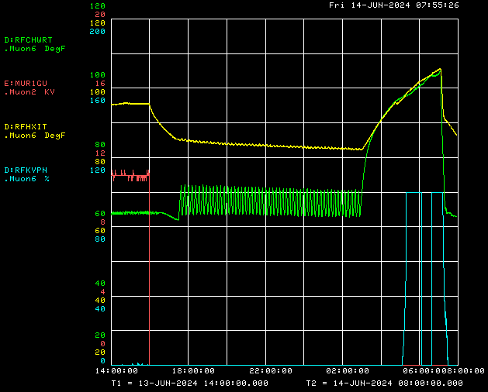
Delivery Ring RF temperature excursion this morning
Chiller trip
Heat Exchanger inlet temperature
RF cavity gap envelope
Chilled Water return temperature
Skid temperature valve position

Slide 4
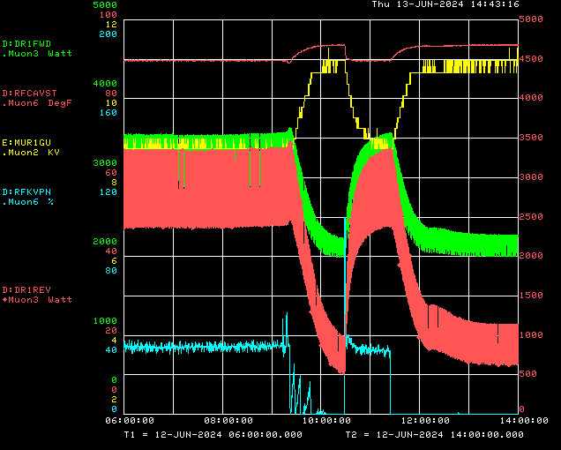
Delivery Ring RF cavity temperature and resonance
Cavity LCW supply temperature
Cavity gap envelope
Amplifier forward power
Amplifier reverse power
Skid temperature valve position

Slide 5
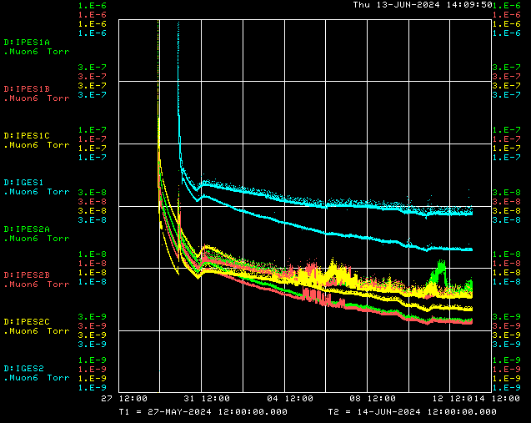
ESS1 & ESS2 vacuum pump-down

Slide 6
Upcoming work
Studies priorities
Finish making Delivery Ring BPM’s work, need closed orbits working
Smooth closed orbit in Delivery Ring and adjust injection closure
Continue working on M39 problems with M1 BPM’s not posting to RR to DR view
When power supply ready, begin conditioning ESS1 & ESS2
First turn extraction without kicker using quadrupole moves
Establish resonant extraction when ESS1 & ESS2 are ready after conditioning
Try to get M4 multiwire profiles with resonantly extracted beam
Other issues
Delivery Ring 2.5 MHz RF cavity needs to have resonance adjusted
D:Q730 needs larger breaker and wiring to run at nominal current
D:V907 occasionally trips breaker though primary current reasonable
Have several circuit breakers running warm, working to understand why
D:QT405 power supply voltage maxed out, output tracks line voltage
Old BR trim power supplies running out, will use those from M2 Line as spares
ESS2
ESS2 cathode electro-polishing next, choosing vendor
After cathode polishing is complete, then component assembly into tank
AP-0 A/C work paused while awaiting controls sub-contractor

