Slide 1
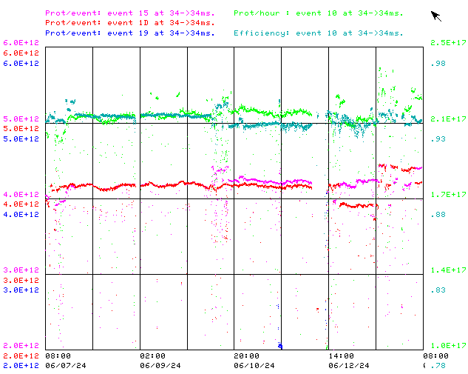
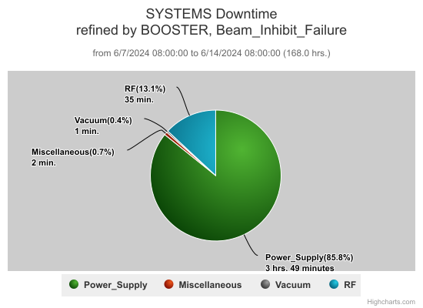
Booster Operations / June 7 - 14
Current conditions:
93% efficiency, 2.3e17 p/hr
$15: 4.4e12 p/p
$1D: 4.4e12 p/p
Access and Digital LLRF Studies
DT : ~4.5hrs.

Slide 2
Summary
Minor RF trips
Minor vacuum trips
Kicker MK07 cooling fan flow switch repair by Booster Group. (Sunday Owl shift)
EAPS cubicle temperature trips expected in afternoons on hotter days
Wednesday: Quick access for pipe insulation sampling and ~3 hours of dedicated new digital LLRF studies. Sent some low intensity beam to BNB successfully by end of study.
GMPS Ground fault meter replacement by Booster Group. (Thursday eve shift).
Had periods of beam throughput at rates of 2.4E17p/hr. Optimized MI8 Line Collimator limits and MI8 autotune settings allowing return to more typical beam throughput to users. Thanks to MI/RR for their updates.
E4R power supply commissioning done with resistive load PESD/Booster grps.
Thanks to Ops for maintaining Booster beam operations

Slide 3
Booster Studies-2024
Proposed

