Slide 1
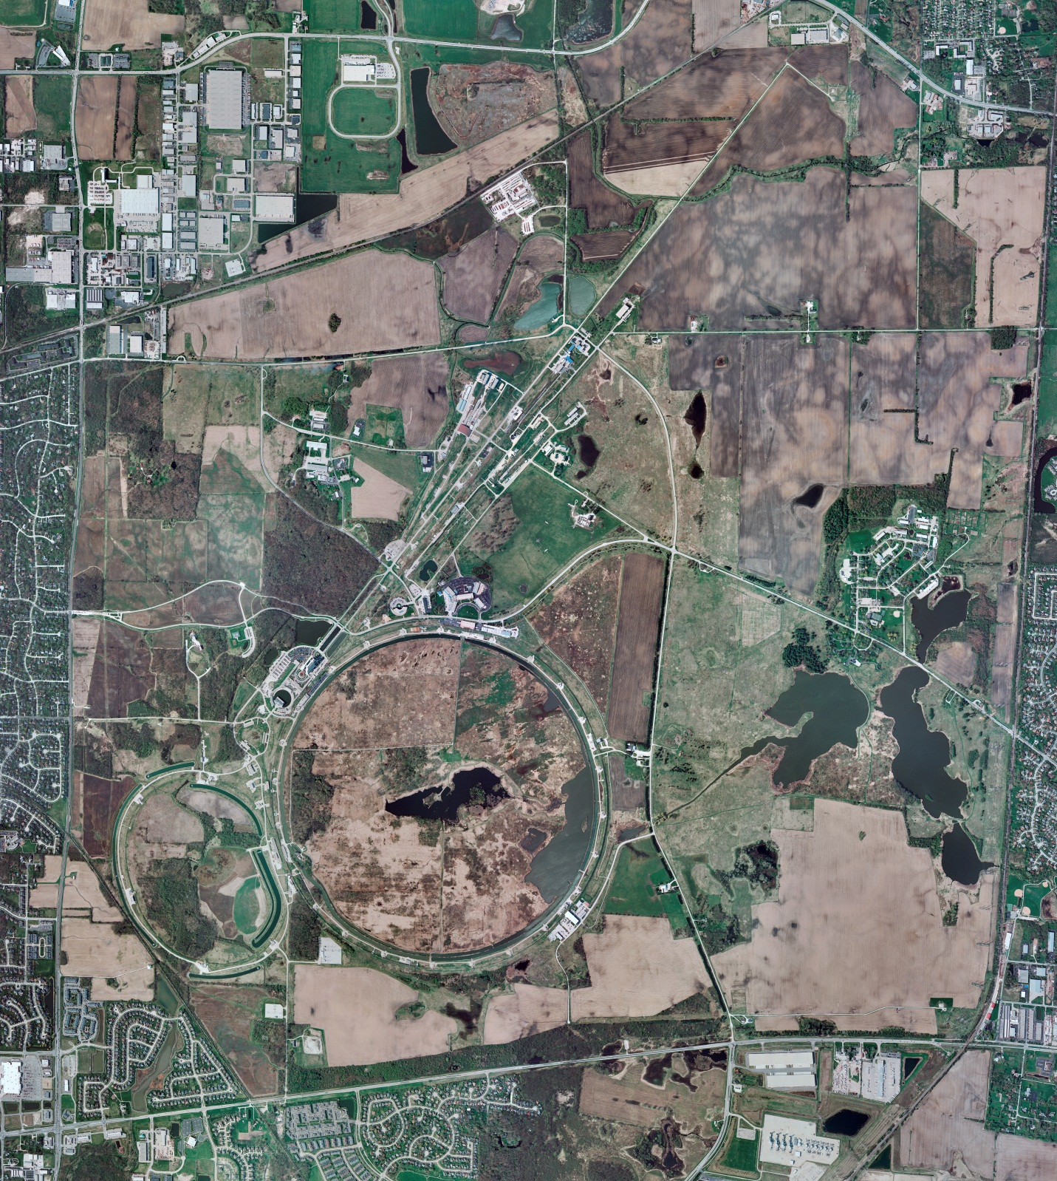
Helium Cryogenics
Status 6/14/2024 J.Makara
CMTF: SCP is cold running fine
CMTS: HECM29 RF testing completed successfully thus being warmed up to RT
PIP2IT: South CM stand being modified for SSR2 pCM
North CM pHB650 operating fine at 2 K; RF and cryo testing ongoing
MCTF: cryo system cold with 3 comprs and 2 Fridges running fine
MDB/HTS: at RT
MDB/STC: at RT but anticipate cooldown again soon
MDB Magnet: at RT
NML/FAST: Cryo system is shut down and isolated for extended shutdown period;
CC1: at RT
CC2: at RT
CM: at RT
IB1: cryo system operations restarting after short maintenance shutdown
Muon Campus: at RT with comprs off and system depressurized; LN2 off
Misc:…

