Slide 1
48 Hour Summary
Patrick Dowdle
MCR Crew Chief
June 14, 2024

Slide 2
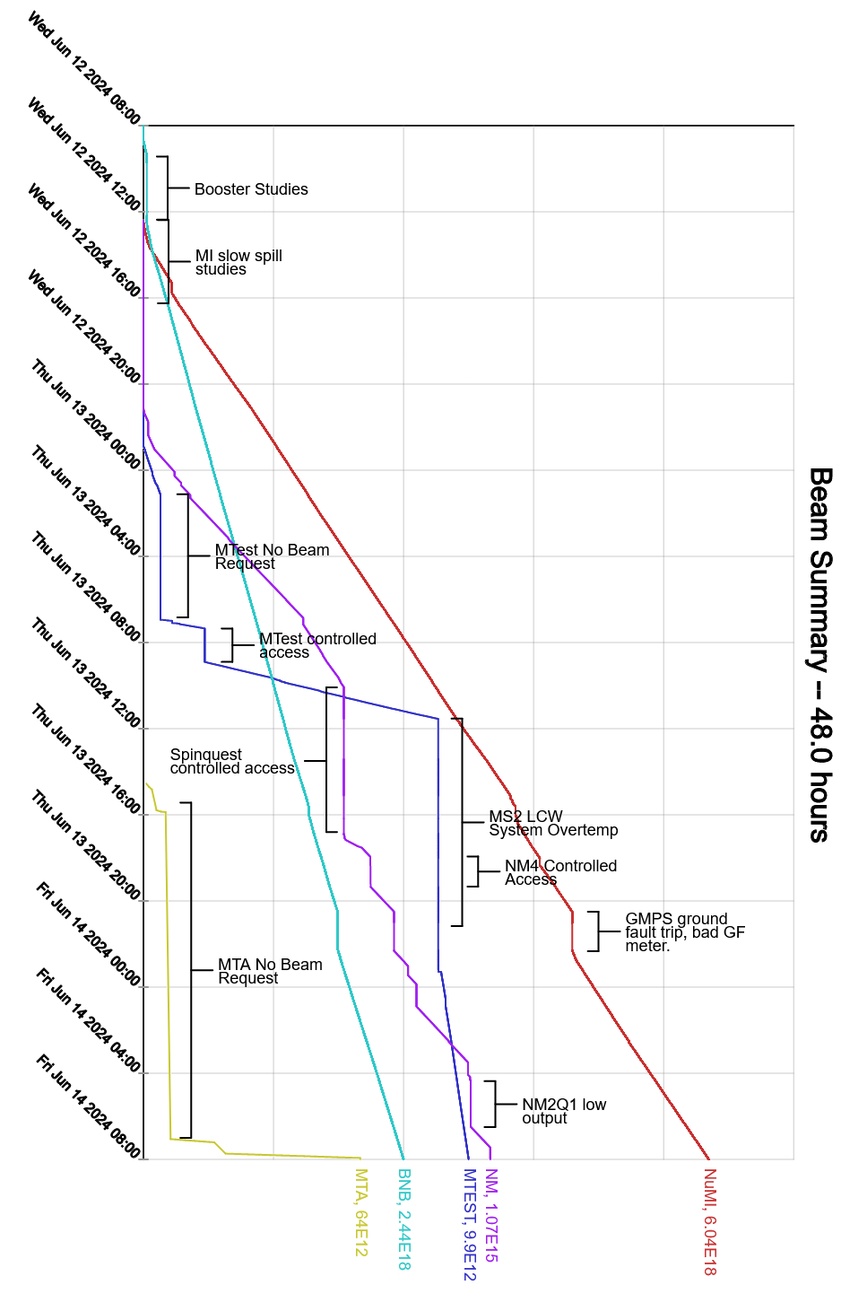
Summary
Wednesday:
MI-52 pond strainer was cleaned
Booster studies
Slow spill studies
RR beam valves 341, 401 issue
MI-30 LCW pump #3 trip
Thursday:
MS2SUP temp too high to run
MI-62 LCW slow leak
Muon studies
Slow spill studies
EAPS trip on room overtemp
GPMS ground fault, meter replaced
Friday:
AP 50 RF skid temps high
F:NM2Q1 regulation issue
Currently:
Beam to NuMI, BNB, SWYD.

